Slide 1
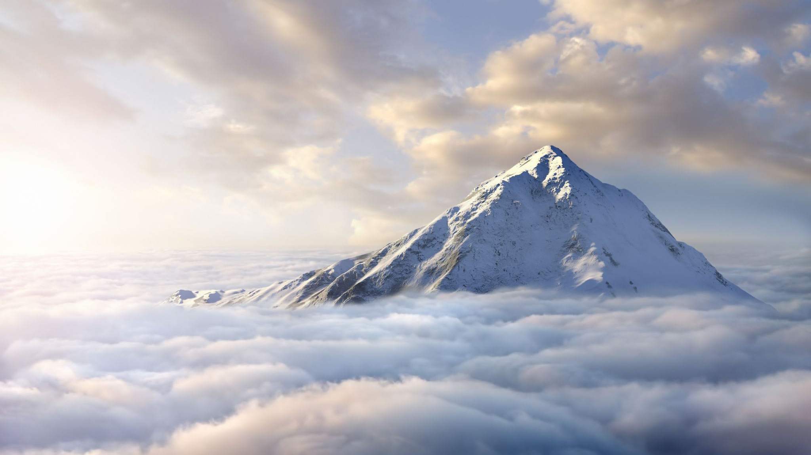
By Faith Noah Condemned the World! Hebrews 11:7
HOW DID NOAH CONDEMN THE WORLD, WAS IT BY BUILDING THE ARK?

Slide 2
Hebrews 11:7
“By faith Noah, being divinely warned of things not yet seen, moved with godly fear, prepared an ark for the saving of his household, by which he condemned the world and became heir of the righteousness which is according to faith.”

Slide 3
DID NOAH SHUT THE DOOR?
In fact by building the Ark, according to God’s pattern there was a door created for the lost to enter in by, if they choose to get in.
Genesis 7:16, “So those that entered, male and female of all flesh, went in as God had commanded him; and the LORD shut him in.”

Slide 4
NOAH DID NOT SHUT THE DOOR
Noah did not close the door on the Ark. He was not responsible for all those who refused to get into the Ark. They drown because they did not respond to Noah’s invitation to get into the Ark.
2 Peter 2:5, “and did not spare the ancient world, but saved Noah, one of eight people, a preacher of righteousness, bringing in the flood on the world of the ungodly”

Slide 5
God’s Grace (Titus 2:11-14) is found in God’s message to Noah
By Faith Noah,
being divinely warned of things
not yet seen,
moved with godly fear,
prepared an ark for the saving
of his household
by which he condemned the
world
and became heir of the
righteousness which is
according to faith!”

Slide 6
Can you see the Unseen things in God’s Word? Believing Eyes See it!
If you do, do you understand what it means and what are you going to do about it?

Slide 7
Romans 1:20
“For since the creation of the world His invisible attributes are clearly seen, being understood by the things that are made, even His eternal power and Godhead, so that they are without excuse,”

Slide 8
2 Corinthians 4:16-18
“while we do not look at the things which are seen, but at the things which are not seen. For the things which are seen are temporary, but the things which are not seen are eternal.”

Slide 9
What did Noah do that saved his household?
Noah walked by faith when he did the will of God.
“This is the genealogy of Noah. Noah was a just man, perfect in his generations. Noah walked with God.” Genesis 6:9
“Thus Noah did; according to all that God commanded him, so he did.” Genesis 6:22

Slide 10
CONCLUSION: If you are a Christian? A New Testament Christian, baptized into Christ according to Romans 6:3-4; Galatians 3:26-27
James 4:4, does your life condemn the world around you?
If you are a Christian walking in the light of God’s word, will your actions cause people to think you are not “one of them?” Perhaps “weird” or “out of step with what everyone thinks is true?”

Slide 11
People would rather see a sermon than to hear one.
What kind of sermon is your life
preaching to the world round about you?

Slide 12
If you were accused of being a Christian, would there be enough evidence to convict you in a court of Law?
Repent and Obey the Gospel of Christ by being baptized into Him, and start walking in the Light of God’s word
1 Peter 2:21, “For to this you were called, because Christ also suffered for us, leaving us an example, that you should follow His steps:”

