Slide 2
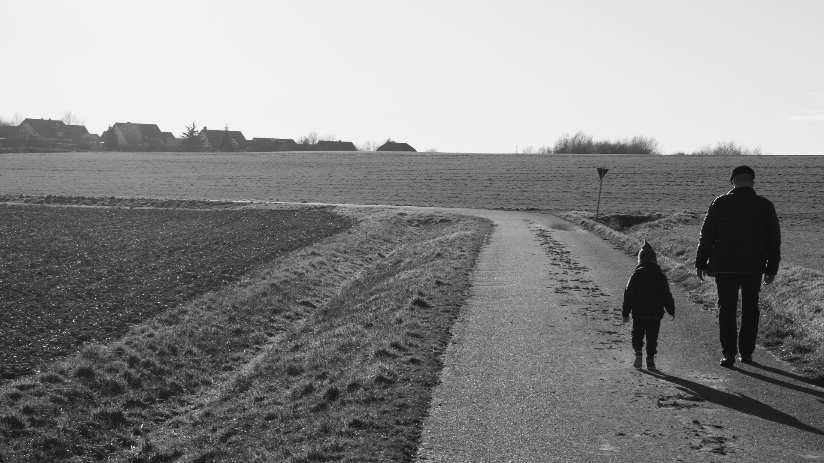
Spiritual Maturity
Growth from Infancy to Full Age
Hebrews 5:12-14
Notes:
A true disciple of Jesus Christ will apply himself to the task of learning and serving his Master.
He starts as an infant
(1 Peter 2:1-3), “Therefore, laying aside all malice, all deceit, hypocrisy, envy, and all evil speaking, ² as newborn babes, desire the pure milk of the word, that you may grow thereby, ³ if indeed you have tasted that the Lord is gracious.”
He persists in spiritual growth until he reaches a state of maturity
(Ephesians 4:11-16), “And He Himself gave some to be apostles, some prophets, some evangelists, and some pastors and teachers, ¹² for the equipping of the saints for the work of ministry, for the edifying of the body of Christ, ¹³ till we all come to the unity of the faith and of the knowledge of the Son of God, to a perfect man, to the measure of the stature of the fullness of Christ; ¹⁴ that we should no longer be children, tossed to and fro and carried about with every wind of doctrine, by the trickery of men, in the cunning craftiness of deceitful plotting, ¹⁵ but, speaking the truth in love, may grow up in all things into Him who is the head—Christ— ¹⁶ from whom the whole body, joined and knit together by what every joint supplies, according to the effective working by which every part does its share, causes growth of the body for the edifying of itself in love.”
A good description of this progress from babes to mature Christians is found in Hebrews 5. Consider what ought to have been the case with the Hebrew readers…
(Hebrews 5:12-14), “For though by this time you ought to be teachers, you need someone to teach you again the first principles of the oracles of God; and you have come to need milk and not solid food. ¹³ For everyone who partakes only of milk is unskilled in the word of righteousness, for he is a babe. ¹⁴ But solid food belongs to those who are of full age, that is, those who by reason of use have their senses exercised to discern both good and evil.”
Please consider three truths regarding spiritual maturity…
Based on an article written by Joe R. Price

Slide 3
Measured not by the passing of time, but by how we use the passing of time
Words of Elihu
(Job 32:1-5)
Do you redeem your time to grow spiritually?
(2 Peter 3:18)
Notes:
Spiritual maturity is not measured by the passing of time, but by how we are using the passing of time.
The passing of time, per se, does make one a stronger, more mature Christian.
Consider the anger of Elihu in Job 32, having listened to the conversation of Job with his three friends, Eliphaz the Temanite, Bildad the Shuhite, and Zophar the Naamathite
(Job 32:1-5), “So these three men ceased answering Job, because he was righteous in his own eyes. ² Then the wrath of Elihu, the son of Barachel the Buzite, of the family of Ram, was aroused against Job; his wrath was aroused because he justified himself rather than God. ³ Also against his three friends his wrath was aroused, because they had found no answer, and yet had condemned Job. ⁴ Now because they were years older than he, Elihu had waited to speak to Job. ⁵ When Elihu saw that there was no answer in the mouth of these three men, his wrath was aroused. ⁶ So Elihu, the son of Barachel the Buzite, answered and said: “I am young in years, and you are very old; Therefore I was afraid, And dared not declare my opinion to you. ⁷ I said, ‘Age should speak, And multitude of years should teach wisdom.’ ⁸ But there is a spirit in man, And the breath of the Almighty gives him understanding. ⁹ Great men are not always wise, Nor do the aged always understand justice.”
There is disagreement over whether Elihu’s advice was any better than the words he rejected from the older men
Regardless, there is truth in his words, “Nor do the aged always understand.”
But, by redeeming our time to learn God’s word, we can grow stronger in our faith and in our faithful service to the Lord.
The use of our time in spiritual service and godly endeavors shows spiritual growth.
Neglecting one’s opportunities to learn and grow in God’s word shows the very immaturity we must move beyond
(Hebrews 5:12), “For though by this time you ought to be teachers, you need someone to teach you again the first principles of the oracles of God; and you have come to need milk and not solid food.”
Question for application:
Do you excuse yourself from Bible learning opportunities (like Bible classes)?
Or, do you prioritize the occasions you have to learn and grow in the knowledge of the Lord?
(2 Peter 3:18), “but grow in the grace and knowledge of our Lord and Savior Jesus Christ.”

Slide 4
Spiritual Maturity is Observable
Various Attributes
Proverbs 19:20; James 3:17
Ecclesiastes 8:1
Discerning Good and Evil
Hebrews 5:13-14
Notes:
Spiritual maturity is observable.
Have you seen someone who is willing to listen and accept instruction? Then you have seen someone who is growing in spiritual maturity
(Proverbs 19:20), “Listen to counsel and receive instruction, that you may be wise in your latter days.”
Have you seen a righteous, peaceable, reasonable, gentle, sincere Christian. Then you have seen a mature Christian
(James 3:17), “But the wisdom that is from above is first pure, then peaceable, gentle, willing to yield, full of mercy and good fruits, without partiality and without hypocrisy.”
Wisdom even effects the countenance of a man
(Ecclesiastes 8:1), “Who is like a wise man? And who knows the interpretation of a thing? A man's wisdom makes his face shine, and the sternness of his face is changed.”
A wise man is approachable because he is kind, gentle and pleasant to talk with
It is amazing how you can often sense spiritual maturity almost immediately in a persons demeanor and conversation.
Spiritual maturity is seen as one uses the word of God to discern good and evil.
(Hebrews 5:13-14), For everyone who partakes only of milk is unskilled in the word of righteousness, for he is a babe. ¹⁴ But solid food belongs to those who are of full age, that is, those who by reason of use have their senses exercised to discern both good and evil.”
The skillful use of God’s word to make careful decisions to do good and to avoid evil is a mark of maturity.

Slide 5
Spiritual Maturity is Expected of Every Christian
From the milk to the meat
(Hebrews 6:1-3)
Failure to grow prevents us from doing spiritual work!
(1 Timothy 4:12-16)
Notes:
Spiritual maturity is expected of every Christian.
Every child wants to grow up to adulthood.
Even so, Christians who feed on the milk of the word want to “go on to perfection” (get to the meat)
(Hebrews 6:1-3), “Therefore, leaving the discussion of the elementary principles of Christ, let us go on to perfection, not laying again the foundation of repentance from dead works and of faith toward God, ² of the doctrine of baptisms, of laying on of hands, of resurrection of the dead, and of eternal judgment. ³ And this we will do if God permits.”
Spiritual growth is a process to which we continually devote ourselves.
Failure to grow and mature prevents us from doing greater spiritual work (like teaching others)
(1 Timothy 4:12-16), “Let no one despise your youth, but be an example to the believers in word, in conduct, in love, in spirit, in faith, in purity. ¹³ Till I come, give attention to reading, to exhortation, to doctrine. ¹⁴ Do not neglect the gift that is in you, which was given to you by prophecy with the laying on of the hands of the eldership. ¹⁵ Meditate on these things; give yourself entirely to them, that your progress may be evident to all. ¹⁶ Take heed to yourself and to the doctrine. Continue in them, for in doing this you will save both yourself and those who hear you.”

Slide 6
Conclusion
God Expects you to mature
You must demand it of yourself!
Psalm 119:97-104
Notes:
God wants and expects you to grow!
Therefore, you must demand it of yourself! (Be like the Psalmist)
(Psalm 119:97-104), “Oh, how I love Your law! It is my meditation all the day. ⁹⁸ You, through Your commandments, make me wiser than my enemies; For they are ever with me. ⁹⁹ I have more understanding than all my teachers, For Your testimonies are my meditation. ¹⁰⁰ I understand more than the ancients, Because I keep Your precepts. ¹⁰¹ I have restrained my feet from every evil way, That I may keep Your word. ¹⁰² I have not departed from Your judgments, For You Yourself have taught me. ¹⁰³ How sweet are Your words to my taste, Sweeter than honey to my mouth! ¹⁰⁴ Through Your precepts I get understanding; Therefore I hate every false way.”
Learn the word of God, live it and teach it to others.
May we all grow to spiritual maturity in Jesus Christ

