Slide 1
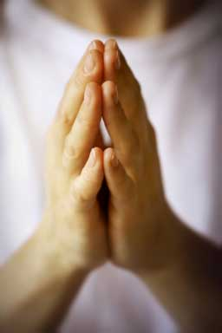
Thanksgiving
Notes:
Introduce Lesson by noting the challenges of the past couple of years
Covid Pandemic
An increasingly contentious and troubling national discourse
However, I just spent four days with my family, enjoying my grandchildren
Debbie and I had a wonderful time
I am a blessed man, and I am thankful for all that I have. Both physically, and spiritually.
I should be, and you should be, expressing our thanks to God for all we have. All we have comes from Him!
(James 1:17), “Every good gift and every perfect gift is from above, and comes down from the Father of lights, with whom there is no variation or shadow of turning.”
Sermon based upon a sermon submitted to Garyslist in 1994, by David Holder
Preached at the West Side church of Christ, June 26, 2009 AM
Print Slides: 2,3,17,19,20,21
Preached again, 12/26/21

Slide 2
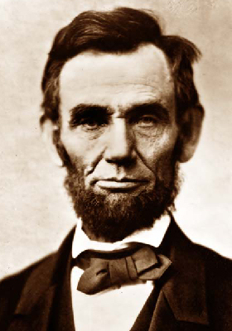
Lincoln Quote: Day of Fasting
“We have been the recipients of the choicest bounties of heaven; we have been preserved these many years in peace and prosperity; we have grown in numbers, wealth and power as no other nation has ever grown. But we have forgotten God. We have forgotten the gracious hand which preserved us in peace and multiplied and enriched and strengthened us. We have vainly imagined, in the deceitfulness of our hearts, that all these blessings were produced by some superior wisdom and virtue in our own lives. Intoxicated with unbroken success, we have become too self-sufficient to feel the necessity of redeeming and preserving grace, too proud to pray to the God that made us.”
Notes:
Lincoln Quote: Day of Fasting (March, 1863)
“We have been the recipients of the choicest bounties of heaven; we have been preserved these many years in peace and prosperity; we have grown in numbers, wealth and power as no other nation has ever grown. But we have forgotten God. We have forgotten the gracious hand which preserved us in peace and multiplied and enriched and strengthened us. We have vainly imagined, in the deceitfulness of our hearts, that all these blessings were produced by some superior wisdom and virtue in our own lives. Intoxicated with unbroken success, we have become too self-sufficient to feel the necessity of redeeming and preserving grace, too proud to pray to the God that made us.”

Slide 3
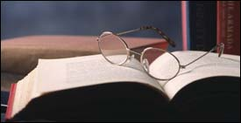
Psalm 100
Make a joyful shout to the LORD, all you lands! ² Serve the LORD with gladness; Come before His presence with singing. ³ Know that the LORD, He is God; It is He who has made us, and not we ourselves; We are His people and the sheep of His pasture. ⁴ Enter into His gates with thanksgiving, And into His courts with praise. Be thankful to Him, and bless His name. ⁵ For the LORD is good; His mercy is everlasting, And His truth endures to all generations.
Notes:
(Psalm 100), “Make a joyful shout to the LORD, all you lands! ² Serve the LORD with gladness; Come before His presence with singing. ³ Know that the LORD, He is God; It is He who has made us, and not we ourselves; We are His people and the sheep of His pasture. ⁴ Enter into His gates with thanksgiving, And into His courts with praise. Be thankful to Him, and bless His name. ⁵ For the LORD is good; His mercy is everlasting, And His truth endures to all generations.”

Slide 4
Thanksgiving Improves…
Our perspective about Ourselves
We need God (Jeremiah 10:23)
We need each other (Phil. 1:3-5; 1 Thess. 1:2-4)
Our perspective about our Things
We aren’t self-made, we’re stewards (1 Cor. 4:2) Blessings bring responsibility (1 Peter 4:9-10)
We should be content (Matt. 6:33; Phil. 4:10-12)
Our perspective about our God
He is the giver of the greatest gifts (James 1:17)
Our anxiety is decreased (Philippians 4:6-7)
Notes:
Thanksgiving Improves…
Our perspective about Ourselves
We need God
(Jeremiah 10:23), “O LORD, I know the way of man is not in himself; It is not in man who walks to direct his own steps.”
As such, God is worthy of our thanksgiving (as Abraham Lincoln observed)
(Psalm 50:14), “Offer to God thanksgiving, And pay your vows to the Most High.”
We need each other (as Paul recognized)
(Philippians 1:3-5), “I thank my God upon every remembrance of you, ⁴ always in every prayer of mine making request for you all with joy, ⁵ for your fellowship in the gospel from the first day until now.”
(1 Thessalonians 1:2-4), “We give thanks to God always for you all, making mention of you in our prayers, ³ remembering without ceasing your work of faith, labor of love, and patience of hope in our Lord Jesus Christ in the sight of our God and Father, ⁴ knowing, beloved brethren, your election by God.”
[CLICK] Our perspective about our Things
We aren’t self-made, we’re stewards
(1 Corinthians 4:2), “Moreover it is required in stewards that one be found faithful.
Blessings bring responsibility
(1 Peter 4:9-10), “Be hospitable to one another without grumbling. ¹⁰ As each one has received a gift, minister it to one another, as good stewards of the manifold grace of God.”
We should be content
(Matthew 6:33), “But seek first the kingdom of God and His righteousness, and all these things shall be added to you.”
(Philippians 4:10-12), “But I rejoiced in the Lord greatly that now at last your care for me has flourished again; though you surely did care, but you lacked opportunity. ¹¹ Not that I speak in regard to need, for I have learned in whatever state I am, to be content: ¹² I know how to be abased, and I know how to abound. Everywhere and in all things I have learned both to be full and to be hungry, both to abound and to suffer need.”
[CLICK] Our perspective about our God
He is the giver of the greatest gifts
(James 1:17), “Every good gift and every perfect gift is from above, and comes down from the Father of lights, with whom there is no variation or shadow of turning.”
Our anxiety is decreased
(Philippians 4:6-7), “Be anxious for nothing, but in everything by prayer and supplication, with thanksgiving, let your requests be made known to God; ⁷ and the peace of God, which surpasses all understanding, will guard your hearts and minds through Christ Jesus.”

Slide 5
Thanksgiving Helps Our Spirituality
A proper perspective about ourselves will keep us from arrogance
A proper perspective about our things will keep us from greed
A proper perspective about our God will keep us from worry
Notes:
Thanksgiving Helps Our Spirituality
A proper perspective about ourselves will keep us from arrogance
A proper perspective about our things will keep us from greed
A proper perspective about our God will keep us from worry

Slide 6
Conclusion
Charles Dickens said that we are mixed up in America. He suggested that instead of having one Thanksgiving Day each year we should have 364. Use that one day for complaining and griping. Use the other 364 to thank God each day for the many blessings He has showered upon you.
Notes:
Conclusion
Charles Dickens said that we are mixed up in America.
He suggested that instead of having one Thanksgiving Day each year we should have 364.
Use that one day for complaining and griping.
Use the other 364 to thank God each day for the many blessings He has showered upon you.

Slide 7
Psalm 95:2
“Let us come before His presence with thanksgiving; Let us shout joyfully to Him with psalms.”
Colossians 4:2
“Continue earnestly in prayer, being vigilant in it with thanksgiving.”
Notes:
(Psalm 95:2), “Let us come before His presence with thanksgiving; Let us shout joyfully to Him with psalms.”
(Colossians 4:2), “Continue earnestly in prayer, being vigilant in it with thanksgiving.”

