Slide 1


Slide 2
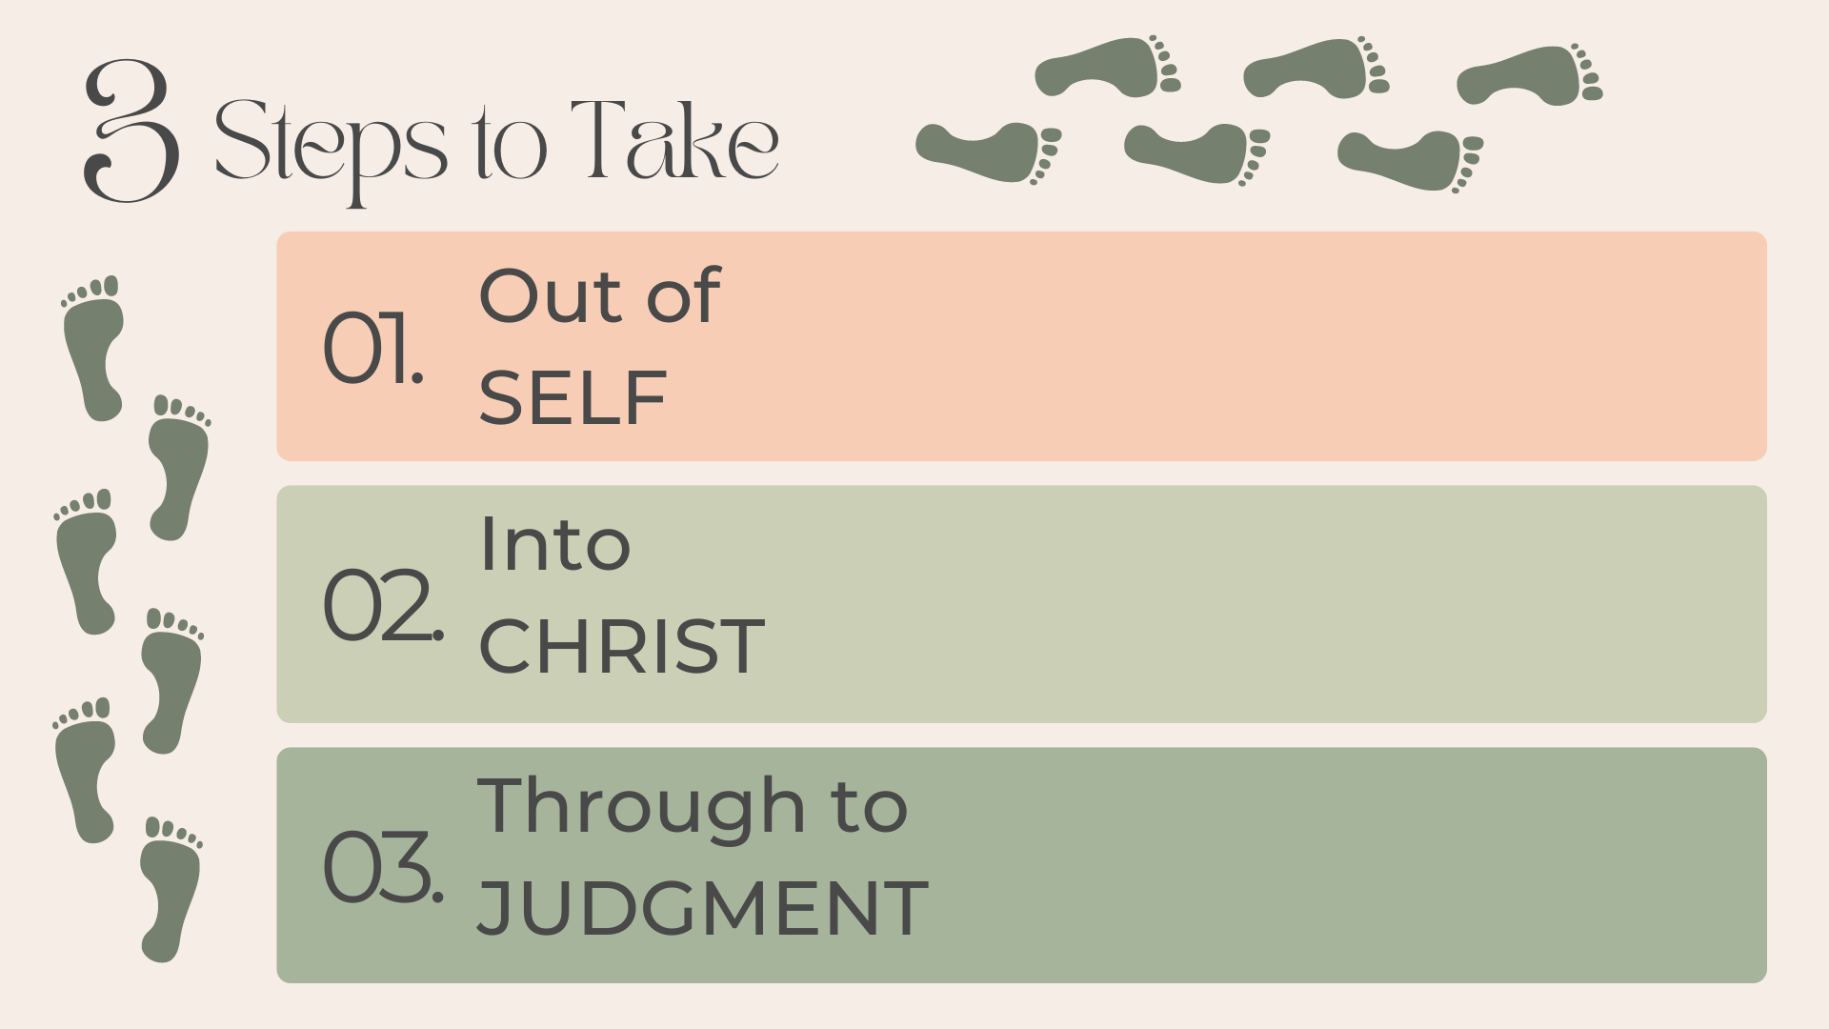
Luke 12:15, 20-21
Matthew 16:24-26
Matthew 11:28-29
Romans 8:1; Eph. 1:3-6
Galatians 3:26-29
Colossians 2:9-10
Ecclesiastes 12:13-14
Rom. 2:6-11; Matt. 25:11-13
Philippians 3:7-11

Slide 3


