Slide 1
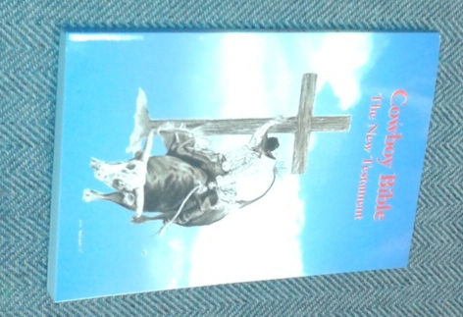
The Cowboy Bible and the Plan of Salvation
Comparing God’s way
to the
“Cowboy” way

Slide 2
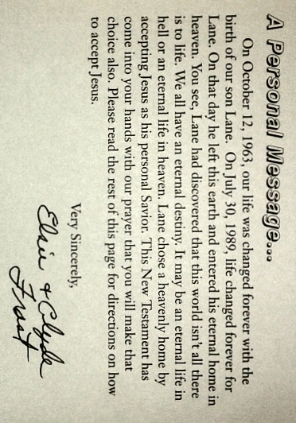
Inside front Cover

Slide 3
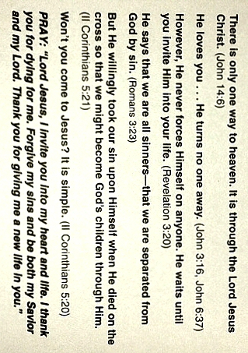
The “Cowboy” Way

Slide 4
John 14:6
Jesus said to him, “I am the way, the truth, and the life. No one comes to the Father except through Me.

Slide 5
The “Cowboy” Way

Slide 6
John 3:16
For God so loved the world that He gave His only begotten Son, that whoever believes in Him should not perish but have everlasting life.

Slide 7
John 6:35-37
And Jesus said to them, “I am the bread of life. He who comes to Me shall never hunger, and he who believes in Me shall never thirst. ³⁶ But I said to you that you have seen Me and yet do not believe. ³⁷ All that the Father gives Me will come to Me, and the one who comes to Me I will by no means cast out.

Slide 8
The “Cowboy” Way

Slide 9
Revelation 3:20
Behold, I stand at the door and knock. If anyone hears My voice and opens the door, I will come in to him and dine with him, and he with Me.

Slide 10
The “Cowboy” Way

Slide 11
Romans 3:23
For all have sinned and fall short of the glory of God.

Slide 12
The “Cowboy” Way

Slide 13
2 Corinthians 5:21
For He made Him who knew no sin to be sin for us, that we might become the righteousness of God in Him.

Slide 14
The “Cowboy” Way

Slide 15
2 Corinthians 5:20
Now then, we are ambassadors for Christ, as though God were pleading through us: we implore you on Christ’s behalf, be reconciled to God.

Slide 16
The “Cowboy” Way
Notes:
Sinner’s Prayer is of recent origin and had its roots in the reformation movement among evangelicals.
In fact, evidence suggests it is a modification of the old “mourner’s bench”, practiced in tent meetings in the 18th and 19th century

Slide 17
God’s Way to Come to Him!
Acts 2
Hear (Romans 10:17)
Believe (Hebrews 11:6)
Repent (Luke 13:3)
Confess (Romans 10:9-10)
Baptism (1 Peter 3:21)

Slide 18
Conclusion
God’s way?
or the
“Cowboy” way?
Which will you follow as you attempt to find and please God?

