Slide 1
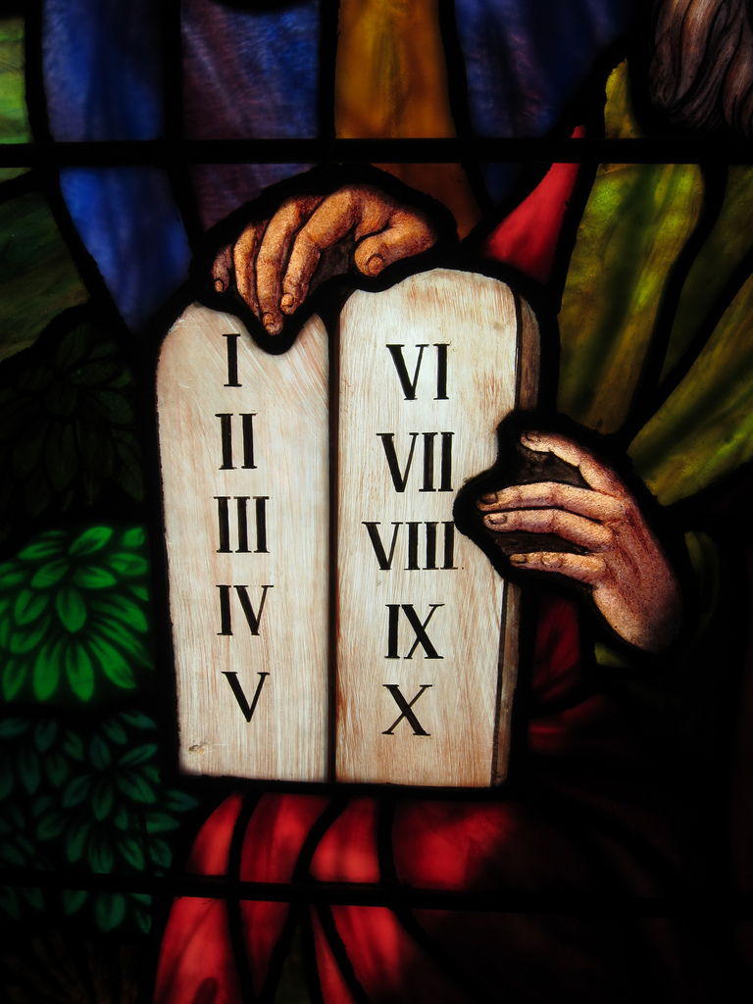
The Law of Moses
“For whatever things were written before were written for our learning, that we through the patience and comfort of the Scriptures might have hope.”
(Romans 15:4)
Notes:
The Old Testament is a valuable part of God’s revelation to man
(Romans 15:4) We learn many wonderful truths and principles from the Old Testament
(1 Corinthians 10:11), [God’s punishment of Israel’s rebellion], “Now all these things happened to them as examples, and they were written for our admonition, upon whom the ends of the ages have come.”

Slide 2
Weaknesses of the Law
Did not take away sin (Hebrews 10:1-4)
Could not justify man (Galatians 3:11-12)
Was a temporary law (Galatians 3:19)
Limited to only one nation (Ephesians 2:14)
Notes:
(Hebrews 10:1-4), “For the law, having a shadow of the good things to come, and not the very image of the things, can never with these same sacrifices, which they offer continually year by year, make those who approach perfect. ² For then would they not have ceased to be offered? For the worshipers, once purified, would have had no more consciousness of sins. ³ But in those sacrifices there is a reminder of sins every year. ⁴ For it is not possible that the blood of bulls and goats could take away sins.”
(Galatians 3:12), “But that no one is justified by the law in the sight of God is evident, for ‘the just shall live by faith.’ ¹² Yet the law is not of faith, but "the man who does them shall live by them.”
(Galatians 3:19), “What purpose then does the law serve? It was added because of transgressions, till the Seed should come to whom the promise was made; and it was appointed through angels by the hand of a mediator.”
(Ephesians 2:14-15), “For He Himself is our peace, who has made both one, and has broken down the middle wall of separation, ¹⁵ having abolished in His flesh the enmity, that is, the law of commandments contained in ordinances, so as to create in Himself one new man from the two, thus making peace.”

Slide 3
Purpose of the Law
Lead man to Christ (Galatians 3:24-25)
Served as a tutor (Galatians 3:24)
Emphasized the horror of sin (Romans 3:20)
Christians are not under the Old Law! (Romans 8:1-2)
Notes:
(Galatians 3:24-25), “Therefore the law was our tutor to bring us to Christ, that we might be justified by faith. ²⁵ But after faith has come, we are no longer under a tutor.”
(tutor – paidagogos). Slave given the responsibility to tend a master’s boy until maturity
Emphasis not on “teaching”, but the passing from submission to freedom and superiority
1) Men “subject” to law; 2) Law responsible for moral discipline until maturity; 3) freedom comes maturity (Christ)
(Romans 3:20), “Therefore by the deeds of the law no flesh will be justified in His sight, for by the law is the knowledge of sin.”
(Romans 8:1-2), “There is therefore now no condemnation to those who are in Christ Jesus, who do not walk according to the flesh, but according to the Spirit. ² For the law of the Spirit of life in Christ Jesus has made me free from the law of sin and death.”

Slide 4
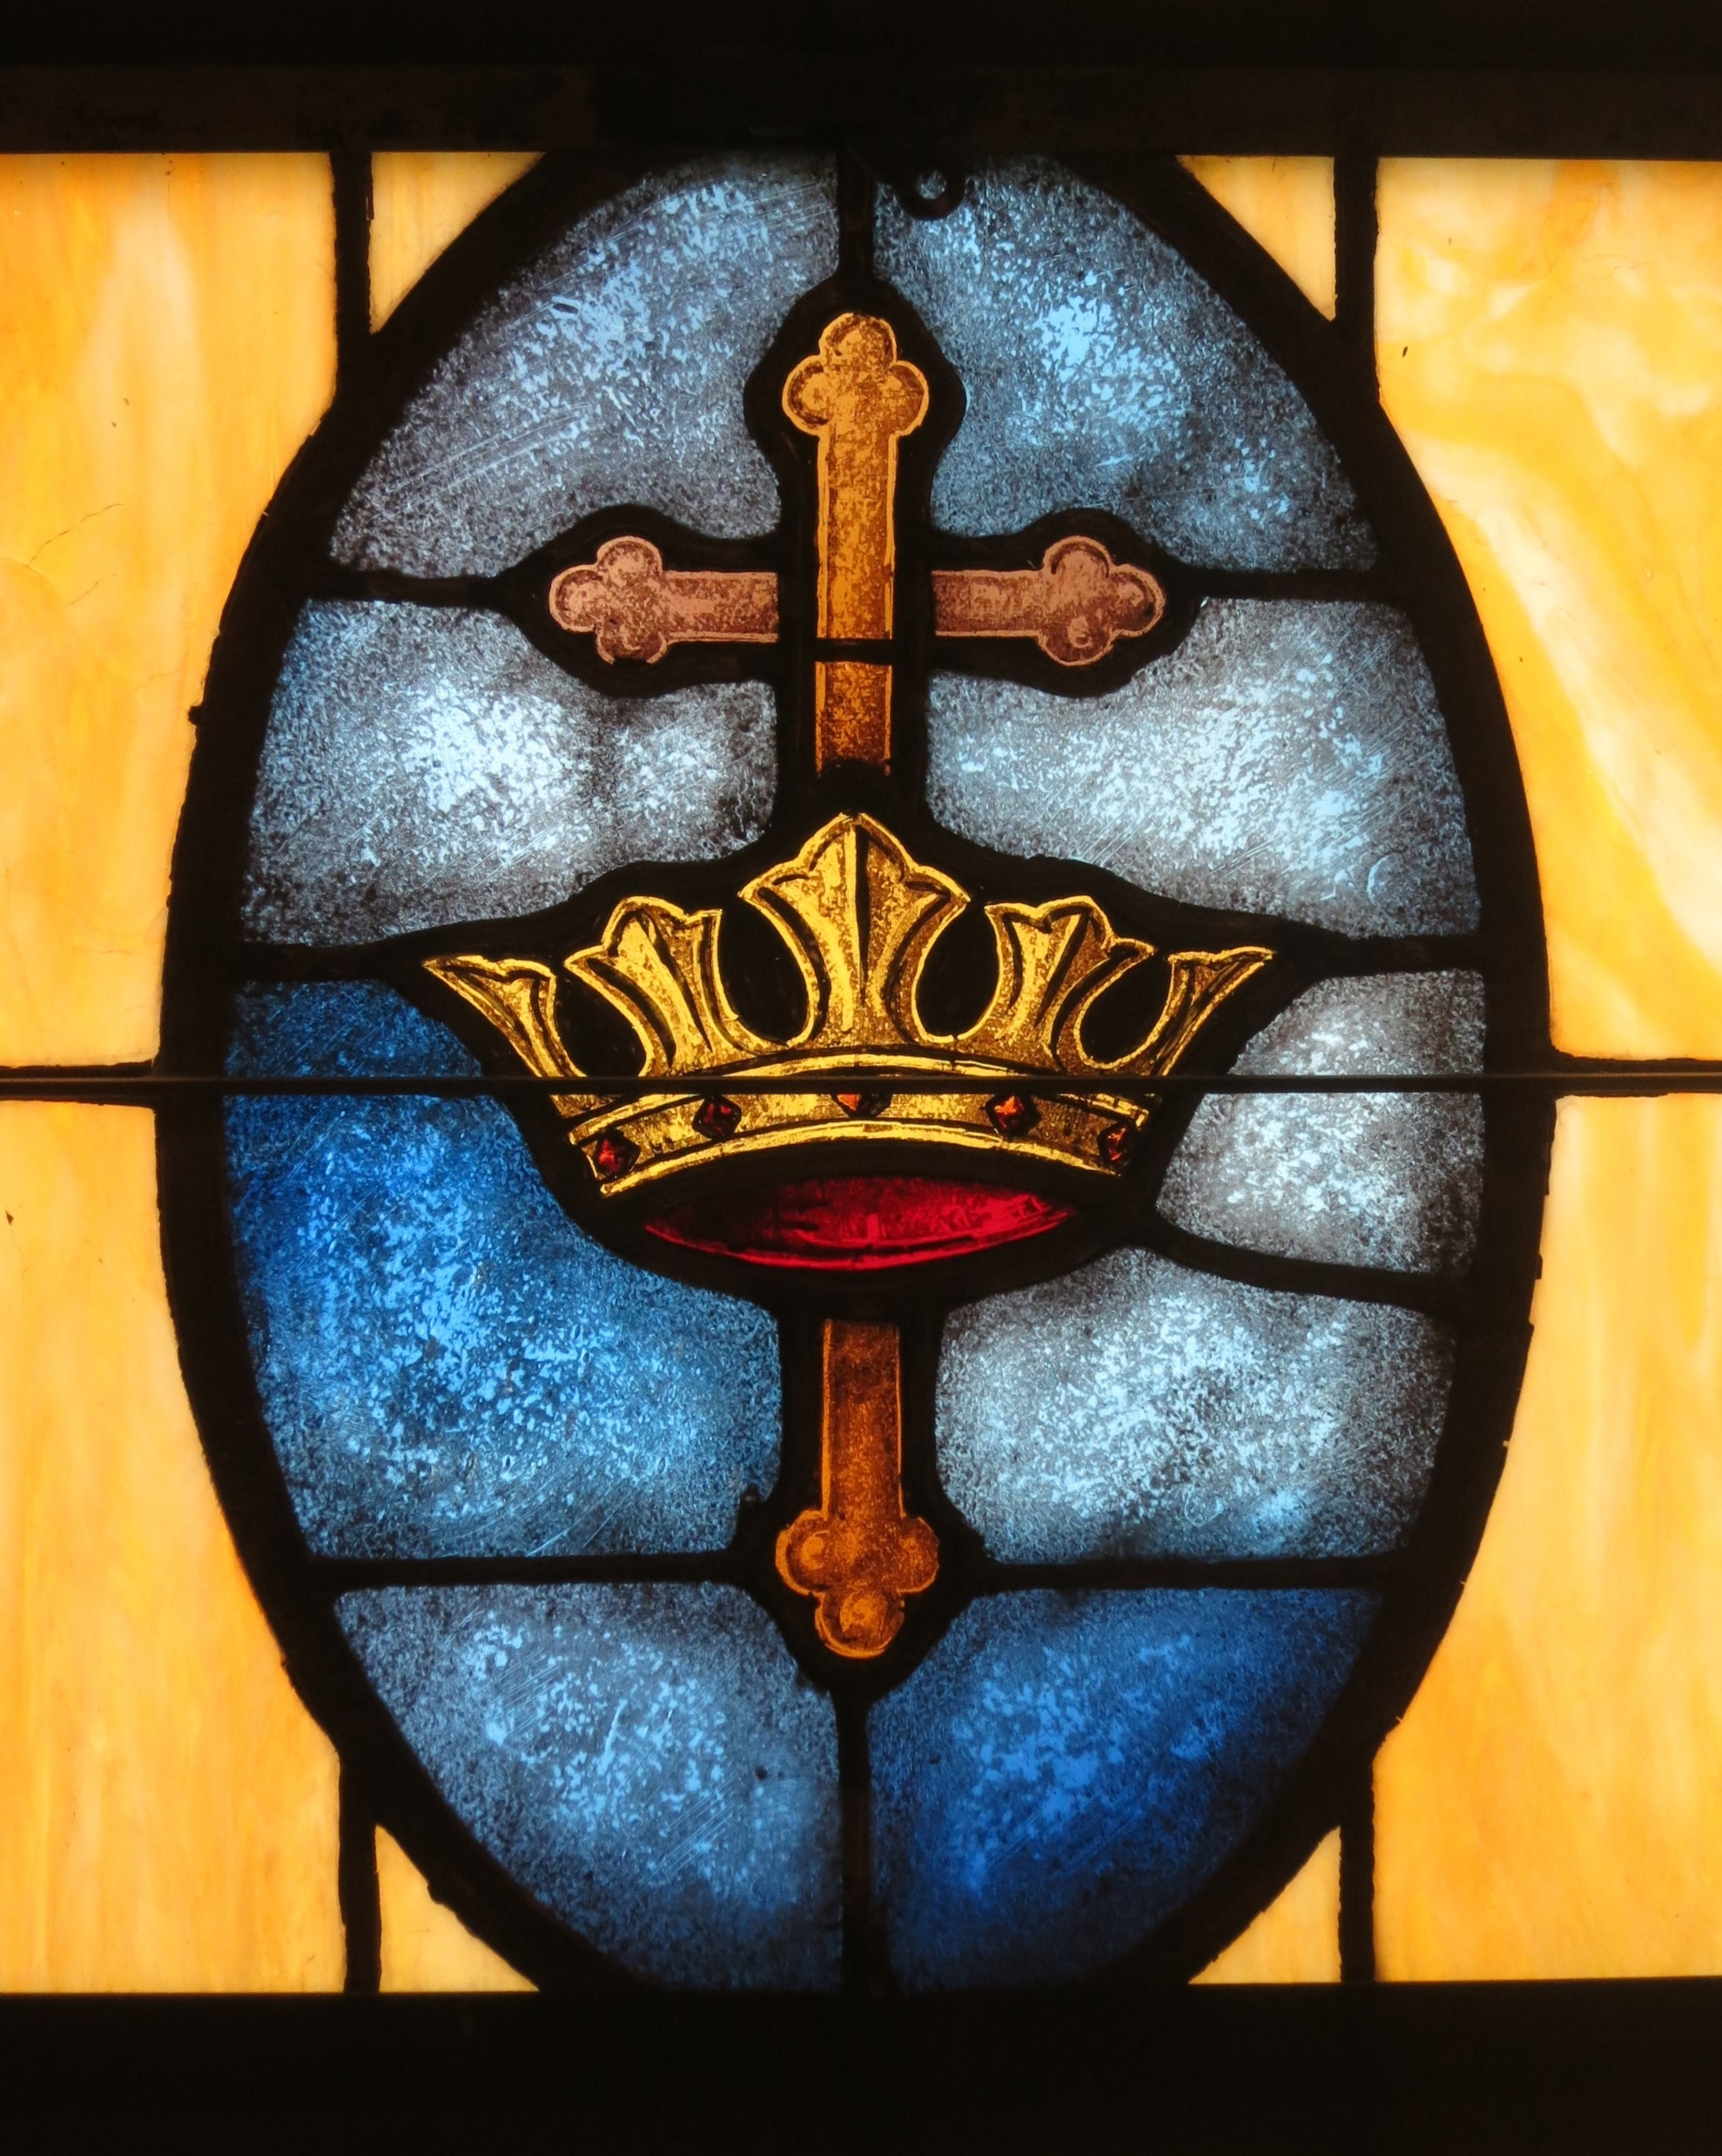
The New Law is Better!
The Law of Jesus Christ is a better covenant (Hebrews 7:22). A Perfect law (James 1:25). It is able to provide the remission of sins (Acts 2:38) and a better hope (Hebrews 7:19).
Notes:
(Hebrews 7:22), [In His perfection as High Priest] “Jesus has become a surety of a better covenant.”
(James 1:25), “But he who looks into the perfect law of liberty and continues in it, and is not a forgetful hearer but a doer of the work, this one will be blessed in what he does.”
(Acts 2:38), “Then Peter said to them, "Repent, and let every one of you be baptized in the name of Jesus Christ for the remission of sins; and you shall receive the gift of the Holy Spirit.”
(Hebrews 7:19), “for the law made nothing perfect; on the other hand, there is the bringing in of a better hope, through which we draw near to God.”
The Patriarchs we all looking for a better country, which had its fruition in Christ Jesus!
(Hebrews 11:16), “But now they desire a better, that is, a heavenly country. Therefore God is not ashamed to be called their God, for He has prepared a city for them.”

