Slide 1
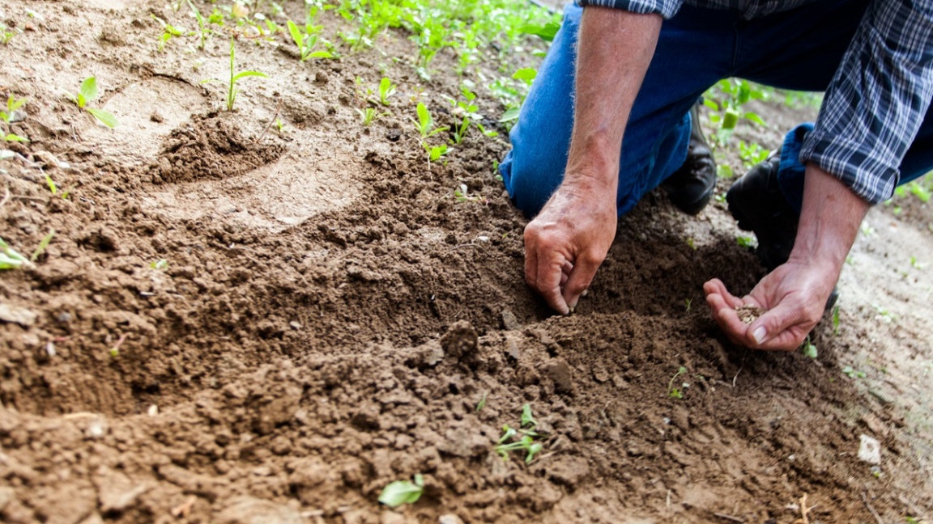
Sowing and
Reaping
Galatians 6:6-10
Notes:
The law of Sowing and Reaping is certain and reliable.
It affects everyone alike.
It reveals the wise and exposes the foolish.
It’s true and just.
There’s no escaping it or outsmarting it.
It’s eternal in its outcome.
(Galatians 6:6-10), “Let him who is taught the word share in all good things with him who teaches. ⁷ Do not be deceived, God is not mocked; for whatever a man sows, that he will also reap. ⁸ For he who sows to his flesh will of the flesh reap corruption, but he who sows to the Spirit will of the Spirit reap everlasting life. ⁹ And let us not grow weary while doing good, for in due season we shall reap if we do not lose heart. ¹⁰ Therefore, as we have opportunity, let us do good to all, especially to those who are of the household of faith.”
(Note: It is demonstrated in the conflict between the flesh and the Spirit, 5:16-25) (flesh/Spirit in both passages)
(Galatians 5:21) [those who indulge in the lust of the flesh], “that those who practice such things will not inherit the kingdom of God.”
(Galatians 5:23) [the fruit of the Spirit] “Against such there is no law.” [Those who practice them] “are Christ’s” (24).

Slide 2
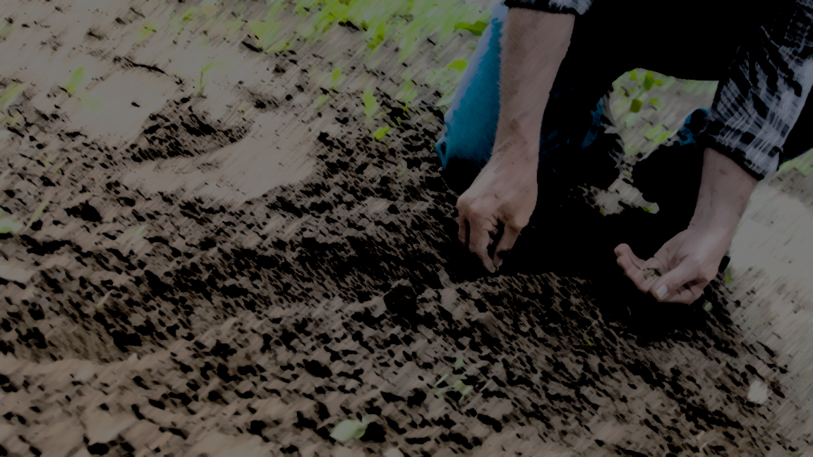
Reap What We Sow
Galatians 6:7-8
2 Thessalonians 1:6-7
Notes:
REAP WHAT WE SOW
(Galatians 6:7-8), “Do not be deceived, God is not mocked; for whatever a man sows, that he will also reap. ⁸ For he who sows to his flesh will of the flesh reap corruption, but he who sows to the Spirit will of the Spirit reap everlasting life.”
Encouragement, [the primary purpose of the imagery as indicated in context] (“he who sows to the Spirit will of the Spirit reap everlasting life.”)
And a Warning (“he who sows to his flesh will of the flesh reap corruption.”)
God is not mocked (Means that we can’t make a fool of God, flouting our disobedience without fear of reprisal) The results are inevitable!
(2 Thessalonians 1:6-7), “It is a righteous thing with God to repay with tribulation those who trouble you, ⁷ and to give you who are troubled rest with us when the Lord Jesus is revealed from heaven with His mighty angels.”
This warning is intended to be Preventative (learn it before suffering the consequences of ignorance!)
We see it demonstrated without fail in the Physical world (plant corn, you don’t get kumquats)
Paul reveals that the principle is as inviolate in the realm of the Moral and Spiritual as well.

Slide 3
Reap More Than We Sow
Galatians 6:8
Notes:
REAP MORE THAN WE SOW
(Galatians 6:8), “For he who sows to his flesh will of the flesh reap corruption, but he who sows to the Spirit will of the Spirit reap everlasting life.”
A seed brings forth fruit
What is the fruit that comes from sowing to the flesh? CORRUPTION (destruction, perishing. In context – misery in Hell)
What is the fruit that comes from sowing to the Spirit? The Spirit will enable us to reap EVERLASTING LIFE!
Consider how many times sin is entertained, and the sinner is surprised at the temporal consequences…
Drunk loses his job
Adulterer loses his family
Gossiper loses his friend
Consider how many sinners will be surprised at the judgment, not realizing just how consequential their rebellion will be to their eternal state.

Slide 4
Reap Only If We Sow
Galatians 6:8
Matthew 13:23; 15:19; Philippians 4:8
Notes:
REAP ONLY IF WE SOW
(Galatians 6:8), “For he who sows to his flesh will of the flesh reap corruption, but he who sows to the Spirit will of the Spirit reap everlasting life.”
In our text, if you want to go to heaven, you have to sow to the Spirit!
Also, consider the concept of sowing and reaping, as revealed in the Parable of the Sower
Sower (preacher) sows seed (the gospel) into the soil (the hearts of men)
Remember the one type of soil that indicates a heart that pleases the Lord?
(Matthew 13:23), “But he who received seed on the good ground is he who hears the word and understands it, who indeed bears fruit and produces: some a hundredfold, some sixty, some thirty.”
The key is sowing good things into a good heart!
(Matthew 15:19), [EVIL], “For out of the heart proceed evil thoughts, murders, adulteries, fornications, thefts, false witness, blasphemies.”
(Philippians 4:8), [GOOD], “Finally, brethren, whatever things are true, whatever things are noble, whatever things are just, whatever things are pure, whatever things are lovely, whatever things are of good report, if there is any virtue and if there is anything praiseworthy—meditate on these things.”

Slide 5
Reap Later Than We Sow
Galatians 6:9
James 5:7-8; 1 Timothy 5:24; Ecclesiastes 8:11
Notes:
REAP LATER THAN WE SOW
(Galatians 6:9), “And let us not grow weary while doing good, for in due season we shall reap if we do not lose heart.”
Harvests take time (both good and evil)
(James 5:7), [GOOD], “Therefore be patient, brethren, until the coming of the Lord. See how the farmer waits for the precious fruit of the earth, waiting patiently for it until it receives the early and latter rain. ⁸ You also be patient. Establish your hearts, for the coming of the Lord is at hand.”
(1 Timothy 5:24), [EVIL], “Some men's sins are clearly evident, preceding them to judgment, but those of some men follow later.”
Men are shortsighted, which leads them to think the law has been suspended. Such is NOT the case
(Ecclesiastes 8:11), “Because the sentence against an evil work is not executed speedily, therefore the heart of the sons of men is fully set in them to do evil.”
Also, righteous men may despair at the seeming prosperity of the wicked!
Finally, righteous men may grow weary that their righteousness does not bring immediate reward. Our text gives us assurance!
Patience on the part of the righteous is worthwhile!

Slide 6
Conclusion
Seeds are actions
Eventually there will be a harvest!
Notes:
It’s a law we cannot evade or be exempted from (in either the physical or spiritual realms!)
It’s a law that if understood will help us to be wise for salvation.
Never forget that seeds are actions, and eventually there WILL BE a harvest.
(Matthew 13:30), [Jesus will harvest. In the parable the righteous are the wheat, the unrighteous are the tares. Jesus’ words], “Let both grow together until the harvest, and at the time of harvest I will say to the reapers, “First gather together the tares and bind them in bundles to burn them, but gather the wheat into my barn.”

