Slide 1

Notes:
INTRODUCTION:
Ezra is a rather straightforward examination of an important period of Old Testament history
The return of a small group of Jews to Jerusalem following a 70 year period of Babylonian captivity
As we have been studying in Isaiah, Judah was conquered by Nebudchanezzar, Jerusalem was destroyed, and the temple was razed to the ground
This was in response to the rebellion and idolatrous practices of Judah
Israel had already lost its identity as a people during the Assyrian reign
Jeremiah, the last prophet to speak to Judah before her fall had this to say...
Jeremiah 25:3-11 "From the thirteenth year of Josiah the son of Amon, king of Judah, even to this day, this is the twenty-third year in which the word of the LORD has come to me; and I have spoken to you, rising early and speaking, but you have not listened. (4) And the LORD has sent to you all His servants the prophets, rising early and sending them, but you have not listened nor inclined your ear to hear. (5) They said, 'Repent now everyone of his evil way and his evil doings, and dwell in the land that the LORD has given to you and your fathers forever and ever. (6) Do not go after other gods to serve them and worship them, and do not provoke Me to anger with the works of your hands; and I will not harm you.' (7) Yet you have not listened to Me," says the LORD, "that you might provoke Me to anger with the works of your hands to your own hurt. (8) "Therefore thus says the LORD of hosts: 'Because you have not heard My words, (9) behold, I will send and take all the families of the north,' says the LORD, 'and Nebuchadnezzar the king of Babylon, My servant, and will bring them against this land, against its inhabitants, and against these nations all around, and will utterly destroy them, and make them an astonishment, a hissing, and perpetual desolations. (10) Moreover I will take from them the voice of mirth and the voice of gladness, the voice of the bridegroom and the voice of the bride, the sound of the millstones and the light of the lamp. (11) And this whole land shall be a desolation and an astonishment, and these nations shall serve the king of Babylon seventy years.
Ezra begins by noting the decree of Cyrus of Persia, after the defeat of the Babylonians
Ezra 1:1-2 Now in the first year of Cyrus king of Persia, that the word of the LORD by the mouth of Jeremiah might be fulfilled, the LORD stirred up the spirit of Cyrus king of Persia, so that he made a proclamation throughout all his kingdom, and also put it in writing, saying, (2) Thus says Cyrus king of Persia: All the kingdoms of the earth the LORD God of heaven has given me. And He has commanded me to build Him a house at Jerusalem which is in Judah.
God's work with Cyrus the king was predicted by Isaiah
Isaiah 44:28 [Jehovah, who declared, "I am the Lord"...] "Who says of Cyrus, 'He is My shepherd, And he shall perform all My pleasure, Saying to Jerusalem, "You shall be built," And to the temple, "Your foundation shall be laid." '
Because of this, a great number of people returned immediately to Judah (42,360 cf. Ezra 2:64-65, as well as over 7,000 servants and singers).
Ezra 1:5 Then the heads of the fathers' houses of Judah and Benjamin, and the priests and the Levites, with all whose spirits God had moved, arose to go up and build the house of the LORD which is in Jerusalem.
Later, as indicated in Ezra 8, Ezra himself travelled to Jerusalem as king Artexerxes renewed the instructions of Cyrus
Under the leadership of Nehemiah, and the priest Ezra, the temple was completed and worship was restored in Jerusalem
Nehemiah 8:5-8 And Ezra opened the book in the sight of all the people, for he was standing above all the people; and when he opened it, all the people stood up. (6) And Ezra blessed the LORD, the great God. Then all the people answered, "Amen, Amen!" while lifting up their hands. And they bowed their heads and worshiped the LORD with their faces to the ground. (7) Also Jeshua, Bani, Sherebiah, Jamin, Akkub, Shabbethai, Hodijah, Maaseiah, Kelita, Azariah, Jozabad, Hanan, Pelaiah, and the Levites, helped the people to understand the Law; and the people stood in their place. (8) So they read distinctly from the book, in the Law of God; and they gave the sense, and helped them to understand the reading.
With this Overview established, there are a few items specific lessons to note in Ezra's book!

Slide 2

Mixed Emotions at the Temple Foundation
  Ezra 3:10-13; Isaiah 40:28-31
Temple Finished (6th year of Darius)
  Ezra 6:15-18
Characterizing Ezra the Priest
  Ezra 7:6,10,21,25; 8:35-36
A Lesson: Pagan Intermarriages
  Ezra 9:2-4; Galatians 3:28; Ezra 9:10-15; Ezra 10:10-12; Ephesians 5:33
Notes:
DISCUSSION
Mixed emotions as the foundation of the temple was laid
Ezra 3:10-13 When the builders laid the foundation of the temple of the LORD, the priests stood in their apparel with trumpets, and the Levites, the sons of Asaph, with cymbals, to praise the LORD, according to the ordinance of David king of Israel. (11) And they sang responsively, praising and giving thanks to the LORD: "For He is good, For His mercy endures forever toward Israel." Then all the people shouted with a great shout, when they praised the LORD, because the foundation of the house of the LORD was laid. (12) But many of the priests and Levites and heads of the fathers' houses, old men who had seen the first temple, wept with a loud voice when the foundation of this temple was laid before their eyes. Yet many shouted aloud for joy, (13) so that the people could not discern the noise of the shout of joy from the noise of the weeping of the people, for the people shouted with a loud shout, and the sound was heard afar off.
Why would there be such great joy?
There is a return to God's comfort and joy, knowing they had not been fully rejected!
Isaiah 40:28-31 Have you not known? Have you not heard? The everlasting God, the LORD, The Creator of the ends of the earth, Neither faints nor is weary. His understanding is unsearchable. (29) He gives power to the weak, And to those who have no might He increases strength. (30) Even the youths shall faint and be weary, And the young men shall utterly fall, (31) But those who wait on the LORD Shall renew their strength; They shall mount up with wings like eagles, They shall run and not be weary, They shall walk and not faint.
Why would there be such sorrow?
The loss of former glory because of their disobedience as a nation!
The dimensions of the temple did not approach the glory of their nation and the temple Solomon first erected at the Zenith of God's help to the nation before the difficult days came due to their sin and rebellion.
[CLICK HERE FOR NEW POINT]
The temple was finished the sixth year of King Darius reign in the Persian Empire
Ezra 6:15-18 Now the temple was finished on the third day of the month of Adar, which was in the sixth year of the reign of King Darius. (16) Then the children of Israel, the priests and the Levites and the rest of the descendants of the captivity, celebrated the dedication of this house of God with joy. (17) And they offered sacrifices at the dedication of this house of God, one hundred bulls, two hundred rams, four hundred lambs, and as a sin offering for all Israel twelve male goats, according to the number of the tribes of Israel. (18) They assigned the priests to their divisions and the Levites to their divisions, over the service of God in Jerusalem, as it is written in the Book of Moses.
[CLICK HERE FOR NEW POINT]
Ezra (A descendent of Aaron, therefore legitimately qualified for the priesthood) is described.
His dedication and character are noted
Ezra 7:6 this Ezra came up from Babylon; and he was a skilled scribe in the Law of Moses, which the LORD God of Israel had given..."
Ezra 7:10 For Ezra had prepared his heart to seek the Law of the LORD, and to do it, and to teach statutes and ordinances in Israel.
King Artexerxes declared the following regarding Ezra
Ezra 7:21 And I, even I, Artaxerxes the king, issue a decree to all the treasurers who are in the region beyond the River, that whatever Ezra the priest, the scribe of the Law of the God of heaven, may require of you, let it be done diligently,
Ezra 7:25 And you, Ezra, according to your God-given wisdom, set magistrates and judges who may judge all the people who are in the region beyond the River, all such as know the laws of your God; and teach those who do not know them.
That is exactly what Ezra did!
Ezra 8:35-36 The children of those who had been carried away captive, who had come from the captivity, offered burnt offerings to the God of Israel: twelve bulls for all Israel, ninety-six rams, seventy-seven lambs, and twelve male goats as a sin offering. All this was a burnt offering to the LORD. (36) And they delivered the king's orders to the king's satraps and the governors in the region beyond the River. So they gave support to the people and the house of God.
[CLICK HERE FOR NEW POINT]
A Lesson for us: Intermarriage to the profane
Jewish leaders informed Ezra of intermarriage between some men and the pagans (Canaanites, Hittites, Perizzites, Jebusites, Ammonites, Moabites, Egyptians and Amorites).
Ezra 9:2-4 For they have taken some of their daughters as wives for themselves and their sons, so that the holy seed is mixed with the peoples of those lands. Indeed, the hand of the leaders and rulers has been foremost in this trespass." (3) So when I heard this thing, I tore my garment and my robe, and plucked out some of the hair of my head and beard, and sat down astonished. (4) Then everyone who trembled at the words of the God of Israel assembled to me, because of the transgression of those who had been carried away captive, and I sat astonished until the evening sacrifice.
What is inappropriate intermarriage in the kingdom of Christ?
Galatians 3:28 There is neither Jew nor Greek, there is neither slave nor free, there is neither male nor female; for you are all one in Christ Jesus.
It is NOT Christians of other races.
It is much more troublesome to marry someone who will not help you get to heaven!
Remember the problem with Israel's intermarriages was Paganism! Again and Again.
Consider Ezra's confession in his prayer to God
Ezra 9:10-15 And now, O our God, what shall we say after this? For we have forsaken Your commandments, (11) which You commanded by Your servants the prophets, saying, 'The land which you are entering to possess is an unclean land, with the uncleanness of the peoples of the lands, with their abominations which have filled it from one end to another with their impurity. (12) Now therefore, do not give your daughters as wives for their sons, nor take their daughters to your sons; and never seek their peace or prosperity, that you may be strong and eat the good of the land, and leave it as an inheritance to your children forever.' (13) And after all that has come upon us for our evil deeds and for our great guilt, since You our God have punished us less than our iniquities deserve, and have given us such deliverance as this, (14) should we again break Your commandments, and join in marriage with the people committing these abominations? Would You not be angry with us until You had consumed us, so that there would be no remnant or survivor? (15) O LORD God of Israel, You are righteous, for we are left as a remnant, as it is this day. Here we are before You, in our guilt, though no one can stand before You because of this!"
We too must be careful to note God's intention for us to raise our children in the nurture and admonition of the Lord.
For fathers to teach their children God's law
For mothers to nurture their children in truth and righteousness
That God's plan for the home can only be fulfilled if both husband and wife are serving Him acceptably.
Ephesians 5:33 Nevertheless let each one of you in particular so love his own wife as himself, and let the wife see that she respects her husband.
Ezra dealt forthrightly with the ungodliness of the remnant at this time
Ezra 10:10-12 Then Ezra the priest stood up and said to them, "You have transgressed and have taken pagan wives, adding to the guilt of Israel. (11) Now therefore, make confession to the LORD God of your fathers, and do His will; separate yourselves from the peoples of the land, and from the pagan wives." (12) Then all the assembly answered and said with a loud voice, "Yes! As you have said, so we must do.
Ezra 10:19 And they gave their promise that they would put away their wives; and being guilty, they presented a ram of the flock as their trespass offering.

Slide 3
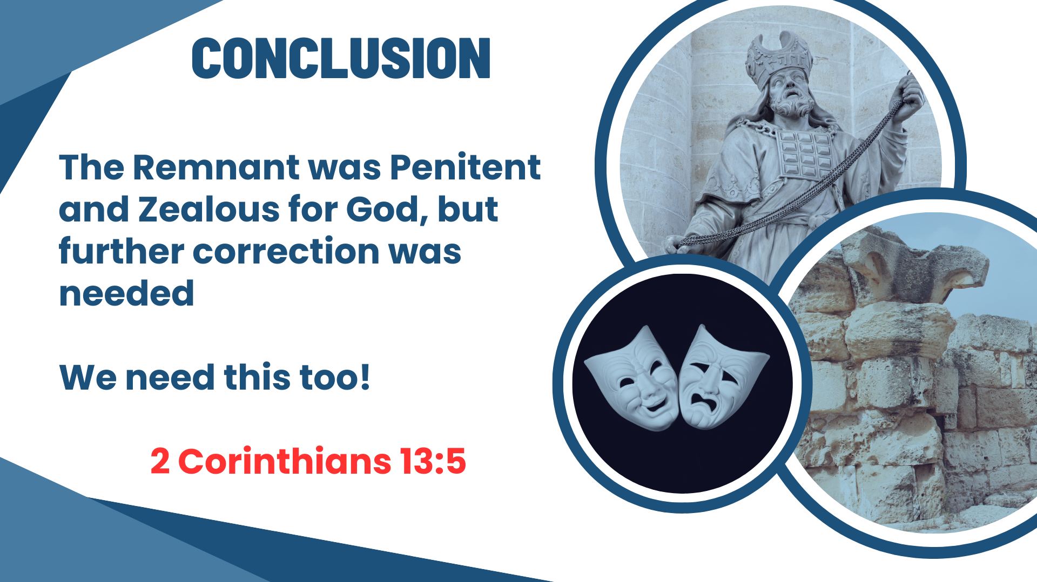
Notes:
CONCLUSION
It is evident that the remnant was penitent and zealous for God
They had learned their lesson, though continued instruction and correction was necessary
From this we learn our own need for self-examination in all things, to please God.
2 Corinthians 13:5 Examine yourselves as to whether you are in the faith. Test yourselves. Do you not know yourselves, that Jesus Christ is in you?—unless indeed you are disqualified.

