Slide 1
the Sovereignty of God
Notes:
One of the biggest of doctrinal errors that has led literally millions of souls away from truth and salvation, is a misunderstanding of the nature of God’s sovereignty.
What do we mean by God’s Sovereignty?
Definition: (English word) – Supreme power or authority
All would agree that God has supreme power and authority.
He answers to no one
He is free from any outside compulsion (He can’t be MADE to do anything).
He is not compelled, He has the authority to compel all others!
The concept is very clearly taught in scripture, though the term is not used in the NKJV
(1 Timothy 6:13-16), “I urge you in the sight of God who gives life to all things, and before Christ Jesus who witnessed the good confession before Pontius Pilate, ¹⁴ that you keep this commandment without spot, blameless until our Lord Jesus Christ's appearing, ¹⁵ which He will manifest in His own time, He who is the blessed and only Potentate, the King of kings and Lord of lords, ¹⁶ who alone has immortality, dwelling in unapproachable light, whom no man has seen or can see, to whom be honor and everlasting power. Amen.”
Greek – Potentate (dunastēs) Thayer Definition:
1) a prince, a potentate;
2) a courtier, high officer, royal minister of great authority

Slide 2
The Error
“God preordained, for his own glory and the display of His attributes of mercy and justice, a part of the human race, without any merit of their own, to eternal salvation, and another part, in just punishment of their sin, to eternal damnation.”
― John Calvin
Notes:
Consider the following quote:
“God preordained, for his own glory and the display of His attributes of mercy and justice, a part of the human race, without any merit of their own, to eternal salvation, and another part, in just punishment of their sin, to eternal damnation.”
― John Calvin
The view of John Calvin in the 16th century, and those like him both before an after:
Acceptance of Sovereignty requires an acknowledgement of God’s complete control
Acknowledgement of God’s complete control requires the recognition that the free will of man is illusory
God is the great puppet master. We only act and do as we act and do because God has planned it that way, before creation.

Slide 3
The Five Tenets of Calvinism
T
U
L
I
P
otal Depravity
nconditional Salvation
imited Atonement
rresistible Grace
erseverance of the Saints
Notes:
Consider how the Five major tenets of Calvinism are tied into this faulty concept of God’s sovereignty
Total Depravity – Man is unable to do good from birth. Only the elect (chosen of God) escape this depravity and do good.
Unconditional Salvation – God chooses who will be saved and who will be lost. If He chooses to save you, you are saved. There is nothing required of you.
Limited Atonement – Jesus shed His blood on the cross only for those who God chose. If you are chosen, his blood atones for your sin. If not, it doesn’t.
Irresistible Grace – If God chooses to save you by His grace, you can’t resist it. You have no choice. He is Sovereign.
Perseverance of the Saints – If God is the one who determines you are among the elect, nothing you do has any bearing on the matter. It is God’s choice.
Consider that to refute the error one must only show that the Sovereign God allows free choice among men
Leads to a fatalistic view
Permeates the thinking of many (even subtly, where we don’t recognize it).
Affects our views of our physical lives (God controls life and death, we are just puppets).
Affects our views of our spiritual destiny (versions of Calvinism)
Biblical teaching to differentiate between God’s providential action, and fatalism

Slide 4
The Refutation
Scriptures are full of references to man’s ability to choose!
Daniel 3:14-18
Matthew 23:37-39; John 7:16-17; Mark 16:15-16
The Sovereign God of Heaven grants freedom to choose to obey or not obey!
Notes:
Consider that to refute the error one must only show that the Sovereign God allows free choice among men
Sovereignty does not require the concept of fatalism (Que Sera, Sera, Whatever will be, will be)
We recognize this in our physical lives
Even dictators who retain full authority over their subjects, are often opposed by rebels
Who can forget Tiananmen Square protests in 1989. Image of single man, bringing a column of tanks to a stop in protests.
Consider a Biblical analogue in Shadrach, Meshach & Abed-Nego’s protest to the edict of Sovereign King Nebuchadnezzar
(Daniel 3:14-18), “Nebuchadnezzar spoke, saying to them, “Is it true, Shadrach, Meshach, and Abed-Nego, that you do not serve my gods or worship the gold image which I have set up? ¹⁵ Now if you are ready at the time you hear the sound of the horn, flute, harp, lyre, and psaltery, in symphony with all kinds of music, and you fall down and worship the image which I have made, good! But if you do not worship, you shall be cast immediately into the midst of a burning fiery furnace. And who is the god who will deliver you from my hands?” ¹⁶ Shadrach, Meshach, and Abed-Nego answered and said to the king, “O Nebuchadnezzar, we have no need to answer you in this matter. ¹⁷ If that is the case, our God whom we serve is able to deliver us from the burning fiery furnace, and He will deliver us from your hand, O king. ¹⁸ But if not, let it be known to you, O king, that we do not serve your gods, nor will we worship the gold image which you have set up.”
Scriptures are full of references to man’s ability to choose to obey or disregard the commands of the Sovereign God! (As well as warnings as to consequence)
(Matthew 23:37-39), ““O Jerusalem, Jerusalem, the one who kills the prophets and stones those who are sent to her! How often I wanted to gather your children together, as a hen gathers her chicks under her wings, but you were not willing! ³⁸ See! Your house is left to you desolate; ³⁹ for I say to you, you shall see Me no more till you say, ‘Blessed is He who comes in the name of the Lord!’ ”
(John 7:16-17), “Jesus answered them and said, “My doctrine is not Mine, but His who sent Me. ¹⁷ If anyone wills to do His will, he shall know concerning the doctrine, whether it is from God or whether I speak on My own authority.”
(Mark 16:15-16), “And He said to them, “Go into all the world and preach the gospel to every creature. ¹⁶ He who believes and is baptized will be saved; but he who does not believe will be condemned.”
The Sovereign God of Heaven GRANTS FREEDOM to choose to obey or not obey
He could compel obedience
He could have created man without free will
He decided rather to make man a pinnacle of His creation, granting him the ability to choose to serve Him!
(Deuteronomy 30:15-20) [Moses’ address to Israel at Moab shortly before His death, as they prepared to cross the Jordan], “See, I have set before you today life and good, death and evil, ¹⁶ in that I command you today to love the Lord your God, to walk in His ways, and to keep His commandments, His statutes, and His judgments, that you may live and multiply; and the Lord your God will bless you in the land which you go to possess. ¹⁷ But if your heart turns away so that you do not hear, and are drawn away, and worship other gods and serve them, ¹⁸ I announce to you today that you shall surely perish; you shall not prolong your days in the land which you cross over the Jordan to go in and possess. ¹⁹ I call heaven and earth as witnesses today against you, that I have set before you life and death, blessing and cursing; therefore choose life, that both you and your descendants may live; ²⁰ that you may love the Lord your God, that you may obey His voice, and that you may cling to Him, for He is your life and the length of your days; and that you may dwell in the land which the Lord swore to your fathers, to Abraham, Isaac, and Jacob, to give them.”
The consequences of this error
Leads to a fatalistic view (Determinism)
Permeates the thinking of many (even subtly, where we don’t recognize it).
Affects our views of our physical lives (God controls life and death, we are just puppets).
Affects our views of our spiritual destiny (versions of Calvinism)
Biblical teaching to differentiate between God’s providential action, and fatalism

Slide 5
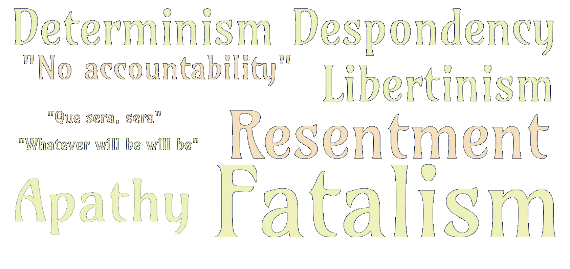
The Consequences
Notes:
Leads to a fatalistic view (Determinism)
Determinism - the doctrine that all events, including human action, are ultimately determined by causes external to the will. Some philosophers have taken determinism to imply that individual human beings have no free will and cannot be held morally responsible for their actions.
Fatalism - the belief that all events are predetermined and therefore inevitable. (Que sera, sera – whatever will be, will be)
Leads to a libertine lifestyle – what I do doesn’t matter
Leads to an unwillingness to be accountable for actions – It’s not me, it’s God!
Leads to despondency – there is nothing I can do to help myself spiritually. God has already decided.
Leads to apathy – why attend worship? why do good? None of it really matters.
Leads to resentment – my lot in life is not my fault, I blame God.
Permeates the thinking of many (even subtly, where we don’t recognize it).
Affects our views of our physical lives
After all, God controls life and death, we are just puppets.
My example: Fast car flying between our cars on the way home from worship one evening. My decisions, and that of the driver of other car.
Other examples: Taking that first drink… Smoking…
February 3, 1959 (The Day the Music died). Buddy Holly chartered a plane to avoid riding the bus to Moorhead, Minnesota. Ritchie Valens died with him because there was extra room, and he won a coin toss. Waylon Jennings lived because let the J.P. Richardson (The Big Bopper) who was ill, take his place. Two choices, one lives one dies. Four people died because Buddy Holly decided to charter a plane in bad weather. They died because the pilot lost control of the plane. No fate involved.
We make decisions that affect where we will live, who we will associate with, where we will work…
Life is a series of choices, whether good or bad, that will affect our lives AND our standing before God!
Affects our views of our spiritual destiny (versions of Calvinism)
Resentment toward a Capricious God (But God is NOT capricious)
(John 3:16-17), “For God so loved the world that He gave His only begotten Son, that whoever believes in Him should not perish but have everlasting life. ¹⁷ For God did not send His Son into the world to condemn the world, but that the world through Him might be saved.”
Apathy and disinterest because of the idea that God has predestined our salvation or condemnation (It doesn’t matter)
Consider how this view would make the preaching of the gospel a moot point. (Why some churches are not evangelical at all)
(Romans 1:15-16), “So, as much as is in me, I am ready to preach the gospel to you who are in Rome also. ¹⁶ For I am not ashamed of the gospel of Christ, for it is the power of God to salvation for everyone who believes, for the Jew first and also for the Greek.”

Slide 6
The Conclusion
Some may object, but isn’t God in control? Doesn’t sovereignty equate with God’s will being done?
Yes, but God has chosen not to override the free will of men to accomplish His will.
Remember Esther (4:13-17)
Notes:
Some may object, but doesn’t isn’t God in control? Doesn’t sovereignty equal with God’s will being done?
Yes, but God has chosen not to override the free will of men to accomplish His will.
Remember Esther
Haman, an enemy of the Jews, determined to convince the king to order their destruction
Mordecai determined to enlist Esther’s help in averting this genocide of the Jews
Esther was at first reluctant as it was dangerous to petition the King
Mordecai’s answer to his niece, and her resolve:
(Esther 4:13-17), “And Mordecai told them to answer Esther: “Do not think in your heart that you will escape in the king's palace any more than all the other Jews. ¹⁴ For if you remain completely silent at this time, relief and deliverance will arise for the Jews from another place, but you and your father's house will perish. Yet who knows whether you have come to the kingdom for such a time as this?” ¹⁵ Then Esther told them to reply to Mordecai: ¹⁶ “Go, gather all the Jews who are present in Shushan, and fast for me; neither eat nor drink for three days, night or day. My maids and I will fast likewise. And so I will go to the king, which is against the law; and if I perish, I perish!” ¹⁷ So Mordecai went his way and did according to all that Esther commanded him.”
Like Esther, God gives us to the right to serve Him or not
There are consequences to our decision to serve Him (our study of Revelation shows this - persecution)
There are consequences in the decision to not serve Him
(Mark 16:15-16), “And He said to them, “Go into all the world and preach the gospel to every creature. ¹⁶ He who believes and is baptized will be saved; but he who does not believe will be condemned.”
Regardless you have the choice… What will you choose?

