Slide 1
The Weakening of Our Faith
Matthew 13:3-9, 18-23
Notes:
Introduction:
The lesson this morning came from a picture that Josh sent me this last week, something that he and I both found a bit funny, but also disturbing
It is a headline from an internet news site, the Independent, based in the United Kingdom
[I will put the headline up here on the screen.]

Slide 2
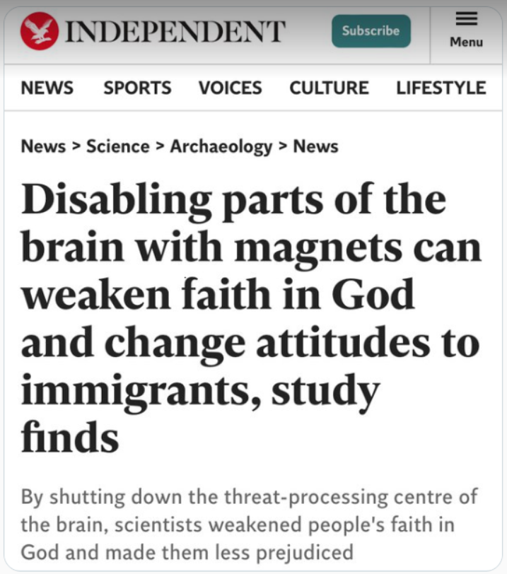
Objections
Inferring that faith in God and racism are in any way similar.
The idea that faith in God leads to a sense of tribalism.
The possibility that some might seek to treat faith in God as a curable ailment.
Notes:
I must confess that the way the information (that, by the way came out seven years ago) is presented in the headline
Headlines are produced specifically to be provocative. They also can be very misleading
This is what the headline produced in my mind.
The equating of faith in God with prejudice. (Why the correlation? We shall see in a quote in a few moments).
The idea that faith in God leads to tribalism (An us against them mentality).
That is something that false religion has always done. And that includes in Catholicism and Protestantism
Faith in God is inclusive, seeking to bring all to God, and to one another!
(Galatians 3:28), “There is neither Jew nor Greek, there is neither slave nor free, there is neither male nor female; for you are all one in Christ Jesus.”
In other words, the problem is not faith, but false faith!
The idea that faith in God (like racism) is an ailment of the brain that can be dealt with my altering the brain.
Note: That is NOT the point of the study. But, it certainly is a thought than many in our society today would find appealing.
Reminds me of the lyrics to John Lennon’s song, IMAGINE.
Imagine there's no heaven It's easy if you try No hell below us Above us, only sky
Imagine there's no countries It isn't hard to do Nothing to kill or die for And no religion, too
Imagine all the people Livin' life in peace
You may say I'm a dreamer But I'm not the only one I hope someday you'll join us And the world will be as one

Slide 3
Quotes
"Parochial ideologies motivate numerous aspects of human social life, from art movements to wars. Moral-istic ideologies involving group chauvinism and religion are arguably the most socially impactful—and, at times, the most perniciously divisive.”
Social Cognitive and Affective Neuroscience Magazine
Notes:
Quote: From the 2017 study, as reported in the “Social Cognitive and Affective Neuroscience” Magazine
"Parochial ideologies motivate numerous aspects of human social life, from art movements to wars. Moral-istic ideologies involving group chauvinism and religion are arguably the most socially impactful—and, at times, the most perniciously divisive.”
Moralistic ideologies involving group chauvinism and religion
This is how the world looks at us.
It is objectionable that we claim there is a standard of morality is objectively better
If we say the righteous will be saved, we are exhibiting chauvinism
As such, we are perniciously divisive!
Definition: Pernicous - having a harmful effect, especially in a gradual or subtle way.
View of world today, the morality of religions is divisive, and something needs to be done about it!

Slide 4
Quotes
"The extent of commit-ment to political and religious ideologies shifts across contexts, with cues of threat eliciting parti-cularly sharp increases in adherence.”
Social Cognitive and Affective Neuroscience Magazine
Notes:
Next Quote
"The extent of commitment to political and religious ideologies shifts across contexts, with cues of threat eliciting particularly sharp increases in adherence.”
The commitment of people to religious ideologies (that they equate to faith in God) becomes stronger when they feel threatened.
There is truth to this, we naturally turn to God in times of trouble (There are no atheists in foxholes. Tommy’s invitation on Wednesday)
However, contextually there seems to be a need to deal with this truth: I.E.
When people fear, they turn to God
Faith in God leads to tribalism (causing pernicioius divisiveness)
Hence, we need to treat the brain to avoid the increase of faith in God!

Slide 5
Quotes
"Accordingly, this study should be regarded as an initial investigation of whether ethnocentrism or religiosity can be experi-mentally neuromodulated by targeting the pMFC (posterior medial frontal cortext).”
Social Cognitive and Affective Neuroscience Magazine
Notes:
Final Quote:
“Accordingly, this study should be regarded as an initial investigation of whether ethnocentrism or religiosity can be experimentally neuromodulated by targeting the pMFC (posterior medial frontal cortext).”
Can we treat someone to reduce their faith in God by using magnets to “shut down” the posterior medial frontal cortext?
Our question: Is it moral to do so? Unfortunately, it would not be us who would decide.
Note: Not saying it would happen, but it is kind of an alarming headline for us to see, as we acknowledge the antagonism of the world toward our Faith
Now for the real question. Are Christian’s susceptible in the world today to having their faith in God decreased? [CLICK]

Slide 6
The Weakening of Our Faith
Worldliness
Matthew 13:22; 2 Timothy 4:10; Matthew 6:24
Evil Companions
1 Cor. 15:33-34; Proverbs 6:27-28; 1 Cor. 5:6-7
Neglect
Haggai 1:2-5, 7-9; Hebrews 2:1-3
Notes:
The Weakening of our Faith
My response when Josh sent the text to me. So, magnets can decrease your faith in God? So can a lobotomy!
To be honest, Medical science forcing us to submit to a procedure to de-religionize us is not a concern of mine.
My concern is that in the real world, it is possible to weaken our faith in God? (Consider how this might happen).
Worldliness (The Seed for the Sower)
(Matthew 13:22), “Now he who received seed among the thorns is he who hears the word, and the cares of this world and the deceitfulness of riches choke the word, and he becomes unfruitful.”
This happened to Demas, a traveling companion of the Apostle Paul
(2 Timothy 4:10), “…Demas has forsaken me, having loved this present world…”
A love for the world naturally lessons and love for and faith in God
(Matthew 6:24), “No one can serve two masters; for either he will hate the one and love the other, or else he will be loyal to the one and despise the other. You cannot serve God and mammon.”
[CLICK] Evil Companions
(1 Corinthians 15:33-34), “Do not be deceived: “Evil company corrupts good habits.” ³⁴ Awake to righteousness, and do not sin; for some do not have the knowledge of God. I speak this to your shame.
(Proverbs 6:27-28), [Specifically, entertaining the immoral woman], “Can a man take fire to his bosom, and his clothes not be burned? ²⁸ Can one walk on hot coals, and his feet not be seared?”
(1 Corinthians 5:6-7), “Your glorying is not good. Do you not know that a little leaven leavens the whole lump? ⁷ Therefore purge out the old leaven, that you may be a new lump, since you truly are unleavened.”
[CLICK] Simple Neglect
Neglect of study, of meditation, of worship, of assembly for edification
(Quote from an article by Tom Roberts: May 2012 Truth Magazine), “Isn’t the spiritual application all too obvious? Isn’t this often the course of a fall from grace? Folks, it doesn’t take a bombshell to destroy faith if faith is left unattended and unguarded. Faith is not an absolute in our life that once attained will never change or diminish. It must constantly be attended, nourished, strengthened .and “added to.” We increase our faith by regularly reading God’s word and meditating on it so that the roots of our faith reach to the Living Water and are sustained. Without this constant tending and increasing of faith, the vicissitudes of life will eat away at our foundations until faith is gone and we know not when it happened. Such has been the case on many sad occasions when Christians leave the Lord and fall back into the world.”
God deserves more from us than apathy and distraction
(Haggai 1:2-5), “Thus speaks the Lord of hosts, saying: ‘This people says, “The time has not come, the time that the Lord's house should be built.” ’ ” ³ Then the word of the Lord came by Haggai the prophet, saying, ⁴ “Is it time for you yourselves to dwell in your paneled houses, and this temple to lie in ruins?” ⁵ Now therefore, thus says the Lord of hosts: “Consider your ways!”
(Haggai 1:7-9), “Thus says the Lord of hosts: “Consider your ways! ⁸ Go up to the mountains and bring wood and build the temple, that I may take pleasure in it and be glorified,” says the Lord. ⁹ “You looked for much, but indeed it came to little; and when you brought it home, I blew it away. Why?” says the Lord of hosts. “Because of My house that is in ruins, while every one of you runs to his own house.”
Our Neglect of the things of God can cost us for an eternity!
(Hebrews 2:1-3), “Therefore we must give the more earnest heed to the things we have heard, lest we drift away. ² For if the word spoken through angels proved steadfast, and every transgression and disobedience received a just reward, ³ how shall we escape if we neglect so great a salvation, which at the first began to be spoken by the Lord, and was confirmed to us by those who heard Him?”

Slide 7
how to Avoid a Weak Faith
Diligence and Work!
2 Peter 1:5-11
Notes:
Conclusion:
How to we avoid our faith becoming weak?
By diligence and a work ethic to serve Him
Consider the words of Peter…
(2 Peter 1:5-11), “But also for this very reason, giving all diligence, add to your faith virtue, to virtue knowledge, ⁶ to knowledge self-control, to self-control perseverance, to perseverance godliness, ⁷ to godliness brotherly kindness, and to brotherly kindness love. ⁸ For if these things are yours and abound, you will be neither barren nor unfruitful in the knowledge of our Lord Jesus Christ. ⁹ For he who lacks these things is shortsighted, even to blindness, and has forgotten that he was cleansed from his old sins. ¹⁰ Therefore, brethren, be even more diligent to make your call and election sure, for if you do these things you will never stumble; ¹¹ for so an entrance will be supplied to you abundantly into the everlasting kingdom of our Lord and Savior Jesus Christ.”

