Slide 1
Notes:
THE ARK OF THE COVENANT
(1 Chronicles 13, 15)
Introduction:
First, lets consider the initial instructions given to Moses regarding the Ark
Consider especially verses 12-15
Exodus 25:10-22 "And they shall make an ark of acacia wood; two and a half cubits shall be its length, a cubit and a half its width, and a cubit and a half its height. (11) And you shall overlay it with pure gold, inside and out you shall overlay it, and shall make on it a molding of gold all around. (12) You shall cast four rings of gold for it, and put them in its four corners; two rings shall be on one side, and two rings on the other side. (13) And you shall make poles of acacia wood, and overlay them with gold. (14) You shall put the poles into the rings on the sides of the ark, that the ark may be carried by them. (15) The poles shall be in the rings of the ark; they shall not be taken from it. (16) And you shall put into the ark the Testimony which I will give you. (17) "You shall make a mercy seat of pure gold; two and a half cubits shall be its length and a cubit and a half its width. (18) And you shall make two cherubim of gold; of hammered work you shall make them at the two ends of the mercy seat. (19) Make one cherub at one end, and the other cherub at the other end; you shall make the cherubim at the two ends of it of one piece with the mercy seat. (20) And the cherubim shall stretch out their wings above, covering the mercy seat with their wings, and they shall face one another; the faces of the cherubim shall be toward the mercy seat. (21) You shall put the mercy seat on top of the ark, and in the ark you shall put the Testimony that I will give you. (22) And there I will meet with you, and I will speak with you from above the mercy seat, from between the two cherubim which are on the ark of the Testimony, about everything which I will give you in commandment to the children of Israel.
Consider what the Hebrew writer says about the tabernacle and the ark of the covenant
Hebrews 9:2-5 For a tabernacle was prepared: the first part, in which was the lampstand, the table, and the showbread, which is called the sanctuary; (3) and behind the second veil, the part of the tabernacle which is called the Holiest of All, (4) which had the golden censer and the ark of the covenant overlaid on all sides with gold, in which were the golden pot that had the manna, Aaron's rod that budded, and the tablets of the covenant; (5) and above it were the cherubim of glory overshadowing the mercy seat. Of these things we cannot now speak in detail.
After a while, perhaps because of the part the ark played in the crossing of the Jordan (where it dried up for them to cross, Joshua 3), and the marching of the people around Jericho, (where the walls fell, Joshua 6), the ark became a sort of talisman to the people. Their thinking was that if they carried the ark into battle, God would be with them!
During the time of Eli, the ark was in the tabernacle at Shiloh (1 Samuel 3:3)
But, as the people went to battle against the Philistines, record in 1 Samuel 4, the use of the ark as a talisman was ineffective, and the Philistines took it.
1 Samuel 4:2-11 Then the Philistines put themselves in battle array against Israel. And when they joined battle, Israel was defeated by the Philistines, who killed about four thousand men of the army in the field. (3) And when the people had come into the camp, the elders of Israel said, "Why has the LORD defeated us today before the Philistines? Let us bring the ark of the covenant of the LORD from Shiloh to us, that when it comes among us it may save us from the hand of our enemies." (4) So the people sent to Shiloh, that they might bring from there the ark of the covenant of the LORD of hosts, who dwells between the cherubim. And the two sons of Eli, Hophni and Phinehas, were there with the ark of the covenant of God. (5) And when the ark of the covenant of the LORD came into the camp, all Israel shouted so loudly that the earth shook. (6) Now when the Philistines heard the noise of the shout, they said, "What does the sound of this great shout in the camp of the Hebrews mean?" Then they understood that the ark of the LORD had come into the camp. (7) So the Philistines were afraid, for they said, "God has come into the camp!" And they said, "Woe to us! For such a thing has never happened before. (8) Woe to us! Who will deliver us from the hand of these mighty gods? These are the gods who struck the Egyptians with all the plagues in the wilderness. (9) Be strong and conduct yourselves like men, you Philistines, that you do not become servants of the Hebrews, as they have been to you. Conduct yourselves like men, and fight!" (10) So the Philistines fought, and Israel was defeated, and every man fled to his tent. There was a very great slaughter, and there fell of Israel thirty thousand foot soldiers. (11) Also the ark of God was captured; and the two sons of Eli, Hophni and Phinehas, died.
The lesson, the power is not in the talisman. The power is in the approval of God. If God is not supporting you, if you have displease Him, no bracelet, necklace, tablet, crown, jewel, or statue will make any difference at all
After the taking of Jericho, the people were defeated by the small city of Ai. When Joshua asked for an explanation, praying to the Lord BEFORE THE ARK
Joshua 7:10-12 So the LORD said to Joshua: "Get up! Why do you lie thus on your face? (11) Israel has sinned, and they have also transgressed My covenant which I commanded them. For they have even taken some of the accursed things, and have both stolen and deceived; and they have also put it among their own stuff. (12) Therefore the children of Israel could not stand before their enemies, but turned their backs before their enemies, because they have become doomed to destruction. Neither will I be with you anymore, unless you destroy the accursed from among you.
So, after the Philistines defeated Israel during the time of Eli, they took the ark, and God punished them (1 Samuel 5).
After 7 months, the ark was returned to Israel, finally coming to the house of Abinadab at Kirjath Jearim
1 Samuel 7:2 So it was that the ark remained in Kirjath Jearim a long time; it was there twenty years. And all the house of Israel lamented after the LORD.
It is here that we find our narrative and text, as David determined to bring the ark to Jerusalem
1 Chronicles 13:1-4 Then David consulted with the captains of thousands and hundreds, and with every leader. (2) And David said to all the assembly of Israel, "If it seems good to you, and if it is of the LORD our God, let us send out to our brethren everywhere who are left in all the land of Israel, and with them to the priests and Levites who are in their cities and their common-lands, that they may gather together to us; (3) and let us bring the ark of our God back to us, for we have not inquired at it since the days of Saul." (4) Then all the assembly said that they would do so, for the thing was right in the eyes of all the people.

Slide 2
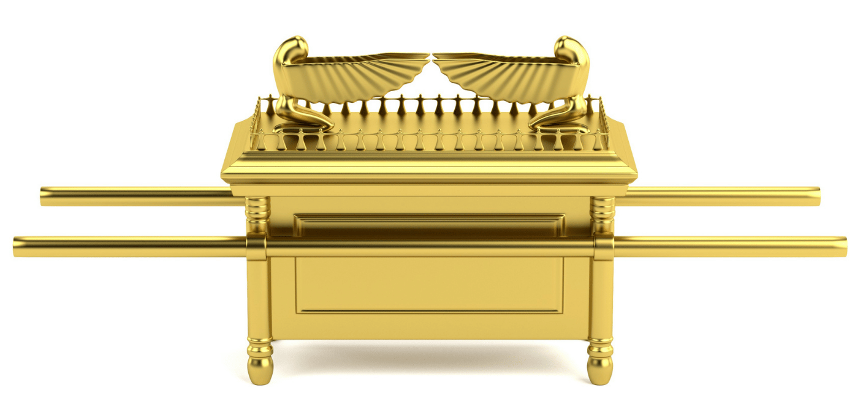
Uzzah Drives a New Cart
David made some bad assumptions! (13:6-8)
These made the Lord angry, costing Uzzah his life! (13:9-10)
David’s response was unreasonable! (13:9-11; Leviticus 10:3)
1 CHRONICLES 13
Notes:
Discussion:
David made some bad assumptions regarding the delivery of the ark to Jerusalem, assuming God would accept the method by which it was to be done.
1 Chronicles 13:6-7 And David and all Israel went up to Baalah, to Kirjath Jearim, which belonged to Judah, to bring up from there the ark of God the LORD, who dwells between the cherubim, where His name is proclaimed. (7) So they carried the ark of God on a new cart from the house of Abinadab, and Uzza and Ahio drove the cart.
Note: There is no indication of insincerity on the part of David. No indication of willful rebellion. In fact, just the opposite!
1 Chronicles 13:8 Then David and all Israel played music before God with all their might, with singing, on harps, on stringed instruments, on tambourines, on cymbals, and with trumpets.
But what was done displeased God, and cost a man named UZZAH his life.
1 Chronicles 13:9-10 And when they came to Chidon's threshing floor, Uzza put out his hand to hold the ark, for the oxen stumbled. (10) Then the anger of the LORD was aroused against Uzza, and He struck him because he put his hand to the ark; and he died there before God.
Notice David's unreasonable response (Like Joshua's at the defeat of Israel at Ai)
1 Chronicles 13:11-14 And David became angry because of the LORD's outbreak against Uzza; therefore that place is called Perez Uzza to this day. (12) David was afraid of God that day, saying, "How can I bring the ark of God to me?" (13) So David would not move the ark with him into the City of David, but took it aside into the house of Obed-Edom the Gittite. (14) The ark of God remained with the family of Obed-Edom in his house three months. And the LORD blessed the house of Obed-Edom and all that he had.
While it is not surprising David was emotional and distressed, the principle is clear and consistent, as it comes from God
Another example of this is the death of Nadab and Abihu at the hand of God, after offering profane fire to the Lord. Notice what Moses said to Aaron
Leviticus 10:3 And Moses said to Aaron, "This is what the LORD spoke, saying: 'By those who come near Me I must be regarded as holy; And before all the people I must be glorified.' " So Aaron held his peace.
If you do His will, He will accept you, however, if you do not there are consequences!
Something the religious world seldom recognizes or deems important!

Slide 3
“ The Proper Order ”
After a time, David made a second attempt. (15:1)
David admitted an egregious error! (15:2, 12-13, 14-15)
In both attempts, the sincerity of the people was the same. (15:28)
1 CHRONICLES 15
Notes:
After some time, David again determined to bring the ark to Jerusalem, and prepared a place for it (the temple had not yet been built)
1 Chronicles 15:1 David built houses for himself in the City of David; and he prepared a place for the ark of God, and pitched a tent for it.
David admitted his error, in changing God's way of transporting the ark
1 Chronicles 15:2 Then David said, "No one may carry the ark of God but the Levites, for the LORD has chosen them to carry the ark of God and to minister before Him forever."
It may be that we think these things of no consequence, but if we dismiss God's instructions, we are NOT REGARDING GOD AS HOLY. Not just a matter of motivation. It is seen in action! (I didn't mean to is no excuse or justification)
Notice the clarity of David's admission
1 Chronicles 15:12-13 He said to them, "You are the heads of the fathers' houses of the Levites; sanctify yourselves, you and your brethren, that you may bring up the ark of the LORD God of Israel to the place I have prepared for it. (13) For because you did not do it the first time, the LORD our God broke out against us, because we did not consult Him about the proper order."
This time, David and the Jews did it the way God has instructed in the beginning
1 Chronicles 15:14-15 So the priests and the Levites sanctified themselves to bring up the ark of the LORD God of Israel. (15) And the children of the Levites bore the ark of God on their shoulders, by its poles, as Moses had commanded according to the word of the LORD.
The sincerity of the people was the same both times
1 Chronicles 15:28 Thus all Israel brought up the ark of the covenant of the LORD with shouting and with the sound of the horn, with trumpets and with cymbals, making music with stringed instruments and harps.
The only difference was this time they actually followed God's commands

Slide 4
Conclusion
There are two aspects of our service to God that make it acceptable to Him.
The Proper Spirit
Submission to His Will
JOHN 4:19-24
Notes:
There are two aspects of our service to God that make it acceptable to Him.
Our sincerity is certainly one, though not the only one!
The second is to submit our hearts to God, and follow His will.
This was something Jesus made clear to the Samaritan woman at Jacob's well in John 4
The Samaritans were worshipping God, but not in the place designated by God Himself, thus the WRONG PLACE
John 4:19-24 The woman said to Him, "Sir, I perceive that You are a prophet. (20) Our fathers worshiped on this mountain, and you Jews say that in Jerusalem is the place where one ought to worship." (21) Jesus said to her, "Woman, believe Me, the hour is coming when you will neither on this mountain, nor in Jerusalem, worship the Father. (22) You worship what you do not know; we know what we worship, for salvation is of the Jews. (23) But the hour is coming, and now is, when the true worshipers will worship the Father in spirit and truth; for the Father is seeking such to worship Him. (24) God is Spirit, and those who worship Him must worship in spirit and truth."

