Slide 1
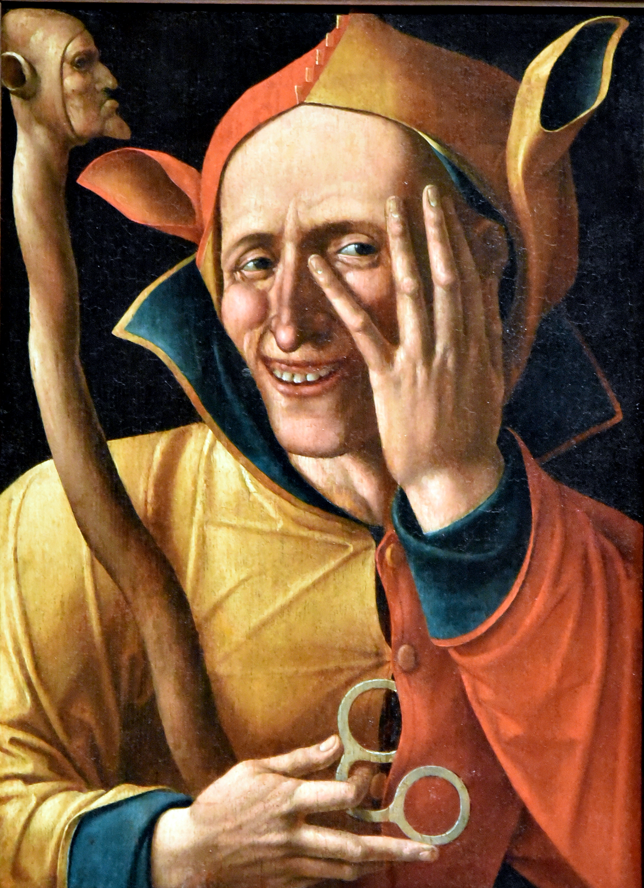
types of Fools
“The fool has said in his heart, ‘There is no God.’”
(Psalm 14:1)
Notes:
Types of Fools
Image search on Google brings up many pictures, and photographs of Jesters
The court jester known in history as one who acts foolishly to make the king laugh
However, the idea of a fool (jester), indicates one who is a bit unhinged. A break from reality.
Definition: Fool (asaphos, as'-of-os) (cf. Eph. 5:15) – a (negative) Sophos (wise, wisdom) opposite of wise.
This particular painting is appropriate, (Titled Laughing Fool, painter unknown, 16th century (Netherlands).
The look on his face is unsettling. He is not stable. The fool is the same.
Consider our text, from Psalm 14:1
(Psalm 19:1-3), “The heavens declare the glory of God; And the firmament shows His handiwork. ² Day unto day utters speech, And night unto night reveals knowledge. ³ There is no speech nor language Where their voice is not heard.
(Romans 1:20-21), “For since the creation of the world His invisible attributes are clearly seen, being understood by the things that are made, even His eternal power and Godhead, so that they are without excuse, ²¹ because, although they knew God, they did not glorify Him as God, nor were thankful, but became futile in their thoughts, and their foolish hearts were darkened.”
(Psalm 14:1-3), “The fool has said in his heart, “There is no God.” They are corrupt, They have done abominable works, There is none who does good. ² The Lord looks down from heaven upon the children of men, To see if there are any who understand, who seek God. ³ They have all turned aside, They have together become corrupt; There is none who does good, No, not one.”
First Preached in late 2005
Preached at West Side on June 29, 2008
Preached at West Side on August 7, 2022

Slide 2
Types of Fools
Atheistic Fool
cf. Psalm 14:1-3 Romans 14:11
Disobedient Fool
Matthew 7:24-27
Prating Fool
Proverbs 10:8 Matthew 12:36-37
Meddling Fool
Prov. 20:3
1 Thessalonians 4:10-12
Careless Fool
Matthew 25:1-13
Notes:
Types of Fools
Atheistic Fool
As we indicated, the atheist is a fool, because he refuses to acknowledge the evidence
And, it is to his detriment. Because he is denying the ONE who will judge Him in the end!
(Romans 14:11), “For it is written: ‘As I live, says the Lord, Every knee shall bow to Me, And every tongue shall confess to God.”
[CLICK] Disobedient Fool
The saying of Jesus bring joy on this earth, and the hope of life eternal.
(Matthew 7:24-27), “Therefore whoever hears these sayings of Mine, and does them, I will liken him to a wise man who built his house on the rock: ²⁵ and the rain descended, the floods came, and the winds blew and beat on that house; and it did not fall, for it was founded on the rock. ²⁶ “But everyone who hears these sayings of Mine, and does not do them, will be like a foolish man who built his house on the sand: ²⁷ and the rain descended, the floods came, and the winds blew and beat on that house; and it fell. And great was its fall.”
[CLICK] Prating Fool
There is no way to overestimate the danger of foolish and evil words
(James 3:6), “And the tongue is a fire, a world of iniquity. The tongue is so set among our members that it defiles the whole body, and sets on fire the course of nature; and it is set on fire by hell.”
To Prate – (1) To talk rapidly, incoherently, or indistinctly; (2) To talk volubly, persistently, and usually inconsequentially. (idioms) run off at the mouth, shoot the breeze (Google definitions)
Hebrew word (lip, language, speech, context: vain)
(Proverbs 10:8), “The wise in heart will receive commands, but a prating fool will fall.”
(Matthew 12:36-37), “But I say to you that for every idle word men may speak, they will give account of it in the day of judgment. ³⁷ For by your words you will be justified, and by your words you will be condemned.”
[CLICK] Meddling Fool
(Proverbs 20:3), “It is honorable for a man to stop striving, Since any fool can start a quarrel.”
Paul stated in 1 Thessalonians 4:9, that refusing to meddle is an expression of brotherly love
(1 Thessalonians 4:10b-12), “But we urge you, brethren, that you increase more and more; ¹¹ that you also aspire to lead a quiet life, to mind your own business, and to work with your own hands, as we commanded you, ¹² that you may walk properly toward those who are outside, and that you may lack nothing.
[CLICK] Careless Fool
Nothing could be more careless than squandering your opportunity for eternal joy
(Matthew 25:1-13), “Then the kingdom of heaven shall be likened to ten virgins who took their lamps and went out to meet the bridegroom. ² Now five of them were wise, and five were foolish. ³ Those who were foolish took their lamps and took no oil with them, ⁴ but the wise took oil in their vessels with their lamps. ⁵ But while the bridegroom was delayed, they all slumbered and slept. ⁶ “And at midnight a cry was heard: ‘Behold, the bridegroom is coming; go out to meet him!’ ⁷ Then all those virgins arose and trimmed their lamps. ⁸ And the foolish said to the wise, ‘Give us some of your oil, for our lamps are going out.’ ⁹ But the wise answered, saying, ‘No, lest there should not be enough for us and you; but go rather to those who sell, and buy for yourselves.’ ¹⁰ And while they went to buy, the bridegroom came, and those who were ready went in with him to the wedding; and the door was shut. ¹¹ “Afterward the other virgins came also, saying, ‘Lord, Lord, open to us!’ ¹² But he answered and said, ‘Assuredly, I say to you, I do not know you.’ ¹³ “Watch therefore, for you know neither the day nor the hour in which the Son of Man is coming.”

Slide 3
Conclusion
“Therefore He says: ‘Awake, you who sleep, Arise from the dead, And Christ will give you light.’ ¹⁵ See then that you walk circumspectly, not as fools but as wise, ¹⁶ redeeming the time, because the days are evil”
(Ephesians 5:14-16)
Notes:
Conclusion
As Christians, our walk must be circumspect
Define: circumspect (akribōs, ak-ree-boce’) (Thayer - exactly, accurately, diligently: …to live carefully, circumspectly, deviating in no respect from the law of duty.
(Ephesians 5:14-16), “Therefore He says: ‘Awake, you who sleep, Arise from the dead, And Christ will give you light.’ ¹⁵ See then that you walk circumspectly, not as fools but as wise, ¹⁶ redeeming the time, because the days are evil”
Today is the day of salvation
Seize the day! Redeem the time!

