Slide 1
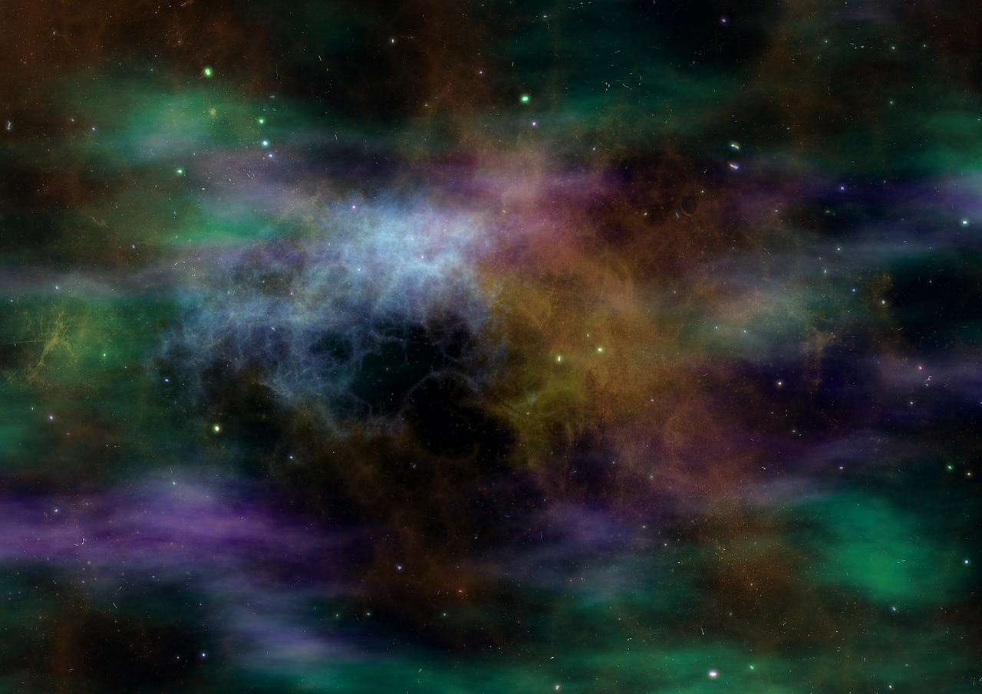
“Who may abide in Your tabernacle?”
Psalm 15
Notes:
Psalm 15 Defines the righteous person. It is a picture of the character, integrity and holiness that is required of one who God will allow in His presence.
A simple Psalm that asks and answers the most important question of all…
Psa. 15:1: The question is raised.
(Psalm 15:1), “Lord, who may abide in Your tabernacle? Who may dwell in Your holy hill?”
Abide – means sojourn (a temporary stay), like the tabernacle itself, a tent that moved with Israel
Dwell- a permanent location (Mount Zion) where the Ark of the Covenant finally came to rest. The fixed position of God’s Temple, erected by Solomon
Both signal the dwelling place of God. Who will be allowed into the presence of the Lord? Who is worthy?
Psa. 15:2-5: The question is answered.
It is answered positively, stating the proper character of those who are candidates for the honor
It is answered negatively, stating the disqualifying nature of those who are rejected.

Slide 2
“Who may abide?” - Positive
Walks Uprightly (2)
Works Righteousness (2)
Speaks the Truth in His Heart (2)
Depises the Vile & Honors Reverence (4)
Keeps His Word, No Matter the Cost (4)
Notes:
Walks Uprightly (2)
Psa. 26:3; 1:1; Prov. 2:1-15; 4:5-9; Col. 2:3.
(Psalm 1:1-2), “Blessed is the man Who walks not in the counsel of the ungodly, Nor stands in the path of sinners, Nor sits in the seat of the scornful; ² But his delight is in the law of the Lord, And in His law he meditates day and night.”
(Proverbs 4:6-8), [The value of wisdom], “For the Lord gives wisdom; From His mouth come knowledge and understanding; ⁷ He stores up sound wisdom for the upright; He is a shield to those who walk uprightly; ⁸ He guards the paths of justice, And preserves the way of His saints.”
Works Righteousness (2)
(1 Timothy 6:11), “But you, O man of God, flee these things and pursue righteousness, godliness, faith, love, patience, gentleness.”
(Hebrews 13:18), “Pray for us; for we are confident that we have a good conscience, in all things desiring to live honorably.”
(Isaiah 33:14-16), “The sinners in Zion are afraid; Fearfulness has seized the hypocrites: “Who among us shall dwell with the devouring fire? Who among us shall dwell with everlasting burnings?” ¹⁵ He who walks righteously and speaks uprightly, He who despises the gain of oppressions, Who gestures with his hands, refusing bribes, Who stops his ears from hearing of bloodshed, And shuts his eyes from seeing evil: ¹⁶ He will dwell on high; His place of defense will be the fortress of rocks; Bread will be given him, His water will be sure.”
Speaks the Truth in His Heart (2)
(Philippians 4:8), “Finally, brethren, whatever things are true, whatever things are noble, whatever things are just, whatever things are pure, whatever things are lovely, whatever things are of good report, if there is any virtue and if there is anything praiseworthy—meditate on these things.”
Despises Irreverence and Honors Reverence (4)
(4) “In whose eyes a vile person is despised… But he honors those who fear the Lord”
(Romans 1:32), “who, knowing the righteous judgment of God, that those who practice such things are deserving of death, not only do the same but also approve of those who practice them.”
(Proverbs 21:21) [Who deserves honor, and as such should receive honor from good men?], “He who follows righteousness and mercy Finds life, righteousness and honor.”
Keeps His Word, Even When it Hurts (4)
(4), “He who swears to his own hurt and does not change”
(Joshua 9:18-19), [Gideonites had obtained a promise of protection, under false pretenses, nevertheless the promise had been made], “But the children of Israel did not attack them, because the rulers of the congregation had sworn to them by the Lord God of Israel. And all the congregation complained against the rulers. ¹⁹ Then all the rulers said to all the congregation, “We have sworn to them by the Lord God of Israel; now therefore, we may not touch them.”
Note: “They did not ask counsel of the Lord” (14)
(Matthew 5:33-37), “Again you have heard that it was said to those of old, ‘You shall not swear falsely, but shall perform your oaths to the Lord.’ ³⁴ But I say to you, do not swear at all: neither by heaven, for it is God's throne; ³⁵ nor by the earth, for it is His footstool; nor by Jerusalem, for it is the city of the great King. ³⁶ Nor shall you swear by your head, because you cannot make one hair white or black. ³⁷ But let your “Yes’ be ‘Yes,’ and your ‘No,’ ‘No.’ For whatever is more than these is from the evil one.”

Slide 3
“Who may abide?” - Negative
Does Not Backbite (3)
Does Not Do Evil to His Neighbor (3)
Does Not Gossip Against His Friend (3)
Does Not Take Advantage of Others (5)
Does Not Profit by Harming Others (4)
Notes:
Does not Backbite (3)
“He who does not backbite with his tongue” (to be a tale bearer, to slander, (Strong))
(Romans 1:30) [Backbiters are among those who are deserving of death because of God’s righteous judgment]
Does not do Evil to His Neighbor (3)
“Nor does evil to his neighbor”
(Proverbs 24:28-29), “Do not be a witness against your neighbor without cause, For would you deceive with your lips? ²⁹ Do not say, “I will do to him just as he has done to me; I will render to the man according to his work.”
(Matthew 7:12), “Therefore, whatever you want men to do to you, do also to them, for this is the Law and the Prophets.”
Does not Gossip or Complain Against His Friend (3)
“Nor does he take up a reproach against his friend” (literally: bring up something shameful, complain against)
i.e. – “You say I’M the problem? YOUR are the ONE that DOES THIS OR THAT!”
(James 5:8-9), “You also be patient. Establish your hearts, for the coming of the Lord is at hand. ⁹ Do not grumble against one another, brethren, lest you be condemned. Behold, the Judge is standing at the door!”
Does not Take Advantage of Others (5).
“He who does not put out his money at usury” (usury – interest. From a word meaning “to bite!”)
Any gain made by taking advantage of another is condemned
(Exodus 22:25), “If you lend money to any of My people who are poor among you, you shall not be like a moneylender to him; you shall not charge him interest.”
Does not Profit by Harming the Innocent (5). Take no bribes
“Nor does he take a bribe against the innocent” (Willingness to do harm, testify falsely, for money)
(Isaiah 1:23), “Your princes are rebellious, And companions of thieves; Everyone loves bribes, And follows after rewards. They do not defend the fatherless, Nor does the cause of the widow come before them.”
(Ezekiel 22:12), [Sins of Jerusalem], “In you they take bribes to shed blood; you take usury and increase; you have made profit from your neighbors by extortion, and have forgotten Me,” says the Lord God.”

Slide 4
Conclusion
“He who does these things shall never be moved”
(Psalm 15:5)
Notes:
Conclusion
God will bless the righteous, although the world will not
(Psalm 5:12), “For You, O Lord, will bless the righteous; With favor You will surround him as with a shield.”
(Psalm 15:5), “He who does these things shall never be moved.”
(2 Peter 1:10-11), “Therefore, brethren, be even more diligent to make your call and election sure, for if you do these things you will never stumble; ¹¹ for so an entrance will be supplied to you abundantly into the everlasting kingdom of our Lord and Savior Jesus Christ.”

