Slide 1

Notes:
Primary source closely followed, Mark Copeland
Preached at West Side on October 4, 2026

Slide 2

The Importance of Access to God’s Word
God’s Kings Required Access
Deuteronomy 17:18-20
Christians are Kings Too!
Revelation 1:4-6; Matthew 28:18-20
If the kings of Israel were to have their own personal copies of the Law, certainly the kings of Christ ought to have (and read) their own personal Bibles!

Slide 3

Reliability: Different Manuscript Philosophies
Textual Traditions
Byzantine
Alexandrian
Majority
KJV
NKJV
ASV
RSV
ESB
NIV
Consensus
Used
Primarily
for
comparison

Slide 4
Reliability: Different Translation Philosophies
Word
For
Word
Thought
for
Thought
Paraphrase
KJV
NKJV
NASB
ESV
NIV
NLT
TLB
GNB

Slide 5


Reliability: Differences in Translators
Diversity
in
Beliefs
Uniformity
in
Beliefs
Many
Translators
One
Translator

Slide 6
My Personal Recommendations
Differences in Style
TEXT BIBLES
STUDY BIBLES
Word for Word
NKJV
ESV
NASB
Thought for Thought
NIV
NLT
ESV Study Bible
NLT Study Bible

Slide 7

Readability
CONSIDERATIONS
Differences in Reading Level
Differences in Page Layout
Differences in Font Size
MY SUGGESTION
A reading level of Grade 7-10
Two column – Verse by Verse
9-10 Point Font Size
Note: Embrace Digital Tech for large fonts and study capabilities

Slide 8

Durability
CONSIDERATIONS
Differences in Cover Differences in Binding
Differences in Paper
MY SUGGESTION
Real leather; Stitched binding; Thicker paper if marking

Slide 9
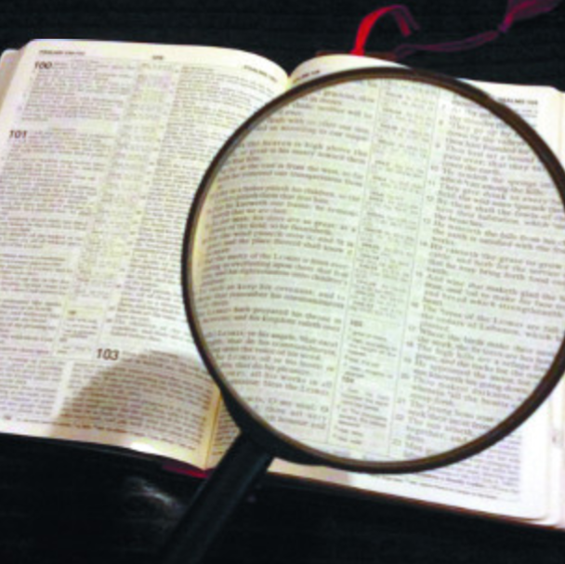
Conclusion:
The Bible offers wisdom beyond the ken of man!
The important thing is that like the kings of Israel we should read our Bible daily!

