Slide 1
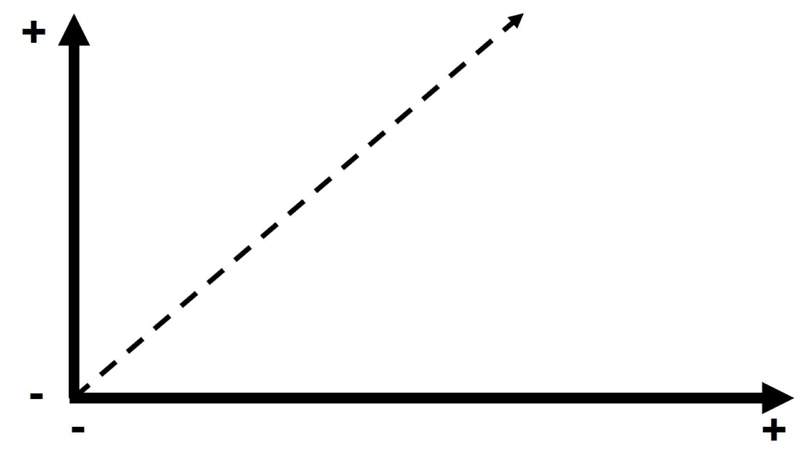

Slide 2
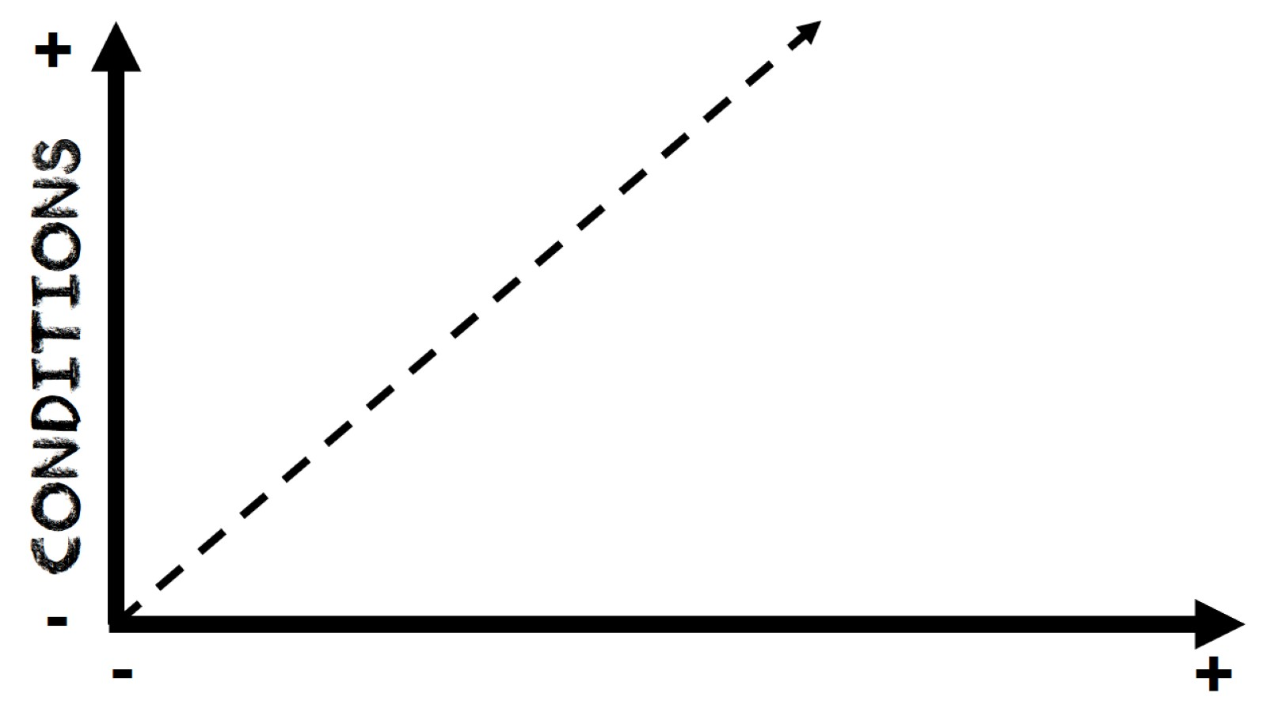
Conditions

Slide 3
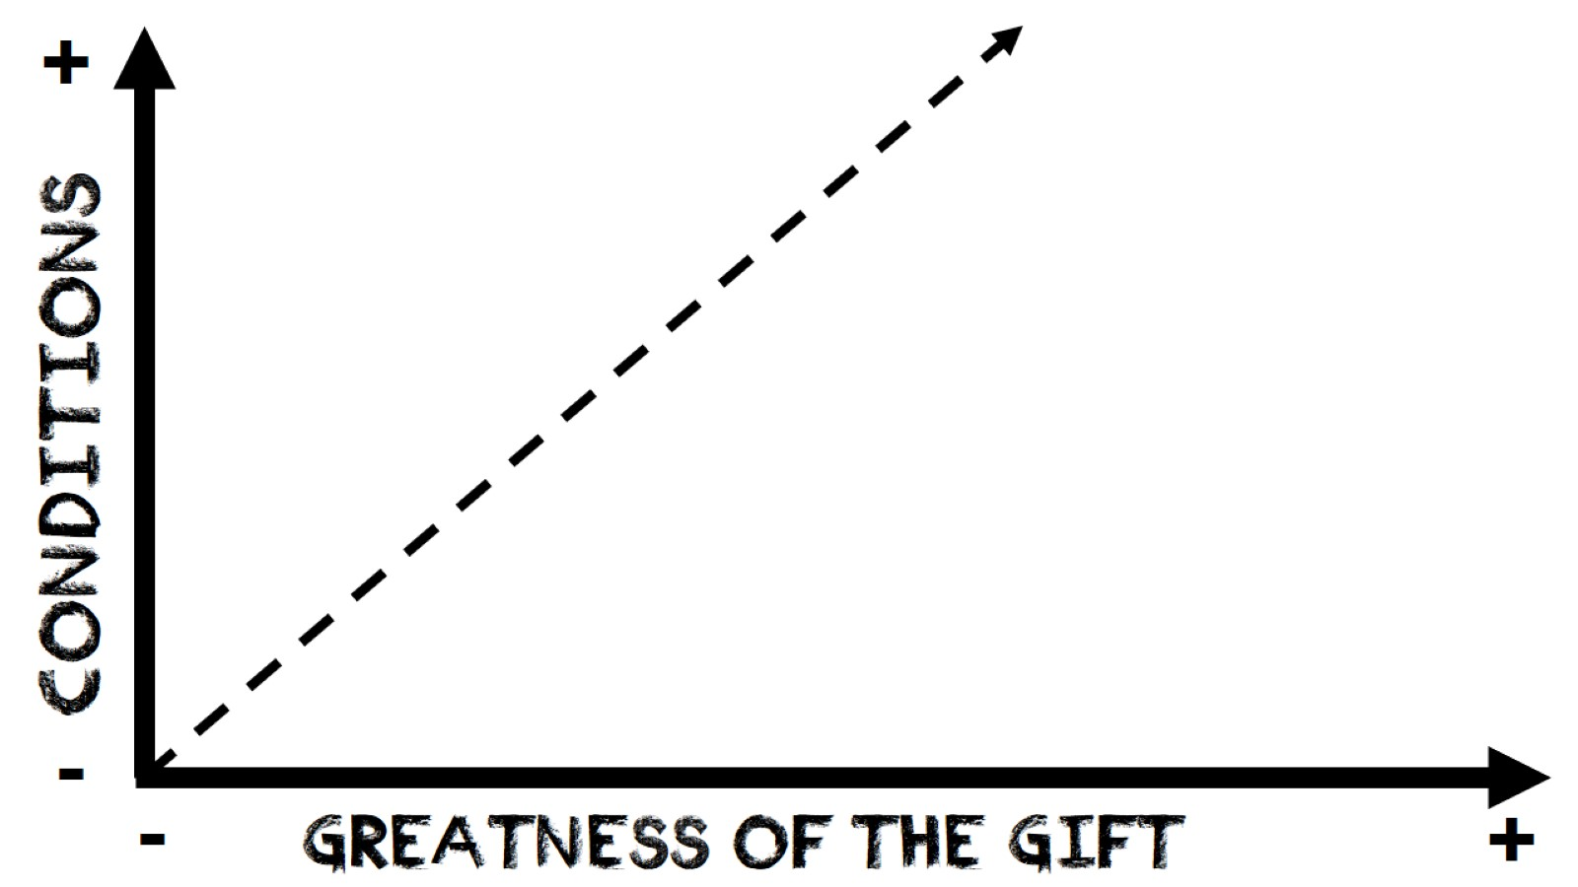
Conditions

Slide 4
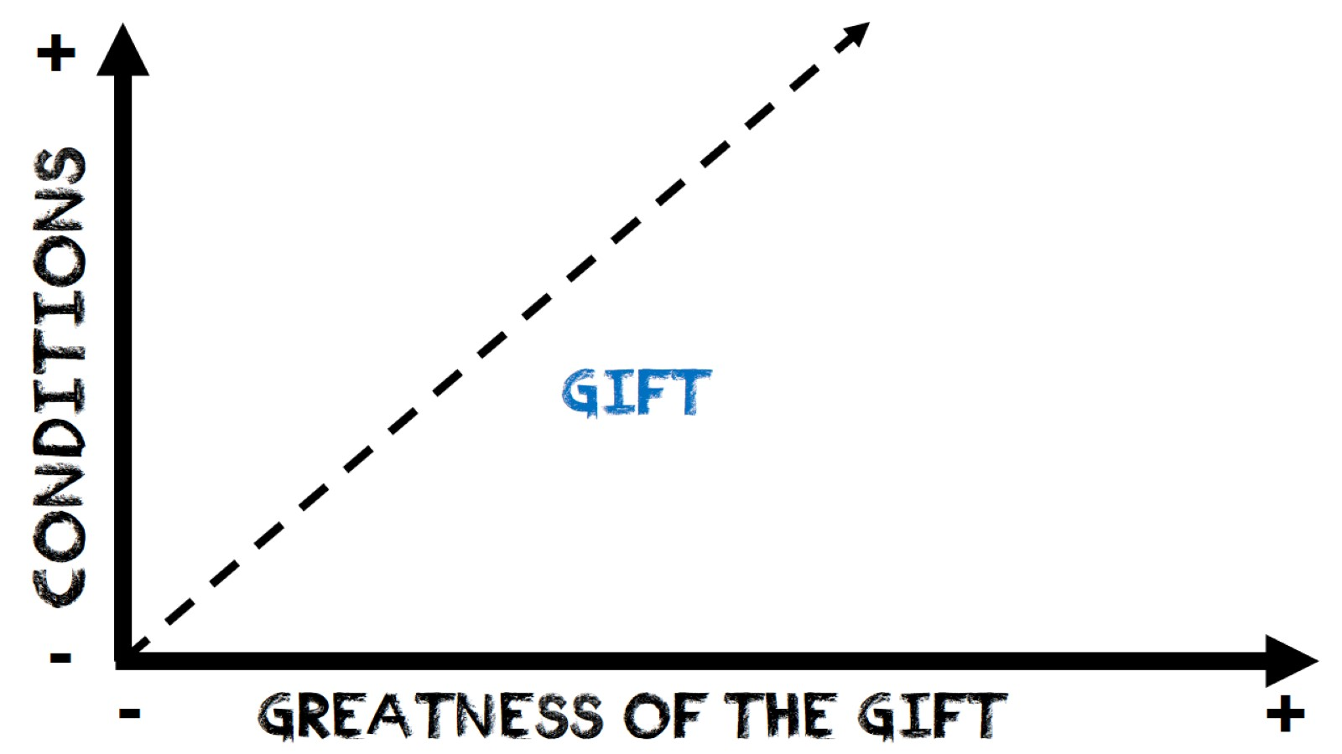
Conditions

Slide 5
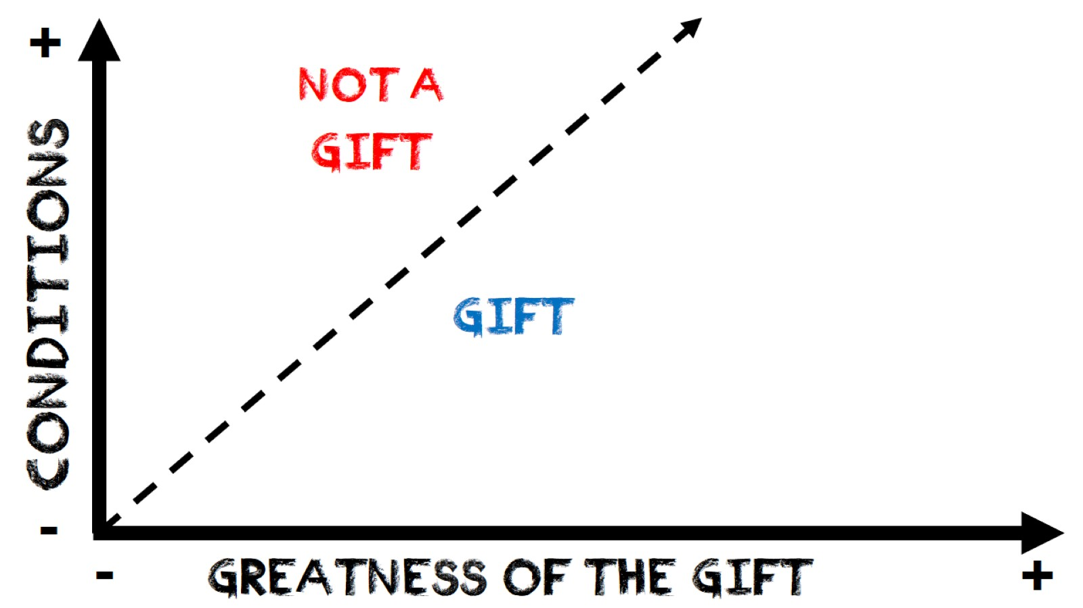
Conditions

Slide 6
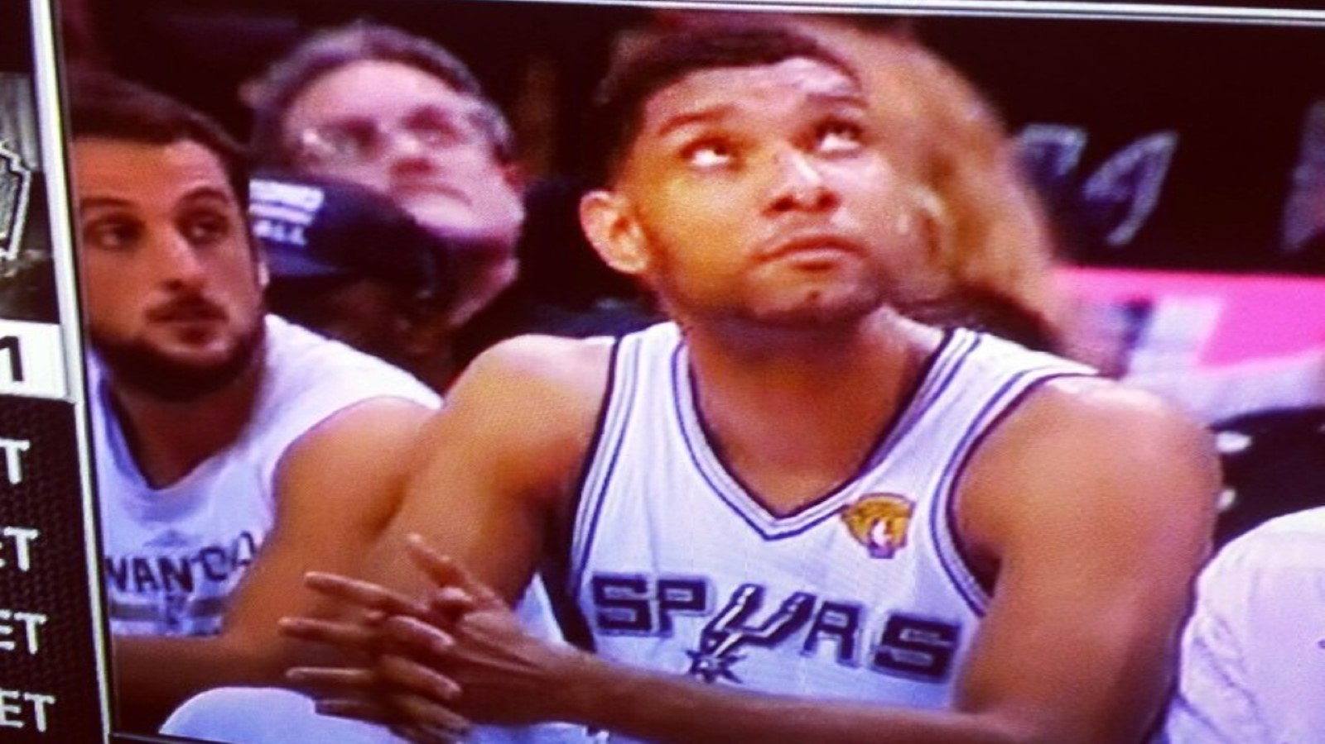

Slide 7
Conditions

Slide 8
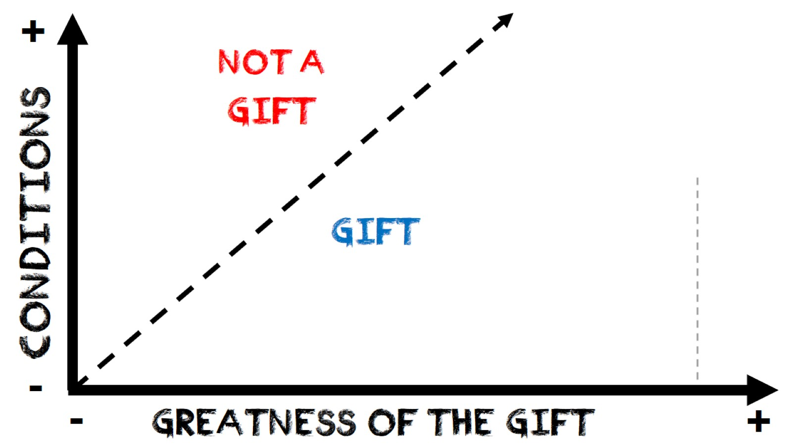
Conditions

Slide 9

Conditions

Slide 10

Conditions

Slide 11

Conditions

Slide 12

Conditions

Slide 13
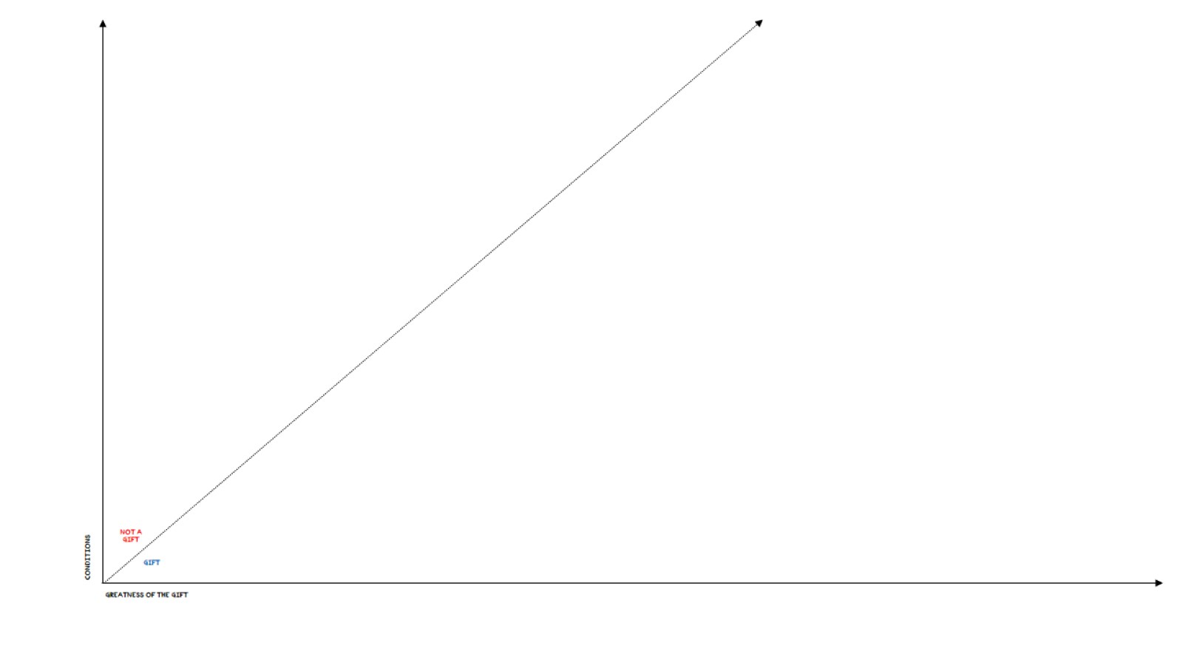
Conditions

