Slide 1
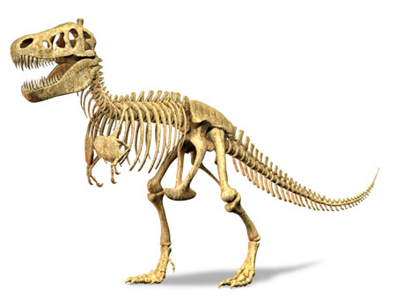
Explaining Dinosaurs

Slide 2
Definition of term Dinosaur: from greek (deinos – terrible) & (sauros – lizard). The term was coined in the mid 19th century. A fossil reptile of the Mesozoic era, often reaching an enormous size.

Slide 3
Why are dinosaurs not mentioned in the Bible?
Term “dinosaur” not known until the mid 1800’s (1842, Richard Owen coined the term)
Note: dinosaurs are classified as reptiles (sometimes very large in size).
Some relatively large reptiles continue to live today (living dinosaurs) – gators & crocs
“creeping things” (Gen. 1:26); “lizard” (Lev. 11:30); “Tortoise” (Lev. 11:29); “serpent” (Job 26:13); “basilisk” (Isaiah 59:5)
Behemoth (Job 40:15-24); Leviathan (Job 41)

Slide 4
Hebrew - tanniyn
Gesenius’ Hebrew Lexicon – a great serpent, a sea monster
The KJV translates Strongs H8577 in the following manner: dragon (21x), serpent (3x), whale (3x), sea monster (1x).
While we can’t know for sure what these animals were, they most closely approximate what we know of dinosaurs from the fossils that have been uncovered.
(Note: Job is one of the most ancient books in the Bible).

Slide 5
Possible explanation of the decline of the Dinosaurs
(From a young earth perspective, the simple explanation would point to the worldwide flood of Genesis 7)
Climate change is one explanation as to why dinosaurs became extinct sometime after the flood.
Another possibility is man himself (hunting to extinction as he has done with other animals). (cf. Genesis 9:2-3). Note, some “dinosaurs” remain (reptiles).

Slide 6
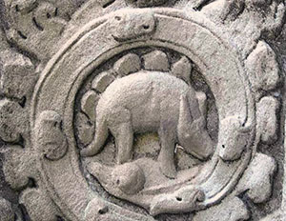
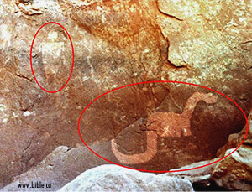
Evidence of Man’s co-existence with Dinosaurs
Biblical references such as those mentioned
Stegosaurus carving at Ta Prom (a Buddhist temple in Cambodia, from the 12th century)
The Apatosaurus drawing in Southeastern Utah (Natural Bridges National Monument. Drawing dated somewhere between 500 & 1450 A.D.

Slide 7
Evidence of Man’s co-existence with Dinosaurs
Biblical references such as those mentioned
Stegosaurus carving at Ta Prom (a Buddhist temple in Cambodia, from from the 12th century)
The Apatosaurus drawing in Southeastern Utah (Natural Bridges National Monument. Drawing dated somewhere between 500 & 1450 A.D.

Slide 8
Evidence of Man’s co-existence with Dinosaurs 2
The ubiquity and antiquity of dragon legends
A 1981 Science Digest article, titled “The Spread of Dragon Myths,” informed readers, “as myth they [dragons—SC] are among the most...persistent and widespread in the world. From millennium to millennium and over all the earth’s continents, dragon and serpent lore shows remarkable similarity” (1981, 89:103). Still, Science Digest was adamant that “[d]ragons, of course, are myth” (89:103).

Slide 9
Something New – Soft Tissue in fossils
Mary Schweitzer (molecular paleontologist) and colleagues discovered soft tissue in “98 million year old T-Rex fossils (2005)
“Seemingly impossible”
Scientists state that most of the time, microbes feast on soft tissue, destroying it in weeks. Even in the best of conditions, scientists have always believed that the proteins that make up soft tissue would degrade fully in less than 1 million years.
(Note: Young earth position would explain)

Slide 10
Evolutionary Theory – Soft Tissue in fossils
Title of Article: Controversial T. Rex Soft Tissue Find Finally Explained (livescience.com)
“The controversial discovery of 68-million-year-old soft tissue from the bones of a Tyrannosaurus rex finally has a physical explanation. According to new research, iron in the dinosaur's body preserved the tissue before it could decay.”
But article, when read fully, is full of “might be’s” and “may be’s”.

Slide 11
Article Quotes
Concerning the existence of soft tissue: “Schweitzer thinks she has the answer: Iron.”
“Dinosaurs' iron-rich blood, combined with a good environment for fossilization, may explain the amazing existence of soft tissue from the Cretaceous (a period that lasted from about 65.5 million to 145.5 million years ago) and even earlier.”

Slide 12
Actual Experiment Used for Theory Re: Iron
“They then tested the iron-as-preservative idea using modern ostrich blood vessels. They soaked one group of blood vessels in iron-rich liquid made of red blood cells and another group in water. The blood vessels left in water turned into a disgusting mess within days. The blood vessels soaked in red blood cells remain recognizable after sitting at room temperature for two years.”

Slide 13
Objections to this Explanation
2 years extrapolated to 98 million years. But trumpeted as the explanation for the preservation (like formaldehyde).
Soft tissue (now that they look for it) is found in almost half of their fossil samples tested. This indicates a common occurrence better explained by a more recent death.
Note: One scientist at California State University discovered soft tissue on the surface of a Triceratops horn. He believes in a young earth, and indicated his belief that this indicates a more recent death for the creature, and was fired. He contends it was for his religious beliefs (and seems to have evidence to back it up). He filed suit against the University in 2013).

