Slide 1
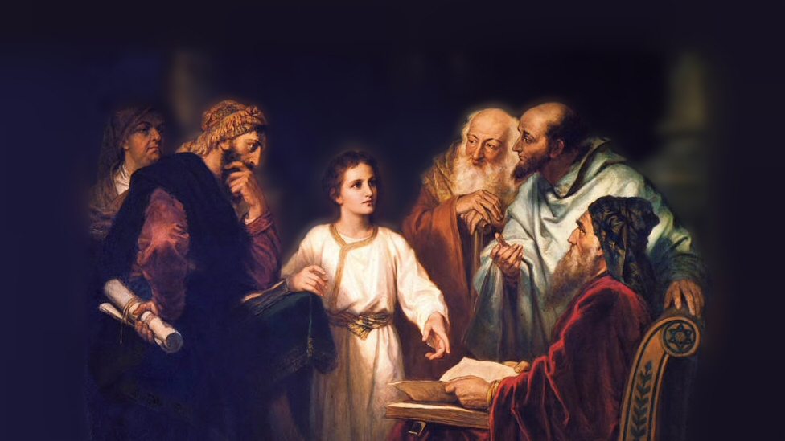
About My Father’s Business
Raising Lazarus from the Dead
(John 11)
Notes:
The gospels record three occasions where Jesus raised someone from the dead
Luke 8:40-56 records the raising of the daughter of Jairus, who had just died.
(52-55), “Now all wept and mourned for her; but He said, ‘Do not weep; she is not dead, but sleeping.’ ⁵³ And they ridiculed Him, knowing that she was dead. ⁵⁴ But He put them all outside, took her by the hand and called, saying, ‘Little girl, arise.’ ⁵⁵ Then her spirit returned, and she arose immediately.”
Luke 7:11-17 records the raising of the son of a widow in Nain, who had been dead long enough that he was in an open coffin.
(14-15), “Then He came and touched the open coffin, and those who carried him stood still. And He said, ‘Young man, I say to you, arise.’ ¹⁵ So he who was dead sat up and began to speak. And He presented him to his mother.”
Our text today (John 11:1-46) records the raising of Jesus’ friend Lazarus four days after he died.
(39), “Jesus said, ‘Take away the stone.’ Martha, the sister of him who was dead, said to Him, ‘Lord, by this time there is a stench, for he has been dead four days.’”
Picture attribution: More Good Foundation (cropped, with background blurred) Creative Commons Liscense
https://www.flickr.com/photos/moregoodfoundation/5135438113

Slide 2
Examining the Text
The Boldness of Jesus (vs 7-8, 16)
Notes:
(John 11:1-16), READ
The little town of Bethany, where Lazarus lived, was near Jerusalem (2 miles away, vs. 18)
Jesus had been in that region earlier, and an attempt was made to stone Him. So, they had traveled several miles, crossing over the Jordan to the east. (Reference, John 10:39-40)
As such, Jesus in going there would be walking into “enemy territory”, as the Jews there were opposed to His teaching, and the miracles He did.
However, in His answer to the disciples, he seems to be hinting at the fact that His time to die was not come. It was still daylight. He still had work to do, and would be protected by the Father.
(9-10), “Jesus answered, ‘Are there not twelve hours in the day? If anyone walks in the day, he does not stumble, because he sees the light of this world. ¹⁰ But if one walks in the night, he stumbles, because the light is not in him.’”
Regardless, he determined to go to Judea. The danger of the decision is seen in the words of Thomas
(16), “Then Thomas, who is called the Twin, said to his fellow disciples, “Let us also go, that we may die with Him.”
His words indicate an understanding of and resignation to the dangers of the trip
They also show the devotion of Jesus’ disciples to their Master!

Slide 3
Examining the Text
The Boldness of Jesus (vs 7-8, 16)
The Purpose of the miracle (4, 15, 42, 45)
Notes:
The Purpose of the NOTABLE Miracle of Lazarus resurrection from the Dead is the same as all the other miracles Jesus did!
To bring faith (belief).
(cf. John 20:30-31), [Brings faith to us as well], “And truly Jesus did many other signs in the presence of His disciples, which are not written in this book; ³¹ but these are written that you may believe that Jesus is the Christ, the Son of God, and that believing you may have life in His name.”
(4), [An allusion to what Lazarus’ sickness would accomplish], “When Jesus heard that, He said, “This sickness is not unto death, but for the glory of God, that the Son of God may be glorified through it.”
(15), [Jesus knew that Lazarus had died while they tarried. In verse 14 he told them plainly that “Lazarus is Dead”], “And I am glad for your sakes that I was not there, that you may believe. Nevertheless let us go to him.”
(42), [As Jesus stood before the dead man], “And Jesus lifted up His eyes and said, “Father, I thank You that You have heard Me. ⁴² And I know that You always hear Me, but because of the people who are standing by I said this, that they may believe that You sent Me.”
(45), [After Lazarus was raised], “Then many of the Jews who had come to Mary, and had seen the things Jesus did, believed in Him.”

Slide 4
Examining the Text
The Boldness of Jesus (vs 7-8, 16)
The Purpose of the miracle (4, 15, 42, 45)
The Lesson learned: “I am the resurrection and the life” (20-27)
Notes:
(John 11:20-27) READ [Jesus’ conversation with Martha upon arrival in Bethany]
Jesus said that Lazarus would be raised
Martha misunderstood (believed this to be at the final resurrection).
Note: The Jews believed in the resurrection (except for the sect of the Sadducees)
Today: A.D. 70 advocates do not believe in the bodily resurrection of the dead
Notice, Jesus did not correct Martha, THERE WILL BE A FINAL, PHYSICAL RESURRECTION AT THE LAST DAY!
(1 Corinthians 15:51-52), “Behold, I tell you a mystery: We shall not all sleep, but we shall all be changed— ⁵² in a moment, in the twinkling of an eye, at the last trumpet. For the trumpet will sound, and the dead will be raised incorruptible, and we shall be changed.”
Jesus, in affirming that He was “the resurrection and the life.” Was affirming that He was “the Christ, the Son of God, who is to come into the world!”
Raising Lazarus was a powerful miracle attesting to the Sonship and Power of Jesus!

Slide 5
Examining the Text
The Boldness of Jesus (vs 7-8, 16)
The Purpose of the miracle (4, 15, 42, 45)
The Lesson learned: “I am the resurrection and the life” (20-27)
The compassion of our Lord (33-36)
Notes:
(John 11:33-36), “Therefore, when Jesus saw her weeping, and the Jews who came with her weeping, He groaned in the spirit and was troubled. ³⁴ And He said, “Where have you laid him?” They said to Him, “Lord, come and see.” ³⁵ Jesus wept. ³⁶ Then the Jews said, “See how He loved him!”
Jesus purposely delayed, so that His power could be demonstrated
However, he felt deeply the pain of Lazarus’ family and friends. Lazarus, Martha and Mary were His friends.
(Matthew 20:28), [This love for men and their souls was His reason for coming to the earth], “the Son of Man did not come to be served, but to serve, and to give His life a ransom for many.”

Slide 6
Examining the Text
The Boldness of Jesus (vs 7-8, 16)
The Purpose of the miracle (4, 15, 42, 45)
The Lesson learned: “I am the resurrection and the life” (20-27)
The compassion of our Lord (33-36)
The resurrection (39-44)
Notes:
The interesting fact about Lazarus resurrection is that it is such an obvious and notable miracle!
(John 11:39-44) READ
There was a stench. Bodies were not embalmed as they are today.
Hollywood has enjoyed the shock value of this scene, but it can’t hold a candle to the shock of reality.
He was wrapped in graveclothes, but he was made fully alive by the power of God!
In this, he foreshadows our own resurrection from the dead!
(John 5:28-29), “Do not marvel at this; for the hour is coming in which all who are in the graves will hear His voice ²⁹ and come forth—those who have done good, to the resurrection of life, and those who have done evil, to the resurrection of condemnation.”

Slide 7
Examining the Text
The Boldness of Jesus (vs 7-8, 16)
The Purpose of the miracle (4, 15, 42, 45)
The Lesson learned: “I am the resurrection and the life” (20-27)
The compassion of our Lord (33-36)
The resurrection (39-44)
The responses of the witnesses (36-37, 45-54)
Notes:
We have mentioned before, that even miracles will not touch an evil heart of unbelief!
Notice the varied response of those who witnessed this great demonstration of power.
(36-37), [Just before the miracle was done], “Then the Jews said, ‘See how He loved him!’ ³⁷ And some of them said, Could not this Man, who opened the eyes of the blind, also have kept this man from dying?’”
Two attitudes, one noting the honest compassion of love and Jesus
One (evil) attributing to Him indifference to His friend
(45-54) READ
The honest hearts believed (45)
Those will ulterior motives
Reported to the Pharisees (enemies of Jesus)
Notice, chief priests and elders got eyewitness testimony, but were not moved
“For this Man works many signs. If we let him alone like this, everyone will believe in Him!” (47-48)
More concerned with maintaining their power than accepting their Messiah
(49-52), God used the evil High Priest (Caiaphas) to prophesy of the Christ. His intent was evil, (give the Romans a scapegoat)… but his words were a true prophesy from God!
(53) They plotted to put Him to death

Slide 8
Conclusion
Jesus proved by this miracle that he had power over death!
“For as in Adam all die, even so in Christ all shall be made alive” (1 Corinthians 15:22).
Do you believe?

