Slide 1
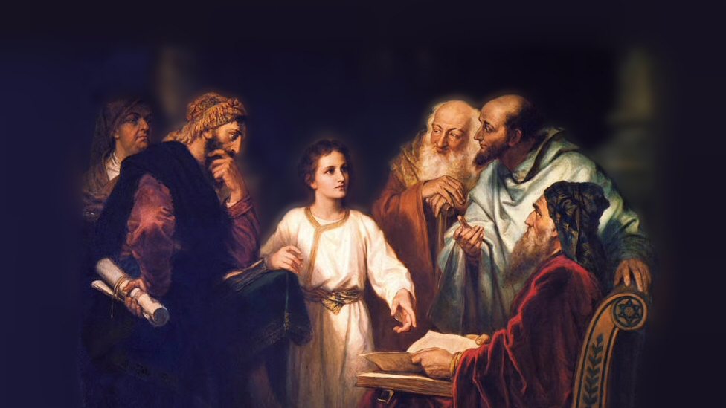
About My Father’s Business
Fishers of Men
(Luke 5:1-11)
Notes:
Our account follows Jesus’ rejection at Nazareth. (4:16-30)
Initially, He was well received there, but it seemed it was because they knew Him, and were impressed with “the gracious words that proceeded out of His mouth” (4:22).
“And they said, ‘Is this not Joseph’s son.’” (4:22).
Here Jesus challenged them, by noting their unwillingness to accept Him as a prophet. In response, they sought to throw him off a cliff.
Following, He went to Capernaum, a city on the north shore of the Sea of Galilee. He cast out a demon, healed Peter’s mother-in-law of a high fever, and laid hands on many who were sick or demon possessed, and healed them.
Multitudes began to follow and press about Him, seeking to hear him, and witness the great miracles.
The setting of our narrative has Jesus in a boat just offshore, teaching the multitudes on the shore.
(Luke 5:1-11) READ (What do we learn from this text)
Picture attribution: More Good Foundation (cropped, with background blurred) Creative Commons Liscense
https://www.flickr.com/photos/moregoodfoundation/5135438113

Slide 2
Lessons learned from Luke 5
The multitude pressed about Him to hear the word of God! (1)
Notes:
It seems like the multitude on this occasion was genuinely interested in hearing God’s word
Unlike the Nazarenes, who were put off by their knowledge of His family
Unlike the leaders of the people, who were concerned with maintaining their power
(Mark 12:37), “…And the common people heard him gladly.”
Note: It doesn’t take great knowledge or education to receive the truth
What God requires is a good and honest heart.
(Luke 8:15), “But the ones that fell on the good ground are those who, having heard the word with a noble and good heart, keep it and bear fruit with patience.”
Be careful, not to allow something other than a sincere desire for God’s word to motivate you!
(John 6:22-27), “On the following day, when the people who were standing on the other side of the sea saw that there was no other boat there, except that one which His disciples had entered, and that Jesus had not entered the boat with His disciples, but His disciples had gone away alone— ²³ however, other boats came from Tiberias, near the place where they ate bread after the Lord had given thanks— ²⁴ when the people therefore saw that Jesus was not there, nor His disciples, they also got into boats and came to Capernaum, seeking Jesus. ²⁵ And when they found Him on the other side of the sea, they said to Him, “Rabbi, when did You come here?” ²⁶ Jesus answered them and said, “Most assuredly, I say to you, you seek Me, not because you saw the signs, but because you ate of the loaves and were filled. ²⁷ Do not labor for the food which perishes, but for the food which endures to everlasting life, which the Son of Man will give you, because God the Father has set His seal on Him.”

Slide 3
Lessons learned from Luke 5
The multitude pressed about Him to hear the word of God! (1)
Simon expressed faith in Jesus (based on what he had already witnessed). (cf. 4:38-41; 5:5)
Notes:
(Luke 4:38-41), “Now He arose from the synagogue and entered Simon's house. But Simon's wife's mother was sick with a high fever, and they made request of Him concerning her. ³⁹ So He stood over her and rebuked the fever, and it left her. And immediately she arose and served them. ⁴⁰ When the sun was setting, all those who had any that were sick with various diseases brought them to Him; and He laid His hands on every one of them and healed them. ⁴¹ And demons also came out of many, crying out and saying, “You are the Christ, the Son of God!” And He, rebuking them, did not allow them to speak, for they knew that He was the Christ.”
(Luke 5:5), “But Simon answered and said to Him, “Master, we have toiled all night and caught nothing; nevertheless at Your word I will let down the net.”
Simon had seen the miracles Jesus performed, which caused him to have faith in Jesus
As we have noted before, this was the purpose of the miracles. To establish Jesus in His claim to be the Son of God.
(John 20:30-31), “And truly Jesus did many other signs in the presence of His disciples, which are not written in this book; ³¹ but these are written that you may believe that Jesus is the Christ, the Son of God, and that believing you may have life in His name.”

Slide 4
Lessons learned from Luke 5
The multitude pressed about Him to hear the word of God! (1)
Simon expressed faith in Jesus (based on what he had already witnessed). (cf. 4:38-41; 5:5)
The Miracle (6-7)
Notes:
(Luke 5:6-7), “And when they had done this, they caught a great number of fish, and their net was breaking. ⁷ So they signaled to their partners in the other boat to come and help them. And they came and filled both the boats, so that they began to sink.”
Catching fist in net is not a miraculous thing
The miracle is seen in it being directed by Jesus, after a night of fruitless toil
The volume of the catch indicates this was a miraculous event.
That it was a miracle is clearly seen in the response of Simon Peter (next slide)…

Slide 5
Lessons learned from Luke 5
The multitude pressed about Him to hear the word of God! (1)
Simon expressed faith in Jesus (based on what he had already witnessed). (cf. 4:38-41; 5:5)
The Miracle (6-7)
Simon’s response, an expression of unworthiness (8)
Notes:
(Luke 5:8), “When Simon Peter saw it, he fell down at Jesus’ knees, saying, “Depart from me, for I am a sinful man, O Lord!”
He fell down at Jesus’ knees. This was a common form of supplication. An indication that the person in his presence was a person of great importance!
Consider that this event led Peter to leave his job, and follow this itinerate preacher
(Luke 18:28-29), “Then Peter said, “See, we have left all and followed You.” ²⁹ So He said to them, “Assuredly, I say to you, there is no one who has left house or parents or brothers or wife or children, for the sake of the kingdom of God, ³⁰ who shall not receive many times more in this present time, and in the age to come eternal life.”
Consider that this event led Peter to confess his sinfulness (he feared being in the presence of this Man)
He had seen enough to know that Jesus was from God
(Albert Barnes – “He had no doubt now of the power and knowledge of Jesus. In amazement, wonder, and gratitude, and not doubting that he was in the presence of some divine being, he prostrated himself to the earth, trembling and afraid. So should sinful people “always” throw themselves at the feet of Jesus at the proofs of his power; so should they humble themselves before him at the manifestations of his goodness.”)
Note: Not all who understood that Jesus was from God responded in this way…
The rich young ruler
(Matthew 19:21-22), “Jesus said to him, “If you want to be perfect, go, sell what you have and give to the poor, and you will have treasure in heaven; and come, follow Me.” ²² But when the young man heard that saying, he went away sorrowful, for he had great possessions.”
Those in Jerusalem who were intimidated by the Jewish leaders.
(John 7:11-13), “Then the Jews sought Him at the feast, and said, “Where is He?” ¹² And there was much complaining among the people concerning Him. Some said, “He is good”; others said, “No, on the contrary, He deceives the people.” ¹³ However, no one spoke openly of Him for fear of the Jews.”
Peter was convicted, and this conviction led him to follow His Lord until death!

Slide 6
Lessons learned from Luke 5
The multitude pressed about Him to hear the word of God! (1)
Simon expressed faith in Jesus (based on what he had already witnessed). (cf. 4:38-41; 5:5)
The Miracle (6-7)
Simon’s response, an expression of unworthiness (8)
“From now on you will catch men” (10-11)
Notes:
A play on words here, I especially like Matthew’s account of this event, though it doesn’t contain a record of our miracle:
(Matthew 4:18-20), “And Jesus, walking by the Sea of Galilee, saw two brothers, Simon called Peter, and Andrew his brother, casting a net into the sea; for they were fishermen. ¹⁹ Then He said to them, “Follow Me, and I will make you fishers of men.” ²⁰ They immediately left their nets and followed Him.”
Note that in addition to Luke’s words about Peter, James and John, Matthew notes that Andrew (Peter’s brother) was there as well.
Four of Jesus apostles were recruited by Him on this occasion.
Compare the two occupations – Fishermen / Fishers of men. (They chose the better part!)
Dropping everything to follow Jesus, that is the proper response God requires of all!
(Matthew 13:45-46), [The Parable of the Pearl of Great Price], “Again, the kingdom of heaven is like a merchant seeking beautiful pearls, ⁴⁶ who, when he had found one pearl of great price, went and sold all that he had and bought it.”
Our commitment must likewise be steadfast for a lifetime.
(Luke 9:57-62), “Now it happened as they journeyed on the road, that someone said to Him, “Lord, I will follow You wherever You go.” ⁵⁸ And Jesus said to him, “Foxes have holes and birds of the air have nests, but the Son of Man has nowhere to lay His head.” ⁵⁹ Then He said to another, “Follow Me.” But he said, “Lord, let me first go and bury my father.” ⁶⁰ Jesus said to him, “Let the dead bury their own dead, but you go and preach the kingdom of God.” ⁶¹ And another also said, “Lord, I will follow You, but let me first go and bid them farewell who are at my house.” ⁶² But Jesus said to him, “No one, having put his hand to the plow, and looking back, is fit for the kingdom of God.”

Slide 7
Conclusion
Are we true disciples of Jesus Christ?
Have we “forsook all and followed Him?”

