Slide 1
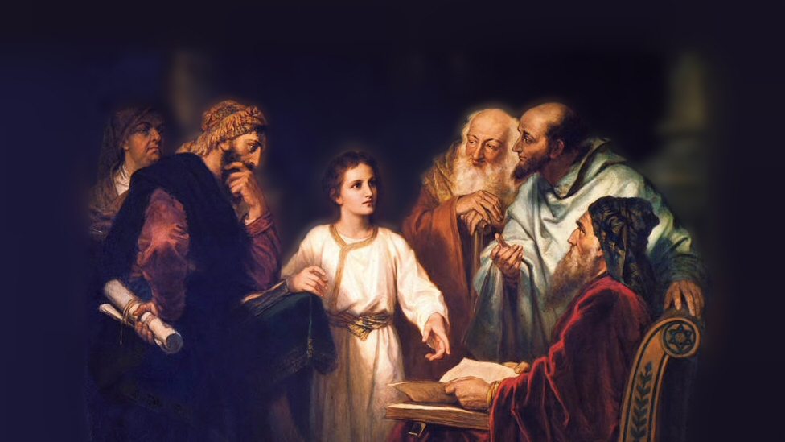
About My Father’s Business
The Man With a Withered Hand
(Mark 3:1-6)
Notes:
In our text, Jesus was traveling in Galilee, healing the sick and teaching. His ministry had provoked the Pharisees
(Mark 3:1-6), “And He entered the synagogue again, and a man was there who had a withered hand. ² So they watched Him closely, whether He would heal him on the Sabbath, so that they might accuse Him. ³ And He said to the man who had the withered hand, “Step forward.” ⁴ Then He said to them, “Is it lawful on the Sabbath to do good or to do evil, to save life or to kill?” But they kept silent. ⁵ And when He had looked around at them with anger, being grieved by the hardness of their hearts, He said to the man, “Stretch out your hand.” And he stretched it out, and his hand was restored as whole as the other. ⁶ Then the Pharisees went out and immediately plotted with the Herodians against Him, how they might destroy Him.”
The account is also found in Matthew (12:9-14) and Luke (6:6-11)
On this occasion, Jesus healed a man with a withered hand. (withered – made dry, dried up. What comes to mind is the byproduct of paralysis.
“and his hand was restored as whole as the other” (5)
The healing was typical of Jesus, Who as the Son of God had the power to heal all manner of sickness and disease
(Mark 3:22-27), [a bit later in the chapter] “And the scribes who came down from Jerusalem said, “He has Beelzebub,” and, “By the ruler of the demons He casts out demons.” ²³ So He called them to Himself and said to them in parables: “How can Satan cast out Satan? ²⁴ If a kingdom is divided against itself, that kingdom cannot stand. ²⁵ And if a house is divided against itself, that house cannot stand. ²⁶ And if Satan has risen up against himself, and is divided, he cannot stand, but has an end. ²⁷ No one can enter a strong man's house and plunder his goods, unless he first binds the strong man. And then he will plunder his house.”
In contrast, Nicodemus knew the truth about Jesus
(John 3:1-2), “There was a man of the Pharisees named Nicodemus, a ruler of the Jews. ² This man came to Jesus by night and said to Him, “Rabbi, we know that You are a teacher come from God; for no one can do these signs that You do unless God is with him.”
I would like you to consider a few important aspects of this narrative, related by Matthew, Mark and Luke
Picture attribution: More Good Foundation (cropped, with background blurred) Creative Commons Liscense
https://www.flickr.com/photos/moregoodfoundation/5135438113

Slide 2
Points to Consider –- Healing on the Sabbath
The plot of the Pharisees (2,4,6)
Mark 8:15; Luke 6:11; Eph. 4:5; Matt. 10:16
Notes:
(Mark 3:1-6), “And He entered the synagogue again, and a man was there who had a withered hand. ² So they watched Him closely, whether He would heal him on the Sabbath, so that they might accuse Him. ³ And He said to the man who had the withered hand, “Step forward.” ⁴ Then He said to them, “Is it lawful on the Sabbath to do good or to do evil, to save life or to kill?” But they kept silent. ⁵ And when He had looked around at them with anger, being grieved by the hardness of their hearts, He said to the man, “Stretch out your hand.” And he stretched it out, and his hand was restored as whole as the other. ⁶ Then the Pharisees went out and immediately plotted with the Herodians against Him, how they might destroy Him.”
It is interesting that Matthew refers to the synagogue as “their synagogue.” Obvious that Matthew considered it enemy territory
Not surprising, as the Pharisees were, along with the Sadducees, Jesus’ primary opponents in His ministry and life.
Note also, they plotted with the Herodians (partisans of Herod, believed to be Herod the Great, who had died 3 decades previously)
(Mark 8:15) [Jesus charged his disciples], “Take heed, beware of the leaven of the Pharisees and the leaven of Herod.”
Some kind of evil influence (Note: Herod had subjugated God’s throne and law to the Roman Empire. Also, though he professed the Jewish religion, he erected images and worshipped in the style of Pagans. Devotees of Herod would have objected to Jesus and His extreme views).
What is most alarming here is the ulterior motives clearly stated
Though we are not aware of the circumstances that brought the man with the withered hand, the Pharisees wanted Jesus to heal someone on the Sabbath
His doing so enraged them! (Their hypocrisy was unacknowledged. Their indignation was not feigned).
(Luke 6:11), “But they were filled with rage, and discussed with one another what they might do to Jesus.”
They were malicious in their plotting against Him, that “they might destroy Him.”
(Ephesians 4:15) [Paul describes such activity in Ephesians], “the cunning craftiness of deceitful plotting”
Such treachery is ungodly. In contrast, God’s people must act with integrity!
(Matthew 10:16) [Jesus’ admonition to disciples, limited commission], “Behold, I send you out as sheep in the midst of wolves. Therefore be wise as serpents and harmless as doves.”

Slide 3
Points to Consider –- Healing on the Sabbath
The plot of the Pharisees (2,4,6)
Mark 8:15; Luke 6:11; Eph. 4:5; Matt. 10:16
Doing good on the Sabbath (2-5)
Mark 11:28-30; Matt. 12:11,12; Gal. 5:22-23
Notes:
(Mark 3:1-6), “And He entered the synagogue again, and a man was there who had a withered hand. ² So they watched Him closely, whether He would heal him on the Sabbath, so that they might accuse Him. ³ And He said to the man who had the withered hand, “Step forward.” ⁴ Then He said to them, “Is it lawful on the Sabbath to do good or to do evil, to save life or to kill?” But they kept silent. ⁵ And when He had looked around at them with anger, being grieved by the hardness of their hearts, He said to the man, “Stretch out your hand.” And he stretched it out, and his hand was restored as whole as the other. ⁶ Then the Pharisees went out and immediately plotted with the Herodians against Him, how they might destroy Him.”
The significance of this miracle is that it occurred on the Sabbath, allowing for Jesus to teach an important principle.
The question, is it lawful, is a legitimate question! (Regardless of the motivation, and hypocrisy of the Pharisees)
(Mark 11:28-30) [The Pharisees questioned Jesus’ authority], “And they said to Him, “By what authority are You doing these things? And who gave You this authority to do these things?” ²⁹ But Jesus answered and said to them, “I also will ask you one question; then answer Me, and I will tell you by what authority I do these things: ³⁰ The baptism of John—was it from heaven or from men? Answer Me.”
The Jews demanded Jesus have authority. They were hypocrites, unwilling to answer his question regarding John’s baptism. To answer “from heaven” condemned them in their unwillingness to submit.
Jesus argument
First, the Pharisees acknowledged that a necessary good dead did not violate Sabbath law
(Matthew 12:11), “Then He said to them, “What man is there among you who has one sheep, and if it falls into a pit on the Sabbath, will not lay hold of it and lift it out? “
Second, Jesus rightly argued the hypocrisy of saving a sheep, and refusing to help a human being!
(Matthew 12:12), “Of how much more value then is a man than a sheep? Therefore it is lawful to do good on the Sabbath.”
Doing good is something that is championed by God, not condemned by Him!
(Galatians 5:22-23), “But the fruit of the Spirit is love, joy, peace, longsuffering, kindness, goodness, faithfulness, ²³ gentleness, self-control. Against such there is no law.”
The fact that they would try to refuse, through their man made traditions, a work that was pleasing to God, indicates the vanity of self-imposed restrictions

Slide 4
Points to Consider –- Healing on the Sabbath
The plot of the Pharisees (2,4,6)
Mark 8:15; Luke 6:11; Eph. 4:5; Matt. 10:16
Doing good on the Sabbath (2-5)
Mark 11:28-30; Matt. 12:11,12; Gal. 5:22-23
The Lord’s Anger (5)
John 2:14-17; Acts 4:14-17; Heb. 3:14-15
Notes:
(Mark 3:1-6), “And He entered the synagogue again, and a man was there who had a withered hand. ² So they watched Him closely, whether He would heal him on the Sabbath, so that they might accuse Him. ³ And He said to the man who had the withered hand, “Step forward.” ⁴ Then He said to them, “Is it lawful on the Sabbath to do good or to do evil, to save life or to kill?” But they kept silent. ⁵ And when He had looked around at them with anger, being grieved by the hardness of their hearts, He said to the man, “Stretch out your hand.” And he stretched it out, and his hand was restored as whole as the other. ⁶ Then the Pharisees went out and immediately plotted with the Herodians against Him, how they might destroy Him.”
Yes, there were times when Jesus got angry! When He did, His indignation was righteous!
(John 2:14-17), “And He found in the temple those who sold oxen and sheep and doves, and the money changers doing business. ¹⁵ When He had made a whip of cords, He drove them all out of the temple, with the sheep and the oxen, and poured out the changers’ money and overturned the tables. ¹⁶ And He said to those who sold doves, “Take these things away! Do not make My Father's house a house of merchandise!” ¹⁷ Then His disciples remembered that it was written, “Zeal for Your house has eaten Me up.”
Was Jesus angry that His behavior had been questioned? (Of course not! The question of authority is legitimate)
Jesus was angry because their hearts were hard
It didn’t matter to them whether what He did was right or wrong. Rather their heart was set to do evil!
(Acts 4:14-17) [Another example, this time after a miracle was done by Peter, healing a lame man in Jerusalem], “And seeing the man who had been healed standing with them, they could say nothing against it. ¹⁵ But when they had commanded them to go aside out of the council, they conferred among themselves, ¹⁶ saying, “What shall we do to these men? For, indeed, that a notable miracle has been done through them is evident to all who dwell in Jerusalem, and we cannot deny it. ¹⁷ But so that it spreads no further among the people, let us severely threaten them, that from now on they speak to no man in this name.”
A lesson for us, a hard heart always displeases God!
(Hebrews 3:14-15), “For we have become partakers of Christ if we hold the beginning of our confidence steadfast to the end, ¹⁵ while it is said: ‘Today, if you will hear His voice, do not harden your hearts as in the rebellion.’” [References the rebellion of Israel during their time in the wilderness]

Slide 5
Conclusion
Jesus did not let the evil plotting of the Pharisees to keep Him from doing good.
Do we sometimes let others keep us from doing good?
Notes:
Jesus was able to work miracles, and was unwilling to let prejudice keep him from doing good
Lesson for us: Don’t let others keep you from doing good!
(Romans 2:5-10) [God always treats men fairly. Paul wrote, admonishing the Jew for his sins], “But in accordance with your hardness and your impenitent heart you are treasuring up for yourself wrath in the day of wrath and revelation of the righteous judgment of God, ⁶ who “will render to each one according to his deeds”: ⁷ eternal life to those who by patient continuance in doing good seek for glory, honor, and immortality; ⁸ but to those who are self-seeking and do not obey the truth, but obey unrighteousness—indignation and wrath, ⁹ tribulation and anguish, on every soul of man who does evil, of the Jew first and also of the Greek; ¹⁰ but glory, honor, and peace to everyone who works what is good, to the Jew first and also to the Greek.”

