Slide 1
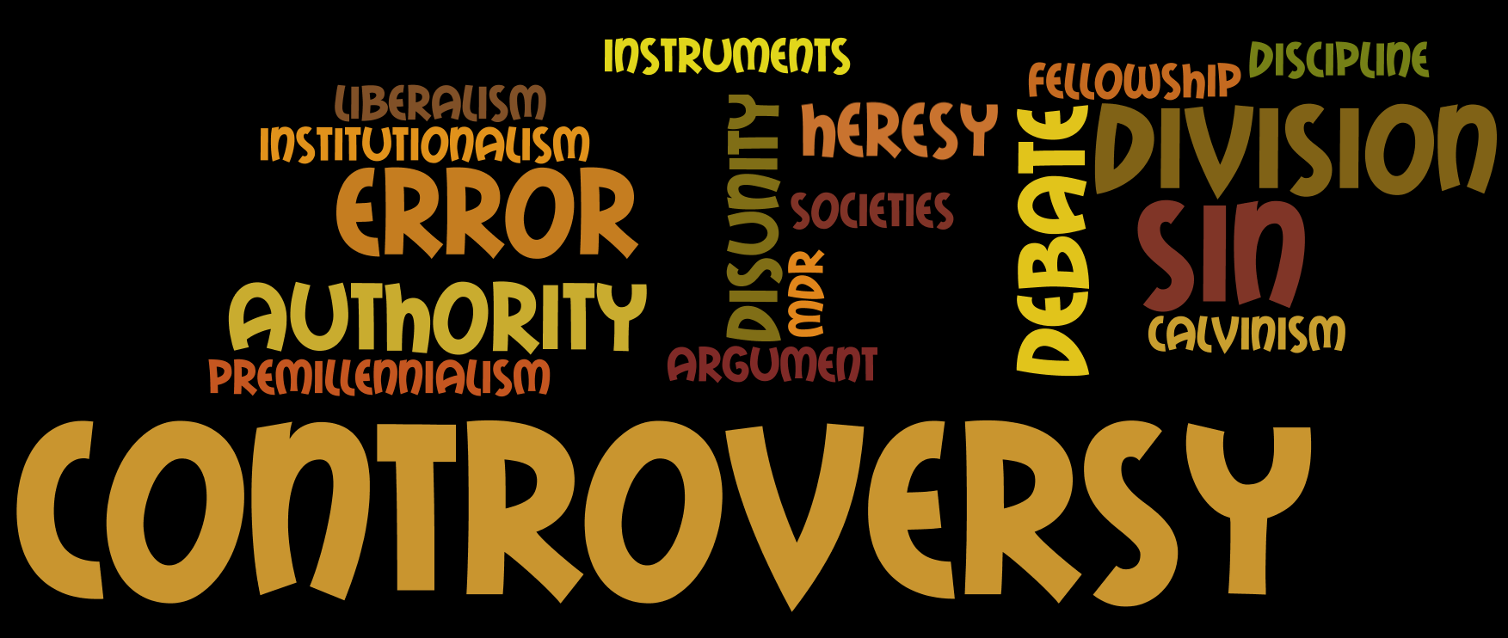
among the people of God
Notes:
Other than this morning’s lesson, our lectureship is designed to deal with specific issues that have impacted God’s people in recent history
This morning we noted some controversies impacting brethren in the first century
The rest of the week we will deal with three major issues that have been debated in the lifetime of many of us today.
Tonight it is my task to give an overview of other Controversial issues among God’s people that had their origin in this country in the 19th & 20th centuries.
A Reminder: The Lord’s church was established shortly after His death in the first century.
He Promised He would build His church
(Matthew 16:18), “And I also say to you that you are Peter, and on this rock I will build My church, and the gates of Hades shall not prevail against it.”
In fulfillment of prophecy, that church was established on Pentecost, following His ascension into heaven
(Acts 2:47), “And the Lord added to the church daily those who were being saved.”
In our lesson tonight, we are concerned with the Lord’s church here in America

Slide 2
A Departure from Denominationalism
Restoration Leaders & Principles
Example: The Last Will & Testament of the Springfield Presbytery
Notes:
Thomas Campbell and his son Alexander were of Scot-Irish descent who emigrated to America in 1807 & 1809.
They had been influenced by preaching in Ireland, calling for a return to a New Testament pattern for the church. Their influence in America led to many leaving the denominations in an effort to become simply “Christians”
Thomas Campbell said in a sermon in 1808: “Where the Bible speaks, we speak. Where the Bible is silent, we are silent.” This return to scripture was novel at the time!
Alexander Campbell on denominationalism: "I have no idea of adding to the catalogue of new sects. I labor to see sectarianism abolished and all Christians of every name united upon the one foundation upon which the apostolic church was founded.“
Note: Neither of these men were entirely successful in their efforts, but we appreciate their call to return to the New Testament pattern. Their efforts, and those of others like them, have led to the establishment of many congregations of the Lord’s church over the past 200 years.
Barton W. Stone was a Presbyterian minister, whose studies led him to reject Calvinism. (He too, was disturbed by the creeds of the various denominations, and felt there should be a return to the N.T. pattern)
In 1803 he left the Presbyterian church, and with others established the Springfield Presbytery (Itself an independent denominational organization)
By 1804 there were 15 churches in that Presbytery, and Stone noted the danger of starting yet another sect. So, a document was drawn up, known as the Last Will and Testament of the Springfield Presbytery (to denote its dissolution). Quote on Next Page:

Slide 3
The Last Will & Testament of the Springfield Presbytery
We will, that our power of making laws for the government of the church, and executing them by delegated authority, forever cease; that the people may have free course to the Bible, and adopt the law of the Spirit of life in Christ Jesus.
(June 28, 1804)
Notes:
Note: NOT their intent and purpose to establish a new denomination: In fact, another quote from the imprimis of the document: (Imprimis – first things, used to introduce the items in the will).
“We will, that this body die, be dissolved, and sink into union with the Body of Christ at large; for there is but one body, and one Spirit, even as we are called in one hope of our calling.”
Note: The result of such efforts at this time led to the following:
The return to the New Testament pattern of work, organization & worship in the church
An adoption of the New Testament teaching regarding the salvation of man
A recognition of Christ’s sole authority in the church
In short, the pure gospel preached, leading to the salvation of souls, and the establishment of churches (congregations) of Christ all over America.
However, as mentioned before, Satan continues his work. So, controversies arose as men once again departed from the New Testament pattern. Our lesson this evening looks at some of these examples…

Slide 4
American Missionary Society
A human institution formed in 1849 to increase church cooperation in Evangelism.
1 Timothy 3:15
Philippians 2:29; 4:15-17
Notes:
Alexander Campbell became disenchanted with the rejection of the gospel by so many in the 19th century
This caused him to rethink his opposition to Missionary societies.
He had been critical of such societies that existed in his day, rightly concluding that they preempted the church’s role in evangelism, and led to division.
His discontent caused him to reverse his views, advocating for more cooperation among congregations, and the establishment of the American Christian Missionary Society in 1849.
The formation of this society DID preempt the place of the church in Evangelist
The formation of this society DID lead to division
Simple explanation: Churches send money to society, which organizes missionary work, and uses the money to direct and pay for missionary work. (Note: Oversight & work done by the society, not the church!)
(1 Timothy 3:15), “but if I am delayed, I write so that you may know how you ought to conduct yourself in the house of God, which is the church of the living God, the pillar and ground of the truth.”
Pattern (Philippians 2:29) [esteem for Epaphroditus], “Receive him therefore in the Lord with all gladness, and hold such men in esteem; ³⁰ because for the work of Christ he came close to death, not regarding his life, to supply what was lacking in your service toward me.”
(Philippians 4:15-17), “Now you Philippians know also that in the beginning of the gospel, when I departed from Macedonia, no church shared with me concerning giving and receiving but you only. ¹⁶ For even in Thessalonica you sent aid once and again for my necessities.”

Slide 5
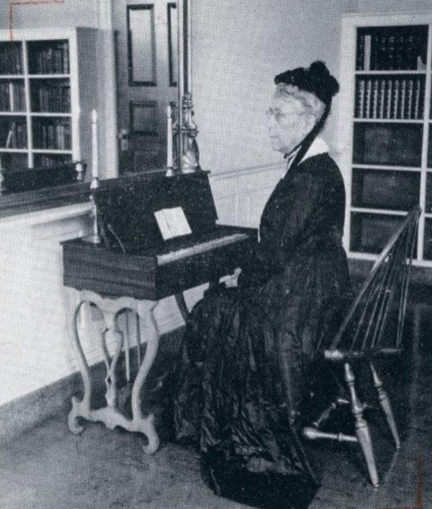
Instrumental Music
Melodeon - Midway, KY in 1859
Ephesians 5:19
Colossians 3:16
Disciples of Christ
Notes:
(Note: Picture above is of that exact Melodeon, now on display at Midway University)
Until that point, the use of mechanical instruments of music in worship was unknown in the church.
Caused division in that congregation (an elder had his slave come through the window in the building, and take the melodeon. He then hid it). Another was brought in and the practice pressed.
A departure from the pattern (There is no command, example or inference)
In the New Testament, worship consisted of singing!
(Ephesians 5:18-19), “And do not be drunk with wine, in which is dissipation; but be filled with the Spirit, ¹⁹ speaking to one another in psalms and hymns and spiritual songs, singing and making melody in your heart to the Lord”
(Colossians 3:16), “Let the word of Christ dwell in you richly in all wisdom, teaching and admonishing one another in psalms and hymns and spiritual songs, singing with grace in your hearts to the Lord.”
Note: This division led to the establishment of a mainstream denomination, The Disciples of Christ (Christian Church). Such error, when embraced, leads to apostasy!

Slide 6
Premillennialism
While popular in the denominations, was entertained in the 1920’s & 30’s in the Lord’s church.
Mark 9:1; Acts 1 & 2
Daniel 2:44; Isaiah 2:2-3
Notes:
Robert H. Boll, a young man of some ability began to proclaim premillennial views of prophecy, first around 1911. His views were not seriously opposed early on.
In 1915, he was dropped from the masthead of the Gospel Advocate because of his writings on the subject.
In 1916 he started the magazine (Word and Work) until his death in 1956, continuing to proclaim his views. (Some influence in the Indianapolis, IN area).
By the late 1930’s, the issue had been recognized as a “fellowship” issue, debates were held, and the error was by and large defeated by many men, with Foy E. Wallace, JR. at the forefront
The debate between Wallace and Charles M. Neal (in Indianapolis) January 1933 remains in print, and helped to stem the tide against the error.
The view that God’s kingdom has not yet been established is doctrinal error
(Mark 9:1), “And He said to them, “Assuredly, I say to you that there are some standing here who will not taste death till they see the kingdom of God present with power.”
Note: The first chapters of Acts show the fulfillment of prophecy. The correct place (Jerusalem), the correct time (the Last days, the days of the Roman kings).
(Daniel 2:44), “And in the days of these kings the God of heaven will set up a kingdom which shall never be destroyed; and the kingdom shall not be left to other people; it shall break in pieces and consume all these kingdoms, and it shall stand forever.”
(Isaiah 2:2-3), “Now it shall come to pass in the latter days that the mountain of the Lord's house shall be established on the top of the mountains, and shall be exalted above the hills; and all nations shall flow to it. ³ Many people shall come and say, “Come, and let us go up to the mountain of the Lord, to the house of the God of Jacob; He will teach us His ways, and we shall walk in His paths.” For out of Zion shall go forth the law, and the word of the Lord from Jerusalem.”
Note: As long as the doctrine was tolerated, treated as inconsequential, it flourished. When men actively began to oppose it, and reveal its destructive nature (claims that God’s plan could be thwarted by man… trivializes the church), it was rejected by God’s people! Contend for the faith!

Slide 7
Grace/Unity (Fellowship)
A view of Grace which would allow for continued fellowship of those who persist in certain sins.
Romans 1:5; 2:8; 6:17; 10:16; 16:26
1 Timothy 1:8-11
Notes:
This doctrine had its origin with Carl Ketcherside in the early 1970’s in the Florida area.
Other names: Leroy Garrett, Edward Fudge
Interestingly, I have spoken with men who were students at FC at that time. (Long conversation with David Baker, recently deceased). They have testified of the destructive nature of Ketcherside’s efforts to influence the young men who went to FC to prepare as preachers
Many of those young men have left the Lords’ church for the denominations. David said he knows of no one who was meeting with Ketcherside (informally, in dorm rooms, etc) who today is preaching the truth.
IN DFW area, brother Tom Roberts and others dealt with the issue, while Tom was preaching here.
Tom edited a book which deals with the error called Neo-Calvinism in the church of Christ
Primary doctrine. A distinction between Gospel and Doctrine. Thus, all who believe (1 Corinthians 15:1-4) can be fellowshipped regardless of any doctrinal differences.
Scripture does not distinguish between gospel and doctrine. (what we obey is one and the same)
(Romans 1:5), [the faith], “Through Him we have received grace and apostleship for obedience to the faith among all nations for His name.”
(Romans 2:8), [the truth], “to those who are self-seeking and do not obey the truth, but obey unrighteousness—indignation and wrath.”
(Romans 6:17), [doctrine], “But God be thanked that though you were slaves of sin, yet you obeyed from the heart that form of doctrine to which you were delivered.”
(Romans 10:16), [gospel], “But they have not all obeyed the gospel. For Isaiah says, “Lord, who has believed our report?”
(Romans 16:26), [the faith], “…the prophetic Scriptures made known to all nations, according to the commandment of the everlasting God, for obedience to the faith.”
Sound doctrine is according to the gospel
(1 Timothy 1:8-11), “But we know that the law is good if one uses it lawfully, ⁹ knowing this: that the law is not made for a righteous person, but for the lawless and insubordinate, for the ungodly and for sinners, for the unholy and profane, for murderers of fathers and murderers of mothers, for manslayers, ¹⁰ for fornicators, for sodomites, for kidnappers, for liars, for perjurers, and if there is any other thing that is contrary to sound doctrine, ¹¹ according to the glorious gospel of the blessed God which was committed to my trust.”
Note: Please understand the worry and concern today when those of us who know of the damage done from this error hear of young people today complain about “not enough teaching done on grace” or “too much emphasis on doctrine.” OUR UNITY IS BASED UPON AN ADHERANCE TO GOD’S TRUTHS!

Slide 8
Conclusion
What we are talking about this week is important!
Error is Destructive
With each new controversy, may we be willing to stand up and be counted
1 Corinthians 16:13-14
Notes:
Many other issues could be raised. Many more lessons could be preached on each of the issues we have touched on tonight.
What we are talking about is important this week
(2 John 9), “Whoever transgresses and does not abide in the doctrine of Christ does not have God. He who abides in the doctrine of Christ has both the Father and the Son. (NKJV)
Error is destructive
(Acts 20:29-30), “For I know this, that after my departure savage wolves will come in among you, not sparing the flock. ³⁰ Also from among yourselves men will rise up, speaking perverse things, to draw away the disciples after themselves. (NKJV)
With each new controversy, may we be willing to stand up and be counted
(1 Corinthians 16:13-14), “Watch, stand fast in the faith, be brave, be strong. ¹⁴ Let all that you do be done with love.”

