Slide 1
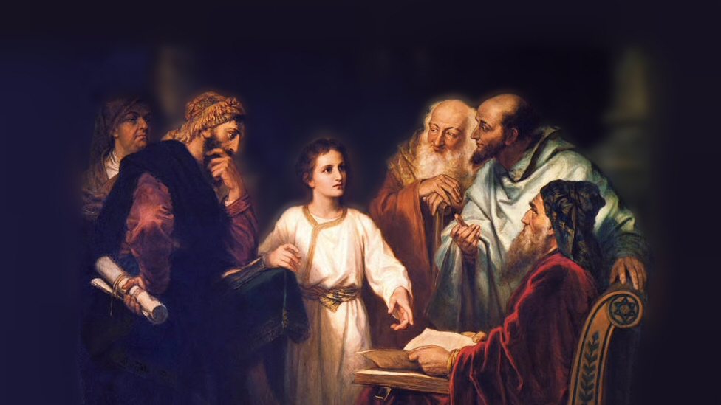
About My Father’s Business
Jesus in the Temple
(Luke 2:41-52)
Notes:
(Luke 2:41-52) READ
This is the only reference we have to the life of Jesus as a boy.
There are a number of absurd apocryphal stories of Jesus as a mean spirited little boy who used His divine powers in selfish and destructive ways.
Infancy Gospel of Thomas (Caused another child to wither completely, because he angered Jesus. A child, while running, dashed against Jesus’ shoulder and angered him, so he said to the child, “You shall not finish your course”, and the child fell down and died. He then struck blind those who accused Him of doing evil. Quote: “And no man after that durst provoke him, lest he should curse him, and he should be maimed.”)
Another (Pseudo-Gospel of Matthew) said that Jesus tamed a horde of fire breathing dragons.
Next time you hear someone argue that the apocryphal books may be legitimate, remember these absurd claims about Jesus as a child…
In contrast, Luke’s gospel describes a thoughtful, spiritually minded young man.
Picture attribution: More Good Foundation (cropped, with background blurred) Creative Commons License
https://www.flickr.com/photos/moregoodfoundation/5135438113

Slide 2
The Passover Feast
Celebrated each year to commemorate the night the Lord passed over Israel when slaying the firstborn of the Egyptians (Exodus 12:1-14)
“when they finished the days” (vs. 43) a reference to the seven days following the Passover when the Israelites were to eat unleavened bread (Deuteronomy 16:3)
One of 3 feasts that Jewish men were required to keep in Jerusalem (Exodus 23:14-17)
Notes:
(Exodus 12:14), “So this day shall be to you a memorial; and you shall keep it as a feast to the Lord throughout your generations. You shall keep it as a feast by an everlasting ordinance.”
Note: Seven day festival of unleavened bread was to remind them of the first days fleeing Egypt when they ate the un leavened bread of affliction and haste.
(Deuteronomy 16:3), “You shall eat no leavened bread with it; seven days you shall eat unleavened bread with it, that is, the bread of affliction (for you came out of the land of Egypt in haste), that you may remember the day in which you came out of the land of Egypt all the days of your life.”
(Exodus 23:14-17), “And in all that I have said to you, be circumspect and make no mention of the name of other gods, nor let it be heard from your mouth. ¹⁴ "Three times you shall keep a feast to Me in the year: ¹⁵ You shall keep the Feast of Unleavened Bread (you shall eat unleavened bread seven days, as I commanded you, at the time appointed in the month of Abib, for in it you came out of Egypt; none shall appear before Me empty); ¹⁶ and the Feast of Harvest, the firstfruits of your labors which you have sown in the field; and the Feast of Ingathering at the end of the year, when you have gathered in the fruit of your labors from the field. ¹⁷ "Three times in the year all your males shall appear before the Lord God.
Note: As Jews were scattered, it became more difficult to travel to Jerusalem for these feasts. But, devout Jews sought to at least attend the Passover and feast of Unleavened bread. Mary and Joseph traveled with Jesus 70 miles from Nazareth to Jerusalem for this feast.
So, it was here that Jesus’ parents found him, after he remained behind, and here that his parent’s questioned him….

Slide 3
“About My Father’s Business”
Jesus’ conversation w/ his parents (46-50)
Jesus’ purpose was to do His Father’s will (John 8:28-29)
Jesus’ life and death fulfilled God’s eternal purpose (Hebrews 1:1-4)
Jesus, and Jesus alone could accomplish God’s intent to redeem mankind (Matthew 26:36-39)
Notes:
(46-50), “Now so it was that after three days they found Him in the temple, sitting in the midst of the teachers, both listening to them and asking them questions. ⁴⁷ And all who heard Him were astonished at His understanding and answers. ⁴⁸ So when they saw Him, they were amazed; and His mother said to Him, "Son, why have You done this to us? Look, Your father and I have sought You anxiously."⁴⁹ And He said to them, " Why did you seek Me? Did you not know that I must be about My Father's business?" ⁵⁰ But they did not understand the statement which He spoke to them.”
Luke relates the uniqueness of young Jesus. He astonished the learned men in the Temple.
Jesus was not being disrespectful of his earthly parents, but a lesson was learned.
Jesus purpose on earth was to do His Father’s will!
(John 8:28-29), “Then Jesus said to them, " When you lift up the Son of Man, then you will know that I am He, and that I do nothing of Myself; but as My Father taught Me, I speak these things. ²⁹ And He who sent Me is with Me. The Father has not left Me alone, for I always do those things that please Him.“
Jesus’ life and death fulfilled God’s eternal purpose
(Hebrews 1:1-4), “God, who at various times and in various ways spoke in time past to the fathers by the prophets, ² has in these last days spoken to us by His Son, whom He has appointed heir of all things, through whom also He made the worlds; ³ who being the brightness of His glory and the express image of His person, and upholding all things by the word of His power, when He had by Himself purged our sins, sat down at the right hand of the Majesty on high, ⁴ having become so much better than the angels, as He has by inheritance obtained a more excellent name than they.”
Only Jesus could do what was needed!
(Matthew 26:36-39), “Then Jesus came with them to a place called Gethsemane, and said to the disciples, " Sit here while I go and pray over there." ³⁷ And He took with Him Peter and the two sons of Zebedee, and He began to be sorrowful and deeply distressed. ³⁸ Then He said to them, " My soul is exceedingly sorrowful, even to death. Stay here and watch with Me.“ ³⁹ He went a little farther and fell on His face, and prayed, saying, " O My Father, if it is possible, let this cup pass from Me; nevertheless, not as I will, but as You will."

Slide 4
What business does God have for us to do?
Worship (John 4:23-24)
Practice Pure Religion (James 1:27)
Love God & Neighbor (Matthew 22:37-40)
Contend for the Faith (Jude 3)
Notes:
Jesus was obedient to the Father (God gave Him a work to do, and He did it conscientiously and successfully)
God has given us work to do as well!
(Ephesians 2:10), “For we are His workmanship, created in Christ Jesus for good works, which God prepared beforehand that we should walk in them.”
(1 Corinthians 4:1-2, 4), “Let a man so consider us, as servants of Christ and stewards of the mysteries of God. ² Moreover it is required in stewards that one be found faithful… 4 … but He who judges me is the Lord.”
Worship (John 4:23-24), “But the hour is coming, and now is, when the true worshipers will worship the Father in spirit and truth; for the Father is seeking such to worship Him. ²⁴ God is Spirit, and those who worship Him must worship in spirit and truth."
Practice Pure Religion (James 1:27), “Pure and undefiled religion before God and the Father is this: to visit orphans and widows in their trouble, and to keep oneself unspotted from the world.”
Love God and Neighbor
(Matthew 22:37-40), “Jesus said to him [Pharisee that asked what are the greatest commandments], " 'You shall love the Lord your God with all your heart, with all your soul, and with all your mind. ' ³⁸ This is the first and great commandment. ³⁹ And the second is like it: 'You shall love your neighbor as yourself. ' ⁴⁰ On these two commandments hang all the Law and the Prophets."
Contend for the Faith
(Jude 3), “Beloved, while I was very diligent to write to you concerning our common salvation, I found it necessary to write to you exhorting you to contend earnestly for the faith which was once for all delivered to the saints.”
Note: Many other duties, (specific to the individual [ex: parents, children, masters, servants, husbands, wives, elders, members, leaders, citizens, etc.) Must be faithful in all these!

Slide 5
Conclusion
Jesus faithfully accomplished the will of His Father. You and I must likewise do His will on earth, so that we may enter heaven’s eternal kingdom!
(Matthew 7:21; 2 Peter 1:10-11)
Notes:
(Matthew 7:21-23), “Not everyone who says to Me, 'Lord, Lord,' shall enter the kingdom of heaven, but he who does the will of My Father in heaven.”
(2 Peter 1:10-11), “Therefore, brethren, be even more diligent to make your call and election sure, for if you do these things you will never stumble; ¹¹ for so an entrance will be supplied to you abundantly into the everlasting kingdom of our Lord and Savior Jesus Christ.”

