Slide 1
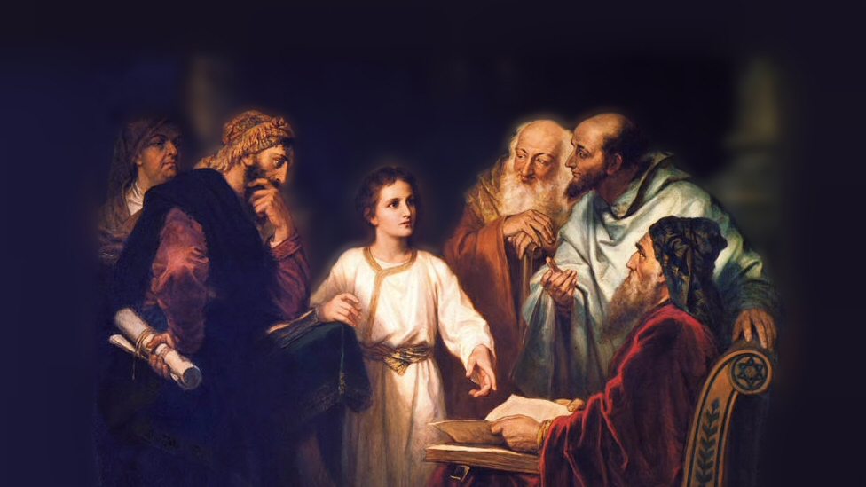
About My Father’s Business
Raising the Widow’s Son
(Luke 7:11-17)
Notes:
(Luke 7:11-17) READ
Note: Luke is the only inspired writer to record this great miracle
This is one of three individuals who Jesus raised from the dead
Jairus’ (ruler of synagogue in Capernaum) Daughter (Luke 8:40-56)
His friend Lazarus (John 11:38-44)
This miracle occurred in Nain (click to see map)
Picture attribution: More Good Foundation (cropped, with background blurred) Creative Commons Liscense
https://www.flickr.com/photos/moregoodfoundation/5135438113

Slide 2
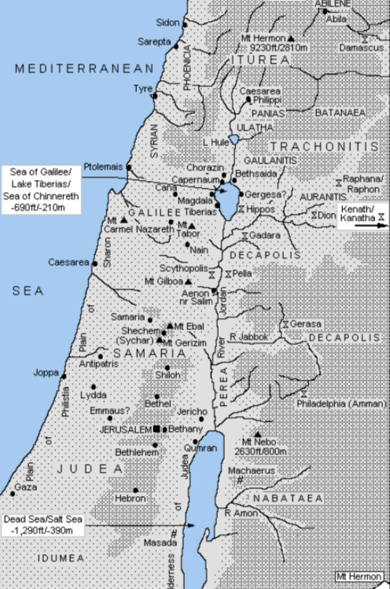
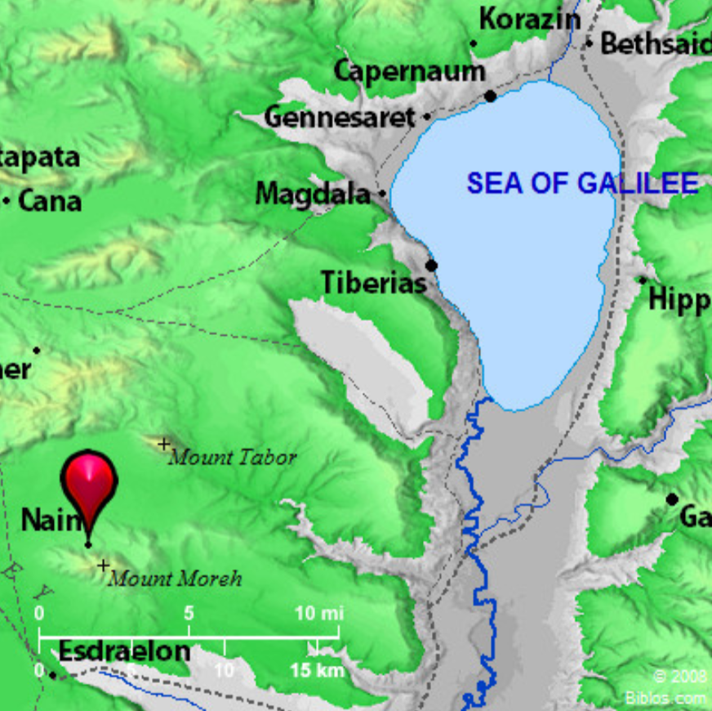
Notes:
The city of Nain was a small village located NW of Hill of Moreh, SW of Mt. Tabor
It was about 6 miles SE of Nazareth.
(Luke 7:11), “Now it happened, the day after, that He went into a city called Nain; and many of His disciples went with Him, and a large crowd.”
The Greek used in this text does not require that it be the day after. It may only be referencing the next event being chronicled. However, it could have been the very next day.
[CLICK] It was a walk of about 20 miles around the Sea of Galilee from Capernaum (vs. 1-10) to Nain
This miracle was witnessed by many of Jesus’ disciples, and by a large crowd of people (see verse 11 above).
They witnessed a great miracle
They also witnessed the great compassion of Jesus
(Luke 7:13), “When the Lord saw her, He had compassion on her and said to her, “Do not weep.”
Define: Compassion - (esplagchnisthe) have pity, feel sympathy
In this, both Christ’s Deity and His humanity are seen!
(Hebrews 4:15), “For we do not have a High Priest who cannot sympathize with our weaknesses, but was in all points tempted as we are, yet without sin.”

Slide 3
Lessons to Learn from this Narrative
We too are to have compassion!
John 11:33-35; Rom. 12:15; Gal. 6:10; Jas. 1:27
Notes:
Yes, Jesus was certainly touched by the pain and sorrow of mankind.
This is clearly shown in His reaction to His friend Lazarus’ death
(John 11:35), “Therefore, when Jesus saw her [Mary] weeping, and the Jews who came with her weeping, He groaned in the spirit and was troubled. ³⁴ And He said, “Where have you laid him?” They said to Him, “Lord, come and see.” ³⁵ Jesus wept. ³⁶ Then the Jews said, “See how He loved him!”
Compassion is a sign of a righteous and pure heart (“tendermercies”/”kindness”/”brotherly kindness”)
(Romans 12:15), “Rejoice with those who rejoice, and weep with those who weep.”
(Galatians 6:10), “Therefore, as we have opportunity, let us do good to all, especially to those who are of the household of faith.”
(James 1:27), “Pure and undefiled religion before God and the Father is this: to visit orphans and widows in their trouble, and to keep oneself unspotted from the world.”

Slide 4
Lessons to Learn from this Narrative
We too are to have compassion!
John 11:33-35; Rom. 12:15; Gal. 6:10; Jas. 1:27
Grief is natural, but Jesus has power over death!
Matt. 23:27; Jer. 6:26; Rev. 1:18; 1 Cor. 15:54-57
Notes:
Establishing the setting of the narrative:
Jewish cemeteries were outside of the town, burials were not allowed there.
Tombs were considered unclean
(Matthew 23:27) [Remember Jesus description of the Pharisees], “Woe to you, scribes and Pharisees, hypocrites! For you are like whitewashed tombs which indeed appear beautiful outwardly, but inside are full of dead men's bones and all uncleanness.”
Jewish burial practices in the first century are almost unchanged to this day
Burial is to occur within 24 hours unless civil law prohibits it
Burial is never to occur on the Sabbath
No cremation or cosmetics on body
No embalming unless required by law
Plain wooden caskets so as to not prohibit the return of the body to the earth.
Regarding the mourning widow, it was a natural response
(Jeremiah 6:26) [God’s words to Judah, comparing the coming judgment to be as bitter as the loss of a son], “O daughter of my people, dress in sackcloth and roll about in ashes! Make mourning as for an only son, most bitter lamentation; for the plunderer will suddenly come upon us.”
However, Jesus gives victory over death! (Both here, and in the resurrection!)
(Revelation 1:18), “I am He who lives, and was dead, and behold, I am alive forevermore. Amen. And I have the keys of Hades and of Death.”
(1 Corinthians 15:54-57), “So when this corruptible has put on incorruption, and this mortal has put on immortality, then shall be brought to pass the saying that is written: “Death is swallowed up in victory.” ⁵⁵ “O Death, where is your sting? O Hades, where is your victory?” ⁵⁶ The sting of death is sin, and the strength of sin is the law. ⁵⁷ But thanks be to God, who gives us the victory through our Lord Jesus Christ.”

Slide 5
Lessons to Learn from this Narrative
We too are to have compassion!
John 11:33-35; Rom. 12:15; Gal. 6:10; Jas. 1:27
Grief is natural, but Jesus has power over death!
Matt. 23:27; Jer. 6:26; Rev. 1:18; 1 Cor. 15:54-57
The plight of a widow indeed, and the son’s responsibility
Mark 12:38-40; Acts 6:1; 1 Timothy 5:16
Notes:
Perhaps Jesus’ compassion on the widow was in part because of her plight
She had lost her husband, and her son
In that day, she would have been without the means to support herself. Her future would be bleak.
Jesus condemned the abuse and mistreatment of widows by those in power
(Mark 12:38-40), “Then He said to them in His teaching, “Beware of the scribes, who desire to go around in long robes, love greetings in the marketplaces, ³⁹ the best seats in the synagogues, and the best places at feasts, ⁴⁰ who devour widows’ houses, and for a pretense make long prayers. These will receive greater condemnation.”
The practice and obligation of the local church was to care for the widows in their number
(Acts 6:1), “Now in those days, when the number of the disciples was multiplying, there arose a complaint against the Hebrews by the Hellenists, because their widows were neglected in the daily distribution.”
The first obligation to care for a widow comes upon the believing son!
(1 Timothy 5:16), “If any believing man or woman has widows, let them relieve them, and do not let the church be burdened, that it may relieve those who are really widows.”

Slide 6
Conclusion
The people feared and glorified God!
Jesus is the Lord!
Notes:
(Luke 7:16-17), “Then fear came upon all, and they glorified God, saying, “A great prophet has risen up among us”; and, “God has visited His people.” ¹⁷ And this report about Him went throughout all Judea and all the surrounding region.”
Their praise to God was focused on two great facts:
Jesus was a great prophet. (Elijah 1 Kings 17; Elisha 2 Kings 4, had raised the dead). “risen up" indicates their belief that God had sent Jesus to give them his message.
“God has visited His people.” It had been almost 400 years since God had sent a prophet with His message, except for John the Baptist. (God visiting through prophets, Ruth 1:6; 1 Samuel 2:21).
Note: The news of this great event spread like wildfire all through the region!
Verse 13 is the first time that Luke refers to Jesus (in his own words) as Lord.
(Luke 7:13), “When the Lord saw her, He had compassion on her and said to her, “Do not weep.”
It is one thing to be a master teacher
This power to raise one from the dead indicates Jesus to be Divine. (Messianic King, coming Ruler).
Note: After His resurrection, all His followers call Him Lord.
(Acts 2:36), “Therefore let all the house of Israel know assuredly that God has made this Jesus, whom you crucified, both Lord and Christ.”

