Slide 1
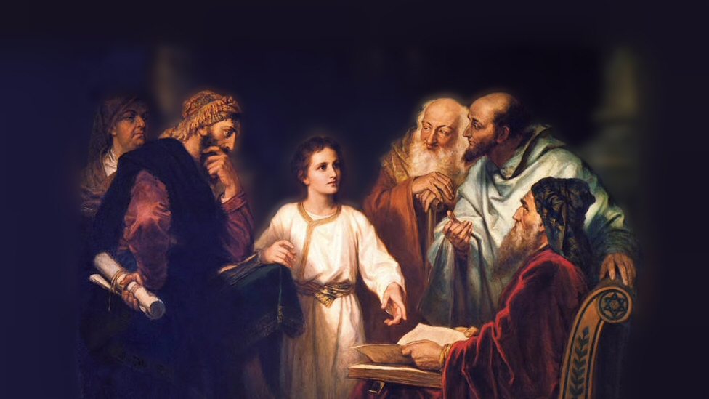
About My Father’s Business
Dependence Upon God
(Matthew 6:19-34)
Notes:
Two types of deception:
Deceiving others (6:1-18) through Hypocrisy
Deceiving ourselves (6:19-34) by pretending to trust in God, while instead trusting in material things.
Picture attribution: More Good Foundation (cropped, with background blurred) Creative Commons Liscense
https://www.flickr.com/photos/moregoodfoundation/5135438113

Slide 2
To Avoid Self-Deception, you must...
Lay up treasures in heaven (19-21)
Prov. 27:24; Jas. 5:2-3
Col. 3:2; 1 Pet. 1:3-5
Notes:
It doesn’t make sense to have as our priority the material world!
Physical universe is not permanent (can be seen by rust and moths, and destruction of good by others.
(Proverbs 27:24), “…riches are not forever, nor does a crown endure to all generations.”
(James 5:2-3), [James to the rich]“Your riches are corrupted, and your garments are moth-eaten. ³ Your gold and silver are corroded, and their corrosion will be a witness against you and will eat your flesh like fire. You have heaped up treasure in the last days.” [He tells them (1) to “weep and howl for your miseries that are coming upon you!”]
Heaven, by contrast, is eternal, no corruption or destruction…
(Colossians 3:2), “Set your mind on things above, not on things on the earth.”
(1 Peter 1:3-5), “Blessed be the God and Father of our Lord Jesus Christ, who according to His abundant mercy has begotten us again to a living hope through the resurrection of Jesus Christ from the dead, ⁴ to an inheritance incorruptible and undefiled and that does not fade away, reserved in heaven for you, ⁵ who are kept by the power of God through faith for salvation ready to be revealed in the last time.”
Where your treasures is indicates clearly what is the focus of your heart!
(2 Chronicles 29:10) [King Hezekiah, in restoring God’s order of worship, said this], “Now it is in my heart to make a covenant with the Lord God of Israel, that His fierce wrath may turn away from us.”

Slide 3
To Avoid Self-Deception, you must...
Lay up treasures in heaven (19-21)
Prov. 27:24; Jas. 5:2-3
Col. 3:2; 1 Pet. 1:3-5
Have a “good” eye (22-23)
Luke 11:35-36
Notes:
Here, the emphasis of the eye has to do with whether one is in darkness or light
Question, is your vision (loyalty) divided or whole?
“good eye” (single) – indicating simple or sincere, clear.
“bad eye” – ill, diseased, evil
Are you seeing clearly? (Again, priorities are under consideration, when discussing a service to God in contrast to a pursuit of material things)
Also, in the “good eye” (single) there is an indication of UNDIVIDED loyalty. We must be single minded in our focus on heavenly treasures!
(Luke 11:35-36), “Therefore take heed that the light which is in you is not darkness. ³⁶ If then your whole body is full of light, having no part dark, the whole body will be full of light, as when the bright shining of a lamp gives you light.”

Slide 4
To Avoid Self-Deception, you must...
Lay up treasures in heaven (19-21)
Prov. 27:24; Jas. 5:2-3
Col. 3:2; 1 Pet. 1:3-5
Have a “good” eye (22-23)
Luke 11:35-36
Have undivided loyalties (24)
Luke 14:26
Philippians 3:18-20
Notes:
This a continuation of the idea of single minded service (Priorities or Loyalties)
A worldly attitude that does not have God as our sole Master, cannot be maintained.
Figure of speech “love” and “hate” (indicates choosing and not choosing)
(Luke 14:26), “If anyone comes to Me and does not hate his father and mother, wife and children, brothers and sisters, yes, and his own life also, he cannot be My disciple.”
Mammon – (Aramaic word) “wealth personified.” a reference again to material possessions
Material concerns can be treated as an idol in their importance, and in the pursuit of them
(Philippians 3:18-20), “For many walk, of whom I have told you often, and now tell you even weeping, that they are the enemies of the cross of Christ: ¹⁹ whose end is destruction, whose god is their belly, and whose glory is in their shame—who set their mind on earthly things. ²⁰ For our citizenship is in heaven, from which we also eagerly wait for the Savior, the Lord Jesus Christ.”

Slide 5
To Avoid Self-Deception, you must...
Lay up treasures in heaven (19-21)
Prov. 27:24; Jas. 5:2-3
Col. 3:2; 1 Pet. 1:3-5
Have a “good” eye (22-23)
Luke 11:35-36
Have undivided loyalties (24)
Luke 14:26
Philippians 3:18-20
Avoid anxiety (25-34)
Psalm 147:9; 37:23-25
Luke 14:26, again
Notes:
The Christian does not have to focus so much on material pursuits, because God has promised us we will provide the basic necessities of life to those who seek Him (verse 33)
DO NOT WORRY! About material needs
God supplies the needs of animals (and plants, lilies of the field)
(Psalm 147:9), “He gives to the beast its food, and to the young ravens that cry.”
You are more valuable TO GOD than the birds and plants. If He cares for them, He will care for you.
Anxiety does not accomplish anything! (verse 27), so why worry? (28-30)
Such worry indicates a lack of faith in God’s ability or willingness to keep His promises
Don’t be like the Gentiles in seeking material things. (God knows what you need)
(Psalm 37:23-25), “The steps of a good man are ordered by the Lord, and He delights in his way. ²⁴ Though he fall, he shall not be utterly cast down; for the Lord upholds him with His hand. ²⁵ I have been young, and now am old; yet I have not seen the righteous forsaken, nor his descendants begging bread.”
Our first priority must be to the kingdom of God! (33)
(Luke 14:26), “If anyone comes to Me and does not hate his father and mother, wife and children, brothers and sisters, yes, and his own life also, he cannot be My disciple.”

Slide 6
Conclusion
“Therefore do not worry about tomorrow, for tomorrow will worry about its own things. Sufficient for the day is its own trouble.”
(6:34)
Notes:
Life is full of challenges
Worry can’t change that
We may plan with prudence, but we shouldn’t have anything more than the ordinary care for daily affairs
If our lives are caught up in anxiety and worry, causing us to lose focus on the Kingdom, we may forfeit our soul!
Do not be self-deceived! Singularly focus on the things of God!

