Slide 1
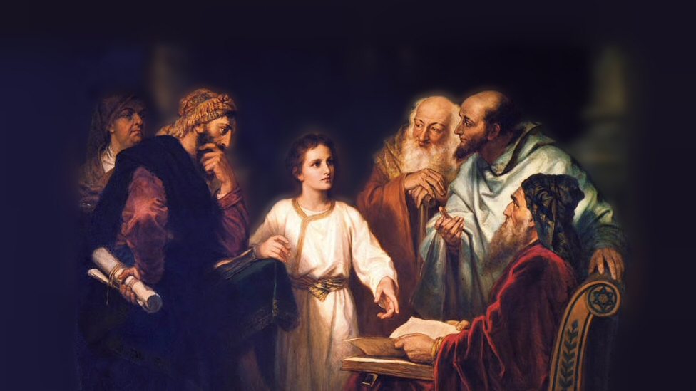
About My Father’s Business
The Death of John the Baptist
(Mark 6:14-29)
Notes:
(Mark 6:14-29) READ
This the most detailed report. Other references (Matthew 14:1-12; Luke 9:7-9)
First, need to know who is involved in this sad story of treachery, cowardice and murder
Picture attribution: More Good Foundation (cropped, with background blurred) Creative Commons Liscense
https://www.flickr.com/photos/moregoodfoundation/5135438113

Slide 2
The Characters in the Narrative
Herod (Herod Antipas)
Herodias (Vengeful Queen)
Herodias’ daughter (Salome?)
Notes:
Herod Antipas
Son of Herod the Great who killed the male children in Bethlehem
Reigned in Judah for four decades
Herodias was his second wife, and a niece. Daughter of one half-brother, and ex-wife of another half brother, (Philip).
Note: Mark records that Herod was conflicted (personally liked John, and recognized him as a righteous man (20).
Herodias
Divorced from Herod’s half brother Philip, and married to Herod
John the Baptist stated what was obvious from the Law of Moses, the marriage was not recognized as just by God.
Note: She initially had no opportunity to carry out vengeance against John (19)
She had murderous intent, in response to the admonition of the preacher (17-19)
The Daughter of Herodias
Identified by Josephus as Salome (Not named in the Gospels, but probable)
Allowed herself to be used as a pawn (not guiltless) (22-25)
Not sure of the nature of the dance, but the response of Herod and rashness of declaration is indicative of inflamed passions (lust). The dance was very possibly lascivious. (Has become synonymous with seduction).

Slide 3
The Characters in the Narrative
Herod (Herod Antipas)
Herodias (Vengeful Queen)
Herodias’ daughter (Salome?)
John the Baptist
Notes:
John the Baptist
Forerunner of the Christ
(Matthew 17:9-13), “Now as they came down from the mountain [transfiguration], Jesus commanded them, saying, “Tell the vision to no one until the Son of Man is risen from the dead.” ¹⁰ And His disciples asked Him, saying, “Why then do the scribes say that Elijah must come first?” ¹¹ Jesus answered and said to them, “Indeed, Elijah is coming first and will restore all things. ¹² But I say to you that Elijah has come already, and they did not know him but did to him whatever they wished. Likewise the Son of Man is also about to suffer at their hands.” ¹³ Then the disciples understood that He spoke to them of John the Baptist.”
An uncompromising preacher of righteousness
(Matthew 3:5-8), “Then Jerusalem, all Judea, and all the region around the Jordan went out to him ⁶ and were baptized by him in the Jordan, confessing their sins. ⁷ But when he saw many of the Pharisees and Sadducees coming to his baptism, he said to them, “Brood of vipers! Who warned you to flee from the wrath to come? ⁸ Therefore bear fruits worthy of repentance,…”
Great man
(Matthew 11:11), [Jesus declares John a prophet, the forerunner “who will prepare Your way before You” and says], “Assuredly, I say to you, among those born of women there has not risen one greater than John the Baptist.”

Slide 4
Lessons to Consider
Silly Superstition
(14-16) Isaiah 8:19-20
Notes:
(14-16), “Now King Herod heard of Him, for His name had become well known. And he said, “John the Baptist is risen from the dead, and therefore these powers are at work in him.” ¹⁵ Others said, “It is Elijah.” And others said, “It is the Prophet, or like one of the prophets.” ¹⁶ But when Herod heard, he said, “This is John, whom I beheaded; he has been raised from the dead!”
Gullible
Guilty Conscience? (Edgar Allan Poe’s, “The Telltale Heart”)
God has always said no to silly superstitions
Subjective, allows you to conform your “reality” to suit yourself
Does not give proper credit to the Almighty God of heaven
Involves you in activities that are condemned as demonic, and dark.
(Isaiah 8:19-20), “And when they say to you, “Seek those who are mediums and wizards, who whisper and mutter,” should not a people seek their God? Should they seek the dead on behalf of the living? ²⁰ To the law and to the testimony! If they do not speak according to this word, it is because there is no light in them.”

Slide 5
Lessons to Consider
Silly Superstition
(14-16) Isaiah 8:19-20
Unlawful Marriage
(17-18) Romans 7:1-3
Notes:
(17-18), “For Herod himself had sent and laid hold of John, and bound him in prison for the sake of Herodias, his brother Philip's wife; for he had married her. ¹⁸ Because John had said to Herod, “It is not lawful for you to have your brother's wife.”
(Romans 7:1-3), “Or do you not know, brethren (for I speak to those who know the law), that the law has dominion over a man as long as he lives? ² For the woman who has a husband is bound by the law to her husband as long as he lives. But if the husband dies, she is released from the law of her husband. ³ So then if, while her husband lives, she marries another man, she will be called an adulteress; but if her husband dies, she is free from that law, so that she is no adulteress, though she has married another man.”

Slide 6
Lessons to Consider
Silly Superstition
(14-16) Isaiah 8:19-20
Unlawful Marriage
(17-18) Romans 7:1-3
Lack of Virtue
(17,26) 2 Peter 1:5-7
Notes:
(17), “For Herod himself had sent and laid hold of John, and bound him in prison for the sake of Herodias, his brother Philip's wife; for he had married her.”
(26), “And the king was exceedingly sorry; yet, because of the oaths and because of those who sat with him, he did not want to refuse her.”
(2 Peter 1:5-7), “But also for this very reason, giving all diligence, add to your faith virtue, to virtue knowledge, ⁶ to knowledge self-control, to self-control perseverance, to perseverance godliness, ⁷ to godliness brotherly kindness, and to brotherly kindness love.”
Virtue – (arete), 1) a virtuous course of thought, feeling and action; 1a) virtue, moral goodness; 2) any particular moral excellence, as modesty, purity

Slide 7
Lessons to Consider
Silly Superstition
(14-16) Isaiah 8:19-20
Unlawful Marriage
(17-18) Romans 7:1-3
Lack of Virtue
(17,26) 2 Peter 1:5-7
Malicious Ends
(19,24) Ephesians 4:26-27
Notes:
(19), “Therefore Herodias held it against him and wanted to kill him, but she could not.”
(24), “So she went out and said to her mother, “What shall I ask?” And she said, “The head of John the Baptist!”
(Ephesians 4:26-27), “Be angry, and do not sin”: do not let the sun go down on your wrath, ²⁷ nor give place to the devil.”

Slide 8
Lessons to Consider
Silly Superstition
(14-16) Isaiah 8:19-20
Unlawful Marriage
(17-18) Romans 7:1-3
Lack of Virtue
(17,26) 2 Peter 1:5-7
Malicious Ends
(19,24) Ephesians 4:26-27
Womanly Seduction
(22-23) Proverbs 6:23-32
Notes:
(22-23), “And when Herodias’ daughter herself came in and danced, and pleased Herod and those who sat with him, the king said to the girl, “Ask me whatever you want, and I will give it to you.” ²³ He also swore to her, “Whatever you ask me, I will give you, up to half my kingdom.”
Not told the nature of the dance. But, Herod’s response to it indicate inflamed passions
Regardless, the dance was used to seduce Herod to make a promise he would not otherwise make.
(Proverbs 6:23-32), "For the commandment is a lamp, and the law a light; reproofs of instruction are the way of life, ²⁴ to keep you from the evil woman, from the flattering tongue of a seductress. ²⁵ Do not lust after her beauty in your heart, nor let her allure you with her eyelids. ²⁶ For by means of a harlot a man is reduced to a crust of bread; and an adulteress will prey upon his precious life. ²⁷ Can a man take fire to his bosom, and his clothes not be burned? ²⁸ Can one walk on hot coals, and his feet not be seared? ²⁹ So is he who goes in to his neighbor's wife; whoever touches her shall not be innocent. ³⁰ People do not despise a thief if he steals to satisfy himself when he is starving. ³¹ Yet when he is found, he must restore sevenfold; he may have to give up all the substance of his house. ³² Whoever commits adultery with a woman lacks understanding; he who does so destroys his own soul.”

Slide 9
Lessons to Consider
Silly Superstition
(14-16) Isaiah 8:19-20
Unlawful Marriage
(17-18) Romans 7:1-3
Lack of Virtue
(17,26) 2 Peter 1:5-7
Malicious Ends
(19,24) Ephesians 4:26-27
Womanly Seduction
(22-23) Proverbs 6:23-32
Persecution Expected
(17-18,27) 2 Timothy 3:12
Notes:
(17-18), “For Herod himself had sent and laid hold of John, and bound him in prison for the sake of Herodias, his brother Philip's wife; for he had married her. ¹⁸ Because John had said to Herod, “It is not lawful for you to have your brother's wife.”
(27), “Immediately the king sent an executioner and commanded his head to be brought. And he went and beheaded him in prison,”
(2 Timothy 3:12), “Yes, and all who desire to live godly in Christ Jesus will suffer persecution. ¹³ But evil men and impostors will grow worse and worse, deceiving and being deceived. ¹⁴ But you must continue in the things which you have learned and been assured of…”

Slide 10
Conclusion
May we exhibit the same courage as John the Baptist in standing for truth. It is a proof that we are worthy!
Notes:
(2 Thessalonians 1:4-5), “we ourselves boast of you among the churches of God for your patience and faith in all your persecutions and tribulations that you endure, ⁵ which is manifest evidence of the righteous judgment of God, that you may be counted worthy of the kingdom of God, for which you also suffer.”

