Slide 1
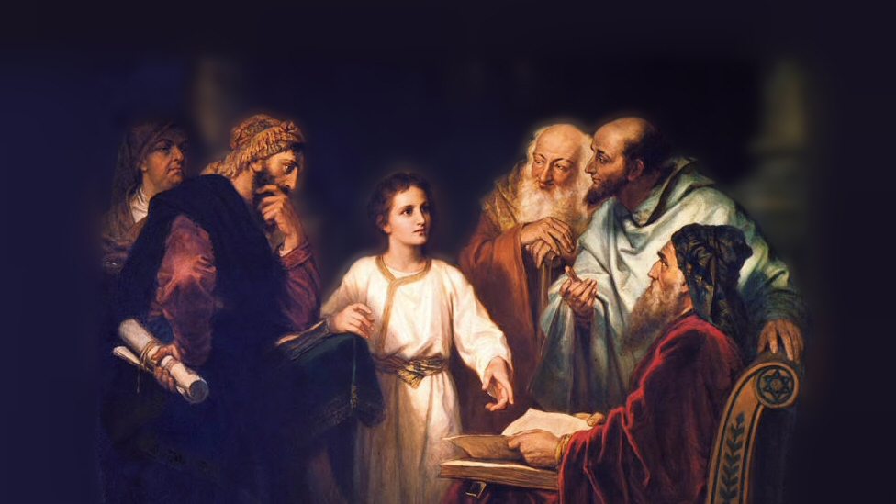
About My Father’s Business
The Samaritan Woman at the Well
(John 4:3-42)
Notes:
People Jesus knew and taught (The Samaritan Woman at the Well)
Read (4:3-26)
Significant that he spoke with a Samaritan woman.
(4:9), “Then the woman of Samaria said to Him, “How is it that You, being a Jew, ask a drink from me, a Samaritan woman?” For Jews have no dealings with Samaritans.”
Who are Samaritans?
The city of Sychar (or Shechem) sat between Mount Gerizim and Mount Ebal. Land given to Joseph by Jacob. There is a well there called “Jacob’s well”. (The well is identified and can be visited today).
Samaria (South of Galilee, but still north of Judah). Part of the Northern Kingdom taken away into Assyrian captivity.
(B.W. Johnson) “The inhabitants of Samaria, a district between Judea and Galilee; descendants of a remnant of the Ten Tribes, mixed with Gentiles colonized there. They accepted the five books of Moses, but worshipped on Mount Gerizim, instead of at Jerusalem. They and the Jews had been for ages bitter enemies.”
Note: King of Assyria, after displacing the Jews, populated the land with Gentile captives who adopted a distorted version of the Jewish faith, without authority from God.
Picture attribution: More Good Foundation (cropped, with background blurred) Creative Commons Liscense
https://www.flickr.com/photos/moregoodfoundation/5135438113

Slide 2
Lessons learned from this conversation
A new relationship (Jew/Gentile)
(9,20,21-23,39-42) (Eph. 2:11-13; Gal. 3:28)
Notes:
(9,20,21-23,39-42) READ
(Ephesians 2:11-13), “Therefore remember that you, once Gentiles in the flesh—who are called Uncircumcision by what is called the Circumcision made in the flesh by hands— ¹² that at that time you were without Christ, being aliens from the commonwealth of Israel and strangers from the covenants of promise, having no hope and without God in the world. ¹³ But now in Christ Jesus you who once were far off have been brought near by the blood of Christ.”
(Galatians 3:28), “There is neither Jew nor Greek, there is neither slave nor free, there is neither male nor female; for you are all one in Christ Jesus.”

Slide 3
Lessons learned from this conversation
A new relationship (Jew/Gentile)
(9,20,21-23,39-42) (Eph. 4:11-13; Gal. 3:28)
A new covenant (grace in Christ)
(10,13-14,25-26,42) (John 1:14-17; Rom. 3:21-26)
Notes:
(10,13-14,25-26,42) READ
(John 1:14-17), “And the Word became flesh and dwelt among us, and we beheld His glory, the glory as of the only begotten of the Father, full of grace and truth. ¹⁵ John bore witness of Him and cried out, saying, “This was He of whom I said, ‘He who comes after me is preferred before me, for He was before me.’ ” ¹⁶ And of His fullness we have all received, and grace for grace. ¹⁷ For the law was given through Moses, but grace and truth came through Jesus Christ.”
(Romans 3:21-26), “But now the righteousness of God apart from the law is revealed, being witnessed by the Law and the Prophets, ²² even the righteousness of God, through faith in Jesus Christ, to all and on all who believe. For there is no difference; ²³ for all have sinned and fall short of the glory of God, ²⁴ being justified freely by His grace through the redemption that is in Christ Jesus, ²⁵ whom God set forth as a propitiation by His blood, through faith, to demonstrate His righteousness, because in His forbearance God had passed over the sins that were previously committed, ²⁶ to demonstrate at the present time His righteousness, that He might be just and the justifier of the one who has faith in Jesus.”

Slide 4
Lessons learned from this conversation
A new relationship (Jew/Gentile)
(9,20,21-23,39-42) (Eph. 4:11-13; Gal. 3:28)
A new covenant (grace in Christ)
(10,13-14,25-26,42) (John 1:14-17; Rom. 3:21-26)
A new worship (in spirit and truth)
(19-24) (Philippians 3:1-11)
Notes:
(19-24) READ
(Philippians 3:1-11), “Finally, my brethren, rejoice in the Lord. For me to write the same things to you is not tedious, but for you it is safe. ² Beware of dogs, beware of evil workers, beware of the mutilation! ³ For we are the circumcision, who worship God in the Spirit, rejoice in Christ Jesus, and have no confidence in the flesh, ⁴ though I also might have confidence in the flesh. If anyone else thinks he may have confidence in the flesh, I more so: ⁵ circumcised the eighth day, of the stock of Israel, of the tribe of Benjamin, a Hebrew of the Hebrews; concerning the law, a Pharisee; ⁶ concerning zeal, persecuting the church; concerning the righteousness which is in the law, blameless. ⁷ But what things were gain to me, these I have counted loss for Christ. ⁸ Yet indeed I also count all things loss for the excellence of the knowledge of Christ Jesus my Lord, for whom I have suffered the loss of all things, and count them as rubbish, that I may gain Christ ⁹ and be found in Him, not having my own righteousness, which is from the law, but that which is through faith in Christ, the righteousness which is from God by faith; ¹⁰ that I may know Him and the power of His resurrection, and the fellowship of His sufferings, being conformed to His death, ¹¹ if, by any means, I may attain to the resurrection from the dead.”

Slide 5
Lessons learned from this conversation
A new relationship (Jew/Gentile)
(9,20,21-23,39-42) (Eph. 4:11-13; Gal. 3:28)
A new covenant (grace in Christ)
(10,13-14,25-26,42) (John 1:14-17; Rom. 3:21-26)
A new worship (in spirit and truth)
(19-24) (Philippians 3:1-11)
A new Hope (living water)
(10,13-14,25-26,42) (Revelation 21:6; 22:17)
Notes:
(10,13-14,25-26,42) READ
(Revelation 21:6), “And He said to me, “It is done! I am the Alpha and the Omega, the Beginning and the End. I will give of the fountain of the water of life freely to him who thirsts.”
(Revelation 22:17), “And the Spirit and the bride say, “Come!” And let him who hears say, “Come!” And let him who thirsts come. Whoever desires, let him take the water of life freely.”

Slide 6
Conclusion:
All Jesus promised to the Samaritan woman, we today enjoy due to His willing sacrifice.
Reconciliation, the right to worship Him, a living hope!
Notes:
(4:42), “and we know that this is indeed the Christ, the Savior of the world.”

