Slide 1
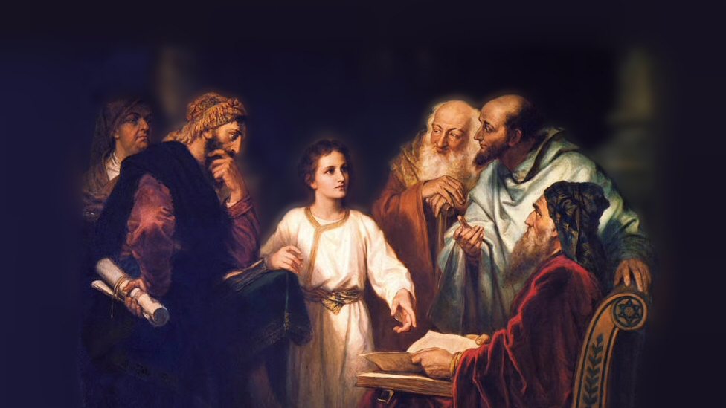
About My Father’s Business
The Woman About to be Stoned
(John 8:1-11)
Notes:
This afternoon we want to discuss an example of Jesus’ masterful dealing’s with man
We see His ability to deftly handle the efforts of His enemies to destroy His reputation
We see His ability to convict the hearts of men
We see His great compassion and love for the souls of men
(John 8:1-11) READ
In this lesson I want to note four important things we learn from Jesus’ words and actions in this passage:
Picture attribution: More Good Foundation (cropped, with background blurred) Creative Commons Liscense
https://www.flickr.com/photos/moregoodfoundation/5135438113

Slide 2
What Jesus Teaches us in John 8:1-11
Adultery is a serious sin!
(8:11) Deut. 17:6-7, 16:18; 2 Cor. 5:10; Gal. 5:19-21
Notes:
Note: Nothing in this passage should be construed as teaching that Jesus is tolerant of sin. He is Not!
(8:11), “And Jesus said to her, ‘Neither do I condemn you; go and sin no more.’”
Jesus did not condemn her to physically die, as was required by the law of Moses for adultery
(Note: It was the accusers/witnesses responsibility to carry out the sentence of death)
(Deuteronomy 17:6-7), “Whoever is deserving of death shall be put to death on the testimony of two or three witnesses; he shall not be put to death on the testimony of one witness. ⁷ The hands of the witnesses shall be the first against him to put him to death, and afterward the hands of all the people. So you shall put away the evil from among you.”
(Note: Jesus was also not an appointed judge in Israel)
(Deuteronomy 16:18), “You shall appoint judges and officers in all your gates, which the Lord your God gives you, according to your tribes, and they shall judge the people with just judgment.”
(Luke 12:14) [Man wanted Jesus to settle a dispute between him and his brother], “But He said to him, ‘Man, who made Me a judge or an arbitrator over you?’”
Finally, only the Romans could sentence a person to die. Something his questioners would know, as they were trying to entangle Him in a trap!
However, He did instruct her to cease sinning. (8:11)
In the judgment, Jesus will condemn the unrepentant!
(2 Corinthians 5:10), “For we must all appear before the judgment seat of Christ, that each one may receive the things done in the body, according to what he has done, whether good or bad.”
Adultery is one of those sins that will lead to condemnation!
(Galatians 5:19-21), “Now the works of the flesh are evident, which are: adultery, fornication, uncleanness, lewdness, ²⁰ idolatry, sorcery, hatred, contentions, jealousies, outbursts of wrath, selfish ambitions, dissensions, heresies, ²¹ envy, murders, drunkenness, revelries, and the like; of which I tell you beforehand, just as I also told you in time past, that those who practice such things will not inherit the kingdom of God.”

Slide 3
What Jesus Teaches us in John 8:1-11
Adultery is a serious sin!
(8:11) Deut. 17:6-7, 16:18; 2 Cor. 5:10; Gal. 5:19-21
Sincerity is an important component of righteousness
(8:6) John 6:28-29; Matt. 7:7-8; Acts 8:26-39
Notes:
Jesus made a distinction between a sincere inquiry, and the conniving of the Jewish leaders
Example, His disciples
(John 6:28-29), “Then they said to Him, “What shall we do, that we may work the works of God?” ²⁹ Jesus answered and said to them, “This is the work of God, that you believe in Him whom He sent.”
True seekers will find their answers!
(Matthew 7:7-8), “Ask, and it will be given to you; seek, and you will find; knock, and it will be opened to you. ⁸ For everyone who asks receives, and he who seeks finds, and to him who knocks it will be opened.”
The Ethiopian Eunuch is a great example of this (Also, Cornelius)
(Acts 8:26), [God sent Philip] “Now an angel of the Lord spoke to Philip, saying, “Arise and go toward the south along the road which goes down from Jerusalem to Gaza.” This is desert.”
(8:30), [the Eunuch was interested in the word], “So Philip ran to him, and heard him reading the prophet Isaiah…”
(8:39) [a receptive Eunuch was baptized, and saved], “Now when they came up out of the water, the Spirit of the Lord caught Philip away, so that the eunuch saw him no more; and he went on his way rejoicing.”

Slide 4
What Jesus Teaches us in John 8:1-11
Adultery is a serious sin!
(8:11) Deut. 17:6-7, 16:18; 2 Cor. 5:10; Gal. 5:19-21
Sincerity is an important component of righteousness
(8:6) John 6:28-29; Matt. 7:7-8; Acts 8:26-39
God’s Law is a standard to which we are accountable
(8:5) Romans 2:17-24; Hebrews 5:9; John 12:48-50
Notes:
Note: Jesus’ opponents recognized the validity of the law (though they themselves were not keeping it).
(Romans 2:17-24) READ
Jesus’ words, “He who is without sin among you, let him throw a stone at her first” (8:7) convicted their conscience. They knew they too were guilty of transgressing the law.
Obedience to Jesus’ words are required for salvation!
(Hebrews 5:9), “And having been perfected, He became the author of eternal salvation to all who obey Him,”
This is why Jesus called upon the woman to “sin no more” (8:11)
A necessary part of repentance is to CEASE THE SIN!
Your Eternal standing depends upon obedience to the law of Christ!
(John 12:48-50), “He who rejects Me, and does not receive My words, has that which judges him—the word that I have spoken will judge him in the last day. ⁴⁹ For I have not spoken on My own authority; but the Father who sent Me gave Me a command, what I should say and what I should speak. ⁵⁰ And I know that His command is everlasting life. Therefore, whatever I speak, just as the Father has told Me, so I speak.”

Slide 5
What Jesus Teaches us in John 8:1-11
Adultery is a serious sin!
(8:11) Deut. 17:6-7, 16:18; 2 Cor. 5:10; Gal. 5:19-21
Sincerity is an important component of righteousness
(8:6) John 6:28-29; Matt. 7:7-8; Acts 8:26-39
God’s Law is a standard to which we are accountable
(8:5) Romans 2:17-24; Hebrews 5:9; John 12:48-50
Compassion is an aspect of our Lord’s character
(8:11) John 3:16-17; Philippians 2:8; Isaiah 63:7-9
Notes:
“Neither do I condemn you”
The Grace of God is a product of His love and compassion for mankind
(John 3:16-17), “For God so loved the world that He gave His only begotten Son, that whoever believes in Him should not perish but have everlasting life. ¹⁷ For God did not send His Son into the world to condemn the world, but that the world through Him might be saved.”
(Philippians 2:8), “And being found in appearance as a man, He humbled Himself and became obedient to the point of death, even the death of the cross.”
(Isaiah 63:7-9), “I will mention the lovingkindnesses of the Lord and the praises of the Lord, according to all that the Lord has bestowed on us, and the great goodness toward the house of Israel, which He has bestowed on them according to His mercies, according to the multitude of His lovingkindnesses. ⁸ For He said, “Surely they are My people, children who will not lie.” So He became their Savior. ⁹ In all their affliction He was afflicted, and the Angel of His Presence saved them; in His love and in His pity He redeemed them; and He bore them and carried them all the days of old.”

Slide 6
Conclusion
Each of us are or have been in the place of the adulterous woman
Guilty of sin, and in need of God’s mercy
Praise God for the gift of His Son!

