Slide 1
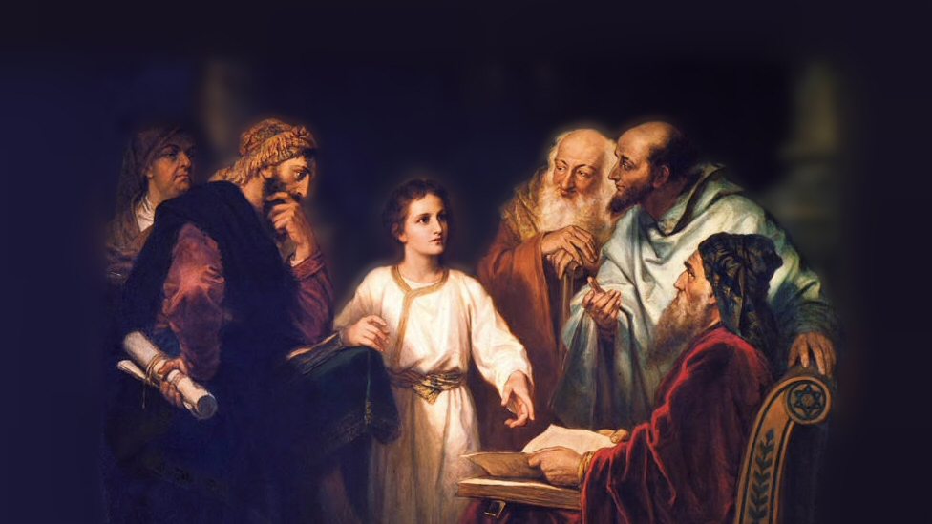
About My Father’s Business
Mary and Martha
(Luke 10:38-42)
Notes:
In his ministry, Jesus befriended a family in the little town of Bethany, just outside of Jerusalem. Lazarus, Martha and Mary.
We don’t know a great deal about the individuals. Most of what we know come from our text, the occasion of Jesus raising Lazarus from the dead (John 11:1-44), and the time at Simon the leper’s house when Mary washed Jesus’s feet with fragrant oil (John 12:1-8).
It is possible that Martha was Simon the Leper’s wife (He a man cleansed of his leprosy). As she served when Jesus ate at Simon’s home. (cf. John 12:2).
The scripture states clearly their friendship on the occasion of Lazarus’ sickness and eventual death.
(John 11:5), “Now Jesus loved Martha and her sister and Lazarus.”
The account we are interested in is recorded in Luke 10, an occasion when Jesus came to visit. It recounts a conversation that Jesus had with Martha about her sister.
(Luke 10:38-42), “Now it happened as they went that He entered a certain village; and a certain woman named Martha welcomed Him into her house. ³⁹ And she had a sister called Mary, who also sat at Jesus’ feet and heard His word. ⁴⁰ But Martha was distracted with much serving, and she approached Him and said, “Lord, do You not care that my sister has left me to serve alone? Therefore tell her to help me.” ⁴¹ And Jesus answered and said to her, “Martha, Martha, you are worried and troubled about many things. ⁴² But one thing is needed, and Mary has chosen that good part, which will not be taken away from her.”
We want to note some lessons we can learn from these two women, from their actions on this occasion in the presence of Jesus.
Picture attribution: More Good Foundation (cropped, with background blurred) Creative Commons Liscense
https://www.flickr.com/photos/moregoodfoundation/5135438113

Slide 2
Martha
Personality? (40)
John 11:21, 39
Notes:
Martha is viewed critically by many, due to the conversations she had with her Lord.
In our text, her complaint that Mary was not helping
(10:40), “But Martha was distracted with much serving, and she approached Him and said, “Lord, do You not care that my sister has left me to serve alone? Therefore tell her to help me.”
Her perceived rebuke of Jesus, who did not come in time to prevent the death of Lazarus (John 11)
Consider the following example, from an article in Truth Magazine. (Note, however, the article was actually complimentary of her overall).
Adviser To The Lord
"Martha was a woman of impulse, energy, practical duty; like Peter, she was ready even to give advice to her Lord, and eager to put everybody in his rightful place" (Pulpit Commentary, Vol. XVII, p. 90). This trait was certainly not one of Martha's good points. When Jesus arrived after Lazarus' death, Martha said, "Lord, if You had been here, my brother would not have died" (Jn. 11:21). When Jesus was ready to raise Lazarus from the dead and had said, "Remove the stone," Martha piped up, "Lord, by this time there will be a stench; for he has been dead four days" (Jn. 11:39). With Mary sitting at the feed of Jesus while she herself served as hostess, Martha felt the need to counsel the Lord. She said, "Lord do You not care that my sister has left me to do all the serving alone? Then tell her to help me" (Lk. 39:40). What nerve!
Of course we still have some around today who feel they must advise the Lord. There are those who feel they need to advise Him on what kind of music He should want in worship to Him. There are those who feel they need to advise Him on which organization can do a better job of doing His work. There are those who feel they need to advise Him on which kind of sinners He should save. All of these advisers need to read Romans 11:34. The passage says, "For who has known the mind of the Lord, or who became His counselor?"
I would like you to consider the context of these conversations – the succinct nature of them (we only have a few words from her lips) – the fact that she was an intimate friend of Jesus. And as such, judge her gently and fairly!

Slide 3
Martha
Personality? (40)
John 11:21, 39
Hospitable (40)
12:1-2; 1 Peter 4:9
Notes:
The little bit we know of her reveals her to be Hospitable
(10:40), “But Martha was distracted with much serving, and she approached Him and said, “Lord, do You not care that my sister has left me to serve alone? Therefore tell her to help me.”
(John 12:1-2), “Then, six days before the Passover, Jesus came to Bethany, where Lazarus was who had been dead, whom He had raised from the dead. ² There they made Him a supper; and Martha served, but Lazarus was one of those who sat at the table with Him.”
It seems Martha was always ready to open up her home to Jesus and His followers.
The Bible certainly teaches that this trait should be found in all of us.
(Romans 12:13), [Call to behave like a Christian should], “distributing to the needs of the saints, given to hospitality.”
(1 Peter 4:9), “Be hospitable to one another without grumbling.”
(Hebrews 13:2), “Do not forget to entertain strangers, for by so doing some have unwittingly entertained angels.”

Slide 4
Martha
Personality? (40)
John 11:21, 39
Hospitable (40)
12:1-2; 1 Peter 4:9
Anxious (40-41)
Matthew 13:22
Matthew 6:25,33
Notes:
(Luke 10:41-42), “But Martha was distracted with much serving, and she approached Him and said, “Lord, do You not care that my sister has left me to serve alone? Therefore tell her to help me.” ⁴¹ And Jesus answered and said to her, “Martha, Martha, you are worried and troubled about many things.”
Consider the woman who rejoices having individuals in their homes, and is unconcerned if all is not perfect. She knows that the important thing is the hospitality and association
The consider the woman who is having individuals over, and MUST have everything JUST SO! She worries about how she will be perceived, what he house looks like, what people might think. Hospitality becomes a burden… or worse, a chance to show off, (an occasion of pride).
Worry and Anxiety is always problematic. The worries of the world can choke out the word!
(Matthew 13:22), “Now he who received seed among the thorns is he who hears the word, and the cares of this world and the deceitfulness of riches choke the word, and he becomes unfruitful.”
(Matthew 6:25), “Therefore I say to you, do not worry about your life, what you will eat or what you will drink; nor about your body, what you will put on. Is not life more than food and the body more than clothing?”
(33), “But seek first the kingdom of God and His righteousness, and all these things shall be added to you. ³⁴ Therefore do not worry about tomorrow, for tomorrow will worry about its own things. Sufficient for the day is its own trouble.”

Slide 5
Martha Mary
Personality? (40)
John 11:21, 39
Hospitable (40)
12:1-2; 1 Peter 4:9
Anxious (40-41)
Matthew 13:22
Matthew 6:25,33
Devoted to Jesus
John 12:1-3
Notes:
(John 12:1-3), “Then, six days before the Passover, Jesus came to Bethany, where Lazarus was who had been dead, whom He had raised from the dead. ² There they made Him a supper; and Martha served, but Lazarus was one of those who sat at the table with Him. ³ Then Mary took a pound of very costly oil of spikenard, anointed the feet of Jesus, and wiped His feet with her hair. And the house was filled with the fragrance of the oil.”
Personal devotion, Mary loved Jesus, as indicated by her actions here.
Such devotion is not always appreciated or understood (great value of the oil, used in this seemingly wasteful way).
We too, are to be entirely devoted to the Lord, regardless of how it will be perceived by others.
This devotion is seen in zeal and discipleship (Paul as example)
(Philippians 1:19-21), “For I know that this will turn out for my deliverance through your prayer and the supply of the Spirit of Jesus Christ, ²⁰ according to my earnest expectation and hope that in nothing I shall be ashamed, but with all boldness, as always, so now also Christ will be magnified in my body, whether by life or by death. ²¹ For to me, to live is Christ, and to die is gain.”

Slide 6
Martha Mary
Personality? (40)
John 11:21, 39
Hospitable (40)
12:1-2; 1 Peter 4:9
Anxious (40-41)
Matthew 13:22
Matthew 6:25,33
Devoted to Jesus
John 12:1-3
Tenderhearted
John 11:32-33
Notes:
In John 11, Mary’s brother Lazarus had died.
Where Martha went out to meet Jesus, Mary remained behind
When Jesus called for her, and she met Him, her grief troubled the Lord.
(John 11:32-33), “Then, when Mary came where Jesus was, and saw Him, she fell down at His feet, saying to Him, “Lord, if You had been here, my brother would not have died.” ³³ Therefore, when Jesus saw her weeping, and the Jews who came with her weeping, He groaned in the spirit and was troubled.”
Mary’s tender heart is obvious in these few glimpses we have. She is a typical woman of righteousness, and it can be seen in her emotions and interactions with Jesus.
(Ephesians 4:31-32), “Let all bitterness, wrath, anger, clamor, and evil speaking be put away from you, with all malice. ³² And be kind to one another, tenderhearted, forgiving one another, even as God in Christ forgave you.”

Slide 7
Martha Mary
Personality? (40)
John 11:21, 39
Hospitable (40)
12:1-2; 1 Peter 4:9
Anxious (40-41)
Matthew 13:22
Matthew 6:25,33
Devoted to Jesus
John 12:1-3
Tenderhearted
John 11:32-33
Spiritually Minded (39,42)
Psalm 19:7-10
Notes:
(Luke 10:39-42), “And she had a sister called Mary, who also sat at Jesus’ feet and heard His word. ⁴⁰ But Martha was distracted with much serving, and she approached Him and said, “Lord, do You not care that my sister has left me to serve alone? Therefore tell her to help me.” ⁴¹ And Jesus answered and said to her, “Martha, Martha, you are worried and troubled about many things. ⁴² But one thing is needed, and Mary has chosen that good part, which will not be taken away from her.”
It is interesting to note that many consider Mary’s actions to be surprising
It was typical in Jewish culture for the men to be so engaged, and the women to keep themselves separate
But, the picture may be very different (Jesus, in reclining would mean that Mary was behind him, outside of the circle).
(Expositor’s Bible – She put herself in the listening attitude, content to be in the shadow, outside the charmed circle, if she only might hear Him speak, whose words fell like a rain of music upon her soul.)
This is an indication of a spiritual thirst on Mary’s part
May we all have such a desire to hear the words of our God!
(Psalm 19:7-10), “The law of the Lord is perfect, converting the soul; The testimony of the Lord is sure, making wise the simple; ⁸ The statutes of the Lord are right, rejoicing the heart; The commandment of the Lord is pure, enlightening the eyes; ⁹ The fear of the Lord is clean, enduring forever; The judgments of the Lord are true and righteous altogether. ¹⁰ More to be desired are they than gold, Yea, than much fine gold; Sweeter also than honey and the honeycomb.”

Slide 8
Conclusion
Mary and Martha, though sisters, seemed to have very different personalities.
However, they were both faithful, and both were loved by the Lord!
Notes:
There is room in the kingdom for all. No matter culture, gender or personality. So long as you are faithful to the Lord!

