Slide 1
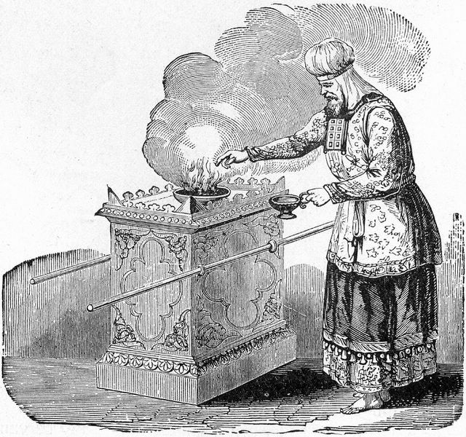
A Holy Priesthood
1 Peter 2:9-10
Notes:
(1 Peter 2:9-10), “But you are a chosen generation, a royal priesthood, a holy nation, His own special people, that you may proclaim the praises of Him who called you out of darkness into His marvelous light; 10 who once were not a people but are now the people of God, who had not obtained mercy but now have obtained mercy.”
I doubt we think of ourselves as priests as much as we should. What an honor to be priests before Almighty God!
The primary work of a priest is to offer sacrifices and gifts unto God
The sacrifices offered by the Levitical priests were acceptable when offered according to the Law
Being a priest should be very important to us. We must understand the sacrifices we are to be offering Him

Slide 2
Our Offered Sacrifices
Our Bodies (Romans 12:1-2)
Notes:
(Romans 12:1-2), “I beseech you therefore, brethren, by the mercies of God, that you present your bodies a living sacrifice, holy, acceptable to God, which is your reasonable service. 2 And do not be conformed to this world, but be transformed by the renewing of your mind, that you may prove what is that good and acceptable and perfect will of God.”
We bring before God a body with which to serve, worship and obey Him.
Our body is to be given to God and not to the indulgences of the flesh (Gal. 5:19-21).

Slide 3
Our Offered Sacrifices
Our Bodies (Romans 12:1-2)
Faith is a sacrifice we offer before God (Philippians 2:17)
Notes:
(Philippians 2:17-18), “Yes, and if I am being poured out as a drink offering on the sacrifice and service of your faith, I am glad and rejoice with you all. 18 For the same reason you also be glad and rejoice with me.
Living by faith is often a trying sacrifice, but one with which He is pleased
(1 Thessalonians 1:2-3), “We give thanks to God always for you all, making mention of you in our prayers, 3 remembering without ceasing your work of faith, labor of love, and patience of hope in our Lord Jesus Christ in the sight of our God and Father”

Slide 4
Our Offered Sacrifices
Our Bodies (Romans 12:1-2)
Faith is a sacrifice we offer before God (Philippians 2:17)
When we support preaching we are rendering priestly service before God (Philippians 4:18)
Notes:
(Philippians 4:18), “Indeed I have all and abound. I am full, having received from Epaphroditus the things sent from you, a sweet- smelling aroma, an acceptable sacrifice, well pleasing to God.”
The Philippians’ support of Paul was a sweet smelling sacrifice to God.
So is ours when we support gospel preachers.

Slide 5
Our Offered Sacrifices
Our Bodies (Romans 12:1-2)
Faith is a sacrifice we offer before God (Philippians 2:17)
When we support preaching we are rendering priestly service before God (Philippians 4:18)
Every priest should offer the sacrifice of Praise (Hebrews 13:15)
Notes:
(Hebrews 13:15), “Therefore by Him let us continually offer the sacrifice of praise to God, that is, the fruit of our lips, giving thanks to His name.”
We must confess the good things that God has done for us (cf. Heb. 13:15 above)
In light of this priestly service, why would any priest be content with not assembling with fellow saints to worship God?
(Hebrews 10:25), “not forsaking the assembling of ourselves together, as is the manner of some, but exhorting one another, and so much the more as you see the Day approaching.”

Slide 6
Conclusion
We are priests!
Our lives are an offering to God. Let us serve Him in all reverence and holiness.
Notes:
(1 Peter 2:5), “You also, as living stones, are being built up a spiritual house, a holy priesthood, to offer up spiritual sacrifices acceptable to God through Jesus Christ.”
As we live by faith, every expression of service and obedience is a “spiritual sacrifice”

