Slide 1
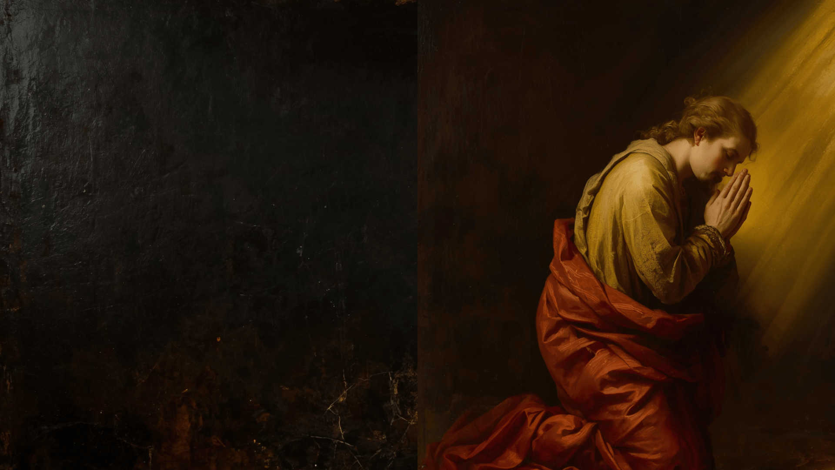
A Life of
DEVOTION
“Devotion is the fragrance of a heart that loves unconditionally.”

Slide 2

Examples of Devotion in Scripture
Isaac (Genesis 24:63; Psalm 63:6-7)
David (Psalm 55:16-17)
Prophetess Anna (Luke 2:36-38)
Mary, sister of Lazarus
(Luke 10:38-39 42)
The Lord Himself
(Mark 1:35; John 5:30)

Slide 3

TRUE DEVOTION
(Psalm 1:1-2)
Some things we try (in and of themselves) fall short of God’s concept of Devotion.
However, private efforts to grow closer to God are full of promise!
(1 Chronicles 28:9; James 4:8)

Slide 4
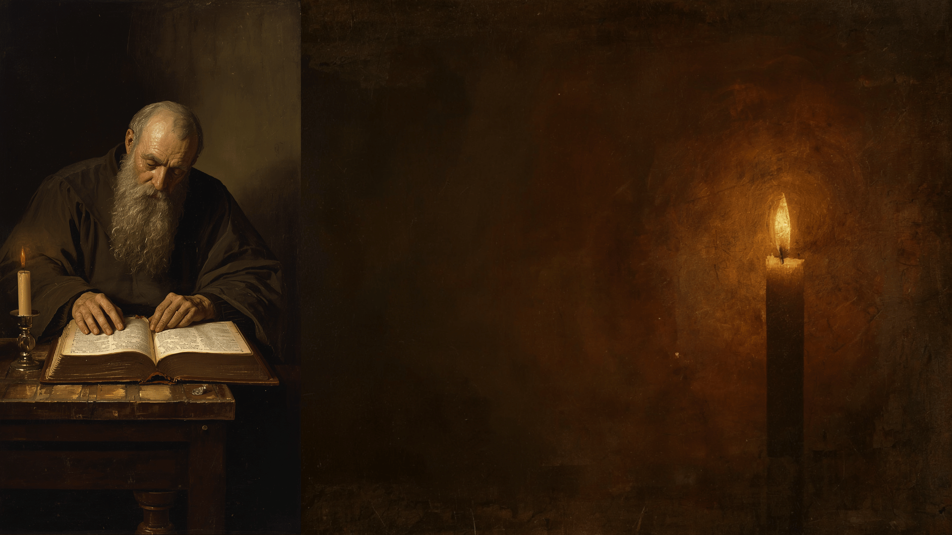
Three Ways to Grow
Devotionally
Spiritual Nourishment (Study)
1 Peter 1:22-23; 2:2-3
Meditation (Musing, Imagination)
Psalm 1:1-2; Joshua 1:8
Prayer (Talking to God)
Philippians 4:6-7; Matthew 26:36-44

Slide 5
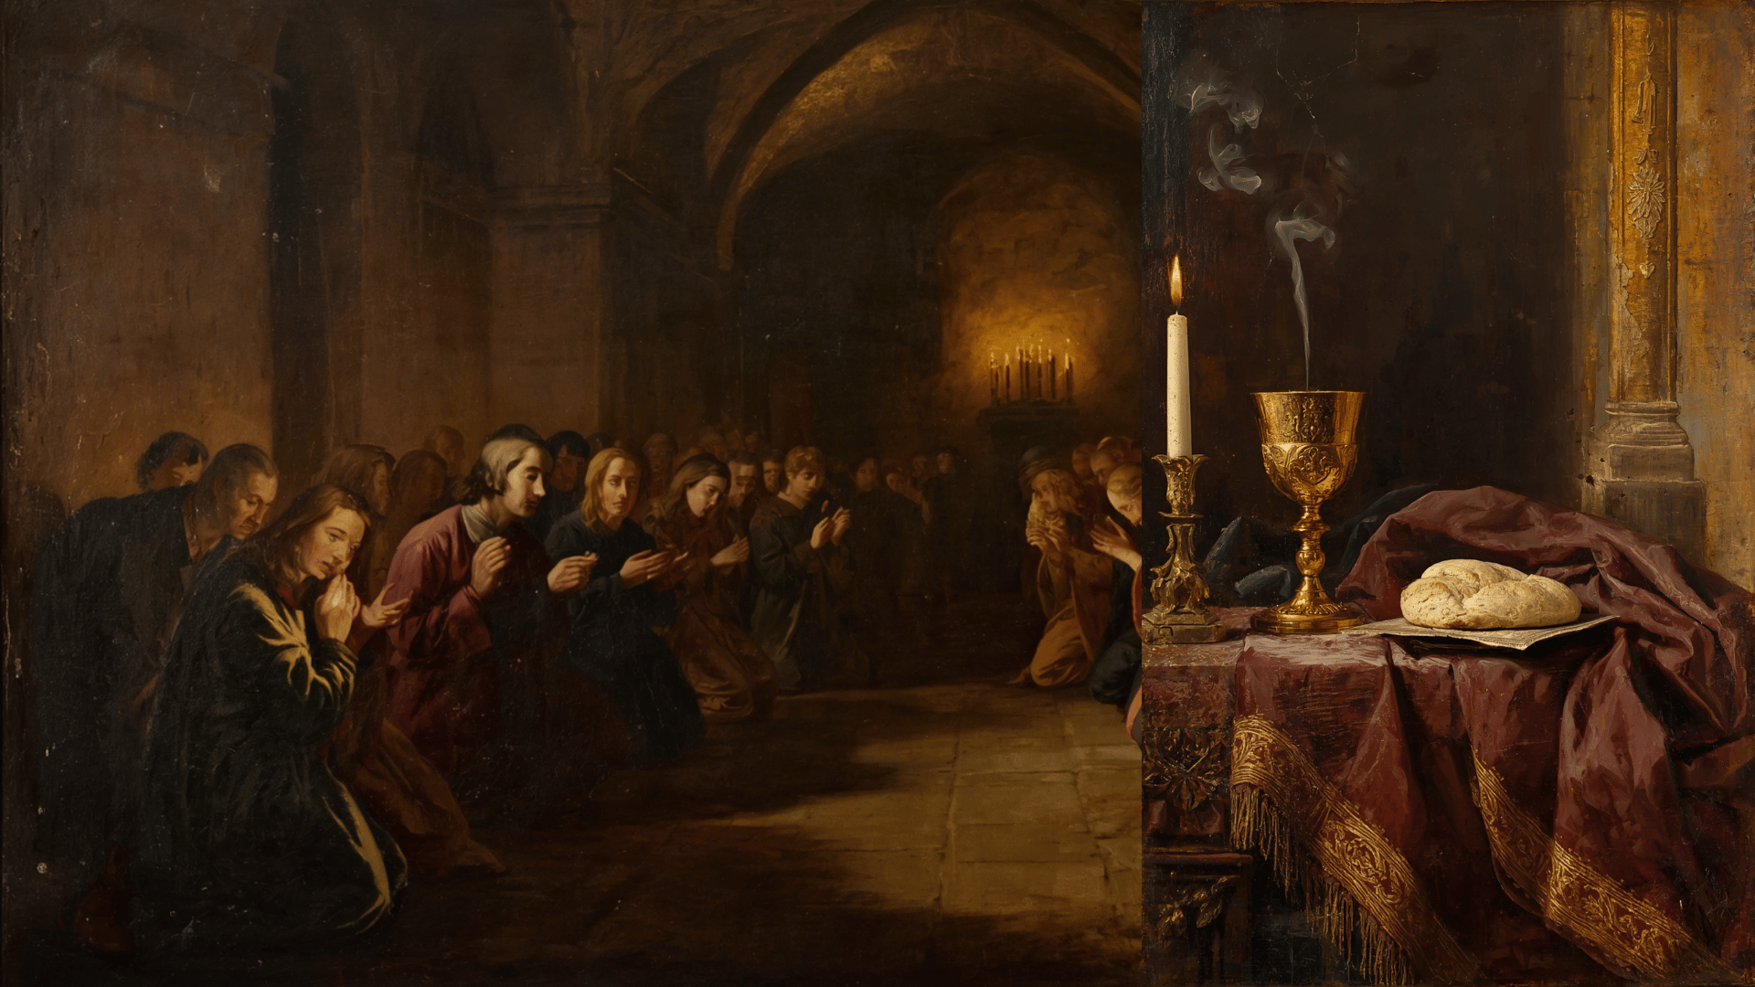
Practical Suggestions
Individual / Reciprocal
Ephesians 4:11-13
A Time That Suits You!
Mark 1:35
Place (Solitary)
Matthew 6:6
Habit
Psalm 40:8
2 Corinthians 8:1-5; 9:7
Hebrews 10:24-25

Slide 6

CONCLUSION
Emulate King David!
1 Samuel 13:14
"Blessed are the single-hearted, for they shall enjoy much peace. If you refuse to be hurried and pressed, if you stay your soul on God, nothing can keep you from that clearness of spirit which is life and peace.”
– Amy Carmichael

