Slide 1
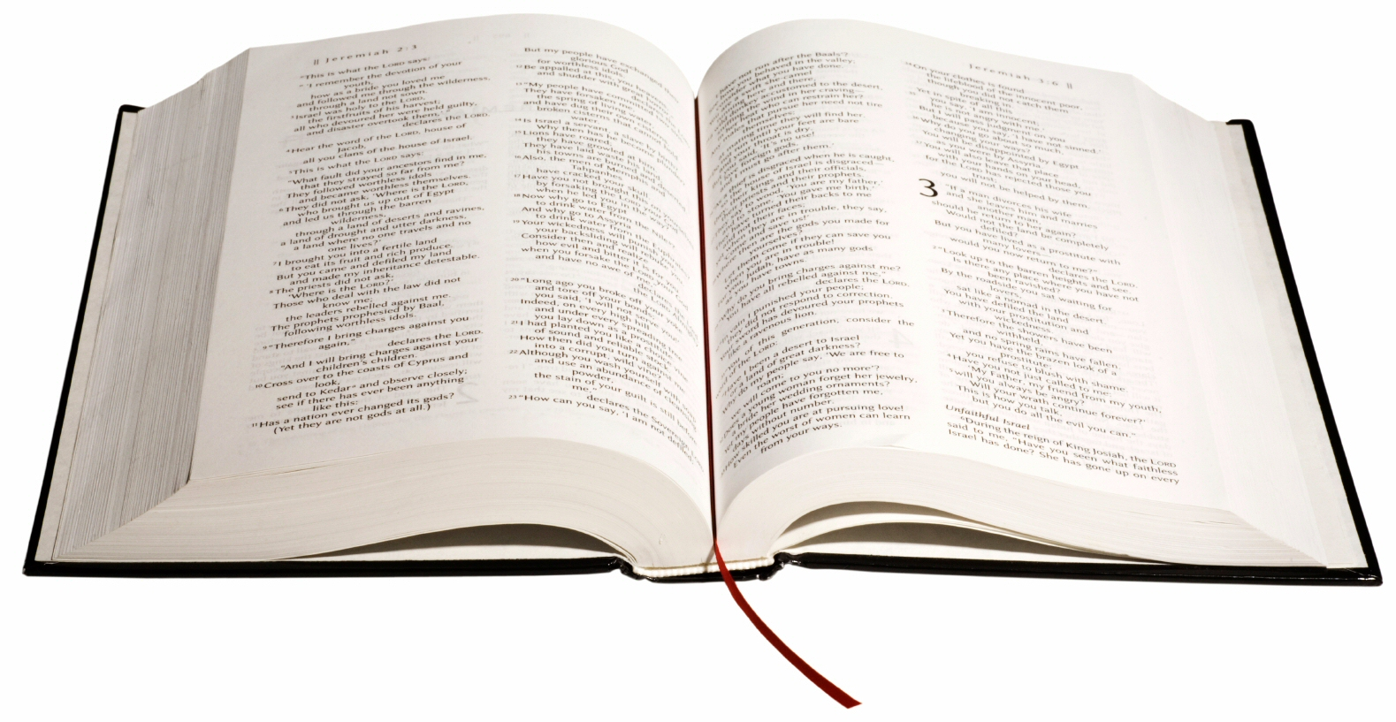
Attitudes in Acts
Toward God’s Word

Slide 2
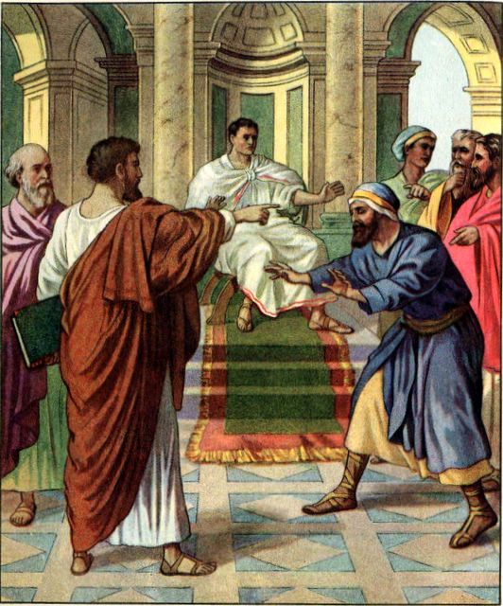
Elymas & Sergius Paulus
Acts 13:4-12
Notes:
Sergius Paulus (Proconsul in Cyprus, City of Salamis)
An Intelligent man
Interested in hearing the gospel Paul preached
Saw Paul’s miracle – But more importantly ASTONISHED at the TEACHING, and believed!
Elymas the Sorcerer
He was WITH Sergius. (Advisor? Sorcerers were impressive cf. Simon in Acts 8)
Enemy of all righteousness (sought to withstand the truth)
Struck blind by Paul’s command

Slide 3
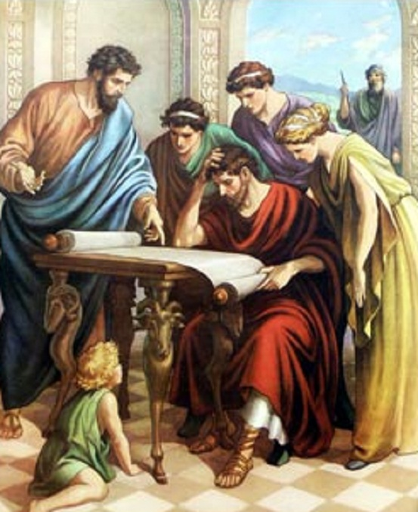
Noble Bereans
Acts 17:10-12

Slide 4
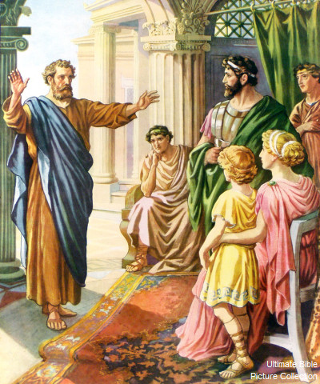
Cornelius & His House
Acts 10:24-33
Notes:
Cornelius
Called all of his relatives together, having been promised by God to hear the truth
We are here to hear all things commanded you by God
Responded in faith, and were baptized (47-48)

Slide 5
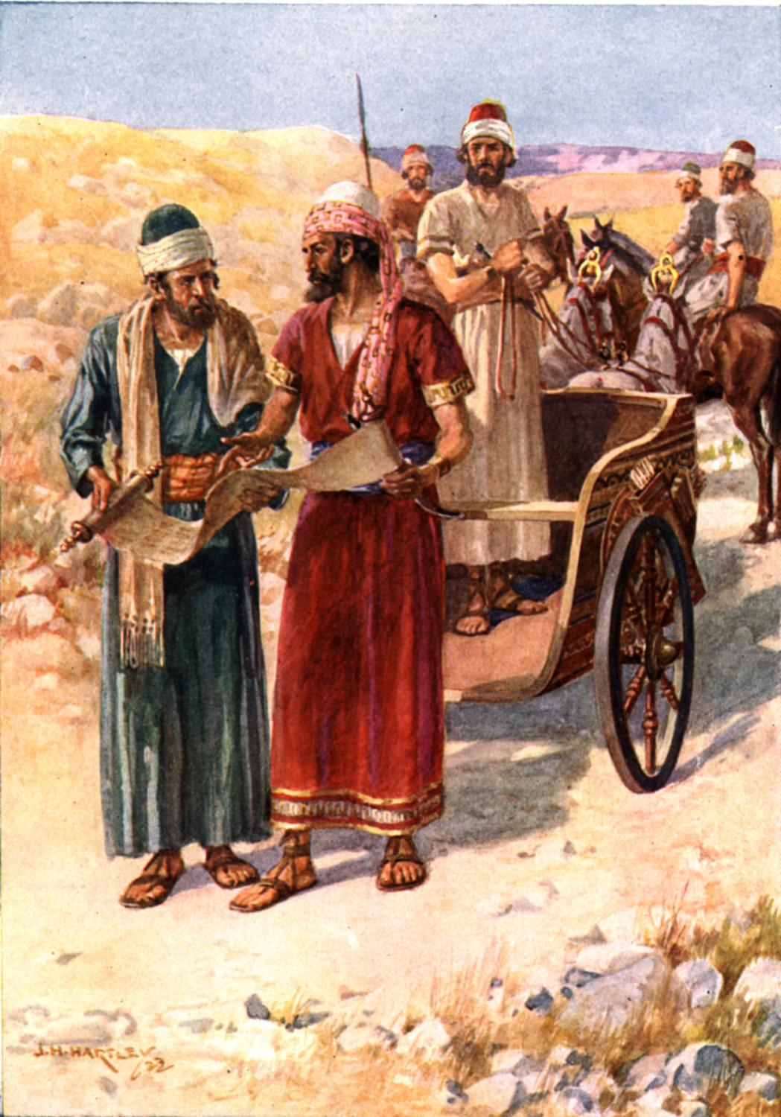
Eunuch from Ethiopia
Acts 8:26-39
Notes:
Eunuch
Recognized the need for guidance (31)
Willingly made the application to HIMSELF (36)
Rejoiced at his response to truth (39)

Slide 6
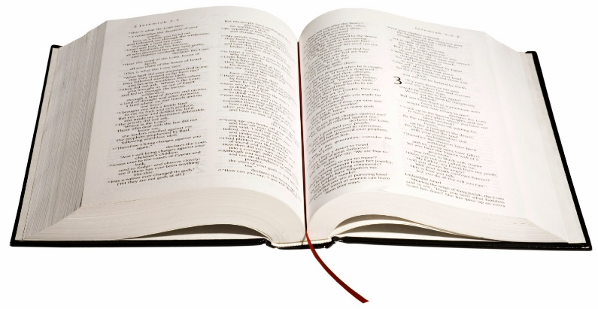
Conclusion
We must all open our hearts to accept the truth of God’s word, listen carefully, and make a personal application to what is heard.
Do not withstand God’s word!
Notes:
Accept the Truth (Bereans)
Listen carefully (Cornelius & Sergius)
Make a personal application (Eunuch)
Do not withstand (Elymas)

