Slide 1

Notes:
Bad Things Happen!
INTRODUCTION
Recent Natural Disasters in the World
Covid Pandemic (Worldwide). Since January 2020, over 7 million have had deaths associated with the virus according to the World Health Orginazation
2020 - Australian brushfires caused almost 500 deaths
2021 - Haitian earthquake killed 2248 people
2022 - Flooding in Asia killed 5,000 and significantly affects 50 million
2023 - Series of earthquakes in Syria kill 58,000 people
2024 - This September, hurricane Helene hit, with the storm and floods killing 230 people, and caused 53 Billion in damages in North Carolina alone.
Worst in recorded history, floods in China in 1931 killed an estimated 4 million
When disasters like these strike, people often raise questions...
Why did it happen? Did God cause it? If not, why did He allow it to happen?
What can I do? Does it do any good? (Both questions we will seek to answer today)
[CLICK HERE FOR NEW SLIDE]
DISCUSSION:
WHY DID IT HAPPEN?
DID GOD CAUSE IT...?
It is common to call such natural disasters "acts of God"
Perhaps because God has used natural disasters in the past; for example:
The flood
Genesis 6:6-7 And the LORD was sorry that He had made man on the earth, and He was grieved in His heart. (7) So the LORD said, "I will destroy man whom I have created from the face of the earth, both man and beast, creeping thing and birds of the air, for I am sorry that I have made them."
Destruction of Sodom and Gomorrah
Genesis 19:24-25 Then the LORD rained brimstone and fire on Sodom and Gomorrah, from the LORD out of the heavens. (25) So He overthrew those cities, all the plain, all the inhabitants of the cities, and what grew on the ground.
Even natural calamities upon rebellious Israel
Amos 4:9-10 "I blasted you with blight and mildew. When your gardens increased, Your vineyards, Your fig trees, And your olive trees, The locust devoured them; Yet you have not returned to Me," Says the LORD. (10) "I sent among you a plague after the manner of Egypt; Your young men I killed with a sword, Along with your captive horses; I made the stench of your camps come up into your nostrils; Yet you have not returned to Me," Says the LORD.
But it would be a mistake to attribute all disasters to the hand of God
Disasters are part of a natural process in a planet's evolution and ecology
Sometimes God simply allows such events to run their course according to "time and chance", and so many experience tragedies due to no fault of their own
Ecclesiastes 9:11 I returned and saw under the sun that—The race is not to the swift, Nor the battle to the strong, Nor bread to the wise, Nor riches to men of understanding, Nor favor to men of skill; But time and chance happen to them all.
[CLICK HERE FOR NEXT POINT]
Some disasters are man-made (Chernobyl, Bhopal, bridge collapses, forest fires)
It was a superstition in Jesus' time that all physical afflictions were caused by sin. No, sometimes the innocent suffer! Paul is an example:
2 Corinthians 11:23 Are they ministers of Christ?—I speak as a fool—I am more: in labors more abundant, in stripes above measure, in prisons more frequently, in deaths often.
Without divine revelation, there is no way we can know if "God caused it"
[CLICK HERE FOR NEXT POINT]
THEN WHY DOES GOD ALLOW IT...?
This relates to the overall problem of suffering, which God may allow for several reasons
It keeps this world from becoming too attractive, encouraging us to seek something better
Hebrews 13:14 For here we have no continuing city, but we seek the one to come.
It can bring out the best in people (patience, generosity)
Romans 5:3-4 And not only that, but we also glory in tribulations, knowing that tribulation produces perseverance; (4) and perseverance, character; and character, hope.
It encourages people to think of God, to draw near to Him in repentance
Whenever the innocent and righteous die, we should bear in mind:
The death of the righteous is truly a blessing!
Revelation 14:13 Then I heard a voice from heaven saying to me, "Write: 'Blessed are the dead who die in the Lord from now on.' " "Yes," says the Spirit, "that they may rest from their labors, and their works follow them."
Even the innocent young are delivered from much heartache and sorrow!
-- Whether caused by God or not, disasters can result in much good!
Which leads to our next question, which often comes from those responding to disaster and suffering.
[CLICK HERE FOR NEXT SLIDE]
WHAT CAN I DO?
AS WE HAVE OPPORTUNITY...
Galatians 6:10 Therefore, as we have opportunity, let us do good to all, especially to those who are of the household of faith.
What we MAY do depends on what we CAN to do
Our skills, our resources
Whether we are nearby or far off (Personally if near, or through Resources such as money, food, clothing, shelter, medical help if far away)
DO GOOD TO ALL...
The Good Samaritan is a good example
Luke 10:30-37 Then Jesus answered and said: "A certain man went down from Jerusalem to Jericho, and fell among thieves, who stripped him of his clothing, wounded him, and departed, leaving him half dead. (31) Now by chance a certain priest came down that road. And when he saw him, he passed by on the other side. (32) Likewise a Levite, when he arrived at the place, came and looked, and passed by on the other side. (33) But a certain Samaritan, as he journeyed, came where he was. And when he saw him, he had compassion. (34) So he went to him and bandaged his wounds, pouring on oil and wine; and he set him on his own animal, brought him to an inn, and took care of him. (35) On the next day, when he departed, he took out two denarii, gave them to the innkeeper, and said to him, 'Take care of him; and whatever more you spend, when I come again, I will repay you.' (36) So which of these three do you think was neighbor to him who fell among the thieves?" (37) And he said, "He who showed mercy on him." Then Jesus said to him, "Go and do likewise."
-- We should not hesitate to help those who may not be Christians
ESPECIALLY THE HOUSEHOLD OF FAITH...
2 Corinthians 8:1-4 Moreover, brethren, we make known to you the grace of God bestowed on the churches of Macedonia: (2) that in a great trial of affliction the abundance of their joy and their deep poverty abounded in the riches of their liberality. (3) For I bear witness that according to their ability, yes, and beyond their ability, they were freely willing, (4) imploring us with much urgency that we would receive the gift and the fellowship of the ministering to the saints.
Churches (collective work) can send aid directly to suffering Christians
As we have opportunity, we are to especially help our brethren - Ga 6:10
FINALLY, WE SHOULD PRAY...!
1 Timothy 2:1-4 Therefore I exhort first of all that supplications, prayers, intercessions, and giving of thanks be made for all men, (2) for kings and all who are in authority, that we may lead a quiet and peaceable life in all godliness and reverence. (3) For this is good and acceptable in the sight of God our Savior, (4) who desires all men to be saved and to come to the knowledge of the truth.
Pray for those directly afflicted, pray for their loved ones, pray for those who are directly helping them. Prayer is effective!
James 5:16 Confess your trespasses to one another, and pray for one another, that you may be healed. The effective, fervent prayer of a righteous man avails much.
[CLICK HERE FOR CONCLUSION SLIDE]
CONCLUSION:
Disasters are terrible, but they can be occasions for much good in this world.
The wicked can turn to God
The righteous can draw closer to God
People can become more charitable, foes can become friends
With faith in God and love for our fellow man, we can make the best of the situation
Strengthening bonds between brethren
Bringing communities together
Appreciating what is really important in life
So in times of calamity, trust in God and reach out to aid your fellow man...!

Slide 2
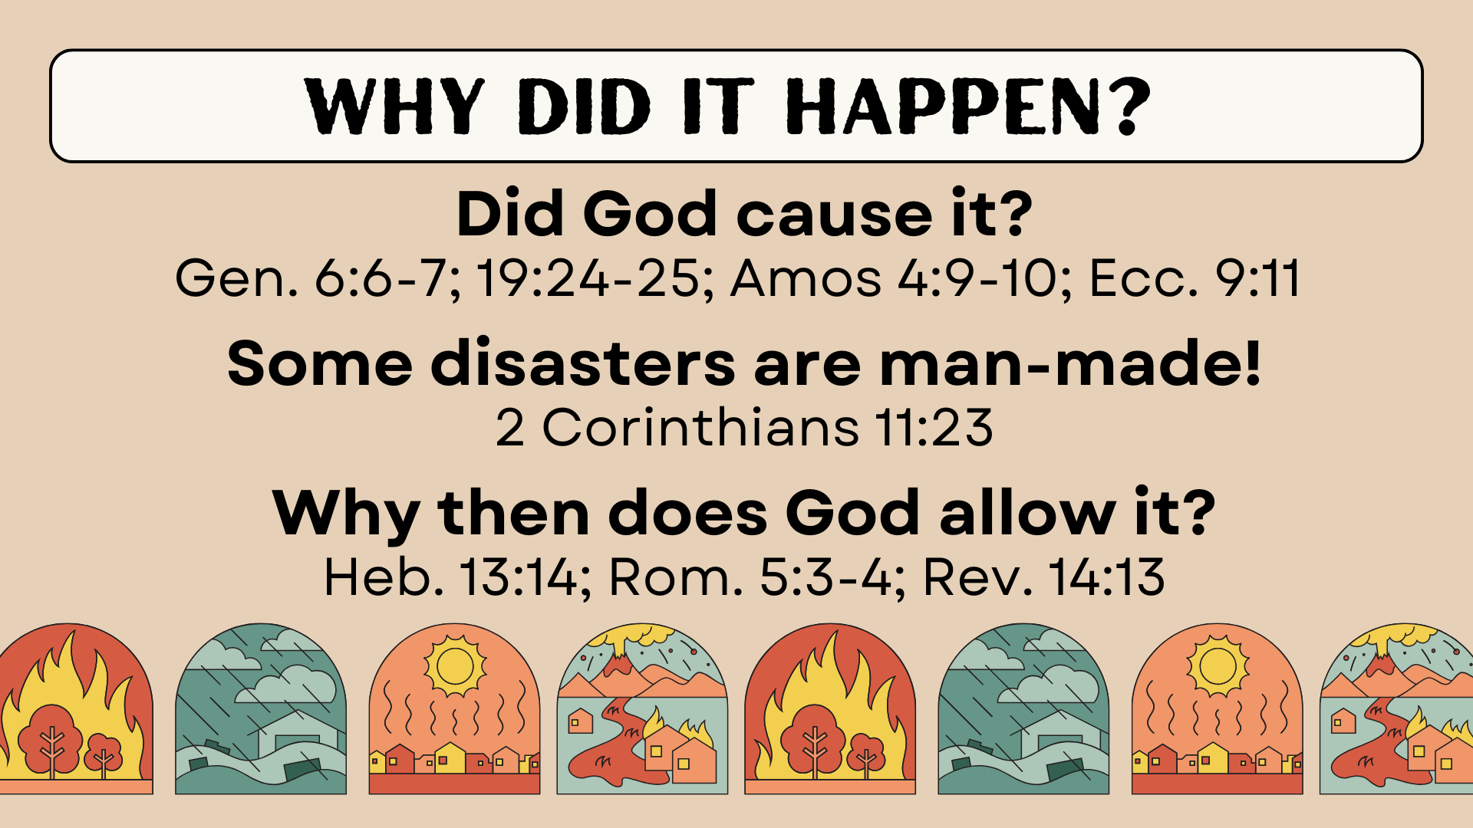

Slide 3
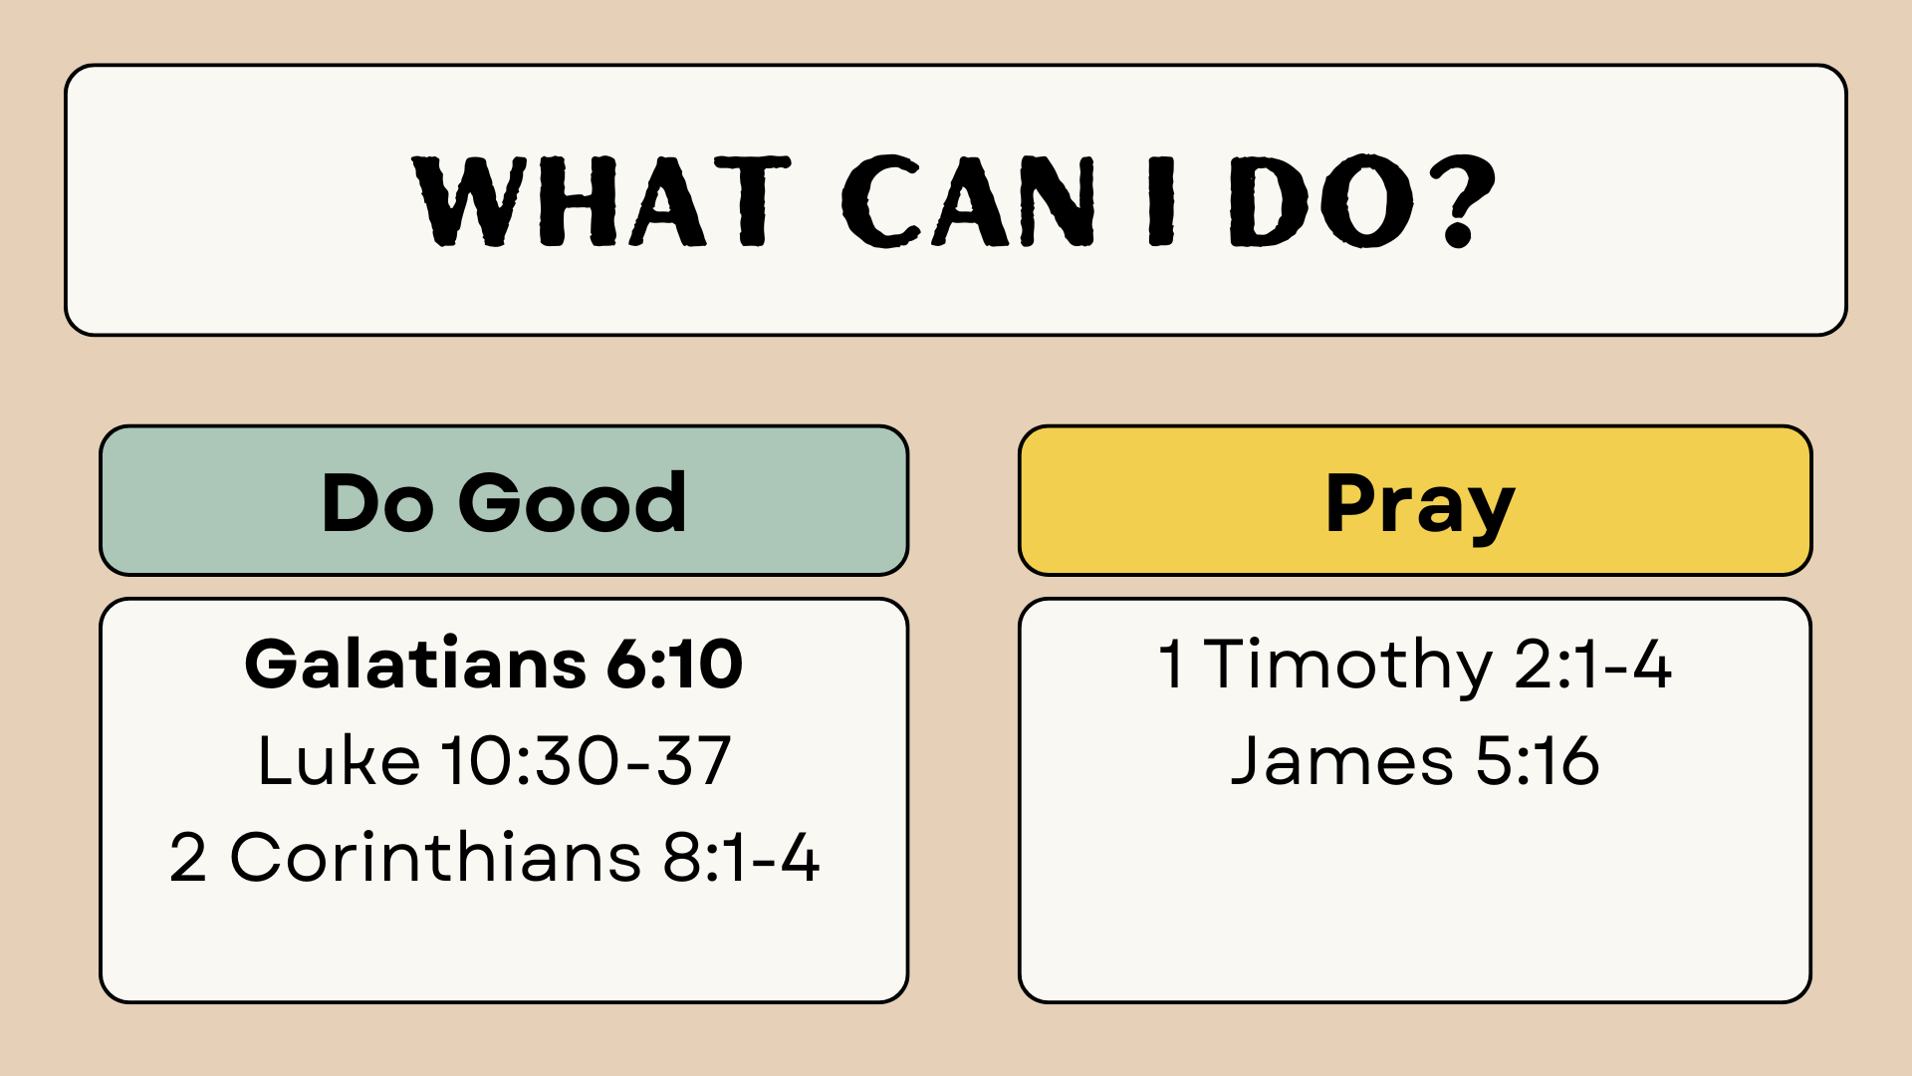

Slide 4
