Slide 1
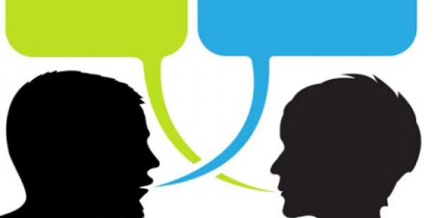
Bitter Words
“Hide me from the secret plots of the wicked, from the throng of evildoers, who whet their tongues like swords, who aim bitter words like arrows”
(Psalm 64:2-3, ESV)
Notes:
The imagery used by the Psalmist (swords and arrows) very graphic and appropriate…
We want to consider in our lesson the impact of the use of “bitter words”
Based on a short article by Jim McDonald

Slide 2
“Bitter” Words
Hebrew (marah) – bitter, angry, chafed, discontented
Greek (pikros) sharp, acrid, pungent, bitter
Greek (pikraino) angry, irritated, bitter
Notes:
Hebrew from our text in Psalm 64 (Marah – Exodus 15:23, location of bitter water when Israel arrived from the Red Sea)
Greek term (pikros) root, for example, bitter water (cf. James 3:11)
Greek term (pikraino) Colossians 3:19
(Colossians 3:19), “Husbands, love your wives and do not be bitter toward them.” (NKJV)
(Colossians 3:19), “Husbands, love your wives, and do not be harsh with them.” (ESV)
The word "bitter" is seen in the concept of "sharp" and that is the Psalmist's thought.
Arrows and swords are designed to pierce.
Bitter words are designed to pierce the heart.

Slide 3
Bitter Words that Harm
Spouses
Children
Colossians 3:9, “Husbands, love your wives and do not be bitter toward them.”
Ephesians 6:4, “And you, fathers, do not provoke your children to wrath, but bring them up in the training and admonition of the Lord.”
Notes:
Bitter words can be "sharp words", words that take no thought for the feelings of another.
Paul urged Husbands in Colossians 3:9 (Read on Slide)
When a husband (or wife) speaks roughly and critical to his mate, that mate may say nothing but always carry that injury in her heart.
The same can be true with our children. Ephesians 6:4 (Read on Slide)
We may provoke our children to wrath by expecting of them more than they can ever manage.
We can also provoke them to wrath by our sharp and critical words.

Slide 4
Cause of Bitter Words
A bitter heart,
dwelling on real or imagined injuries
“A good man out of the good treasure of his heart brings forth good; and an evil man out of the evil treasure of his heart brings forth evil. For out of the abundance of the heart his mouth speaks.”
(Luke 6:45)
Notes:
Bitter words are a sort of "verbal revenge"; a desire to hurt with words as one feels he has himself been injured.
Distortion of the golden rule. “Do unto others how you perceive they have done to you.”
Paul shows in Romans 3:9, that all are guilty of sin: “What then? Are we better than they? Not at all. For we have previously charged both Jews and Greeks that they are all under sin.”
He then begins to quote Old Testament scripture, describing such sinners. One passage he quotes is Psalm 10:7, when he writes in verse 14, “Whose mouth is full of cursing and bitterness.“
The man who "curses" is a sinner. The man whose mouth is filled with bitterness is a sinner as well!

Slide 5
Bitter Words Destroy
Your target
Yourself
For all the law is fulfilled in one word, even in this: "You shall love your neighbor as yourself." ¹⁵ But if you bite and devour one another, beware lest you be consumed by one another!
(Galatians 5:14-15)
Notes:
Bitter words are destructive both to the person who speaks them and to those he aims those bitter words toward.
(Galatians 5:15 READ on Slide)
Consider a dog fight. One may be “victorious”, but both will suffer injury!
Bitterness is a cancer that eats away at him who harbors it.
It is imperative that God's children remember the REAL Golden Rule
(Matthew 7:12), “Therefore, whatever you want men to do to you, do also to them, for this is the Law and the Prophets.“

Slide 6
Conclusion: Put away bitterness!
“Let all bitterness, wrath, anger, clamor, and evil speaking be put away from you, with all malice. ³² And be kind to one another, tender-hearted, forgiving one another, even as God in Christ forgave you” (Ephesians 4:31-32).

