Slide 1
Boasting Against the Lord
“Thus says the king [of Assyria]: ‘Do not let Hezekiah deceive you, for he will not be able to deliver you; ¹⁵ nor let Hezekiah make you trust in the Lord, saying, “The Lord will surely deliver us; this city will not be given into the hand of the king of Assyria.”’” (Isaiah 36:14-15)
Notes:
seh-NAK-er-ihb
The narrative under consideration is found in Isaiah, chapters 36 and 37, as well as 2 Kings 18 and 2 Chronicles 32.
It relates the failure of Assyrian king Sennacherib’s failure to fully defeat Hezekiah, king of Judah.
As Assyria ascended as a World power, under King Sennacharib, the Northern Kingdom of Israel was defeated and taken away into captivity. This was a judgment of God against idolatrous Israel
(Hosea 11:1-5), “When Israel was a child, I loved him, and out of Egypt I called My son. ² As they called them, so they went from them; they sacrificed to the Baals, and burned incense to carved images. ³ “I taught Ephraim to walk, taking them by their arms; but they did not know that I healed them. ⁴ I drew them with gentle cords, with bands of love, and I was to them as those who take the yoke from their neck. I stooped and fed them. ⁵ “He shall not return to the land of Egypt; but the Assyrian shall be his king, because they refused to repent.”
Most are aware that Judah was not utterly defeated like Israel was. Much of the reason for that was the leadership of King Hezekiah, as revealed in our text.
Let’s look at the context for a few moments
(Isaiah 36:1-2), “Now it came to pass in the fourteenth year of King Hezekiah that Sennacherib king of Assyria came up against all the fortified cities of Judah and took them. ² Then the king of Assyria sent the Rabshakeh with a great army from Lachish to King Hezekiah at Jerusalem…”
Rabshakeh (rab shake ah) – Assyrian authority. Personal servant of the king. (lit. cup-bearer).
Consider the threat made to the King by this man, on Assyrian King Sennacherib’s behalf.
(Isaiah 36:13-20), “Then the Rabshakeh stood and called out with a loud voice in Hebrew, and said, “Hear the words of the great king, the king of Assyria! ¹⁴ Thus says the king: ‘Do not let Hezekiah deceive you, for he will not be able to deliver you; ¹⁵ nor let Hezekiah make you trust in the Lord, saying, “The Lord will surely deliver us; this city will not be given into the hand of the king of Assyria.” ’ ¹⁶ Do not listen to Hezekiah; for thus says the king of Assyria: ‘Make peace with me by a present and come out to me; and every one of you eat from his own vine and every one from his own fig tree, and every one of you drink the waters of his own cistern; ¹⁷ until I come and take you away to a land like your own land, a land of grain and new wine, a land of bread and vineyards. ¹⁸ Beware lest Hezekiah persuade you, saying, “The Lord will deliver us.” Has any one of the gods of the nations delivered its land from the hand of the king of Assyria? ¹⁹ Where are the gods of Hamath and Arpad? Where are the gods of Sepharvaim? Indeed, have they delivered Samaria from my hand? ²⁰ Who among all the gods of these lands have delivered their countries from my hand, that the Lord should deliver Jerusalem from my hand?’ ”
Notice the threat. Sennacherib had defeated and taken into captivity the nations around. And said he was going to do it to Judah as well!
So, what happened? Well, let’s first hear from the Assyrians… (Next Slide)

Slide 2
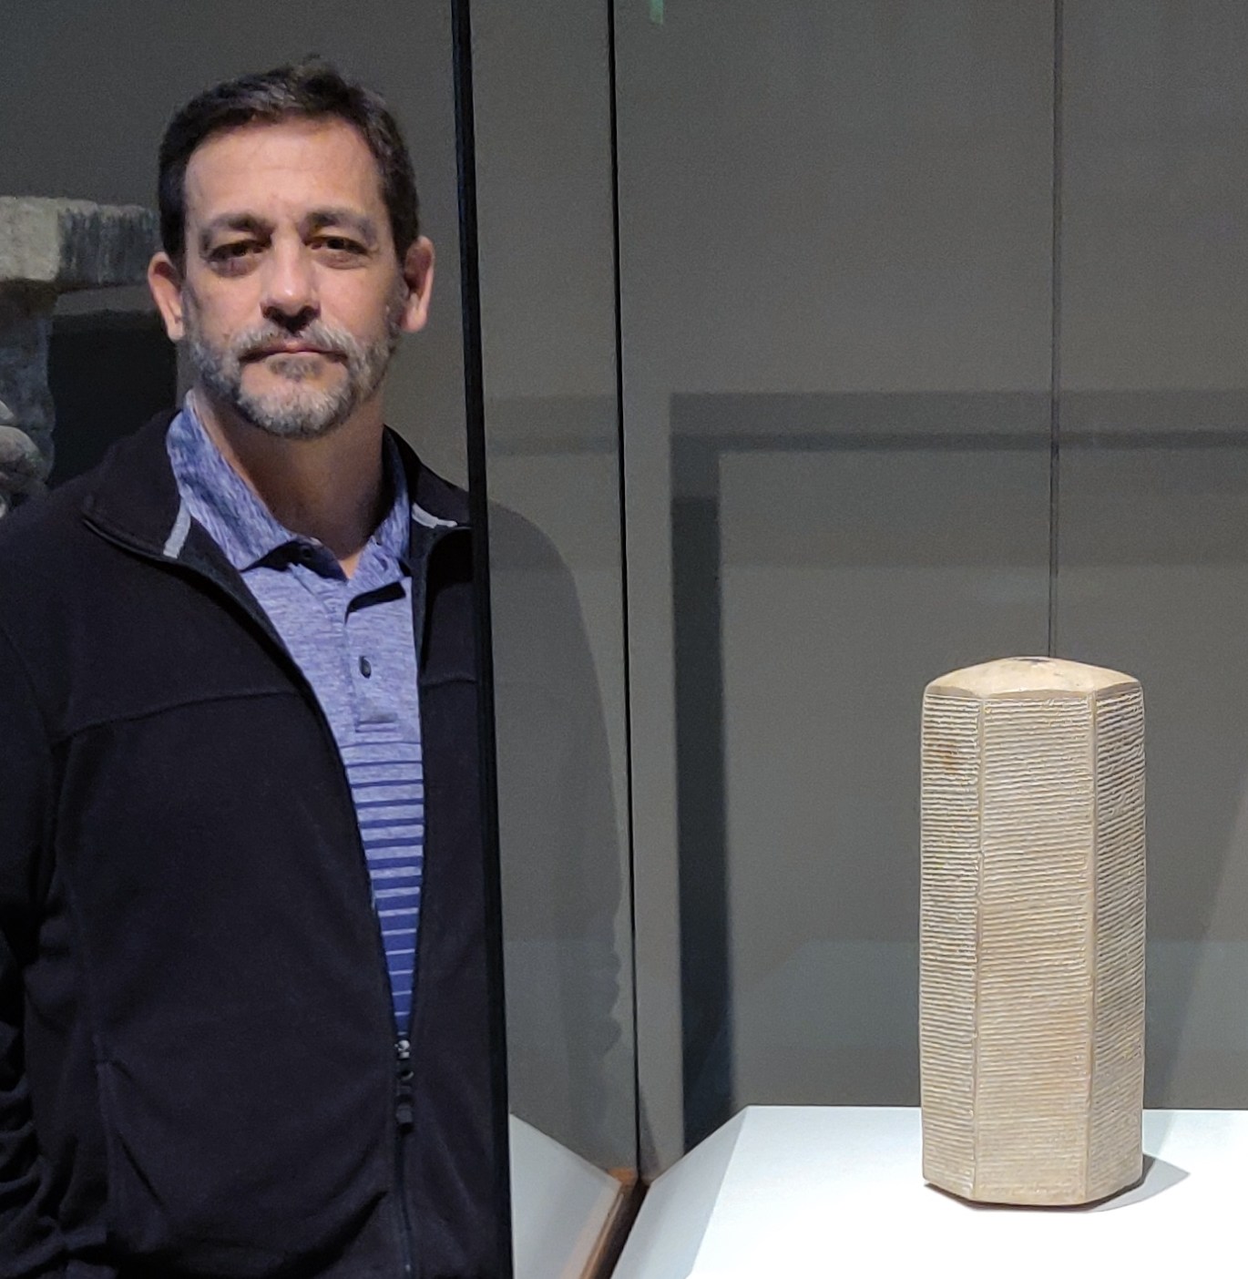
Prism of Sennacherib
Oriental Institute of Chicago
Dated, 689 B.C.
“As for Hezekiah, I shut him up like a caged bird in his royal city of Jerusalem.”
Notes:
The picture on the screen is of an archaeological discovery called the Sennacherib Prism. It first came to light after being purchased from a Bagdad antiquities dealer by a man named James Breasted for the Oriental Institute of Chicago in 1919.
It is one of 3 almost identical prisms which exist, dated to 689 B.C. (contemporary to Sennacheribs’s reign).
The prism contains six paragraphs of cuneiform text.
It is hexagonal in shape, made of red baked clay, and stands about 15 inches hight, and is about 5.5” wide.
The picture on the left is to give it some scale. (I was fortunate to visit the institute in April).
The Prism contains the military exploits of the King as the Assyrian empire expanded.
The Biblically significant part of the text gives the boast of Sennacherib regarding Judah
"As for the king of Judah, Hezekiah, who had not submitted to my authority, I besieged and captured forty-six of his fortified cities, along with many smaller towns, taken in battle with my battering rams. ... I took as plunder 200,150 people, both small and great, male and female, along with a great number of animals including horses, mules, donkeys, camels, oxen, and sheep. As for Hezekiah, I shut him up like a caged bird in his royal city of Jerusalem. I then constructed a series of fortresses around him, and I did not allow anyone to come out of the city gates. His towns which I captured I gave to the kings of Ashod, Ekron, and Gaza.“
Significance?
Sennacherib had boasted he would do to Hezekiah and he did to the nations around him.
However, though he besieged the city of Jerusalem, he did not destroy the city, nor did he take the nation into captivity as he did the northern kingdom.
What happened?

Slide 3
God Delivered Judah!
The King Petitioned the Prophet
(37:1-4)
The Prophet Promised Deliverance (37:5-7)
Hezekiah Prayed to God
(37:15-20)
God Delivered Judah
(37:36-38)
Notes:
What Happened, is that God Delivered Judah from destruction by the Hand of Sennacherib, the Mighty King of Assyria
The King Petitioned the Prophet
(Isaiah 37:1-4), “And so it was, when King Hezekiah heard it, that he tore his clothes, covered himself with sackcloth, and went into the house of the Lord. ² Then he sent Eliakim, who was over the household, Shebna the scribe, and the elders of the priests, covered with sackcloth, to Isaiah the prophet, the son of Amoz. ³ And they said to him, “Thus says Hezekiah: ‘This day is a day of trouble and rebuke and blasphemy; for the children have come to birth, but there is no strength to bring them forth. ⁴ It may be that the Lord your God will hear the words of the Rabshakeh, whom his master the king of Assyria has sent to reproach the living God, and will rebuke the words which the Lord your God has heard. Therefore lift up your prayer for the remnant that is left.’ ”
The Prophet Promised Deliverence
(Isaiah 37:5-7), “So the servants of King Hezekiah came to Isaiah. ⁶ And Isaiah said to them, “Thus you shall say to your master, ‘Thus says the Lord: “Do not be afraid of the words which you have heard, with which the servants of the king of Assyria have blasphemed Me. ⁷ Surely I will send a spirit upon him, and he shall hear a rumor and return to his own land; and I will cause him to fall by the sword in his own land.’ ”
Notice Good King Hezekiah’s Prayer to God
(Isaiah 37:15-20), “Then Hezekiah prayed to the Lord, saying: ¹⁶ ‘O Lord of hosts, God of Israel, the One who dwells between the cherubim, You are God, You alone, of all the kingdoms of the earth. You have made heaven and earth. ¹⁷ Incline Your ear, O Lord, and hear; open Your eyes, O Lord, and see; and hear all the words of Sennacherib, which he has sent to reproach the living God. ¹⁸ Truly, Lord, the kings of Assyria have laid waste all the nations and their lands, ¹⁹ and have cast their gods into the fire; for they were not gods, but the work of men's hands—wood and stone. Therefore they destroyed them. ²⁰ Now therefore, O Lord our God, save us from his hand, that all the kingdoms of the earth may know that You are the Lord, You alone.’ ”
God Delivered as He promised He would
(Isaiah 37:36-38), “Then the angel of the Lord went out, and killed in the camp of the Assyrians one hundred and eighty-five thousand; and when people arose early in the morning, there were the corpses—all dead. ³⁷ So Sennacherib king of Assyria departed and went away, returned home, and remained at Nineveh. ³⁸ Now it came to pass, as he was worshiping in the house of Nisroch his god, that his sons Adrammelech and Sharezer struck him down with the sword; and they escaped into the land of Ararat. Then Esarhaddon his son reigned in his place.”
A few short lessons we from what we just read…
Ultimately, it is God who determines the fate of nations
(Acts 17:26), “And He has made from one blood every nation of men to dwell on all the face of the earth, and has determined their preappointed times and the boundaries of their dwellings”
Intercession and Entreaty can sway the decisions God makes
(1 Timothy 2:1-2), “Therefore I exhort first of all that supplications, prayers, intercessions, and giving of thanks be made for all men, ² for kings and all who are in authority, that we may lead a quiet and peaceable life in all godliness and reverence.”
God is capable of protecting His own
(Isaiah 41:10), “Fear not, for I am with you; be not dismayed, for I am your God. I will strengthen you, yes, I will help you, I will uphold you with My righteous right hand.”

Slide 4
Lessons to Learn
There are many today who seek to elevate themselves against God
(Romans 1:28-32)
God is Sovereign (Obadiah 3-4)
For us, Victory is in Jesus
(Romans 8:28-39)
Notes:
Lessons to Learn
There are many today who seek to elevate themselves against God
The foolish boasts of the atheists, as an example
19th Century German Philosopher Friedrich Nietzsche if famous for saying, God is dead. He meant by this not that God once existed, but does no more. Rather, that we no longer need the idea of God, because our modern society has progressed to the point where such superstition is no longer relevant.
Nietzsche wrote "God is Dead; but given the way of men, there may still be caves for thousands of years in which his shadow will be shown. And we — we still have to vanquish his shadow, too."
The foolish words of the proud and self reliant (Beatles)
On August 11, 1966, John Lennon said, “Christianity will go. It will vanish and shrink. I needn’t argue about that; I know I’m right and I will be proved right. We’re more popular than Jesus now. I don’t know which will go first – rock & roll or Christianity.”
Lyrics to Imagine (beautiful melody), “Imagine there's no heaven / It's easy if you try / No hell below us / Above us only sky / Imagine all the people / Living for today. / Imagine there's no countries / It isn't hard to do / Nothing to kill or die for / And no religion, too / …You may say that I'm a dreamer / But I'm not the only one / I hope someday you'll join us / And the world will be as one.”
The attacks only grow stronger everyday. Attacks against Jesus and His followers in our time have served to marginalize all who name His name.
In June, 2017 after a terrorist attack in London that left 6 dead and and more than 40 injured, Michael Stone wrote an article titled (Don’t Pray for London – Reject Religious Extremism). Following is a quote from the article: “The uncomfortable truth is the God that both the terrorists and the non-terrorists alike beseech with their prayers is useless, or worse … The uncomfortable truth that many cannot accept is that God most probably does not exist, and that prayers are ultimately futile gestures – empty expressions of existential desperation and metaphysical confusion.”
Just wait after the horrible, hateful, terroristic shooting yesterday in El Paso. There will be many who will express contempt and express vile words against Christians who have the temerity to pray for those who have been killed or injured, as well as for the families.
God’s relevance does not change just because men deny it!
(Romans 1:28-32), “And even as they did not like to retain God in their knowledge, God gave them over to a debased mind, to do those things which are not fitting; ²⁹ being filled with all unrighteousness, sexual immorality, wickedness, covetousness, maliciousness; full of envy, murder, strife, deceit, evil-mindedness; they are whisperers, ³⁰ backbiters, haters of God, violent, proud, boasters, inventors of evil things, disobedient to parents, ³¹ undiscerning, untrustworthy, unloving, unforgiving, unmerciful; ³² who, knowing the righteous judgment of God, that those who practice such things are deserving of death, not only do the same but also approve of those who practice them.”
God is Sovereign
His sovereignty shows it is useless to contend with or boast against Him!
God condemned the pride of Edom, who treated Israel treacherously, and thought that her natural protections would spare her from consequence
(Obadiah 3-4), “The pride of your heart has deceived you, you who dwell in the clefts of the rock, whose habitation is high; you who say in your heart, ‘Who will bring me down to the ground?’ ⁴ Though you ascend as high as the eagle, and though you set your nest among the stars, from there I will bring you down,” says the Lord.”
For us, Victory is in Jesus
(Romans 8:28-39), “And we know that all things work together for good to those who love God, to those who are the called according to His purpose. ²⁹ For whom He foreknew, He also predestined to be conformed to the image of His Son, that He might be the firstborn among many brethren. ³⁰ Moreover whom He predestined, these He also called; whom He called, these He also justified; and whom He justified, these He also glorified. ³¹ What then shall we say to these things? If God is for us, who can be against us? ³² He who did not spare His own Son, but delivered Him up for us all, how shall He not with Him also freely give us all things? ³³ Who shall bring a charge against God's elect? It is God who justifies. ³⁴ Who is he who condemns? It is Christ who died, and furthermore is also risen, who is even at the right hand of God, who also makes intercession for us. ³⁵ Who shall separate us from the love of Christ? Shall tribulation, or distress, or persecution, or famine, or nakedness, or peril, or sword? ³⁶ As it is written: “For Your sake we are killed all day long; We are accounted as sheep for the slaughter.” ³⁷ Yet in all these things we are more than conquerors through Him who loved us. ³⁸ For I am persuaded that neither death nor life, nor angels nor principalities nor powers, nor things present nor things to come, ³⁹ nor height nor depth, nor any other created thing, shall be able to separate us from the love of God which is in Christ Jesus our Lord.”

