Slide 2
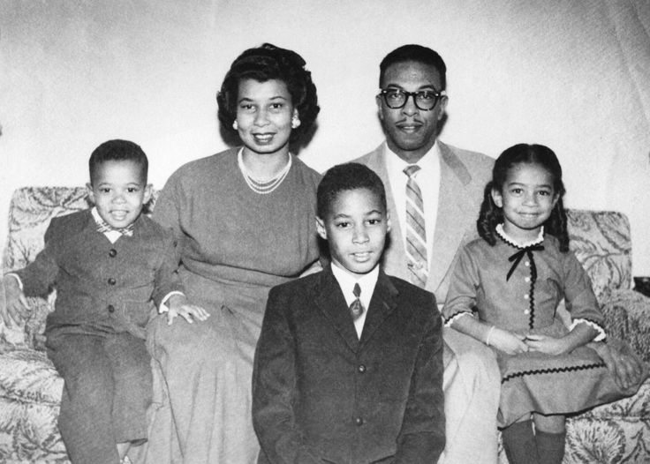

Slide 3
Therefore what God has joined together, let not man separate.
Matthew 19:6

Slide 4
Agree that your marriage is a covenant (Gen 2:22; Mal 2:14)
Agree to make your marriage succeed (1 Cor 7:10-11)
Agree to fulfill your individual roles (Eph 5:22-33)

Slide 5
One Man + One Woman = Lifetime (Gen 2:18-24)
Marriage forms a Companionship (Mal 2:14)
Leave & be Joined (cleave) to spouse (Matt 19:5)

Slide 6
Always speak the truth to each other (v25)
Don’t let the sun set on your anger (v26)
Put away all corrupt words (v29)

