Slide 2
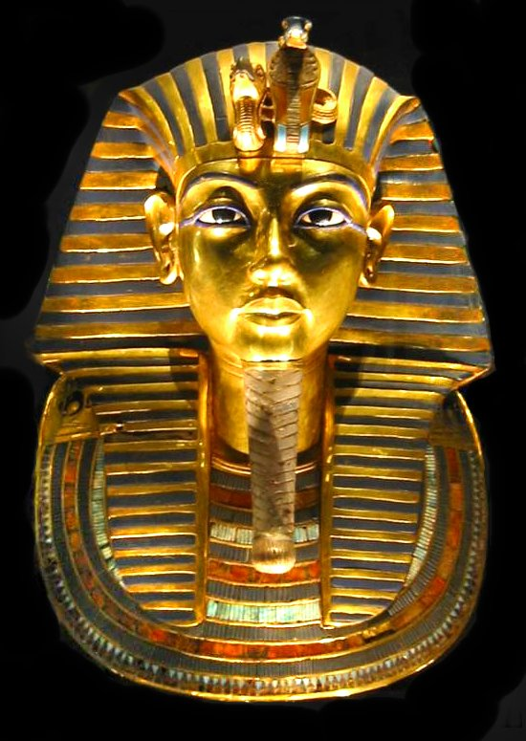
And I will harden Pharaoh’s heart, and multiply My signs and My wonders in the land of Egypt (Exod 7:3).
Then the magicians of Egypt did so with their enchantments; and Pharaoh’s heart grew hard, and he did not heed them, as the Lord had said (Exod 7:22).
But when Pharaoh saw that there was relief, he hardened his heart and did not heed them, as the Lord had said (Exod 8:15).

