Slide 1
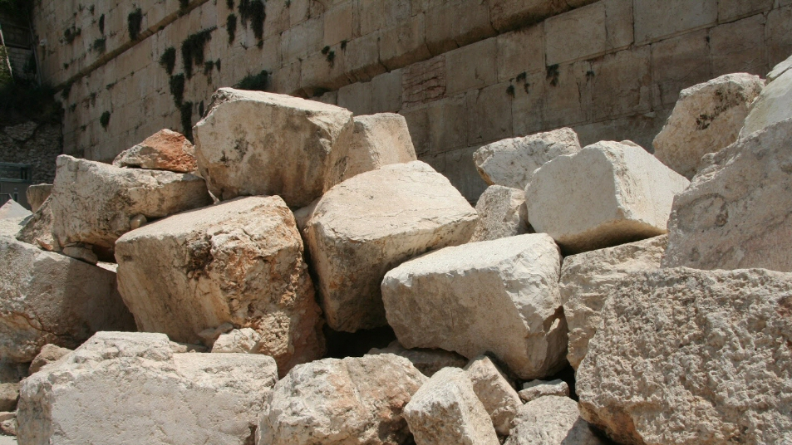
Building for the Lord
Nehemiah 2:17-20
Notes:
Nehemiah finds the beloved city of his fathers in ruins.
Had been destroyed about 150 years before by Babylon.
Was still in ruins about 100 years after the return from captivity.
Nehemiah rallies the people to rise up and rebuild the wall.
(Nehemiah 2:17-20) READ
They finished it ahead of schedule in spite of many problems.
They leave us an example for help us in building up any congregation.
Nehemiah and his people had some traits needed to build and rebuild for the Lord.
Based on outline by Ed Bragwell

Slide 2
Building for the Lord
They had a working mentality
  (2:18; 4:6; Ephesians 4:16)
Notes:
Nehemiah was a great leader, but people had mind to work (4:6; 2:18).
(2:18), “And I told them of the hand of my God which had been good upon me, and also of the king's words that he had spoken to me. So they said, "Let us rise up and build." Then they set their hands to this good work.”
(4:6), “So we built the wall, and the entire wall was joined together up to half its height, for the people had a mind to work.”
Leadership can do little unless people want to work. True of any organization. Especially true of the church
(Ephesians 4:16), [the body of Christ] “…the whole body, joined and knit together by what every joint supplies, according to the effective working by which every part does its share, causes growth of the body for the edifying of itself in love.”
(Acts 8:4), [Christ preached in Samaria], “Therefore those who were scattered went everywhere preaching the word.”
(Acts 11:29), [Benevolent work during famine], “Then the disciples, each according to his ability, determined to send relief to the brethren dwelling in Judea.”
A working mentality will minimize many internal problems. (Too mentally involved for petty strife and criticism. Too absorbed to notice most irritations of brethren.)

Slide 3
Building for the Lord
They had a working mentality
  (2:18; 4:6; Ephesians 4:16)
They had a balanced approach
  (4:16-17; 2 Timothy 4:2-4; Jude 3)
Notes:
They Had a Balanced Approach. They mixed weapons with work
(4:16-17), “So it was, from that time on, that half of my servants worked at construction, while the other half held the spears, the shields, the bows, and wore armor; and the leaders were behind all the house of Judah. ¹⁷ Those who built on the wall, and those who carried burdens, loaded themselves so that with one hand they worked at construction, and with the other held a weapon.”
Weapons without work would have left the wall in ruins. Work without weapons would made the work impossible.
Churches are not built up by either weapons or work alone.
It takes a lot of planting, watering, teaching, exhorting
(2 Timothy 4:2-4), “Preach the word! Be ready in season and out of season. Convince, rebuke, exhort, with all longsuffering and teaching. ³ For the time will come when they will not endure sound doctrine, but according to their own desires, because they have itching ears, they will heap up for themselves teachers; ⁴ and they will turn their ears away from the truth, and be turned aside to fables.”
It also takes a lot of contending for the faith
(Jude 3), “Beloved, while I was very diligent to write to you concerning our common salvation, I found it necessary to write to you exhorting you to contend earnestly for the faith which was once for all delivered to the saints.”

Slide 4
Building for the Lord
They had a working mentality
  (2:18; 4:6; Ephesians 4:16)
They had a balanced approach
  (4:16-17; 2 Timothy 4:2-4; Jude 3)
They were hindrance resistant
  (4:1-3; 4:7-8; 6:1-9)
Notes:
Unhindered by ridicule from enemies
(4:1-3), READ
Unhindered by open threats to attack (They fortified themselves by keeping working)
(4:7-8), READ, cf. 14-15
Unhindered by subtle efforts to stop the work
(6:1-4), READ
Unhindered by unfounded rumors
(6:5-9), READ
Unhindered because they believed they were doing a great work
(6:3), READ

Slide 5
Building for the Lord
They had a working mentality
  (2:18; 4:6; Ephesians 4:16)
They had a balanced approach
  (4:16-17; 2 Timothy 4:2-4; Jude 3)
They were hindrance resistant
  (4:1-3; 4:7-8; 6:1-9)
They were responsibility conscious
  (8:7-8; cf. Ephesians 4:11-16)
Notes:
They Were Responsibility Conscious. (“The people stood in their place”)
(8:7-8), “Also Jeshua, Bani, Sherebiah, Jamin, Akkub, Shabbethai, Hodijah, Maaseiah, Kelita, Azariah, Jozabad, Hanan, Pelaiah, and the Levites, helped the people to understand the Law; and the people stood in their place. ⁸ So they read distinctly from the book, in the Law of God; and they gave the sense, and helped them to understand the reading.”
Churches are built up each member standing in his place.
The Leaders aware their place of responsibility and stand in it.
Other members aware of their place responsibility and stand in it.
When each does his share the whole body is built up
(Ephesians 4:11-16), READ

Slide 6
Conclusion
We should follow the example of those who rebuilt the walls of Jerusalem
Get involved in building up the LORD’s house!
Notes:
Conclusion: A. Let’s all get involved in greatest work in the work — building up the LORD’s house. B. Let us follow the example of those who rebuilt the walls of Jerusalem

