Slide 1
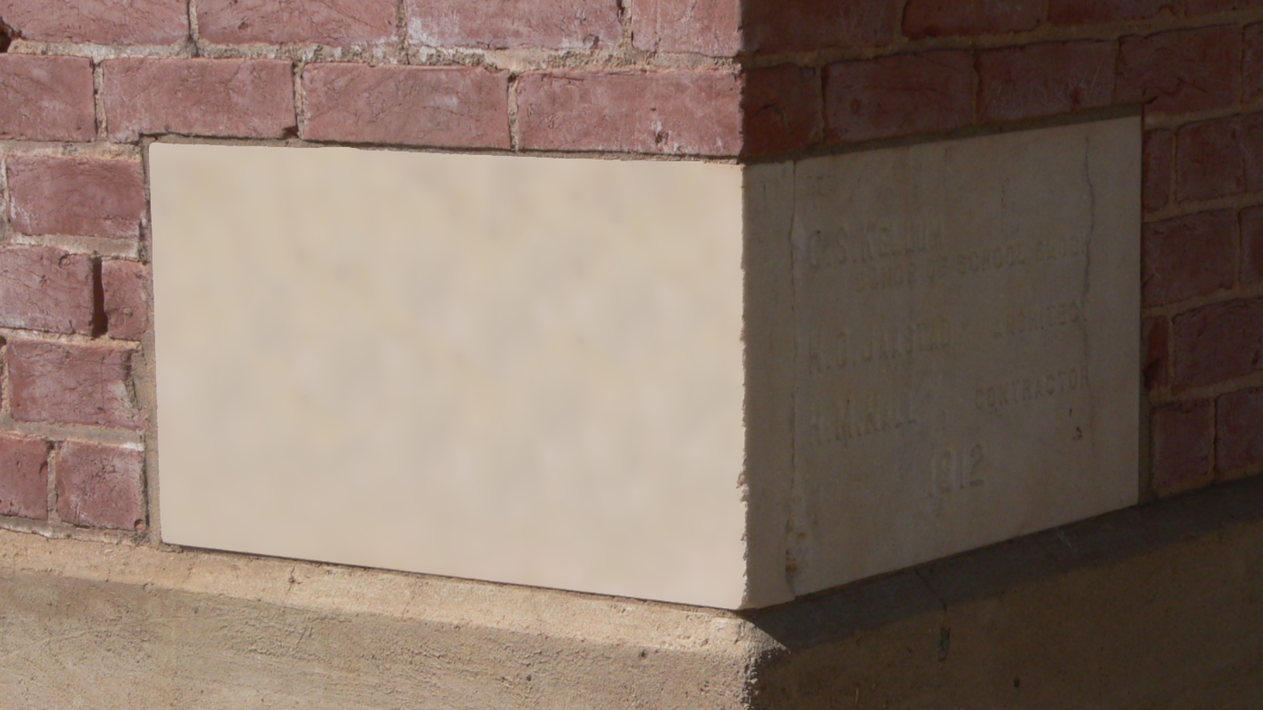
CHOSEN
The Stone
&
His People
1 Peter 2:4-10
Notes:
Introduction:
(1 Peter 2:1-3), “Therefore, laying aside all malice, all deceit, hypocrisy, envy, and all evil speaking, ² as newborn babes, desire the pure milk of the word, that you may grow thereby, ³ if indeed you have tasted that the Lord is gracious.”
These verses are important to the context of our study
Peter’s first figure is that of a newborn babe, who desires God’s will
He refrains from immorality, which violates God’s will for man
He desires to learn from God’s words, to know God’s will for Him
He begins to grow as he applies himself
This application of oneself, to grow and to draw near to God, is referred to in verse 4 as “coming to Him as to a living stone.”
Later, the Christian is likewise referred to as a living stone, but verse 4 refers to Jesus as a living stone
This might not be apparent in the NKJV translation, but it is in the Greek. That is why the text reads “as to” rather than “as.”
(1 Peter 2:4-10), “Coming to Him as to a living stone, rejected indeed by men, but chosen by God and precious, ⁵ you also, as living stones, are being built up a spiritual house, a holy priesthood, to offer up spiritual sacrifices acceptable to God through Jesus Christ. ⁶ Therefore it is also contained in the Scripture, “Behold, I lay in Zion a chief cornerstone, elect, precious, and he who believes on Him will by no means be put to shame.” ⁷ Therefore, to you who believe, He is precious; but to those who are disobedient, “the stone which the builders rejected has become the chief cornerstone,” ⁸ and “a stone of stumbling and a rock of offense.” They stumble, being disobedient to the word, to which they also were appointed. ⁹ But you are a chosen generation, a royal priesthood, a holy nation, His own special people, that you may proclaim the praises of Him who called you out of darkness into His marvelous light; ¹⁰ who once were not a people but are now the people of God, who had not obtained mercy but now have obtained mercy.”
Note: AS CHRISTIANS, we are told to “come to” Jesus
Coming to Christ is an ongoing thing
An alien sinner comes to Christ through obedience to the gospel./
But, we must continue to draw close to Him through growth
(2 Peter 1:5-11), “But also for this very reason, giving all diligence, add to your faith virtue, to virtue knowledge, ⁶ to knowledge self-control, to self-control perseverance, to perseverance godliness, ⁷ to godliness brotherly kindness, and to brotherly kindness love. ⁸ For if these things are yours and abound, you will be neither barren nor unfruitful in the knowledge of our Lord Jesus Christ. ⁹ For he who lacks these things is shortsighted, even to blindness, and has forgotten that he was cleansed from his old sins. ¹⁰ Therefore, brethren, be even more diligent to make your call and election sure, for if you do these things you will never stumble; ¹¹ for so an entrance will be supplied to you abundantly into the everlasting kingdom of our Lord and Savior Jesus Christ.”
Paul agrees with this call
(Philippians 2:12), “Therefore, my beloved, as you have always obeyed, not as in my presence only, but now much more in my absence, work out your own salvation with fear and trembling.”
Our Text changes the imagery to that of stones. Jesus as the chief cornerstone, and us as living stones
There are many good lessons to be learned by examining Peter’s thoughts here: Starting with his characterization of the Christ

Slide 2

Jesus – God’s Chosen
A living stone (4)
  1 Corinthians 15:17-20
Rejected by Men (4)
  Acts 2:22-23; 7:51-53
Chosen by God (4)
  Acts 2:24,36; Isa. 42:1
Chief cornerstone (6)
  Eph. 2:19-22; 1 Cor. 3:11
Savior of man (6)
  1 Peter 1:3
A stone of stumbling & rock of offense (8)
  Mark 16:15-16
Notes:
Jesus God’s Chosen
Living stone (4) – (zōnta) Thayer – to live, be among the living, be alive.
Though the metaphor utilizes inanimate objects, it is applied to Jesus and Christians as living beings.
Yes, Jesus died on the cross, but a chief doctrine of the scriptures is that Jesus is alive!
(John 5:26), “For as the Father has life in Himself, so He has granted the Son to have life in Himself.”
(1 Corinthians 15:17-20), “And if Christ is not risen, your faith is futile; you are still in your sins! ¹⁸ Then also those who have fallen asleep in Christ have perished. ¹⁹ If in this life only we have hope in Christ, we are of all men the most pitiable. ²⁰ But now Christ is risen from the dead, and has become the firstfruits of those who have fallen asleep.”
Rejected by men (4)
(Acts 2:22-23), “Men of Israel, hear these words: Jesus of Nazareth, a Man attested by God to you by miracles, wonders, and signs which God did through Him in your midst, as you yourselves also know— ²³ Him, being delivered by the determined purpose and foreknowledge of God, you have taken by lawless hands, have crucified, and put to death.”
(Acts 7:51-53), “You stiff-necked and uncircumcised in heart and ears! You always resist the Holy Spirit; as your fathers did, so do you. ⁵² Which of the prophets did your fathers not persecute? And they killed those who foretold the coming of the Just One, of whom you now have become the betrayers and murderers, ⁵³ who have received the law by the direction of angels and have not kept it.”
Chosen by God (4)
(Acts 2:24,36), “whom God raised up, having loosed the pains of death, because it was not possible that He should be held by it…” (36), “Therefore let all the house of Israel know assuredly that God has made this Jesus, whom you crucified, both Lord and Christ.”
(Isaiah 42:1), “Behold! My Servant whom I uphold, My Elect One in whom My soul delights! I have put My Spirit upon Him; He will bring forth justice to the Gentiles.”
Chief Cornerstone (6) Note: Verse 6 is a quotation from Psalm 118:22
Jesus quoted this text, referring to Himself in Matthew 21:42.
Peter attributes it to Jesus as well.
God made the rejected stone the chief cornerstone!
Cornerstone - of great importance in binding together the sides of a building. The phrase "corner-stone" is sometimes used to denote any principal person, as the princes of Egypt, Isa_19:13, and is thus, applied to our Lord. Isa_28:16; Mat_21:42; 1Pe_2:6-7. (Smith’s Bible Dictionary)
Most often a foundational stone, but sometimes a capstone that ties the final stones together in the building.
The princes of Egypt
(Isaiah 19:13), “The princes of Zoan have become fools; The princes of Noph are deceived; They have also deluded Egypt, Those who are the mainstay [corner-stone] of its tribes.”
Another prophecy regarding the Christ
(Isaiah 28:16), “Therefore thus says the Lord God: “Behold, I lay in Zion a stone for a foundation, a tried stone, a precious cornerstone, a sure foundation; whoever believes will not act hastily.”
Consider the truth established by the Apostles’ pens
(Ephesians 2:19-22), “Now, therefore, you are no longer strangers and foreigners, but fellow citizens with the saints and members of the household of God, ²⁰ having been built on the foundation of the apostles and prophets, Jesus Christ Himself being the chief cornerstone, ²¹ in whom the whole building, being fitted together, grows into a holy temple in the Lord, ²² in whom you also are being built together for a dwelling place of God in the Spirit.”
(1 Corinthians 3:11), “For no other foundation can anyone lay than that which is laid, which is Jesus Christ.”
Savior of Man (6), “he who believes on Him will by no means be put to shame.”
Sense of the word “ashamed” as explained by Thayer – “one is said to be put to shame who suffers a repulse, or whom some hope has deceived”
Our hope as Christians, in that it is in Christ, is not a false hope! We will not be disappointed!
(1 Peter 1:3), “Blessed be the God and Father of our Lord Jesus Christ, who according to His abundant mercy has begotten us again to a living hope through the resurrection of Jesus Christ from the dead.”
A stone of stumbling & rock of offense (8),
For the Christian, this precious stone is the same stone that the ungodly resent and reject
“They stumble, being disobedient to the word, to which they also were appointed” (8).
Jesus Christ greatly annoyed the religious leaders of the day
His death on the cross did not suit the Jews who had a different conception of the Messiah
So, they despised and rejected Him!
Note: Their disobedience was (and now is) the cause of their stumbling and offense.
(Mark 16:15-16), “And He said to them, “Go into all the world and preach the gospel to every creature. ¹⁶ He who believes and is baptized will be saved; but he who does not believe will be condemned.”

Slide 3
The Elect – Living Stones
A spiritual house (5)
  Ephesians 4:16
Priesthood (5,9)
  2 Pet. 1:15-16; Rev. 1:6
Protected by Jesus (6)
  John 10:28-30
Chosen, holy, special (9)
  2 Cor. 7:1; 1 Cor. 6:9-11
Purpose (9)
  Matt. 5:16; Isaiah 43:21
People of God (10)
  Hosea 1:9-11; Romans 9:24-26
Notes:
The Elect – living stones
A spiritual house (5) “being built up a spiritual house”
Again, though stones, not inanimate or inert. Living stones, making up a spiritual house
This indicates an important point, similar to another metaphor (that of the body)
Every part of the body, and every stone in the house has a part to play, and is needed!
(Ephesians 4:16), “from whom the whole body, joined and knit together by what every joint supplies, according to the effective working by which every part does its share, causes growth of the body for the edifying of itself in love.”
Consider the fact that this house is not finished “being built”
Other stones are added, some are removed, and this will continue until the work of redeeming men is complete on earth!
A holy priesthood – royal priesthood (5,9)
Holy (vs. 5) indicates a priesthood that has been set apart for God… exclusively His
This requires holy action on our part
(2 Peter 1:15-16), “but as He who called you is holy, you also be holy in all your conduct, ¹⁶ because it is written, “Be holy, for I am holy.”
Contrast with Nadab and Abihu, punished by God because they did not respect His holiness
(Leviticus 10:3), “And Moses said to Aaron, “This is what the Lord spoke, saying: ‘By those who come near Me I must be regarded as holy; and before all the people I must be glorified.’ ” So Aaron held his peace.”
Royal (vs. 9) indicates kingship. (Interesting, in that Jesus Himself is priest after Melchizedek. King and Priest
Our priesthood is likewise after Melchizedek! Christ is our King, and we have the privileges of citizenship in His kingdom! Because we are His, our priesthood is regal, or kingly.
(Revelation 1:5-6), “and from Jesus Christ, the faithful witness, the firstborn from the dead, and the ruler over the kings of the earth. To Him who loved us and washed us from our sins in His own blood, ⁶ and has made us kings and priests to His God and Father, to Him be glory and dominion forever and ever. Amen.”
Protected – “by no means be put to shame” (6) (Referencing Christ as our Savior, from previous slide)
Jesus Christ is not only faithful concerning the hope he offers, He is also capable!
(John 10:28-30), “And I give them eternal life, and they shall never perish; neither shall anyone snatch them out of My hand. ²⁹ My Father, who has given them to Me, is greater than all; and no one is able to snatch them out of My Father's hand. ³⁰ I and My Father are one.”
Chosen generation, holy nation, His own special people (9)
Chosen generation (geno) – Thayer – “offspring, family, stock, race” – Our election is as a group. Individually we determine whether we are part of that group. (Are we part of that family or nation).
(John 3:16), “And I give them eternal life, and they shall never perish; neither shall anyone snatch them out of My hand. ²⁹ My Father, who has given them to Me, is greater than all; and no one is able to snatch them out of My Father's hand. ³⁰ I and My Father are one.”
Holy nation – (hagios) (already discussed as “holy priesthood.”
Israel was a holy nation, separated to God, and different than the Pagan nations around her
If she became like them, she lost the very thing that made her special to God!
So do we, that is why we MUST live holy lives. To be special and different. To be differentiated in the eyes of God!
(2 Corinthians 7:1), “Therefore, having these promises, beloved, let us cleanse ourselves from all filthiness of the flesh and spirit, perfecting holiness in the fear of God.”
His own special people – His (belonging to Him, His property or possession). Special (to be over and above).
Those who are redeemed, are set apart completely from ALL OTHERS!
(1 Corinthians 6:9-11), “Do you not know that the unrighteous will not inherit the kingdom of God? Do not be deceived. Neither fornicators, nor idolaters, nor adulterers, nor homosexuals, nor sodomites, ¹⁰ nor thieves, nor covetous, nor drunkards, nor revilers, nor extortioners will inherit the kingdom of God. ¹¹ And such were some of you. But you were washed, but you were sanctified, but you were justified in the name of the Lord Jesus and by the Spirit of our God.”
Purpose – to proclaim the praises of Him (9)
We can proclaim our God (the one who called us out of darkness) by our example
(Matthew 5:16), “Let your light so shine before men, that they may see your good works and glorify your Father in heaven.”
We can also proclaim the praises of Him through the fruit of our lips (testimony, songs, prayers).
(Isaiah 43:21), “This people I have formed for Myself; they shall declare My praise.”
From no people to God’s people (having obtained mercy) (10)
The idea of being a people (having an identity) that is “of God” brings great hope and joy!
Consider the prophecy concerning the restoration of Israel in Hosea 1.
(Hosea 1:9-11) [Third child of Hosea and Gomer], “Then God said: “Call his name Lo-Ammi, for you are not My people, and I will not be your God. ¹⁰ “Yet the number of the children of Israel shall be as the sand of the sea, which cannot be measured or numbered. And it shall come to pass in the place where it was said to them, ‘You are not My people,’ There it shall be said to them, ‘You are sons of the living God.’ ¹¹ Then the children of Judah and the children of Israel shall be gathered together, and appoint for themselves one head; and they shall come up out of the land, for great will be the day of Jezreel!”
Paul applied this passage to the Gentiles as well in Romans 9
(Romans 9:24-26), “even us whom He called, not of the Jews only, but also of the Gentiles? ²⁵ As He says also in Hosea: “I will call them My people, who were not My people, and her beloved, who was not beloved.” ²⁶ “And it shall come to pass in the place where it was said to them, ‘You are not My people,’ there they shall be called sons of the living God.”

Slide 4
Conclusion
Proclaim the praises of the chief-cornerstone!
Live our lives in sanctification and zeal!
Psalm 24:7-10; 1 Peter 1:13-16
Notes:
We rejoice in the fact we are a people of God
It is special to be a holy nation, and royal priesthood, the special people of God.
As such, we should sing His praises, AND
(Psalm 24:7-10), “Lift up your heads, O you gates! And be lifted up, you everlasting doors! And the King of glory shall come in. ⁸ Who is this King of glory? The Lord strong and mighty, the Lord mighty in battle. ⁹ Lift up your heads, O you gates! Lift up, you everlasting doors! And the King of glory shall come in. ¹⁰ Who is this King of glory? The Lord of hosts, He is the King of glory.”
Live our lives as sanctified, zealous children of His.
(1 Peter 1:13-16), “Therefore gird up the loins of your mind, be sober, and rest your hope fully upon the grace that is to be brought to you at the revelation of Jesus Christ; ¹⁴ as obedient children, not conforming yourselves to the former lusts, as in your ignorance; ¹⁵ but as He who called you is holy, you also be holy in all your conduct, ¹⁶ because it is written, “Be holy, for I am holy.”

