Slide 1
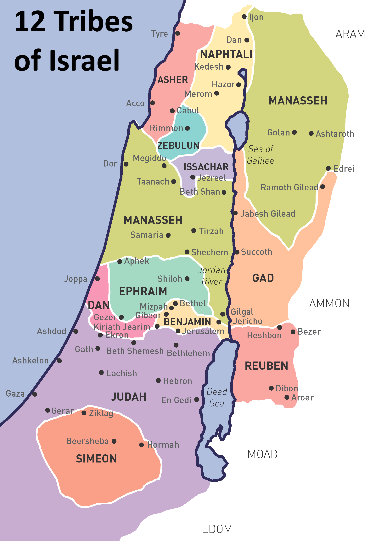
Dan a history of idolatry
Judges 18
“In those days there was no king in Israel; everyone did what was right in his own eyes.”
Judges 17:6
Notes:
Dan – A History of Idolatry
Judges 18
Introduction:
Dan was Jacob's fifth son, the first born to Bilhah, Rachel's maid.
Leah:Reuben1, Simeon2, Levi3, Judah 4, Issachar9, Zebulun10
Bilhah (Rachel's Maid):Dan5,Naphtali6,
Zilpah (Leah's Maid): Gad7, Asher8,
Rachel: Joseph11, Benjamin
[CLICK] Dan's inheritance, twestern slopes of mountains of Israel to sea.
We are told that the tribe of Dan was not successful in completely driving out the Amorites, in taking the inheritance of their land. They instead were "driven into the mountains, for they [the Amorites] would not allow them to come down to the valley." (Judges 1:34).
The portion assigned to Dan adjoined those of Ephraim, Benjamin and Judah, and lay on the western slopes of the mountain. The reference in Jdg_5:17 : “And Dan, why did he remain in ships?” seems to mean that on the West, Dan had reached the sea. But the passage is one of difficulty. We are told that the Amorites forced the children of Dan into the mountain (Jdg_1:34), so they did not enjoy the richest part of their ideal portion, the fertile plain between the mountain and the sea... Later we find Dan oppressed by the Philistines, against whom the heroic exploits of Samson were performed (Jdg 14ff)...
Judges 17 reveals a man named Micah from the mountains of Ephraim who used 200 shekels from his mother to make an idol. He then hired a priest, a man from the tribe of Levi, to be his personal priest.
We know this to be a time of lawlessness, superstition and ignorance in Israel.
Judges 17:6 In those days there was no king in Israel; everyone did what was right in his own eyes.
Micah actually thought that hiring a Levite (as a priest of an idol) would please the LORD God!
Judges 17:13 Then Micah said, "Now I know that the LORD will be good to me, since I have a Levite as priest!"
This is where a party of Danites come into the picture (Judges 18), as they try to find more land to dwell in (i.e. trying to do God's work for him!)
Five spies were sent to Micah's house, and they found the young Levite serving as his priest.
He sent them on to the city of Laish, which the Danites determined to make their own. (The people there were vulnerable to invastion, secure only in isolation from others).
They went and got a total of 600 men, and returned to the house of Michah, where we pick up the narrative:
(Judges 18:18-31) READ

Slide 2
Applications of the Text
The Sin of Anarchy (17:6; 18:1; 19:1) Romans 10:1-2
The Sin of Idolatry (18:30-31) 1 Kings 12:29-31; Acts 17:29
Our Choice: Culture? or God? 1 Corinthians 6:9-11; 1 Peter 4:3-5
Notes:
[NEW SLIDE: CLICK]
DISCUSSION:
Major Points to Make
The Sin of Anarchy
No king indicated 3 timeSs in the remote context
Judges 17:6 In those days there was no king in Israel; everyone did what was right in his own eyes.
Judges 18:1 In those days there was no king in Israel. And in those days the tribe of the Danites was seeking an inheritance for itself to dwell in; for until that day their inheritance among the tribes of Israel had not fallen to them.
Judges 19:1 And it came to pass in those days, when there was no king in Israel, that there was a certain Levite staying in the remote mountains of Ephraim. He took for himself a concubine from Bethlehem in Judah.
Note: The Kings were appointed to make the people serve God (David, Josiah, etc.)
There was not authority other than the ignored ultimate authority
Every man did what he wanted, if he had the ability to do so (Micah) was taken advantage of, but Danites were unenbumbered by any desire other than their own!
Today, people (as in Jesus' day) still ignore the ultimate authority of God, both culturally and even religiously
Romans 10:1-4 Brethren, my heart's desire and prayer to God for Israel is that they may be saved. (2) For I bear them witness that they have a zeal for God, but not according to knowledge. (3) For they being ignorant of God's righteousness, and seeking to establish their own righteousness, have not submitted to the righteousness of God. (4) For Christ is the end of the law for righteousness to everyone who believes.
[CLICK] The Sin of Idolatry
Judges 18:30-31 Then the children of Dan set up for themselves the carved image; and Jonathan the son of Gershom, the son of Manasseh, and his sons were priests to the tribe of Dan until the day of the captivity of the land. (31) So they set up for themselves Micah's carved image which he made, all the time that the house of God was in Shiloh.
Note: The city of Dan was founded in idolatry. Remained idolatrous throughout the entire time that Jerusalem was the central place of worship, and continued in idolatry until taken away into Assyrian captivity.
[CLICK] Arrows to Dan and Bethel by Jereboam
It is not surprising the city would be open to Jeroboam setting up a northern place of worship to keep the people from Jerusalem.
1 Kings 12:28-31 Therefore the king asked advice, made two calves of gold, and said to the people, "It is too much for you to go up to Jerusalem. Here are your gods, O Israel, which brought you up from the land of Egypt!" (29) And he set up one in Bethel, and the other he put in Dan. (30) Now this thing became a sin, for the people went to worship before the one as far as Dan. (31) He made shrines on the high places, and made priests from every class of people, who were not of the sons of Levi.
The New Testament condemns idolatry with the shame strength found in the Old
Acts 17:29 Therefore, since we are the offspring of God, we ought not to think that the Divine Nature is like gold or silver or stone, something shaped by art and man's devising.
It is Our Choice!
Whether, Idolatry, immorality, or any other issue, that impacts man in our day, we must choose to follow our own unrighteous culture, or the Righteous God of Heaven!
1 Corinthians 6:9-11 Do you not know that the unrighteous will not inherit the kingdom of God? Do not be deceived. Neither fornicators, nor idolaters, nor adulterers, nor homosexuals, nor sodomites, (10) nor thieves, nor covetous, nor drunkards, nor revilers, nor extortioners will inherit the kingdom of God. (11) And such were some of you. But you were washed, but you were sanctified, but you were justified in the name of the Lord Jesus and by the Spirit of our God.
1 Peter 4:3-5 For we have spent enough of our past lifetime in doing the will of the Gentiles—when we walked in lewdness, lusts, drunkenness, revelries, drinking parties, and abominable idolatries. (4) In regard to these, they think it strange that you do not run with them in the same flood of dissipation, speaking evil of you. (5) They will give an account to Him who is ready to judge the living and the dead.

Slide 3
Conclusion
Ask yourself the question:
Men? Yourself? God?
“You will show me the path of life; In Your presence is fullness of joy; At Your right hand are pleasures forevermore.”
Psalms 16:11
Notes:
Conclusion:
The lesson of the Danites is an important one for us today!
We too can be guilty of anarchy, of idolatry, of being affected by the culture that surrounds us
1 Corinthians 10:7-12 And do not become idolaters as were some of them. As it is written, "THE PEOPLE SAT DOWN TO EAT AND DRINK, AND ROSE UP TO PLAY." (8) Nor let us commit sexual immorality, as some of them did, and in one day twenty-three thousand fell; (9) nor let us tempt Christ, as some of them also tempted, and were destroyed by serpents; (10) nor complain, as some of them also complained, and were destroyed by the destroyer. (11) Now all these things happened to them as examples, and they were written for our admonition, upon whom the ends of the ages have come. (12) Therefore let him who thinks he stands take heed lest he fall.
Ask yourself the question: Men, Yourself, or GOD!
Psalms 16:11 You will show me the path of life; In Your presence is fullness of joy; At Your right hand are pleasures forevermore.

