Slide 1
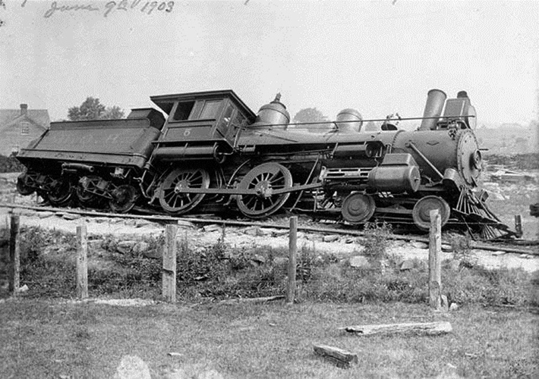
Derailed While Young
Ecclesiastes 11:9 – 12:1
Notes:
Important to follow God while young, lest you ruin or damage your life just as it is getting started!
(Ecclesiastes 11:9 – 12:1), “Rejoice, O young man, in your youth, And let your heart cheer you in the days of your youth; Walk in the ways of your heart, And in the sight of your eyes; But know that for all these God will bring you into judgment. ¹⁰ Therefore remove sorrow from your heart, And put away evil from your flesh, For childhood and youth are vanity. ^{(Chapter 12:1)} Remember now your Creator in the days of your youth, Before the difficult days come, And the years draw near when you say, "I have no pleasure in them":
Acknowledgement: This lesson taken from a sermon outline by Joe Price, which was in turn taken from an article, 10 Ways to Ruin Your Life in Your 20s by Jonathan Pokluda

Slide 2
10 Ways to Get Derailed
Imprudent Ideas (Genesis 2:16-17; 3:4)
Notes:
1) Believe that ideas don’t have consequences.
(Genesis 2:16-17), “And the Lord God commanded the man, saying, "Of every tree of the garden you may freely eat; ¹⁷ but of the tree of the knowledge of good and evil you shall not eat, for in the day that you eat of it you shall surely die."
(Genesis 3:4-5), “Then the serpent said to the woman, "You will not surely die. ⁵ For God knows that in the day you eat of it your eyes will be opened, and you will be like God, knowing good and evil."
REMEMBER
-The simple believe anything, but the prudent give thought to their steps. (Proverbs 14:15, ESV)

Slide 3
10 Ways to Get Derailed
Imprudent Ideas (Genesis 2:16-17; 3:4)
Foolish Spending (Ecclesiastes 2:10)
Notes:
Live outside your means.
(Ecclesiastes 2:10), “Whatever my eyes desired I did not keep from them. I did not withhold my heart from any pleasure, For my heart rejoiced in all my labor; And this was my reward from all my labor.”
a. When you spend more than you can afford, you still have to pay for it...plus interest. b. "Good times" now may mean "bad times" of debt later.
REMEMBER
-The rich rule over the poor, and the borrower is slave to the lender. (Proverbs 22:7, ESV)

Slide 4
10 Ways to Get Derailed
Imprudent Ideas (Genesis 2:16-17; 3:4)
Foolish Spending (Ecclesiastes 2:10)
Feeding Addiction (2 Peter 2:19)
Notes:
Feed an addiction
(2 Peter 2:19), “While they promise them liberty, they themselves are slaves of corruption; for by whom a person is overcome, by him also he is brought into bondage.”
Alcohol, money, sex, drugs, pornography, shopping... Addictions bring death, spiritually and sometimes physically, sometimes of relationships, freedom and joy
REMEMBER
-The righteousness of the upright delivers them, but the unfaithful are trapped by evil desires. (Proverbs 11:6, ESV)

Slide 5
10 Ways to Get Derailed
Imprudent Ideas (Genesis 2:16-17; 3:4)
Foolish Spending (Ecclesiastes 2:10)
Feeding Addiction (2 Peter 2:19)
Evil Companions (Proverbs 4:14-17)
Notes:
Run with fools.
(Proverbs 4:14-17), “Do not enter the path of the wicked, And do not walk in the way of evil.¹⁵ Avoid it, do not travel on it; Turn away from it and pass on. ¹⁶ For they do not sleep unless they have done evil; And their sleep is taken away unless they make someone fall. ¹⁷ For they eat the bread of wickedness, And drink the wine of violence.”
Hang around with faithless, idiots, addicts or criminals and that is what you will become; vice versa.
REMEMBER
-Walk with the wise and become wise, for a companion of fools suffers harm. (Proverbs 13:20, ESV)

Slide 6
10 Ways to Get Derailed
Imprudent Ideas (Genesis 2:16-17; 3:4)
Foolish Spending (Ecclesiastes 2:10)
Feeding Addiction (2 Peter 2:19)
Evil Companions (Proverbs 4:14-17)
Careless Affection (Proverbs 20:25)
Notes:
Carelessly give your heart away.
(Proverbs 20:25), “It is a snare for a man to devote rashly something as holy, And afterward to reconsider his vows.”
Example: Sexual purity - Only someone totally committed to protecting your heart will not break it or sin against it. Only give your heart away once, at your marriage!
REMEMBER
-Above all else, guard your heart, for everything you do flows from it. (Proverbs 4:23, ESV)

Slide 7
10 Ways to Get Derailed
Imprudent Ideas (Genesis 2:16-17; 3:4)
Foolish Spending (Ecclesiastes 2:10)
Feeding Addiction (2 Peter 2:19)
Evil Companions (Proverbs 4:14-17)
Careless Affection (Proverbs 20:25)
Toleration of Evil (Ephesians 5:5-7,11)
Notes:
Tolerate evil.
(Ephesians 5:5-7, 11), “For this you know, that no fornicator, unclean person, nor covetous man, who is an idolater, has any inheritance in the kingdom of Christ and God. ⁶ Let no one deceive you with empty words, for because of these things the wrath of God comes upon the sons of disobedience. ⁷ Therefore do not be partakers with them.”
(11), “And have no fellowship with the unfruitful works of darkness, but rather expose them.”
REMEMBER
-To fear the Lord is to hate evil; I hate pride and arrogance, evil behavior and perverse speech. (Proverbs 8:13, ESV)

Slide 8
10 Ways to Get Derailed
Imprudent Ideas (Genesis 2:16-17; 3:4)
Foolish Spending (Ecclesiastes 2:10)
Feeding Addiction (2 Peter 2:19)
Evil Companions (Proverbs 4:14-17)
Careless Affection (Proverbs 20:25)
Toleration of Evil (Ephesians 5:5-7,11)
Wrong Priorities (Matthew 6:33)
Notes:
Make secondary things ultimate and ultimate things secondary.
(Matthew 6:33), “But seek first the kingdom of God and His righteousness, and all these things shall be added to you.”
REMEMBER
-Keep falsehood and lies far from me; give me neither poverty nor riches, but give me only my daily bread. Otherwise, I may have too much and disown you and say, ‘Who is the Lord?’ Or I may become poor and steal, and so dishonor the name of my God. (Proverbs 30:8-9, ESV)

Slide 9
10 Ways to Get Derailed
Imprudent Ideas (Genesis 2:16-17; 3:4)
Foolish Spending (Ecclesiastes 2:10)
Feeding Addiction (2 Peter 2:19)
Evil Companions (Proverbs 4:14-17)
Careless Affection (Proverbs 20:25)
Toleration of Evil (Ephesians 5:5-7,11)
Wrong Priorities (Matthew 6:33)
Self Importance (Mark 10:42-45)
Notes:
Believe that this life is all about you.
(Mark 10:42-45), “But Jesus called them to Himself and said to them, " You know that those who are considered rulers over the Gentiles lord it over them, and their great ones exercise authority over them. ⁴³ Yet it shall not be so among you; but whoever desires to become great among you shall be your servant. ⁴⁴ And whoever of you desires to be first shall be slave of all. ⁴⁵ For even the Son of Man did not come to be served, but to serve, and to give His life a ransom for many."
REMEMBER (There are 7 billion people on earth, each soul precious in God’s eyes)
-Pride goes before destruction, a haughty spirit before a fall. (Proverbs 16:18, ESV)

Slide 10
10 Ways to Get Derailed
Imprudent Ideas (Genesis 2:16-17; 3:4)
Foolish Spending (Ecclesiastes 2:10)
Feeding Addiction (2 Peter 2:19)
Evil Companions (Proverbs 4:14-17)
Careless Affection (Proverbs 20:25)
Toleration of Evil (Ephesians 5:5-7,11)
Wrong Priorities (Matthew 6:33)
Self Importance (Mark 10:42-45)
Living for Immediate Gratification (1 Corinthians 9:25-27)
Notes:
Live for immediate gratification
(1 Corinthians 9:25-27), “And everyone who competes for the prize is temperate in all things. Now they do it to obtain a perishable crown, but we for an imperishable crown. ²⁶ Therefore I run thus: not with uncertainty. Thus I fight: not as one who beats the air. ²⁷ But I discipline my body and bring it into subjection, lest, when I have preached to others, I myself should become disqualified.”
It has been said that modern man has microwave patience and gourmet expectations!
REMEMBER
-The wise store up choice food and olive oil, but fools gulp theirs down. (Proverbs 21:20, ESV)

Slide 11
10 Ways to Get Derailed
Imprudent Ideas (Genesis 2:16-17; 3:4)
Foolish Spending (Ecclesiastes 2:10)
Feeding Addiction (2 Peter 2:19)
Evil Companions (Proverbs 4:14-17)
Careless Affection (Proverbs 20:25)
Toleration of Evil (Ephesians 5:5-7,11)
Wrong Priorities (Matthew 6:33)
Self Importance (Mark 10:42-45)
Living for Immediate Gratification (1 Corinthians 9:25-27)
Avoiding Responsibility (2 Corinthians 5:10)
Notes:
Avoid accountability
(2 Corinthians 5:10), “For we must all appear before the judgment seat of Christ, that each one may receive the things done in the body, according to what he has done, whether good or bad.”
Example in the News: Young man killed 4 with his car while drunk – Affluenza?
Don't run from those who help hold you accountable; they love you!
REMEMBER
-Whoever loves discipline loves knowledge, but whoever hates correction is stupid. (Proverbs 12:1, ESV)

Slide 12
Conclusion
Don’t ruin your life before it gets started!
Notes:
(Ecclesiastes 12:13-14), “Let us hear the conclusion of the whole matter: Fear God and keep His commandments, For this is man's all. ¹⁴ For God will bring every work into judgment, Including every secret thing, Whether good or evil.”

