Slide 1
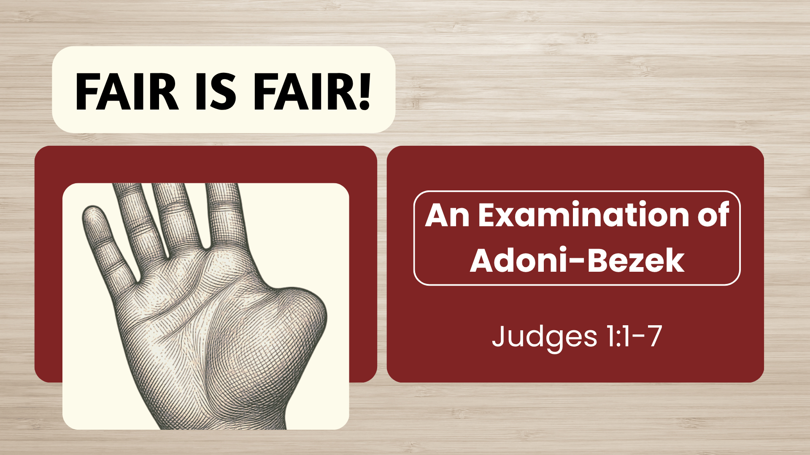

Slide 2

LEX TALIONIS
“Law of Retaliation”
lex (law) – talis (like, same)
Principle of Justice in the Old Testament
Leviticus 24:17-20; Isaiah 33:1; 1 Samuel 15:32-33
Our Government has been Appointed by God for This Purpose
Acts 17:26-27; Romans 13:1-4; Ecclesiastes 8:11

Slide 3
DIVINE “LEX TALIONIS”
This principle seems to be built into nature
Galatians 6:7-8; Ecclesiastes 8:12;
God’s righteousness requires Him to condemn the unrepentant
2 Thessalonians 1:6-10; Revelation 21:7-8

Slide 4
WE SHOULD CONSIDER…
The Christian is not to personally desire or exercise vengeance
Matthew 5:38-39; Romans 12:17; James 2:13
If Retribution Must Fall, it will Come from God Himself
Romans 12:19-21
Our Call is to Love
Matthew 5:43-45; James 2:13

Slide 5

Christ’s Sacrifice – Our Gift (1 John 1:8-9) “Therefore, though the thunder-cloud of retribution may seem as dark as ever, if we only look high enough we shall see the rainbow of God’s mercy above it prom-ising peace and forgiveness to all who repent and trust in his grace” (Pulpit Commentary)

