Slide 1
Spiritual Collateral Damage And Blessings

Slide 2
Spiritual Collateral Damage
Ecclesiastes 9:18
Wisdom is better than weapons of war; But one sinner destroys much good.”
Collateral Damage-Is a general term for deaths, injuries, or other damage on an unintended target.

Slide 3
Those Closest To You Get Hurt First By Spiritual Collateral Damage
Exodus 20:5
you shall not bow down to them nor serve them. For I, the Lord your God, am a jealous God, visiting the iniquity of the fathers upon the children to the third and fourth generations of those who hate Me,

Slide 4
Those Closest To You Get Hurt First By Spiritual Collateral Damage
1 Corinthians 5:6
Your boasting is not good. Do you not know that a little leaven leavens the whole lump?

Slide 5
Those Closest To You Get Hurt First By Spiritual Collateral Damage
Numbers 16:24-26
“Say to the congregation, Get away from the dwelling of Korah, Dathan, and Abiram.”
“Depart, please, from the tents of these wicked men, and touch nothing of theirs, lest you be swept away with all their sins.

Slide 6
The Resonation And Amplification Of Spiritual Collateral Damage
1 Corinthians 5:6
Your boasting is not good. Do you not know that a little leaven leavens the whole lump?

Slide 7
The Resonation And Amplification Of Spiritual Collateral Damage
Ecclesiastes 10:1 Dead flies putrefy the perfumer's ointment, And cause it to give off a foul odor; So does a little folly to one respected for wisdom and honor.
Ecclesiastes 10:5 There is an evil I have seen under the sun, As an error proceeding from the ruler:

Slide 8
The Resonation And Amplification Of Spiritual Collateral Damage
1 Kings 11:4-8
For it was so, when Solomon was old, that his wives turned his heart after other gods; and his heart was not loyal to the Lord his God, as was the heart of his father David. For Solomon went after Ashtoreth the goddess of the Sidonians, and after Milcom the abomination of the Ammonites. Solomon did evil in the sight of the Lord, and did not fully follow the Lord, as did his father David. Then Solomon built a high place for Chemosh the abomination of Moab, on the hill that is east of Jerusalem, and for Molech the abomination of the people of Ammon.

Slide 9
The Resonation And Amplification Of Spiritual Collateral Damage
Hosea 8:7
“They sow the wind,
And reap the whirlwind.

Slide 10
That It May Go Well With You And With Your Children After You
Proverbs 20:7
The righteous man walks in his integrity;
His children are blessed after him.

Slide 11
That It May Go Well With You And With Your Children After You
Deuteronomy 12:28
Observe and obey all these words which I command you, that it may go well with you and your children after you forever,

Slide 12
That It May Go Well With You And With Your Children After You
Deuteronomy 6:7
You shall teach them diligently to your children, and shall talk of them when you sit in your house, when you walk by the way, when you lie down, and when you rise up.

Slide 13
That It May Go Well With You And With Your Children After You
2 Timothy 1:5
when I call to remembrance the genuine faith that is in you, which dwelt first in your grandmother Lois and your mother Eunice, and I am persuaded is in you also.

Slide 14
That It May Go Well With You And With Your Children After You
Psalms 37:25-27
I have been young, and now am old; Yet I have not seen the righteous forsaken, Nor his descendants begging bread. He is ever merciful, and lends; And his descendants are blessed. Depart from evil, and do good; And dwell forevermore.

Slide 15
The Resonation And Amplification Of Righteousness
Ecclesiastes 11:1-2
Cast your bread upon the waters, For you will find it after many days. Give a serving to seven, and also to eight, For you do not know what evil will be on the earth.

Slide 16
The Resonation And Amplification Of Righteousness
Proverbs 11:11 By the blessing of the upright the city is exalted, But it is overthrown by the mouth of the wicked.
Proverbs 14:34 Righteousness exalts a nation, But sin is a reproach to any people.

Slide 17
The Resonation And Amplification Of Righteousness
Mark 4:30-32 Then He said, “To what shall we liken the kingdom of God? Or with what parable shall we picture it? It is like a mustard seed which, when it is sown on the ground, is smaller than all the seeds on earth; but when it is sown, it grows up and becomes greater than all herbs, and shoots out large branches, so that the birds of the air may nest under its shade.”

Slide 18
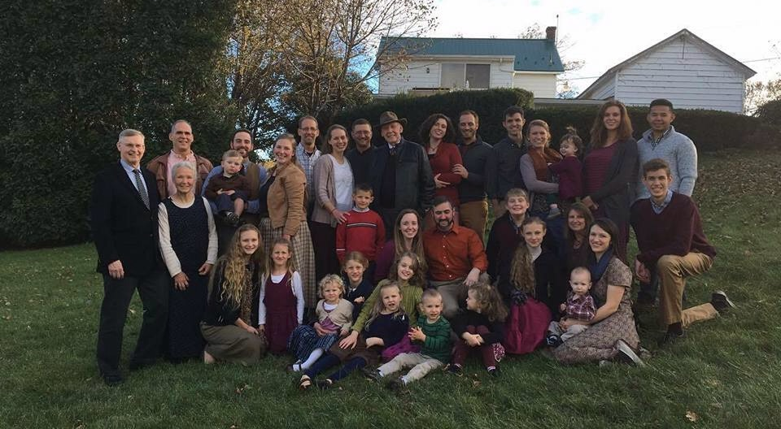
When Righteousness Resonates

