Slide 1
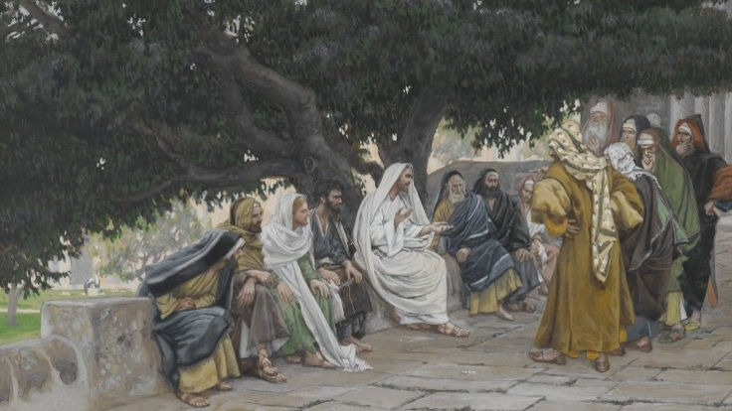
Faulty Assumptions
Matthew 22:23-33
Notes:
(2 Timothy 2:15), “Be diligent to present yourself approved to God, a worker who does not need to be ashamed, rightly dividing the word of truth.”
The text is typically used to indicate the importance of Bible study
Equally important to the study itself is “rightly dividing the word of truth.”
There are many learned individuals who have made certain faulty assumptions about God or His will, and because of it hold to error. Such error can endanger the soul!
The Sadducees in Matthew 22 serve as an example
(Matthew 22:23-33) READ

Slide 2
The Sadducees’ Faulty Assumptions
The assumptions they made regarding the doctrine of the resurrection showed they did not know scripture.
The Sadducees also didn’t understand the power of God, having a very materialistic view that does not acknowledge the full extent of His creation.
Notes:
The Sadducees didn't believe in the resurrection.
They asked Jesus a question that seemed to them to substantiate their belief. Based on Deuteronomy 25:5
(Deuteronomy 25:5), “If brothers dwell together, and one of them dies and has no son, the widow of the dead man shall not be married to a stranger outside the family; her husband's brother shall go in to her, take her as his wife, and perform the duty of a husband's brother to her.”
The reasoning of the Sadducees goes like this: If a woman had seven husbands on earth, and died after her seventh husband died, she couldn't be married to all seven men in the resurrection.
So, there can't be a resurrection
The Sadducees made two false assumptions, in constructing their doctrine on the resurrection.
They didn't understand the Scriptures.
Jesus quotes from Exodus 3:6 to show that dead saints were still alive, because of the present tense used by God who said, "I am the God of Abraham. . . ,“
(Matthew 22:32), “God is not the God of the dead, but of the living.”
This truth is demonstrated in Luke 16:19-31, in Jesus recounting of the fates of the rich man and the beggar Lazarus. Both continued to exist [live] (the soul) after their deaths.
They didn't understand the power of God.
In their skewed view of the afterlife, men would still be unchanged. The supposed heaven would be just like it is on earth.
(Note: We struggle with the same. How will I be happy, knowing about family that are lost? I either will not be happy, or I will not know. That doesn’t allow for the great change that will be eternity in God’s presence).
In the resurrection, we won't be like men who marry, but like angels.
(Matthew 22:30), “For in the resurrection they neither marry nor are given in marriage, but are like angels of God in heaven.”
The result of making these false assumptions, was the creation of a false religious doctrine.
(1 Corinthians 15:16-19), “For if the dead do not rise, then Christ is not risen. ¹⁷ And if Christ is not risen, your faith is futile; you are still in your sins! ¹⁸ Then also those who have fallen asleep in Christ have perished. ¹⁹ If in this life only we have hope in Christ, we are of all men the most pitiable.”

Slide 3
False Assumptions in Religion Today
The thief hadn’t been forgiven before his crucifixion. (There is not direct statement of forgiveness, only the declaration, “today you will be with Me in Paradise”, Lk. 23:43)
The thief hadn’t been baptized by John the Baptist.
The terms of forgiveness for the thief were the same as they are today.
Notes:
False Assumptions in Religion Today Like the Sadducees, many people make assumptions to try and justify their beliefs.
Calvinism is based on a false assumption regarding the sovereignty of God
The toleration of sin is based upon a false assumption regarding God’s character (Love)
People argue for infant baptism based on the false assumption that there were infants in Lydia’s household. (Acts 16:15), “And when she and her household were baptized…”
An example: Some people make unsubstantiated assumptions about the thief on the cross, trying to prove that we don't have to be baptized to be saved.
(Luke 23:40-43), [The first thief had blasphemed Jesus, the second…], “But the other, answering, rebuked him, saying, “Do you not even fear God, seeing you are under the same condemnation? ⁴¹ And we indeed justly, for we receive the due reward of our deeds; but this Man has done nothing wrong.” ⁴² Then he said to Jesus, “Lord, remember me when You come into Your kingdom.” ⁴³ And Jesus said to him, “Assuredly, I say to you, today you will be with Me in Paradise.”
Some of the assumptions are: (Click on Slide to Reveal)
The thief hadn’t been forgiven before his crucifixion. (There is not direct statement of forgiveness, only the declaration, “today you will be with Me in Paradise”, Lk. 23:43)
The thief hadn’t been baptized by John the Baptist.
The terms of forgiveness for the thief were the same as they are today.
This last one is certainly a faulty assumption!
(Matthew 9:6-7) [Healing of Paralytic… Jesus had said to him, “Son, be of good cheer; your sins are forgiven you” (2). Scribes said He blasphemed. His response…] , “But that you may know that the Son of Man has power on earth to forgive sins”—then He said to the paralytic, “Arise, take up your bed, and go to your house.” ⁷ And he arose and departed to his house.”
(Acts 2:38), “Then Peter said to them, “Repent, and let every one of you be baptized in the name of Jesus Christ for the remission of sins; and you shall receive the gift of the Holy Spirit.”

Slide 4
Beware!
Never accept a doctrine built upon an assumption (“God doesn’t care how we worship Him…”, “All that is required is sincerity”, “We do many things for which we have no authority”, etc.)
Everything we say and do must be authorized by Jesus! (Colossians 3:17)
Notes:
Beware Never accepted a doctrine built upon an assumption.
“God doesn’t care how we worship Him…”
“All that is required is sincerity”
“As long as you keep the 10 commandments you are OK with God”
“We do many things for which we have no authority”,
Everything we say and do, must be authorized by Jesus
(Colossians 3:17), “And whatever you do in word or deed, do all in the name of the Lord Jesus, giving thanks to God the Father through Him.”
Using our example of the thief…
Peter said, in 1 Peter 3:21…
(1 Peter 3:21), “There is also an antitype which now saves us—baptism (not the removal of the filth of the flesh, but the answer of a good conscience toward God), through the resurrection of Jesus Christ.”
A doctrine that contradicts this fact must be false
(Mark 16:16), “He who believes and is baptized will be saved; but he who does not believe will be condemned.”
(Acts 22:16), “And now why are you waiting? Arise and be baptized, and wash away your sins, calling on the name of the Lord.’”

Slide 5
Conclusion
Are you rightly dividing the word of Truth?
Notes:
(Revelation 22:18-19), “For I testify to everyone who hears the words of the prophecy of this book: If anyone adds to these things, God will add to him the plagues that are written in this book; ¹⁹ and if anyone takes away from the words of the book of this prophecy, God shall take away his part from the Book of Life, from the holy city, and from the things which are written in this book.”
IT MATTERS WHAT YOU BELIEVE AND TEACH!

