Slide 1
Be Not Many Of You Teachers… Heavier Judgment
Do Not Overlook Your Speech!
James 3:1-12

Slide 2
Do Not Overlook Your Speech
Because the Discipline in controlling our speech gives us the ability to control the whole body (3:1-4)
Spiritual Maturity – Mastery of Speech (Rom. 12:1, Eccl. 3:7)
“The conqueror of pleasure is not the man who never uses pleasure” –Aristippus

Slide 3
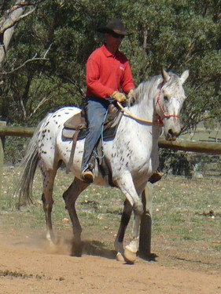
Control the small member tongue - able to bridle the whole body also (v. 2-3)

Slide 4
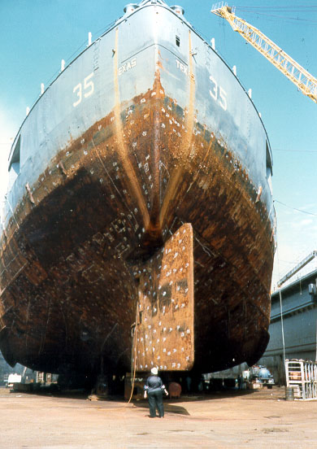
Great ships turned by small rudder in great winds (v.4)

Slide 5
Do Not Overlook Your Speech
Because of the Potentially Destructive Force of our words (v.5-8)
LIKE A FIRE (Prov. 16:27, 26:18-19)
Often comes in the form of “whispering” and “backbiting” – Gossip – Slander (Rom. 1:29-30, 2 Cor. 12:20)
Murmuring ; “hiss like a serpent” (whispering) (Deut. 1:27, Psm. 41:7, Prov. 16:28)

Slide 6
Do Not Overlook Your Speech
Because of the Potentially Destructive Force of our words (v.5-8)
LIKE A FIRE (Prov. 16:27, 26:18-19)
Often spreads through a willing listener (Prov.18:8)
Many contentions can cease (Prov. 26:20. 25:23, Psm. 15:3)
A Problem for every generation – “wheel of nature”
Influenced by “Hell” – Gehenna (Matt. 5:22)

Slide 7
Do Not Overlook Your Speech
Like a deadly poison (v.8)
Animals Tamed (Gen. 1:28, Psm. 8:6)
Tongue can no man tame – restless evil (Rom. 3:13)

Slide 8
Do Not Overlook Your Speech
Because we can manifest INCONSISTENCY through our speech (v.9-12).
Bless God – Curse Man (image of God) (Gen. 1:26, 9:6, cf. Mk. 11:21)
Illustrations: Same Fountain opening: bitter and sweet??? Fig trees yield olives??? Vines yield figs??? Salt water yield sweet???
“ought not to be”

Slide 9
Do Not Overlook Your Speech
Our Speech Should Be…
That which Blesses man, not curses him (Rom. 12:14. Lk. 6:28)
That which edifies – builds up – not tears down (Eph. 4:29, I Cor. 14:2-3, Col. 4:6)
That which Gives Grace to those who hear (Eph. 4:29)
Full of Thanksgiving – not murmurings (Eph. 5:4, Phil. 2:14-15)

Slide 10
How To Guard Your Speech
Combat the selfish desire to PROMOTE SELF – “boasts” (v. 5,9; cf. I Cor. 13:4)
I am important because I am in the know with a devastating rumor???
Combat the malevolent desire to DEMOTE OTHERS – “curse”
I can bring one lower through a harmful rumor – I will then be elevated???

Slide 11
It will strengthen You toward spiritual maturity!
It can be destructive at any moment!
Pay Attention To Your Speech!
It is inconsistent to bless God and tear down man – curse !
Make what many overlook your constant focus!

