Slide 1
For we must all be made manifest before the judgment seat of Christ; that each one may receive the things done in the body, according to what he have done, whether it be good or bad.
2 Corinthians 5:10

Slide 2
For we must all be made manifest before the judgment seat of Christ; that each one may receive the things done in the body, according to what he have done, whether it be good or bad.
2 Corinthians 5:10

Slide 3
For we must all be made manifest before the judgment seat of Christ; that each one may receive the things done in the body, according to what he hath done, whether it be good or bad.
2 Corinthians 5:10

Slide 4
For we must all be made manifest before the judgment seat of Christ; that each one may receive the things done in the body, according to what he have done, whether it be good or bad.
2 Corinthians 5:10

Slide 5
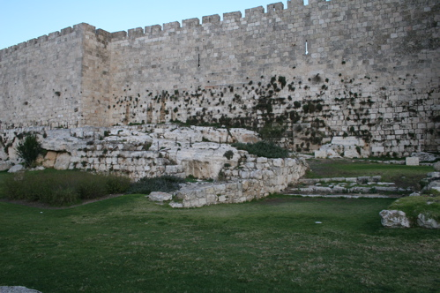

Slide 6
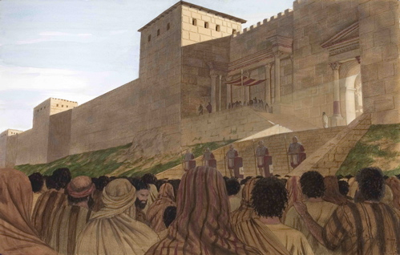

Slide 7
Every Kind – Two Classes
Good – Bad
Righteous - Wicked
Surprises: At The Judgment
Matt. 13:47-50
Rom. 10:1-10
2 Cor. 5:10

Slide 8
“the first” left out
I Thought I was “the few”
Aware of the Lord -submitting to the Lord
Surprises: At The Judgment
Luke 13:22-30
Luke 13:28-30
Luke 13:25-27

Slide 9
Steadfast or Stagnant ?
I Did Not Lose It!
Grow to Salvation !
Surprises: At The Judgment
Matthew 25:25-30
I Cor. 15:58
I Pet 2:2

Slide 10
Did it not. . . To least of my brethren
Who, You Lord?
Did it. . . To least of my brethren
Surprises: At The Judgment
Matthew 25: 31-46
I Jn. 3:16-17
2 Cor. 5:10

Slide 11
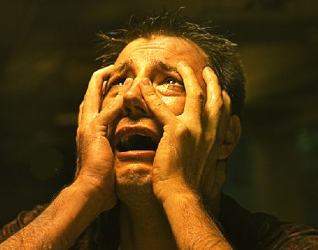
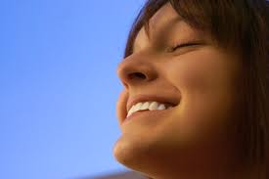
What will YOUR Judgment Seat experience be like?
The Final Judgment: Personal Responsibility NOW!!!

