Slide 1
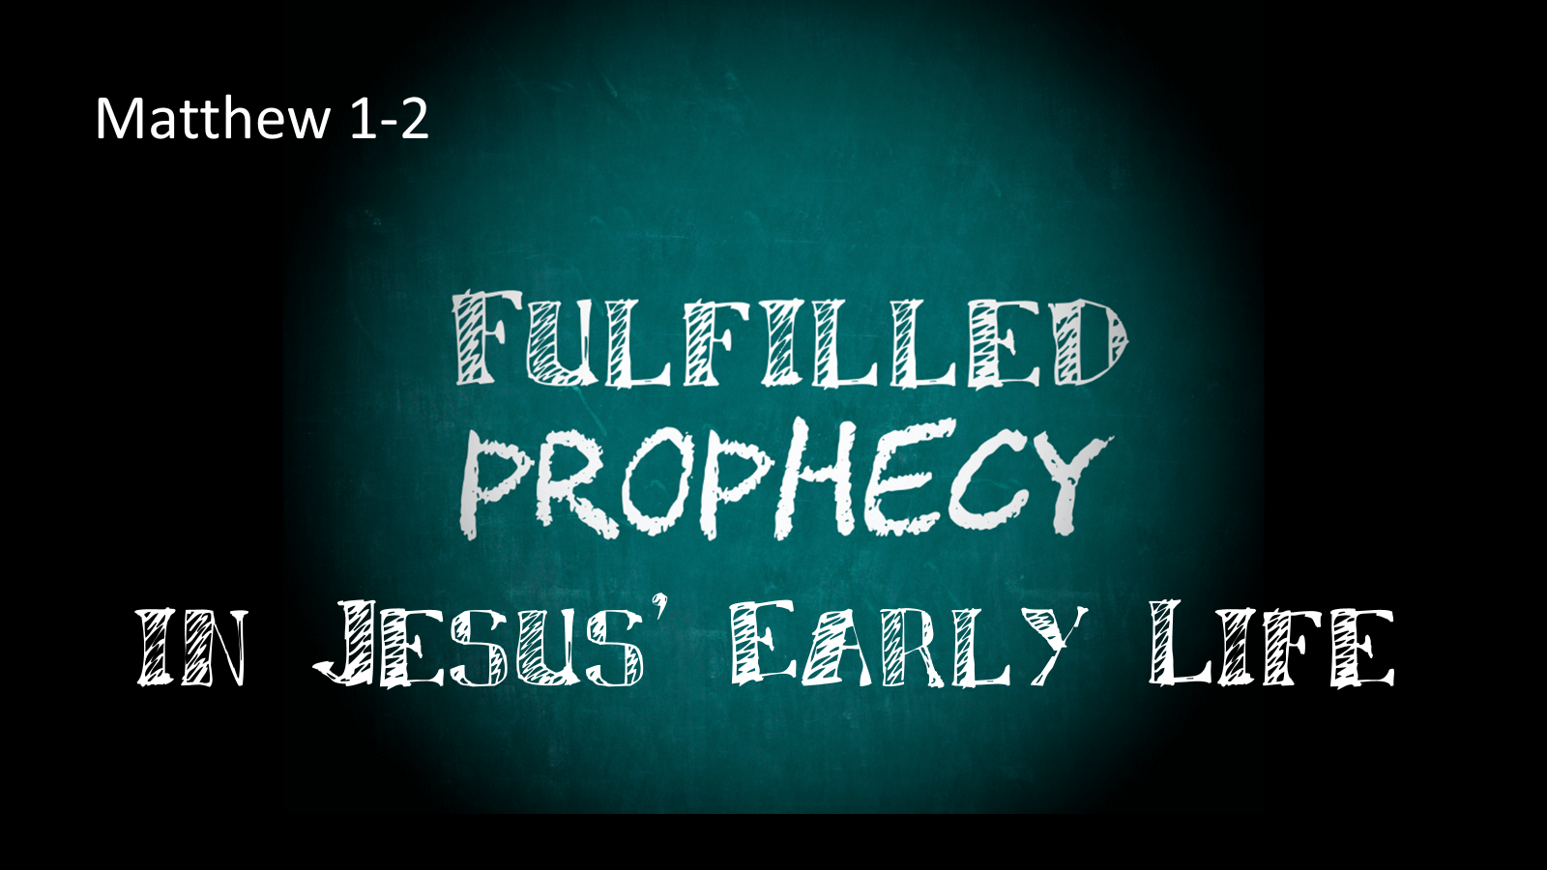
in Jesus’ Early Life
Matthew 1-2
Notes:
One of the greatest proofs that Jesus of Nazareth is the anointed of God is the numerous prophecies (A typical count has it at around 300 prophecies) His existence and actions were fulfilled in His life on earth.
Some of these prophecies were fulfilled early, as our discussion of Matthew chapters 1 and 2 reveal.
I would like to consider them today.

Slide 2
Jesus the Son of David the Son of Abraham
(1:1)
Genesis 12:3; 2 Samuel 7:12-13
Notes:
Our first example is the fulfillment of God’s promise to Abraham and David, see in the Geneology of Jesus
(Matthew 1:1), “The book of the genealogy of Jesus Christ, the Son of David, the Son of Abraham.”
(Genesis 12:1-3), “Now the LORD had said to Abram: “Get out of your country, from your family and from your father’s house, to a land that I will show you. ² I will make you a great nation; I will bless you and make your name great; and you shall be a blessing. ³ I will bless those who bless you, and I will curse him who curses you; and in you all the families of the earth shall be blessed.”
(2 Samuel 7:12-13), “When your days are fulfilled and you rest with your fathers, I will set up your seed after you, who will come from your body, and I will establish his kingdom. ¹³ He shall build a house for My name, and I will establish the throne of his kingdom forever.”
Note that this prophecy was fulfilled without the volition of Jesus. You don’t choose your parents!

Slide 3
Jesus Born of a Virgin
(1:20-23)
Isaiah 7:14
Notes:
Our second example is the fulfillment of the prophecy concerning Jesus’ virgin birth (His mother Mary), conceived from the Holy Spirit.
(Matthew 1:20-23), “But while he thought about these things, behold, an angel of the Lord appeared to him in a dream, saying, “Joseph, son of David, do not be afraid to take to you Mary your wife, for that which is conceived in her is of the Holy Spirit. ²¹ And she will bring forth a Son, and you shall call His name JESUS, for He will save His people from their sins.” ²² So all this was done that it might be fulfilled which was spoken by the Lord through the prophet, saying: ²³ “Behold, the virgin shall be with child, and bear a Son, and they shall call His name Immanuel,” which is translated, “God with us.”
(Isaiah 7:14), “Therefore the Lord Himself will give you a sign: Behold, the virgin shall conceive and bear a Son, and shall call His name Immanuel.”
Again, note the fulfillment of this prophecy had nothing to do with the will of Jesus, events that He could consciously control

Slide 4
Jesus Born in Bethlehem
(2:3-6)
Isaiah 7:14
Notes:
Our third example is the location of Jesus birth in the little village of Bethlehem.
(Matthew 2:3-6), “When Herod the king heard this, he was troubled, and all Jerusalem with him. ⁴ And when he had gathered all the chief priests and scribes of the people together, he inquired of them where the Christ was to be born. ⁵ So they said to him, “In Bethlehem of Judea, for thus it is written by the prophet: ⁶ ‘But you, Bethlehem, in the land of Judah, Are not the least among the rulers of Judah; For out of you shall come a Ruler Who will shepherd My people Israel.’ ”
(Micah 5:2), “But you, Bethlehem Ephrathah, though you are little among the thousands of Judah, yet out of you shall come forth to Me the One to be Ruler in Israel, whose goings forth are from of old, from everlasting.”
A pattern is being established. Neither Jesus nor his parents had a choice regarding where the child would be born!

Slide 5
Jesus Fleeing to Egypt to Escape Herod
(2:13-15)
Hosea 11:1
Notes:
Our fourth example is regarding Jesus fleeing to Egypt to escape the wrath of King Herod
(Matthew 2:13-15), “Now when they had departed, behold, an angel of the Lord appeared to Joseph in a dream, saying, “Arise, take the young Child and His mother, flee to Egypt, and stay there until I bring you word; for Herod will seek the young Child to destroy Him.” ¹⁴ When he arose, he took the young Child and His mother by night and departed for Egypt, ¹⁵ and was there until the death of Herod, that it might be fulfilled which was spoken by the Lord through the prophet, saying, “Out of Egypt I called My Son.”
(Hosea 11:1), “When Israel was a child, I loved him, and out of Egypt I called My son.”
Similar language in Numbers 24:8. A parallel between Israel’s departure escape from Egypt under the leadership of Moses, and Jesus leaving Egypt after Herod’s death.

Slide 6
Jesus The Massacre in Bethlehem
(2:16-18)
Jeremiah 31:15
Notes:
Our fifth example shows the consequences of the fear and anger of Herod who perceived Jesus as a threat
(Matthew 2:16-18), “Then Herod, when he saw that he was deceived by the wise men, was exceedingly angry; and he sent forth and put to death all the male children who were in Bethlehem and in all its districts, from two years old and under, according to the time which he had determined from the wise men. ¹⁷ Then was fulfilled what was spoken by Jeremiah the prophet, saying: ¹⁸ “A voice was heard in Ramah, Lamentation, weeping, and great mourning, Rachel weeping for her children, Refusing to be comforted, Because they are no more.”
(Jeremiah 31:15), “Thus says the LORD: ‘A voice was heard in Ramah, lamentation and bitter weeping, Rachel weeping for her children, refusing to be comforted for her children, because they are no more.”
While this does not directly involve Jesus, it shows the fulfillment of the circumstances prophesied in his early life.

Slide 7
Jesus his Home in Nazareth
(2:22-23)
?
Notes:
Our fifth example shows the consequences of the fear and anger of Herod who perceived Jesus as a threat
(Matthew 2:22-23), “But when he heard that Archelaus was reigning over Judea instead of his father Herod, he was afraid to go there. And being warned by God in a dream, he turned aside into the region of Galilee. ²³ And he came and dwelt in a city called Nazareth, that it might be fulfilled which was spoken by the prophets, “He shall be called a Nazarene.”
Note in the final reference, the phrase “spoken by the prophets” does not directly refer to any place in scripture. There are several ideas of what might be referred to here by the Holy Spirit
The first is that Matthew may be referring to an oral prophecy that many were familiar with at that time. Regardless nothing in scripture directly refers to Nazareth as being the home of Jesus. (Though it was where His earthly father Joseph lived)
The second idea revolves around the etymology of the city name Nazareth. It is believed that the name of the city has the meaning of holiness, or being set apart. If so, it was an indication of Jesus’ character, which proved to be true in His life.
Conclusion
These first few chapters of the New Testament are chock full of fulfilled prophecies, though of course the prophecies continued to be filled throughout His life on this earth.
These, as the others, show Him to be the Christ of prophecy!

