Slide 1
Gaining the Father’s Reward
Matthew 6:1-18
Notes:
Read verses 1-4, 5-6, 16-18
Key phrase we will revisit several times in this lesson:
“and your Father who sees in secret will Himself ^{[4]} reward you openly” (4,6,18)
Gives rise to the important question of motivation:
WHY do you do the things you do of a religious nature? To be seen by men? Or to seek the reward of the Father?

Slide 2
Charitable Deeds
Matthew 6:1
Notes:
(Matthew 6:1), “Take heed that you do not do your charitable deeds before men, to be seen by them. Otherwise you have no reward from your Father in heaven.”
KJV – “alms”. (Thayer - “a donation to the poor”)
Variant reading in some Greek manuscripts “righteousness”, would make it inclusive of all righteous acts
Note: This not a command, merely instructions on HOW to do charitable deeds
The Christian (motivated by love) looks for opportunities to help others
(Luke 10:33) [The Samaritan, who came across an unfortunate soul who had been robbed, beaten and left for dead], “But a certain Samaritan, as he journeyed, came where he was. And when he saw him, he had compassion.”
(James 1:27), “Pure and undefiled religion before God and the Father is this: to visit orphans and widows in their trouble, and to keep oneself unspotted from the world.”
(Galatians 2:10), [Desires of James, Peter & John, as they gave the right hand of fellowship to Paul and Barnabas] “They desired only that we should remember the poor, the very thing which I also was eager to do.

Slide 3
Prayer to God
Matthew 6:6
Notes:
(Matthew 6:6), “But you, when you pray, go into your room, and when you have shut your door, pray to your Father who is in the secret place; and your Father who sees in secret will reward you openly.”
In our text, Jesus taught his disciples what an acceptable prayer contains
Praise to God, Expressions of loyalty and submission, Petitions for spiritual and physical blessings, Acknowledgment of the Preeminence of God.
Again, no command to pray, simply an explanation of HOW to pray. (Christians should always be eager to communicate with God).
(Mark 1:35) [Solitary prayer was a staple of Jesus’ life], “Now in the morning, having risen a long while before daylight, He went out and departed to a solitary place; and there He prayed.”
(Hebrews 4:16), [Prayer should be a common part of our devotion to God] “Let us therefore come boldly to the throne of grace, that we may obtain mercy and find grace to help in time of need.”
(1 Thessalonians 5:16-18), “Rejoice always, ¹⁷ pray without ceasing, ¹⁸ in everything give thanks; for this is the will of God in Christ Jesus for you.”

Slide 4
Fasting
Matthew 6:17-18
Notes:
(Matthew 6:17-18), “But you, when you fast, anoint your head and wash your face, ¹⁸ so that you do not appear to men to be fasting, but to your Father who is in the secret place; and your Father who sees in secret will reward you openly.”
Fast – [Thayer] to abstain as a religious exercise from food and drink: either entirely, if the fast lasted but a single day, or from customary and choice nourishment, if it continued several days
Note: Again, not a command to fast, simply an explanation of how to go about fasting. Difference, where disciples are elsewhere commanded to both be benevolent, and to pray, fasting for a Christian is a liberty, not a command.
Purpose of fasting is to enable spiritual focus, without distraction…
(cf. 1 Corinthians 7:5), “Do not deprive one another except with consent for a time, that you may give yourselves to fasting and prayer; and come together again so that Satan does not tempt you because of your lack of self- control.”
Fasting often associated with mourning (loss of life, sorrow for sin)… Hence, sackcloth & ashes
(Daniel 9:3), [Daniel, mourning the captivity of Judah due to her sin], “And I set my face unto the Lord God, to seek by prayer and supplications, with fasting, and sackcloth, and ashes”
(2 Corinthians 11:27-28), [Deprivations of Paul, concern for churches], “in weariness and toil, in sleeplessness often, in hunger and thirst, in fastings often, in cold and nakedness — ²⁸ besides the other things, what comes upon me daily: my deep concern for all the churches.”

Slide 5
Inappropriate Practice of Christian Devotions
Before men
To be seen by men
Sounding a trumpet
To have glory from men
Standing in the synagogues or on street corners
Vain repetitions
Many words
With a sad countenance
With disfigured faces
Note: All of the aforementioned designed to gain the attention of men
Notes:
Note: All of these “to be seen by men” (1,5,16)
(Matthew 6:16), “Moreover, when you fast, do not be like the hypocrites, with a sad countenance. For they disfigure their faces that they may appear to men to be fasting. Assuredly, I say to you, they have their reward.”
This a contemptible characteristic of the Pharisees: (Matthew 23:1-12) READ
Sought positions of visibility, authority and distinction
THE CHILD OF GOD IS TO BE HUMBLE (God will exalt him)
NOT a condemnation of good deeds being done in public
When that is done, God is glorified
(Matthew 5:16), “Let your light so shine before men, that they may see your good works and glorify your Father in heaven.”
A difference between good influence, and glory seeking. Motivation: Why are you doing it? Result: Who seems to be getting the glory?
Note: They got what they wanted, the admiration of men… (This brings NO reward from God)
(Matthew 6:1), “Take heed that you do not do your charitable deeds before men, to be seen by them. Otherwise you have no reward from your Father in heaven.”

Slide 6
Appropriate Practice of Christian Devotions
Do not let your left hand know what your right hand is doing
Charitable deed in secret
Go to your room/shut your door
Pray in secret
Simple & Direct words
Anoint your head & wash your face/don’t appear to be fasting
Note: All of the aforementioned designed to gain the attention of God
Notes:
Note: All of these indicate a humble mind, with no ego, or desire to bring attention to oneself!
(Luke 18:13-14), [Tax collector, contrasted with the egotistical Pharisee] “And the tax collector, standing afar off, would not so much as raise his eyes to heaven, but beat his breast, saying, 'God, be merciful to me a sinner! ' ¹⁴ I tell you, this man went down to his house justified rather than the other; for everyone who exalts himself will be humbled, and he who humbles himself will be exalted.“
The only way to please God is to seek His approval, rather than that of man!
(Galatians 1:10), [Paul, unwillingness to preach anything other than the gospel], “For do I now persuade men, or God? Or do I seek to please men? For if I still pleased men, I would not be a bondservant of Christ.”
(James 4:7-8, 10), “Therefore submit to God. Resist the devil and he will flee from you. ⁸ Draw near to God and He will draw near to you… ¹⁰ Humble yourselves in the sight of the Lord, and He will lift you up.

Slide 7
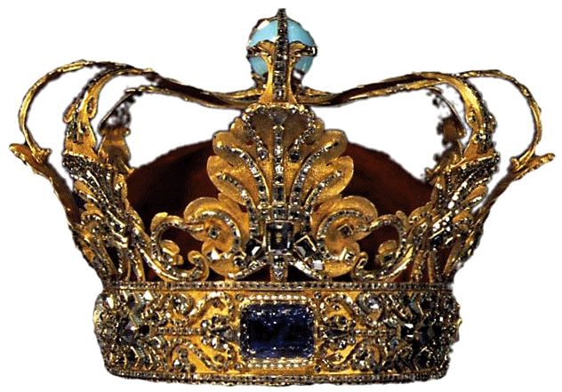
The Father’s Reward
Matthew 6:4,6,18
Notes:
(6:4), [Do] “…your charitable deed may be in secret; and your Father who sees in secret will Himself reward you openly.”
(6:6), “…pray to your Father who is in the secret place; and your Father who sees in secret will reward you openly.”
(6:18), [your fasting should be to…], “…your Father who is in the secret place; and your Father who sees in secret will reward you openly.”
“reward you openly” – (Best manuscripts do not contain the phrase in verse 18)
Alms – You will not be impoverished (cf. Matthew 6:33). [Also, glory of the Macedonians], (2 Corinthians 8:3), “For I bear witness that according to their ability, yes, and beyond their ability, they were freely willing.”
Prayer- Such private prayers will result in an answer (blessings) from God
General reward of God to the Faithful!
(2 Timothy 4:8), “Finally, there is laid up for me the crown of righteousness, which the Lord, the righteous Judge, will give to me on that Day, and not to me only but also to all who have loved His appearing.”
In that day of judgment, before all men, Jesus will confess us to the Father in Heaven!

