Slide 1
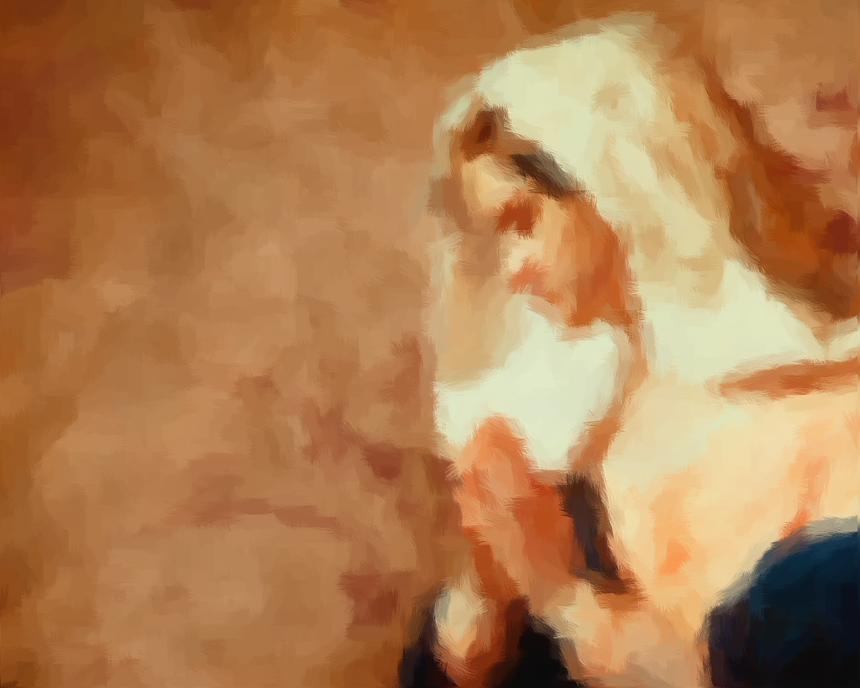
Hannah’s
Prayer
1 Samuel 1
Notes:
Based loosely on material from Mark Copeland’s lesson “Hannah – A Woman of Faith”
Preached at West Side on April 6, 2014 AM
Print Slides: 1,5,6,11-13

Slide 2
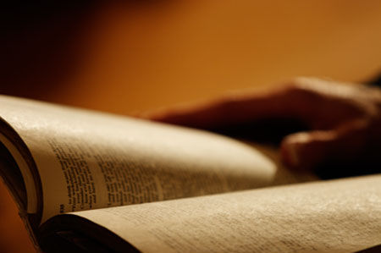
1 Samuel 1:1-2
Now there was a certain man of Ramathaim Zophim, of the mountains of Ephraim, and his name was Elkanah the son of Jeroham, the son of Elihu, the son of Tohu, the son of Zuph, an Ephraimite. ² And he had two wives: the name of one was Hannah, and the name of the other Peninnah. Peninnah had children, but Hannah had no children.
Godly women can have problems,
as did Hannah

Slide 3
1 Samuel 1:4-7
And whenever the time came for Elkanah to make an offering, he would give portions to Peninnah his wife and to all her sons and daughters. ⁵ But to Hannah he would give a double portion, for he loved Hannah, although the Lord had closed her womb. ⁶ And her rival also provoked her severely, to make her miserable, because the Lord had closed her womb. ⁷ So it was, year by year, when she went up to the house of the Lord, that she provoked her; therefore she wept and did not eat.

Slide 4
1 Samuel 1:8
Then Elkanah her husband said to her, “Hannah, why do you weep? Why do you not eat? And why is your heart grieved? Am I not better to you than ten sons?”
Nothing can replace or substitute for the presence of a child.
Psalm 113:5,9; 127:3

Slide 5
Psalm 113:5,9; 127:3
(113:5), “Who is like the LORD our God, who is seated on high, …
(113:9), “… He gives the barren woman a home, making her the joyous mother of children. Praise the LORD!”
(English Standard Version)
(127:3), “Behold, children are a heritage from the Lord, The fruit of the womb is a reward.

Slide 6
When godly women like Hannah have problems and sadness, what distinguishes them as godly is the way they handle those problems. They go to their God in prayer.
1 Samuel 1:9-18

Slide 7
Hannah’s Prayer
With bitterness of soul (10)
With anguished weeping (10)
With offers of a solemn vow (11)
With persistence (12)
With her heart (13)
With all her soul (15-16)
With faith in God’s promise (18)

Slide 8
What we learn from Hannah’s Prayer
Pray fervently and consistently
  Colossians 4:2

Slide 9
Colossians 4:2
Continue earnestly in prayer, being vigilant in it with thanksgiving.
(cf. 1 Thessalonians 5:17, “Pray without ceasing”.)

Slide 10
What we learn from Hannah’s Prayer
Pray fervently and consistently
  Colossians 4:2
Pray with Faith
  1 John 5:14-15

Slide 11
1 John 5:14-15
Now this is the confidence that we have in Him, that if we ask anything according to His will, He hears us. ¹⁵ And if we know that He hears us, whatever we ask, we know that we have the petitions that we have asked of Him.

Slide 12
What we learn from Hannah’s Prayer
Pray fervently and consistently
  Colossians 4:2
Pray with Faith
  1 John 5:14-15
God answers prayer
  1 Samuel 1:19-21 (Read)
  Note: God sometimes gives us what we want, but always gives us what we need!
You must keep your promises!
  1 Samuel 1:24-28 (Read)

Slide 13
Conclusion
Each of us can and should react as godly Hannah during times of difficulty and provocation. And, if we do, like her we will be able to say…

Slide 14
1 Samuel 2:1-2
And Hannah prayed and said:
“My heart rejoices in the Lord;
My horn is exalted in the Lord.
I smile at my enemies,
Because I rejoice in Your salvation.
² “No one is holy like the Lord,
For there is none besides You,
Nor is there any rock like our God.

