Slide 1
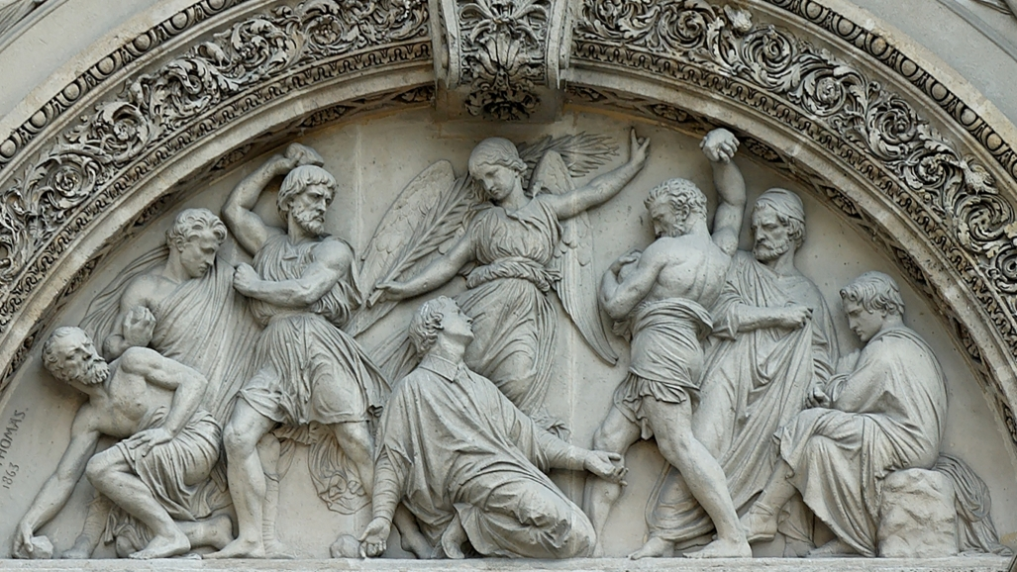
Hating the Prophet
1 Kings 22:8
Notes:
All through the history of sinful man the word of God has always had two effects upon man:
It makes him repent and turn to righteousness
(Acts 2:36-37), “Therefore let all the house of Israel know assuredly that God has made this Jesus, whom you crucified, both Lord and Christ.” ³⁷ Now when they heard this, they were cut to the heart, and said to Peter and the rest of the apostles, “Men and brethren, what shall we do?”
Or it makes him hate the message and the prophet who brings it.
(Acts 7:54-58), “When they heard these things they were cut to the heart, and they gnashed at him with their teeth. ⁵⁵ But he, being full of the Holy Spirit, gazed into heaven and saw the glory of God, and Jesus standing at the right hand of God, ⁵⁶ and said, “Look! I see the heavens opened and the Son of Man standing at the right hand of God!” ⁵⁷ Then they cried out with a loud voice, stopped their ears, and ran at him with one accord; ⁵⁸ and they cast him out of the city and stoned him. And the witnesses laid down their clothes at the feet of a young man named Saul.”
When Ahab was king of Israel, he followed a very wicked course and gathered about him many false prophets who would prophesy as he desired.
This is very much like religious conditions in the world today.
Based on an article by H.E. Phillips - Hating the Prophet

Slide 2
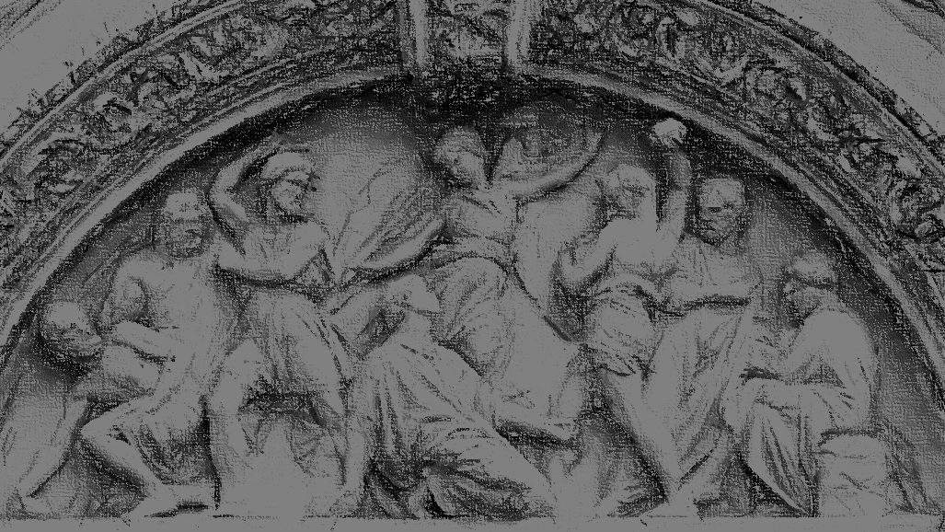
Ahab VS Elijah
Elijah proclaims a drought on the Land during Ahab’s reign (17:1-4; cf. 18:7-10, 17-18)
Jezebel vows to kill Elijah (19:1-3)
A prophet of God foretells Ahab’s death (20:42-43)
Elijah foretells Ahab’s death (21:17-29)
Notes:
Elijah proclaims a drought on the Land during Ahab’s reign
(17:1-4) “hide by the brook Cherith”
(Had to hide from Ahab because of his proclamation. Ahab had provoked the Lord).
(cf. 18:7-10) Ahab had been looking for Elijah
(18:17-18) “Is that you, O troubler of Israel?”
Jezebel vows to kill Elijah
(19:1-3) “he arose and ran for his life”
A prophet of God foretells Ahab’s death
(20:42-43)
Ahab had made a treaty with defeated King of Syria (despite God’s intent that the man be killed for his words against Jehovah
This unknown prophet predicted Ahab’s death because of his disobedience to God
“So the king of Israel went to his house sullen and displeased.”
Elijah foretells Ahab’s death
(21:17-29)
Jezebel had two scoundrels falsely accuse Naboth of blasphemy, and he was stoned to death. All this because Ahab wanted Naboth’s vineyard
“So Ahab said to Elijah, ‘Have you found me, O my enemy?’”

Slide 3
Ahab VS Micaiah
Jehoshaphat requested confirmation by the prophets (22:5)
False prophets predicted victory (22:6)
Ahab and Micaiah’s conversation (22:7-28)
Consider Ahab’s attitude toward Micaiah because of his willingness to prophesy truth (22:8, 13-14, 16-18, 35-38)
Notes:
Ahab and Jehoshaphat (King of Judah) made plans to go to war again with Syria over a land dispute
Jehoshaphat requested confirmation by the prophets
(22:5), “Please inquire for the word of the Lord today”
False prophets predicted victory
(22:6), “Go up, for the Lord will deliver it [Ramoth Gilead] into the hand of the king.”
Why? There are always those willing to tell you what you want to hear (In business, “Yes men.”) In religion, ear scratchers!
(2 Timothy 4:1-5), “I charge you therefore before God and the Lord Jesus Christ, who will judge the living and the dead at His appearing and His kingdom: ² Preach the word! Be ready in season and out of season. Convince, rebuke, exhort, with all longsuffering and teaching. ³ For the time will come when they will not endure sound doctrine, but according to their own desires, because they have itching ears, they will heap up for themselves teachers; ⁴ and they will turn their ears away from the truth, and be turned aside to fables. ⁵ But you be watchful in all things, endure afflictions, do the work of an evangelist, fulfill your ministry.”
Ahab and Micaiah’s conversation (22:7-28) JUST READ IT
Consider Ahab’s attitude toward Micaiah because of his willingness to prophesy truth
(22:8), “but I hate him, because he does not prophesy good concerning me, but evil.”
(22:13), [Messenger’s request of Micaiah], “Please, let your word be like the word of one of them, and speak encouragement.”
(22:14), [Micaiah’s response], “As the Lord lives, whatever the Lord says to me, that I will speak”
(22:16-18), [Irrational Ahab], Wants Micaiah to tell him the truth, but then seeks to kill him for doing so!
Many are like that today. They say they want truth, but don’t react well to it!
“Did I not tell you he would not prophesy good concerning me, but evil?”
(22:26-28) [Ahab refused to believe, and gave instructions to have Micaiah imprisoned for his prophesy]
Consider, Micaiah’s prophesy WAS true, and came to pass (22:28-38) (cf. 21:19, “dogs shall lick your blood.”)
Though Ahab disguised himself, a random arrow struck him between the joints of his armor (34)
(22:35-38), “The battle increased that day; and the king was propped up in his chariot, facing the Syrians, and died at evening. The blood ran out from the wound onto the floor of the chariot. ³⁶ Then, as the sun was going down, a shout went throughout the army, saying, “Every man to his city, and every man to his own country!” ³⁷ So the king died, and was brought to Samaria. And they buried the king in Samaria. ³⁸ Then someone washed the chariot at a pool in Samaria, and the dogs licked up his blood while the harlots bathed, according to the word of the Lord which He had spoken.”

Slide 4
Two Important Lessons
If the prophet (preacher) proclaims God’s word, and it hurts you to hear it…
Listen and accept his words
If you are the prophet (preacher),
and sharing God’s message…
Expect rejection, but look for the honest heart!
Notes:
Why do so many react poorly to being convicted of sin? If you told them they were in physical danger, they would thank you!
Perhaps their pride is hurt (for being ignorant of God’s will for them)?
Perhaps their view of religion (as a personal matter) causes them to be offended if you tell them their thoughts on the matter are illegitimate?
Perhaps they consider themselves knowledgeable, but their righteousness is from men rather than God?
Ahab (and many today) simply want to do what they desire to do, without reaping the consequences.
The truth remains the truth whether we believe it or not, and even if we hate the preacher.
Do not confuse the message with the messenger. You will not destroy the truth by killing the bearer of that truth!
(Galatians 4:13-16) [The Galatians had first received Paul, but now were antagonized by his preaching], “You know that because of physical infirmity I preached the gospel to you at the first. ¹⁴ And my trial which was in my flesh you did not despise or reject, but you received me as an angel of God, even as Christ Jesus. ¹⁵ What then was the blessing you enjoyed? For I bear you witness that, if possible, you would have plucked out your own eyes and given them to me. ¹⁶ Have I therefore become your enemy because I tell you the truth?”
If the prophet (preacher) proclaims God’s word, and it hurts you to hear it… Listen and accept his words!
If you are the prophet (preacher), and sharing God’s message… Expect rejection, but look for the honest heart!
Consider Jesus’ instructions to His disciples (limited commission) in Matthew 10
“I sent you out as a sheep in the midst of wolves” (16)
“Beware of men, for they will deliver you up to councils and scourge you in their synagogues” (17)
“Brother will deliver up brother to death…father his child… children against parents” (21)
“You will be hated by all for My name’s sake” (22)
“If they have called the master of the house Beelzebub, how much more will they call those of his household.” (25)
(Matthew 10:27-33), “Whatever I tell you in the dark, speak in the light; and what you hear in the ear, preach on the housetops. ²⁸ And do not fear those who kill the body but cannot kill the soul. But rather fear Him who is able to destroy both soul and body in hell. ²⁹ Are not two sparrows sold for a copper coin? And not one of them falls to the ground apart from your Father's will. ³⁰ But the very hairs of your head are all numbered. ³¹ Do not fear therefore; you are of more value than many sparrows. ³² “Therefore whoever confesses Me before men, him I will also confess before My Father who is in heaven. ³³ But whoever denies Me before men, him I will also deny before My Father who is in heaven.”

