Slide 1
Have Compassion
Jude 20-25
“to have pity, a feeling of distress through the ills of others” (Vine)
Notes:
READ TEXT: Teaches us to show compassion on others
Click to reveal definition from VINE
Compassion is a trait of our Savior and one we are expected to possess develop in our hearts and lives,
(Colossians 3:12-13), “Therefore, as the elect of God, holy and beloved, put on tender mercies, kindness, humility, meekness, longsuffering; 13 bearing with one another, and forgiving one another, if anyone has a complaint against another; even as Christ forgave you, so you also must do.”
We need compassion and mercy from others, and we must have it toward others!
(1 Peter 3:8), “Finally, all of you be of one mind, having compassion for one another; love as brothers, be tenderhearted, be courteous”

Slide 2
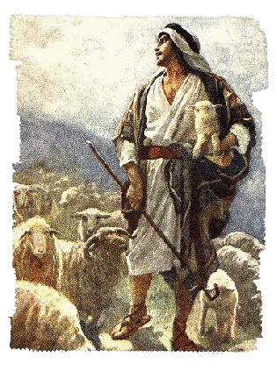
The Compassion of a Shepherd
Isaiah 40:11
Notes:
(Isaiah 40:11), [God’s compassion on his people], “He will feed His flock like a shepherd; He will gather the lambs with His arm, and carry them in His bosom, and gently lead those who are with young.”
(Matthew 15:24), [Jesus, characterizing the Jews], “But He answered and said, ‘I was not sent except to the lost sheep of the house of Israel.’”
Compassion Gives Help to the Helpless
(Luke 6:36-38), “Therefore be merciful, just as your Father also is merciful. 37 "Judge not, and you shall not be judged. Condemn not, and you shall not be condemned. Forgive, and you will be forgiven. 38 Give, and it will be given to you: good measure, pressed down, shaken together, and running over will be put into your bosom. For with the same measure that you use, it will be measured back to you.“
B. Compassion Sacrifices for the Safety of Others,
(John 10:11-15, READ)

Slide 3
The Compassion of a SAviour
Isaiah 53:4-5
Notes:
(Isaiah 53:4-5), “Surely He has borne our griefs and carried our sorrows; yet we esteemed Him stricken, smitten by God, and afflicted. 5 But He was wounded for our transgressions, He was bruised for our iniquities; the chastisement for our peace was upon Him, and by His stripes we are healed.”
Compassion is Willing to Act Out of Pity for Others, Matt. 8:2-3; 14:14; 20:34
(Matthew 8:1-3), “When He had come down from the mountain, great multitudes followed Him. 2 And behold, a leper came and worshiped Him, saying, "Lord, if You are willing, You can make me clean.“ 3 Then Jesus put out His hand and touched him, saying, " I am willing; be cleansed." Immediately his leprosy was cleansed.”
B. Compassion Recognizes the Trouble that Exists, and EMPATHIZES!
(Hebrews 4:15), [Jesus our example], “For we do not have a High Priest who cannot sympathize with our weaknesses, but was in all points tempted as we are, yet without sin.”
(Romans 12:15), “Rejoice with those who rejoice, and weep with those who weep.”
C. Compassion takes Effort
(Mark 6:34), “And Jesus, when He came out, saw a great multitude and was moved with compassion for them, because they were like sheep not having a shepherd. So He began to teach them many things.”

Slide 4
Conclusion
Compassion exists in the heart that has not given up!
Compassion exists in the heart that grasps its own need for mercy (Matthew 5:7)
Notes:
There is still hope, so compassion responds toward those hurting and in need of merciful help.
(Matthew 5:7), “Blessed are the merciful, for they shall obtain mercy.”

