Slide 1
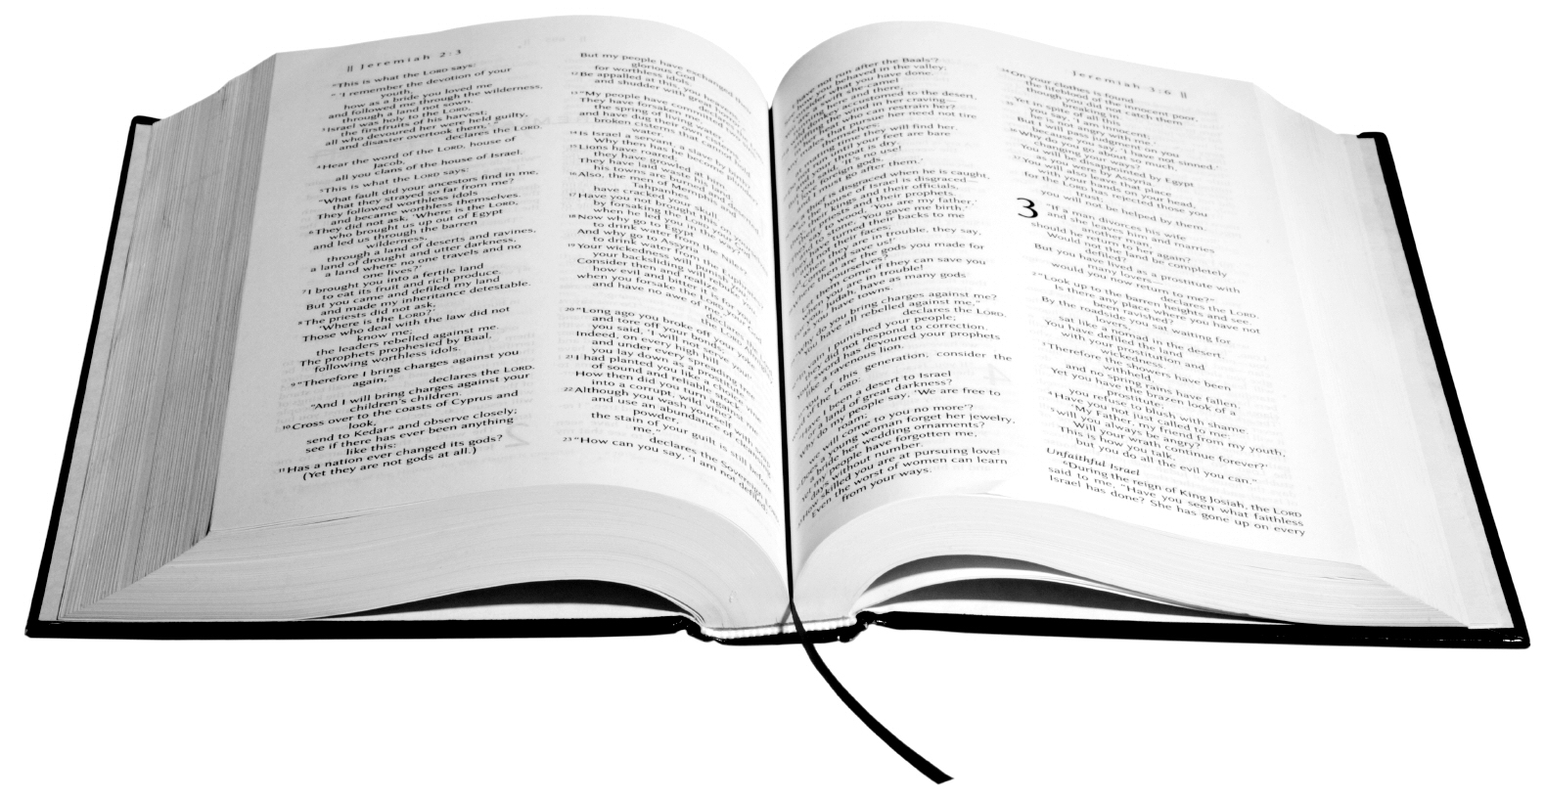
James 1:21-22
Hearing the Word
What to do BEFORE the Sermon (21a)
What to do DURING the Sermon (21b)
What to do AFTER the Sermon (22)

